Slide 1
Cloud / Data Centers / Laptops
APEX Backup Services
Daniel.Olkowski@dell.com

Slide 2
Agenda
Shall I backup cloud Exchange / SharePoint / Teams / …
What is APEX Backup Service?
Why APEX Backup Service?
Security
Value of APEX Backup Service
Licensing
Workshop – Full day architecture / technology

Slide 3
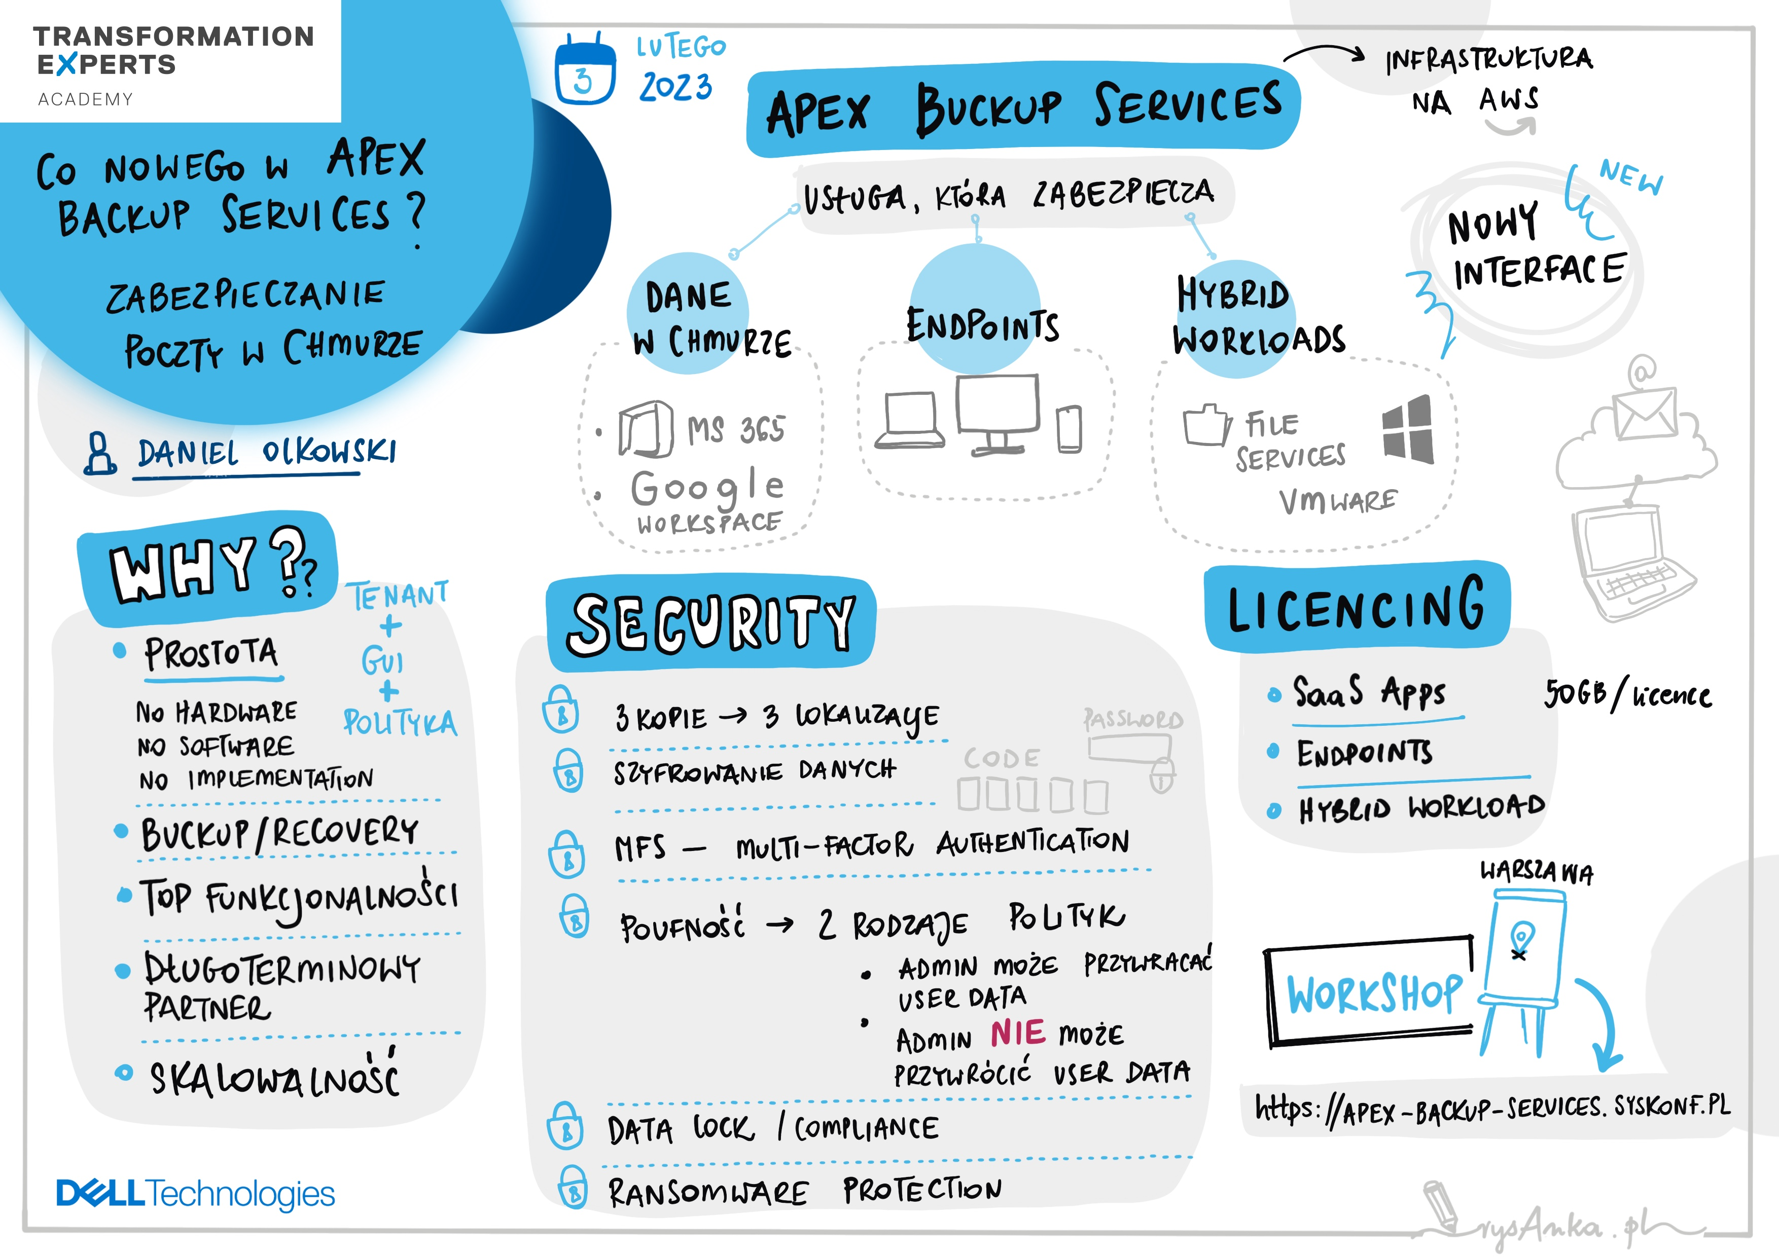

Slide 4
Shall I backup cloud Exchange / SharePoint / Teams / …? APEX Backup Services

Slide 5


Cloud vendor approach to backup their services
“You are responsible for protecting your data.”
“We recommend you use a partner backup solution.”
“Assuming SaaS applications don’t require backup is dangerous.”

Slide 6
What is APEX Backup Service?

Slide 7
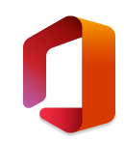

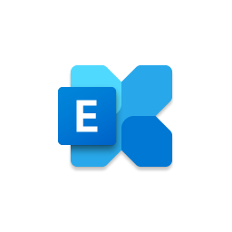




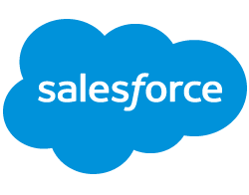

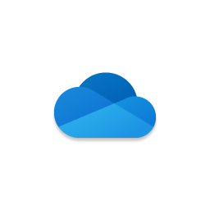



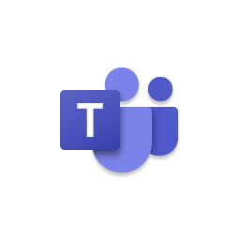
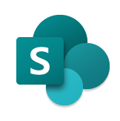




APEX Backup Services
SaaS Apps
Endpoints
Hybrid Workloads
Microsoft 365
Salesforce.com
Exchange Online
Gmail
File servers
Laptops
Microsoft OneDrive
Google Drive
Desktops
Microsoft Teams
Google Docs
Microsoft SharePoint
Google Slides
Mobile Devices
NAS

Slide 8
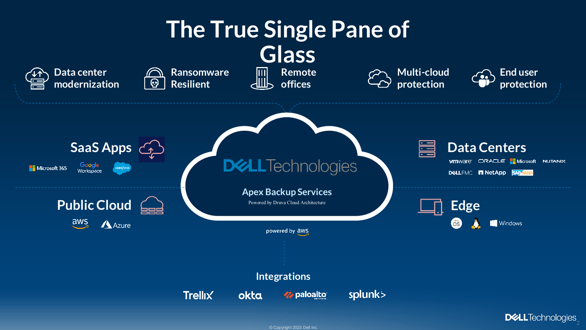

Slide 9
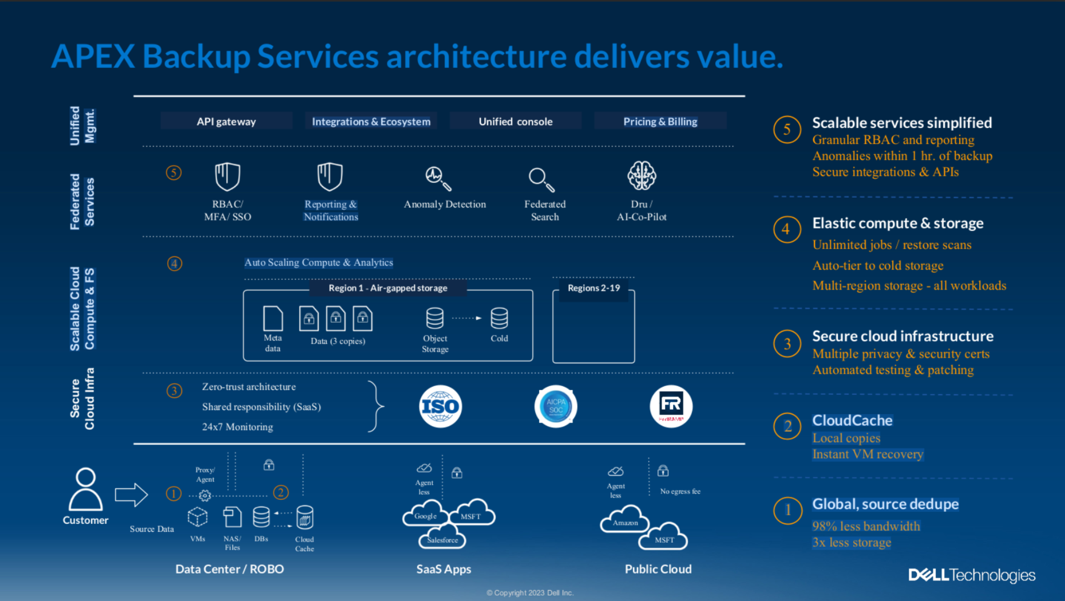

Slide 10
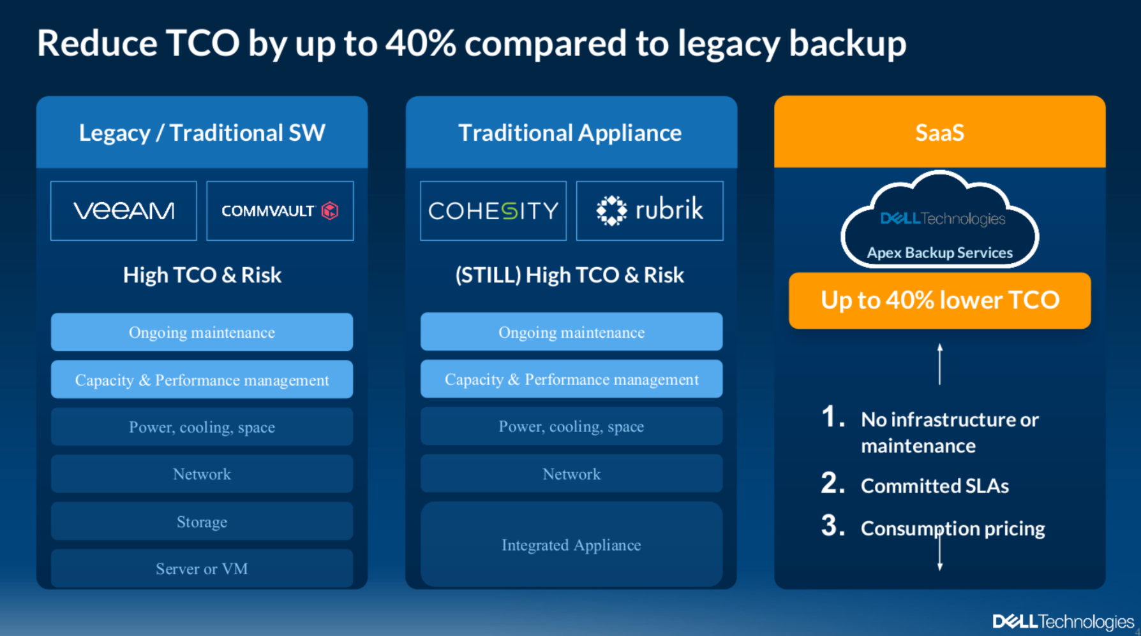

Slide 11
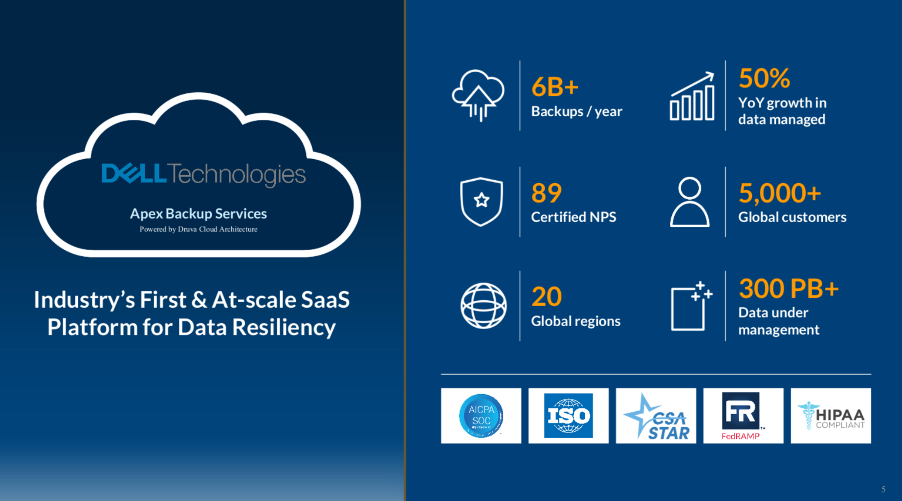

Slide 12
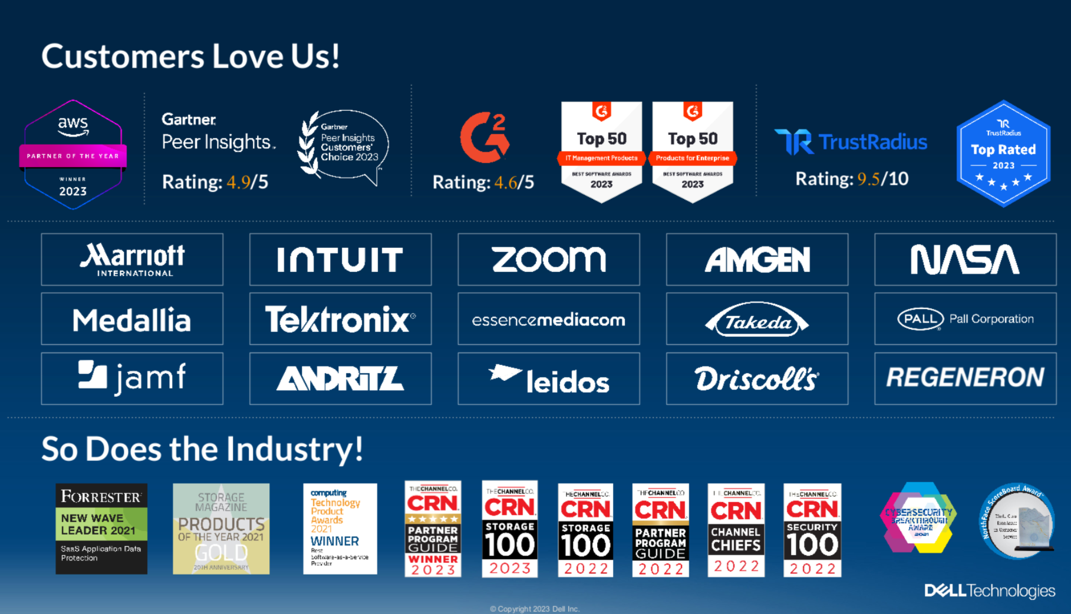

Slide 13
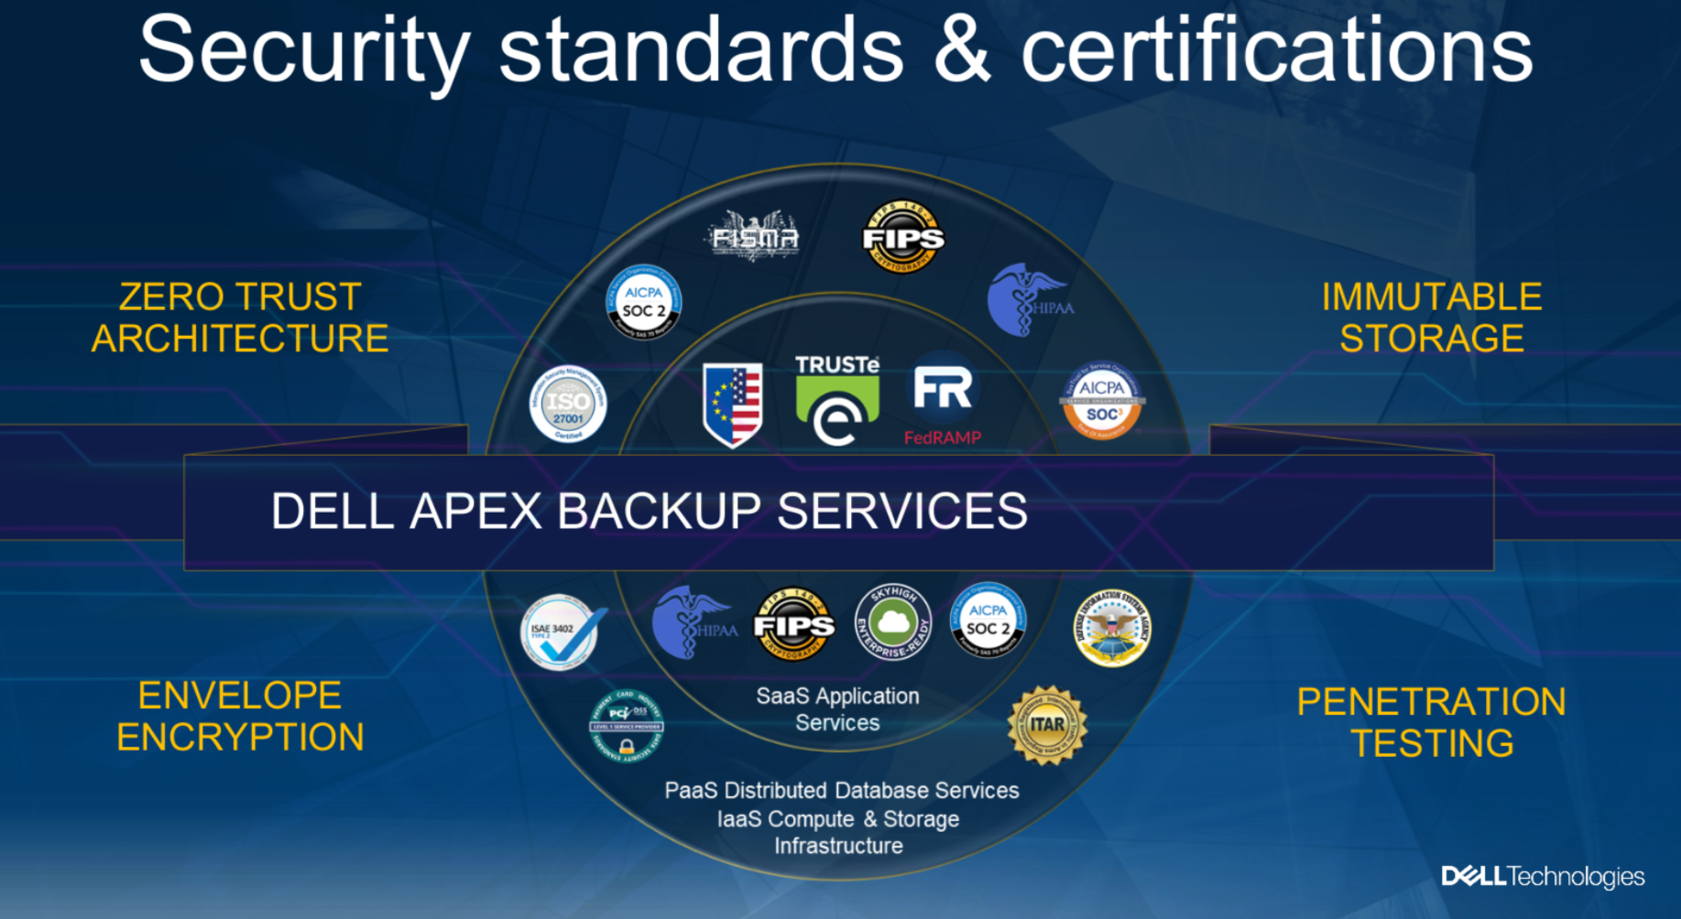

Slide 14
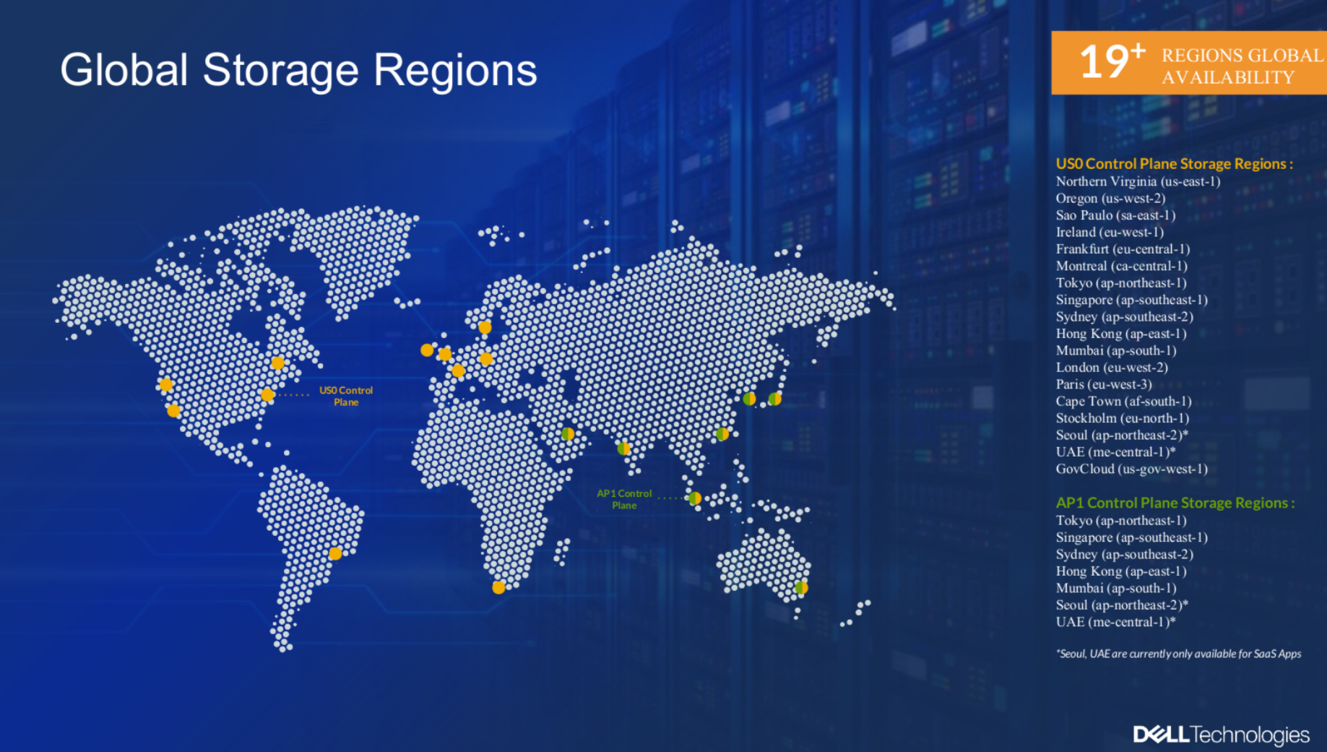

Slide 15
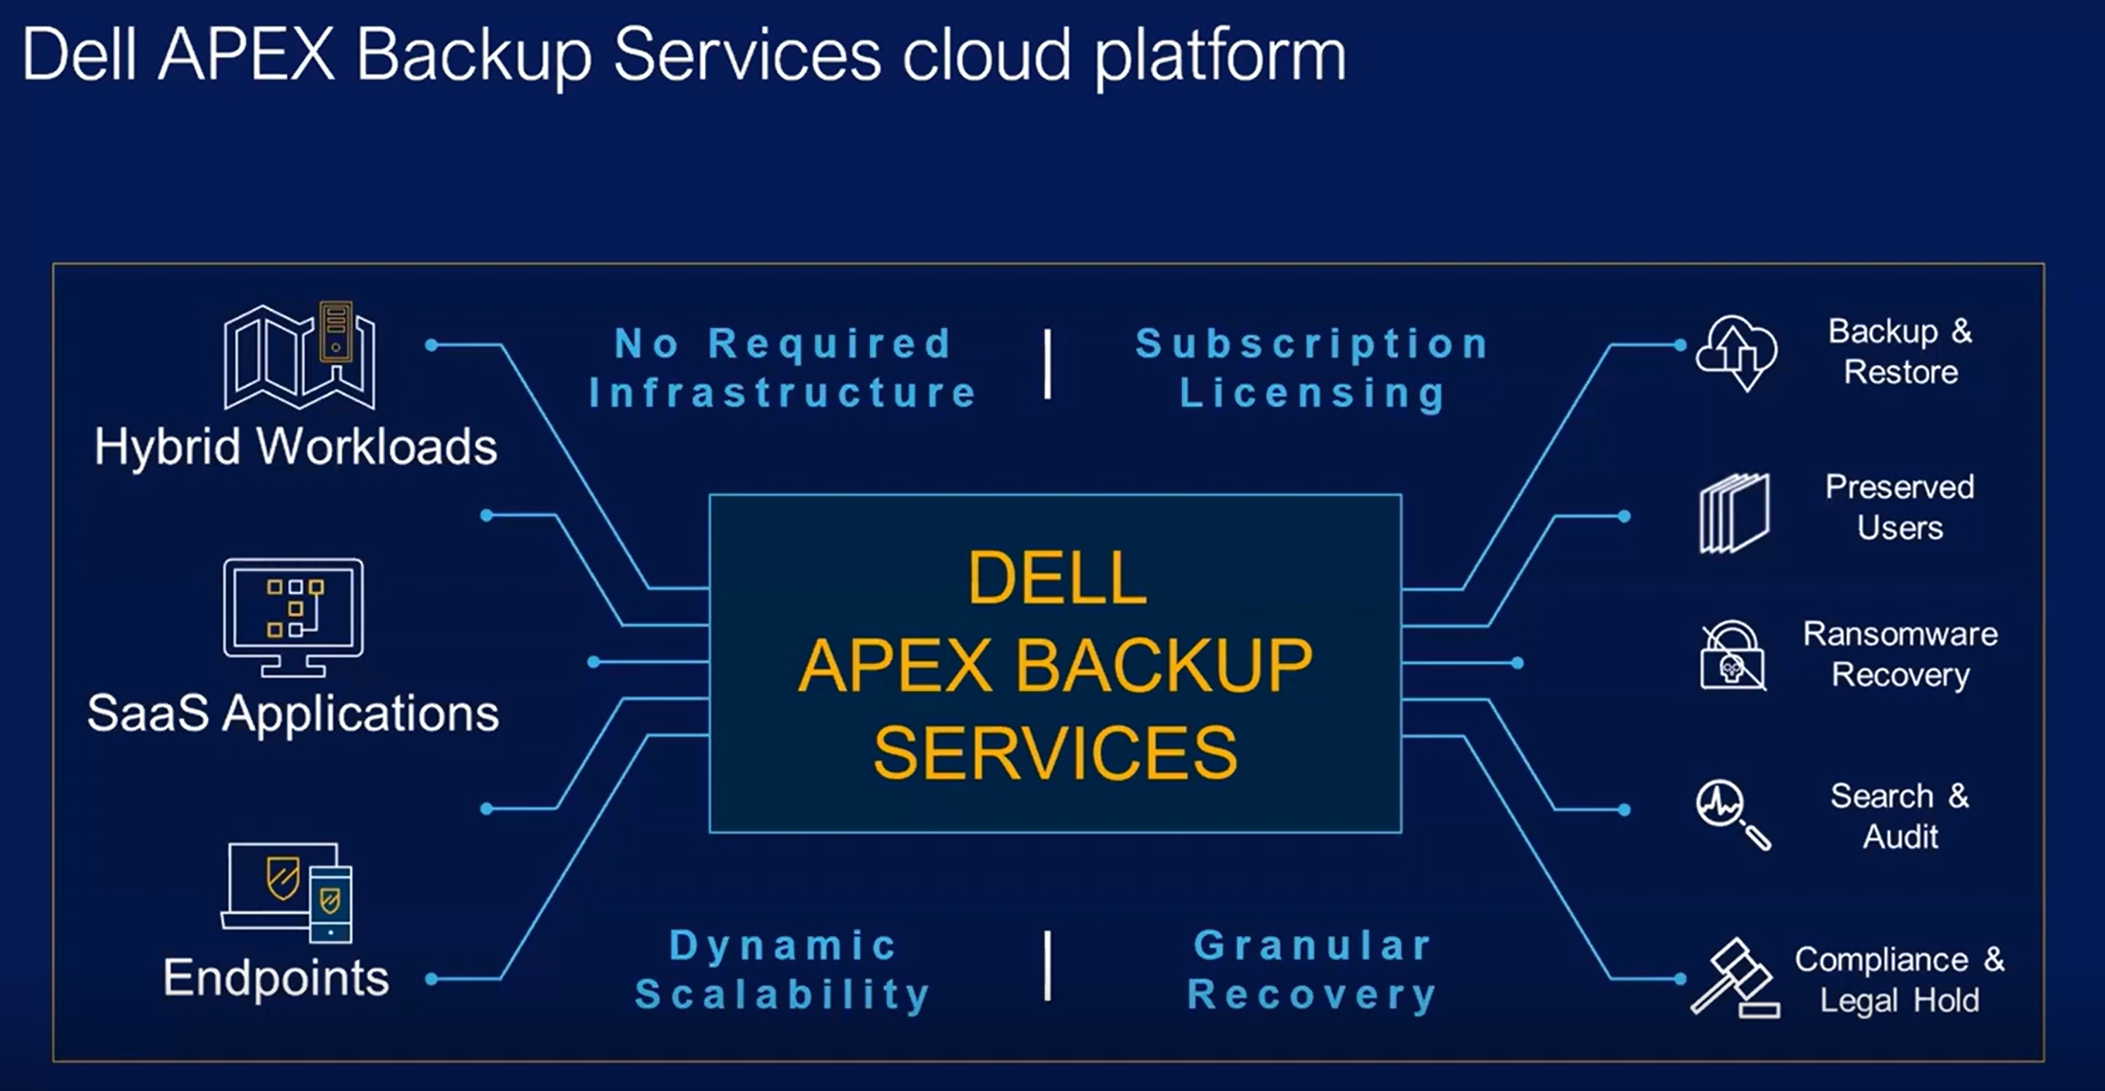

Slide 16
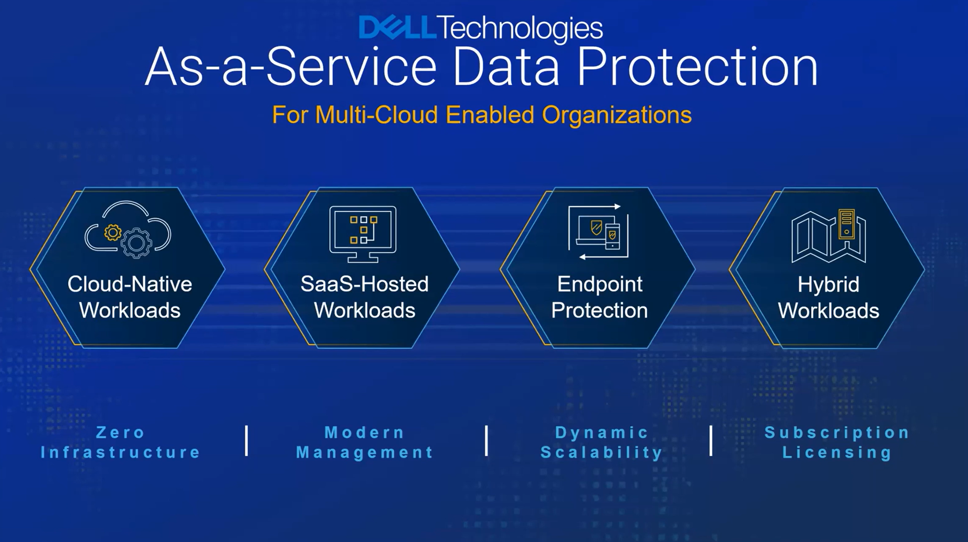

Slide 17
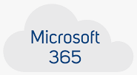
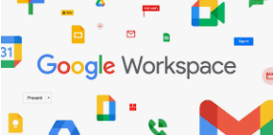
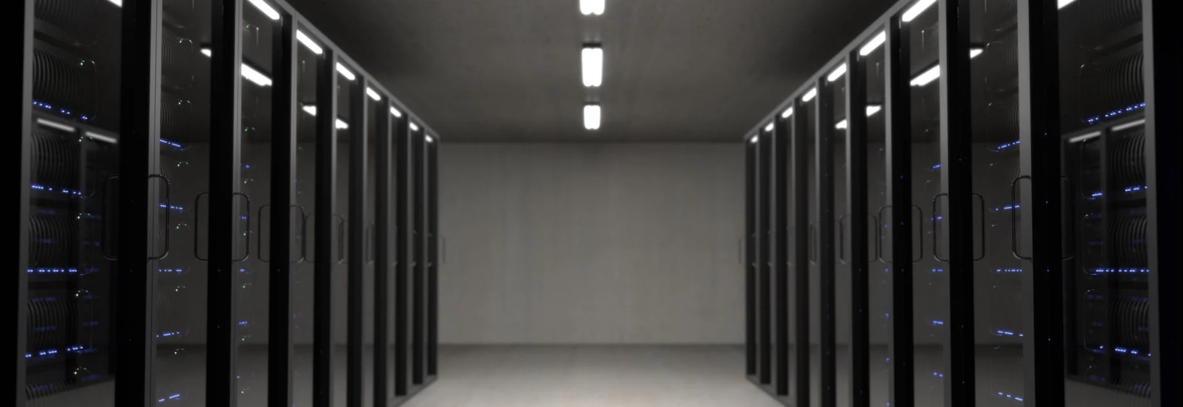


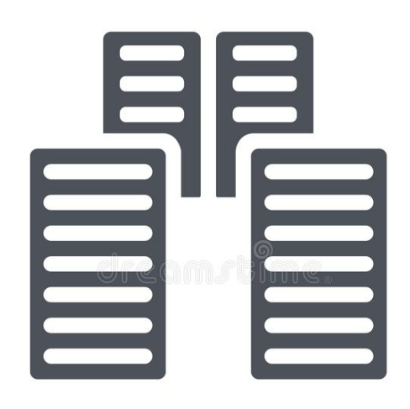

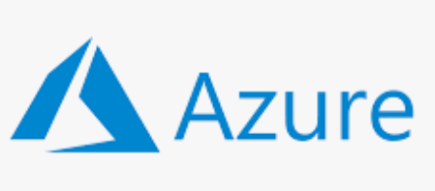
APEX Backup Services
Laptops
Mobile Devices
Remote office

Slide 18
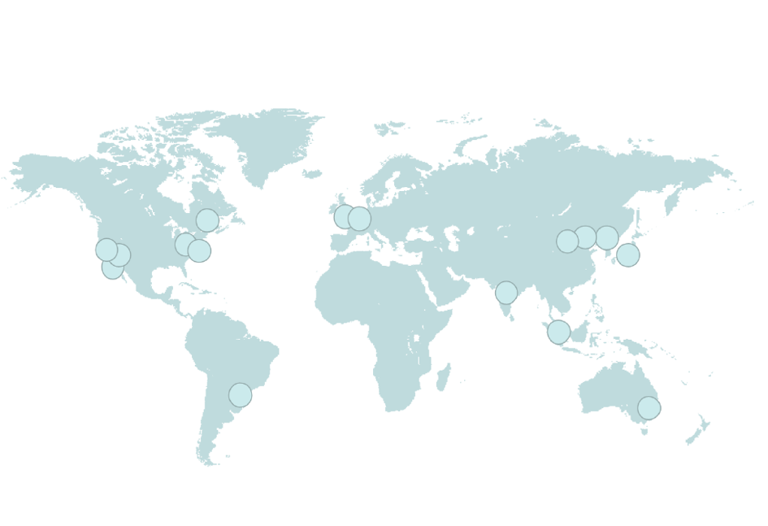
APEX Backup Services – Data Centers
US East (N. Virginia)
US West (N. California)
US West (Oregon)
Asia Pacific (Mumbai)
Asia Pacific (Singapore)
Asia Pacific (Sydney)
Asia Pacific (Tokyo)
Canada (Central)
Europe (Frankfurt)
Europe (Ireland)
Europe (London)
Europe (Paris)
South America (Sao Paulo)
AWS GovCloud (US-West)

Slide 19
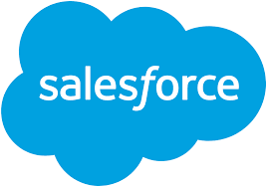


What is protected?
Exchange Online
OneDrive
SharePoint Online
Teams
Consistent experience across Microsoft apps
Granular and flexible recovery experience for admins and end-users
Save costs on archived license, storage
Optimize MS throttling management
Gmail
GDrive
Calendars
Google Team Drive
Protection across GMail and Gsuite including:
Emails along with the attachments and all metadata
Calendar events along with links to the attachments
All Contacts details
All GDrive contents, permissions, metadata
Backup/Restore Production and Sandbox Org
Cross Org Restores (Sandbox Test/Dev and Production)
Comprehensive backup: objects, records, metadata, attachments, reports, dashboards and workflows
Flexible and granular recovery
Native Salesforce app - backup and restore from within your familiar environment
Cross-org restore

Slide 20
Why APEX Backup Service?

Slide 21
Why APEX Backup Services?
Easy
No hardware
No software
No implementation
Just backup / recovery
Microsoft 365
Salesforce.com
Exchange Online
Gmail
File servers
Top functionalities
Laptops
Microsoft OneDrive
Google Drive
Desktops
Microsoft Teams
Google Docs
Long term partner
Microsoft SharePoint
Google Slides
Mobile Devices
NAS

Slide 22
Why APEX Backup Services?
No ERRORS!
No backup server, configuration, etc…
We fight many Times with backup server settings, configuration, proxies, etc.
Easy
No hardware
No software
No implementation
Just backup / recovery
Microsoft 365
Salesforce.com
Exchange Online
Gmail
File servers
Top functionalities
Laptops
Microsoft OneDrive
Google Drive
Desktops
Microsoft Teams
Google Docs
Long term partner
Microsoft SharePoint
Google Slides
Mobile Devices
NAS

Slide 23
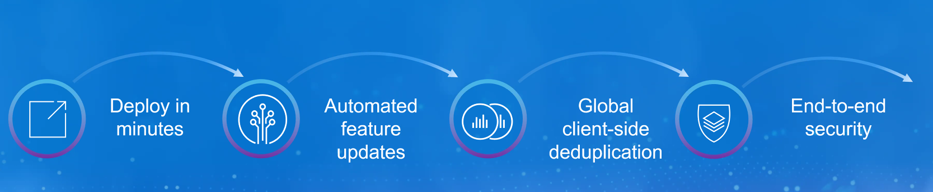
Usually, every 2 weeks
We are up to date within the price!

Slide 24

Easy
No design
No software
No deployment
No hardware
No upgrades
No management

Slide 25
Why APEX Backup Services?
Do nothing – just backup
Eliminate all not necessary cost
Make it simple
Pay for what you use
Scalability? Why do we talk about
New user?
10 000 new employees?
Immediately

Slide 26
Why APEX Backup Services?
All costs included
Network / download / licenses / etc.
Upgrades / maintenance / workings / 99.9s
Add on services – ransomware for all use cases
No chanced that there will be any admin with single tool that provide all the services within the price
Disaster Recovery

Slide 27
Why APEX Backup Services?
I am sure I have a backup
Easy – no experience with backup required
Reports
All feature without great knowledge
Single console
Single experience
All use cases / Cloud / Laptops / Data Center

Slide 28
Why APEX Backup Services?
3 locations
Confidentiality
Encryption with private key
MFA
Data Lock
Sensitive data analysis

Slide 29
Why APEX Backup Services?
Base
Unusual data activity - Anomaly Detection – learn user behavior / automated
Rollback actions
Extended
Scans for ransomware
Quarantine
Curated snapshot

Slide 30
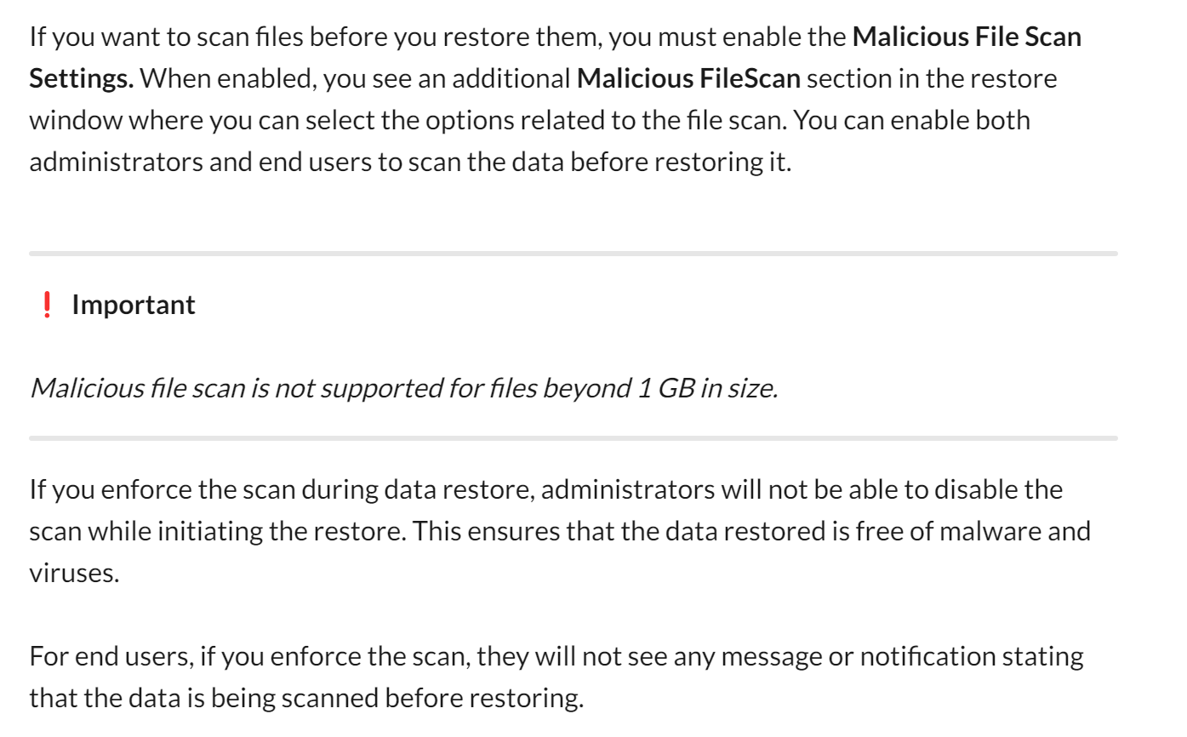

Slide 31
Why APEX Backup Services?
Case study:
https://www.druva.com/resources/media/videos/video-vertrax-restores-files?x=o1CcKq&xs=122096%3Fwtime&wtime=%7Bseek_to_second_number%7D

Slide 32
Why APEX Backup Services?
Different locations than M365 / Google
Delayed data deletion
Geo-fencing
Port 443 for laptops
Private data
Admin / user data recovery

Slide 33
Why for Laptops
Laptop replace
Application settings restore
Localization for end points

Slide 34
Licensing
Preserved users
10% free
Special low price for additional ones
Shared mailboxes
50% free

Slide 35
Easy
All software updates are automatically deployed every 2 weeks with no impact to the customer’s applications or environment.

Slide 36
Trusted partner
Over 10 years on the market
Dynamic development

Slide 37
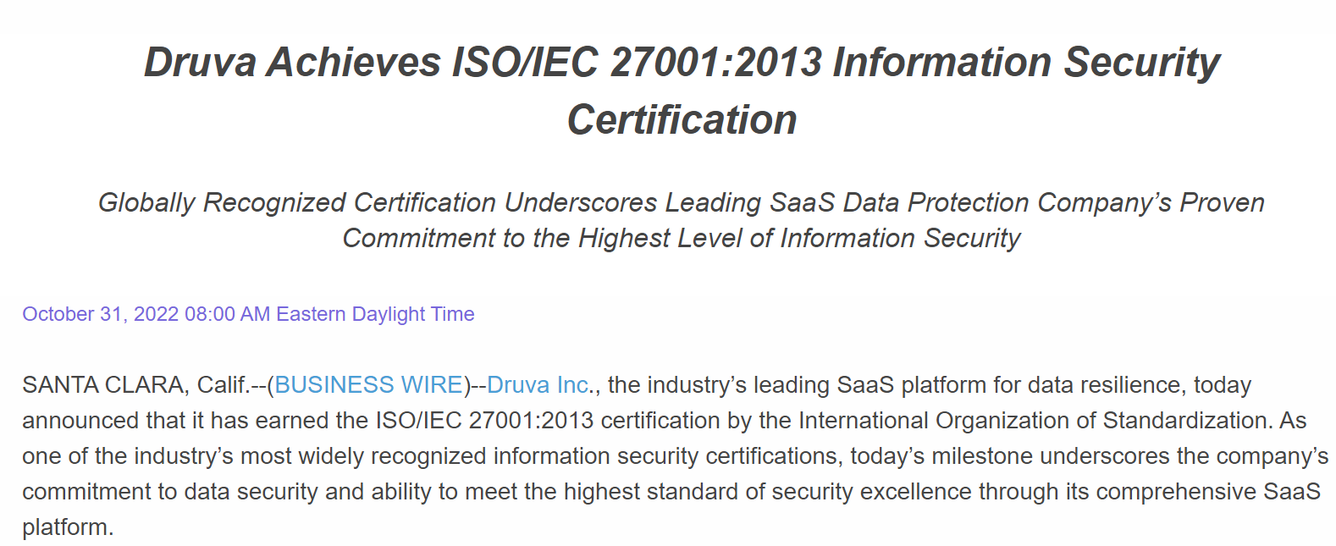
Need to fulfill certifications?

Slide 38
Need to fulfill certifications?
ISO/IEC 27001:2013
https://www.businesswire.com/news/home/20221031005129/en/Druva-Achieves-ISOIEC-270012013-Information-Security-Certification
Security procedures that must be implemented within the organization – from top mangement to regular employees

Slide 39
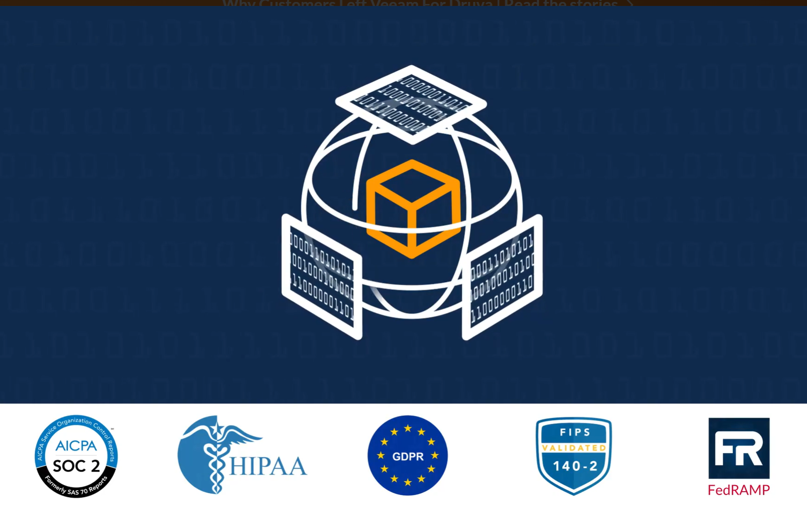

Slide 40
What do we need in cloud?
Apex Backup Services
Laptops
Mobile Devices
Hybrid Workloads

Slide 41
What do we need in cloud?
Apex Backup Services
Laptops
Mobile Devices
Top functionalities
Bandwidth
Easy
Partner / development
Security
Cost
Hybrid Workloads

Slide 42
SaaS v On Premise M365 Data Protection
Why the Difference Matters?
 | SaaS | On Premise
Pricing | Predictable, transparent with consumption-based pricing. | Hidden, unpredictable costs. SW + On-Prem H/W = yearly maintenance costs Additional infrastructure, power, cooling, transaction, management costs.
Deployment | Zero infrastructure means easy, faster to deploy and manage. Scalable platform for growth including non-disruptive updates. | Deployment cost, hardware delivery time, difficult to scale, and ongoing SW maintenance. Updates and patching the solution need to be planned.
Management | One Simple UI to manage multiple sites globally, API driven, SIEM Logging, audit trails, RBAC | Complex environments can be difficult to manage with multiple interfaces, admin accounts, very challenging with ROBO sites
Security | Built-in security features by design. Default protection includes encryption, immutability, multiple copies across AGs, envelope encryption, legal hold, Anomaly detection, eDiscovery and many more security features. | Secure by implementation means the customer is responsible for hardening all aspects of the solution and keeping it secure. Build and configure yourself can create limited, separate tools.
Accessibility | Easy to access from any part of the world. 19+ storage regions available you choose where you store data. Direct connection from Microsoft’s Datacenter to Dell’s SaaS platform. Ingres and Egress charges are included. | Difficult to access and restore data from on-premise to the cloud. No flexibility, verification, Ingress and Egress charges need to be considered.
Modern Architecture | Built to scale, support multi cloud native workloads, AI integration, Gen AI assistant, Unusual Activity Detection. | Mature environments, multiple appliances and software compatibility restraints, difficult to restore cloud services.
Proof of Concept (POC) | Free Trial with quick demo setup (15mins) no infrastructure to set-up and maintain | Demo would need to be scoped and built around the customers requirements and environment.

Slide 43
Use cases APEX Backup Service?

Slide 44
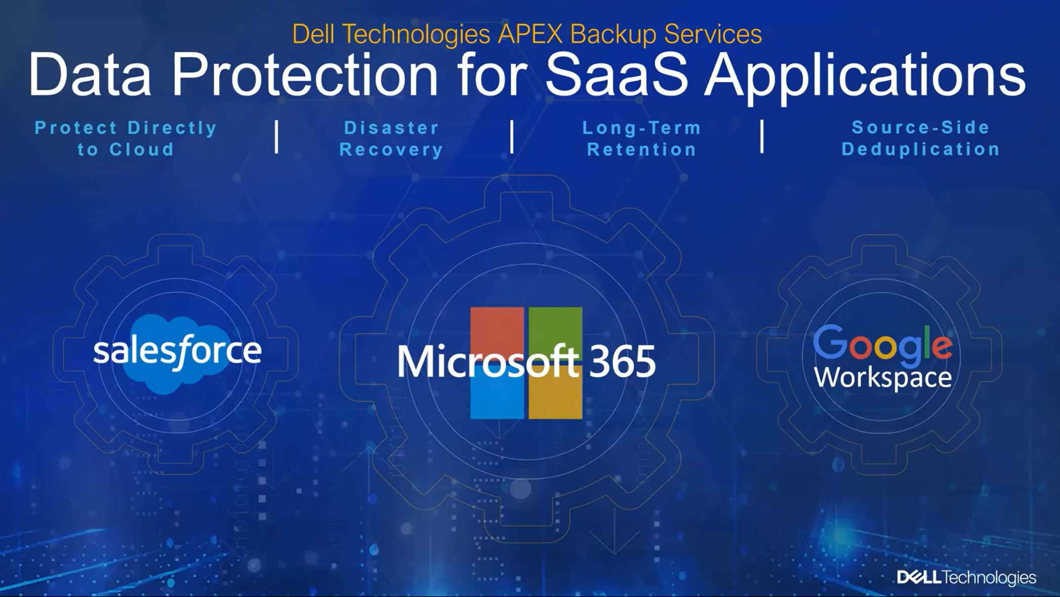

Slide 45
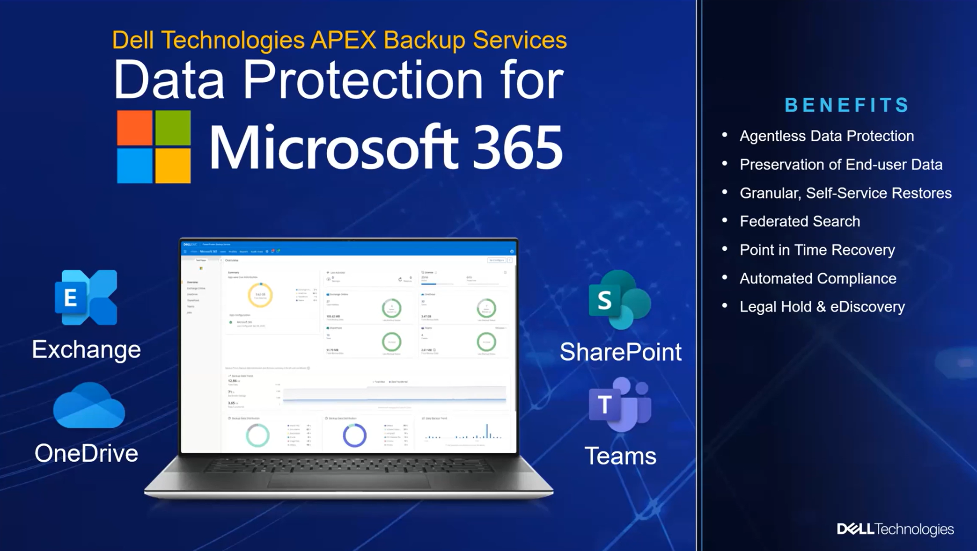

Slide 46
What M365 data can we protect with APEX Backup Services?
Per user
Exchange
OneDrive
Per organization
SharePoint
Teams

Slide 47
Adding users
Individually
Import as CSV
Import form Azure AD

Slide 48
Mapping users to profile (policies)
When adding from GUI
Indivudally
CSV
Auto mapping – new user will be automatically added to specific profile

Slide 49
What APEX Backup Services provide for M365?
Single pane of glass
Agentless (SaaS)
Federated Search
Search data for recovery / compliance
Recovery from any Point in Time snapshot
Backup from 2 times per day to once per week
We can request for our own frequency

Slide 50
What APEX Backup Services provide for M365?
Lock data
eDiscovery proces
Automated compliance
Legal hold,
Federated search
Reporting

Slide 51
Exchange – what can we protect?
All atributes of Exchange environment
Public Folders
Mailboxes
Individual Subfolders
Individual messages

Slide 52
SharePoint – what can we protect?
Entire site
Data in the site
Metdata

Slide 53
Teams – what can we protect?
Entire site
Data
Metdata
Chat

Slide 54
OneDrive
Exclusions
Files
Paths
Retention
Grandfather / father / son

Slide 55
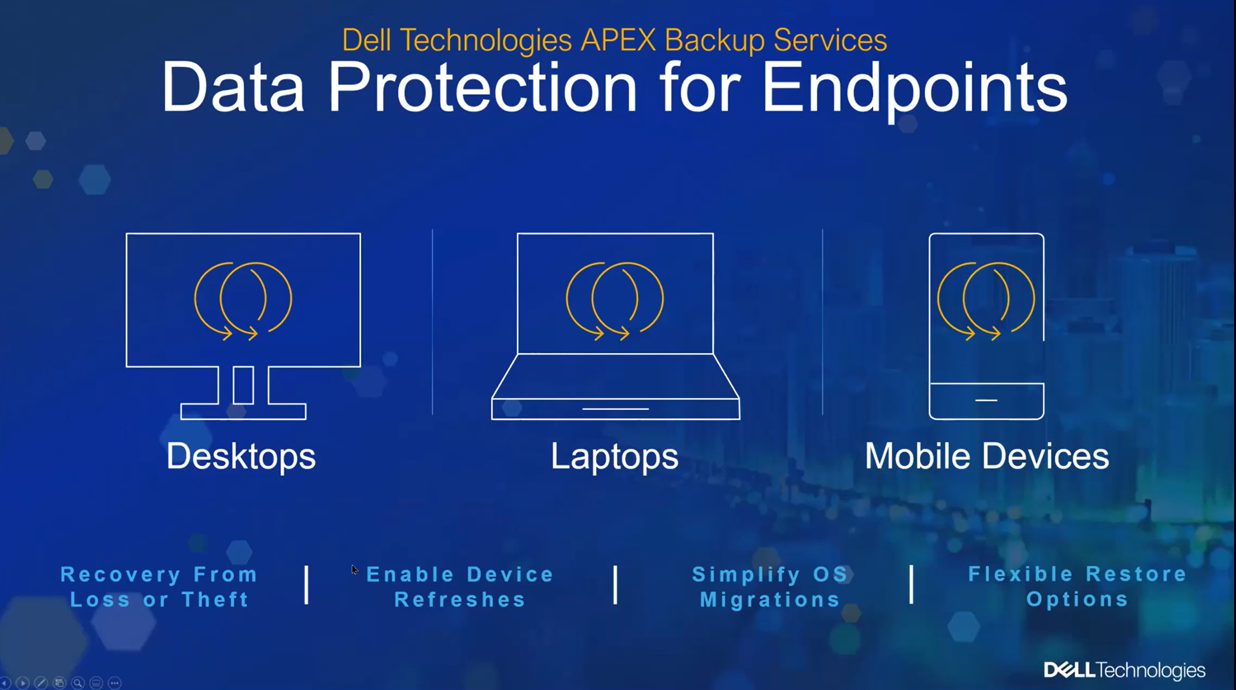

Slide 56
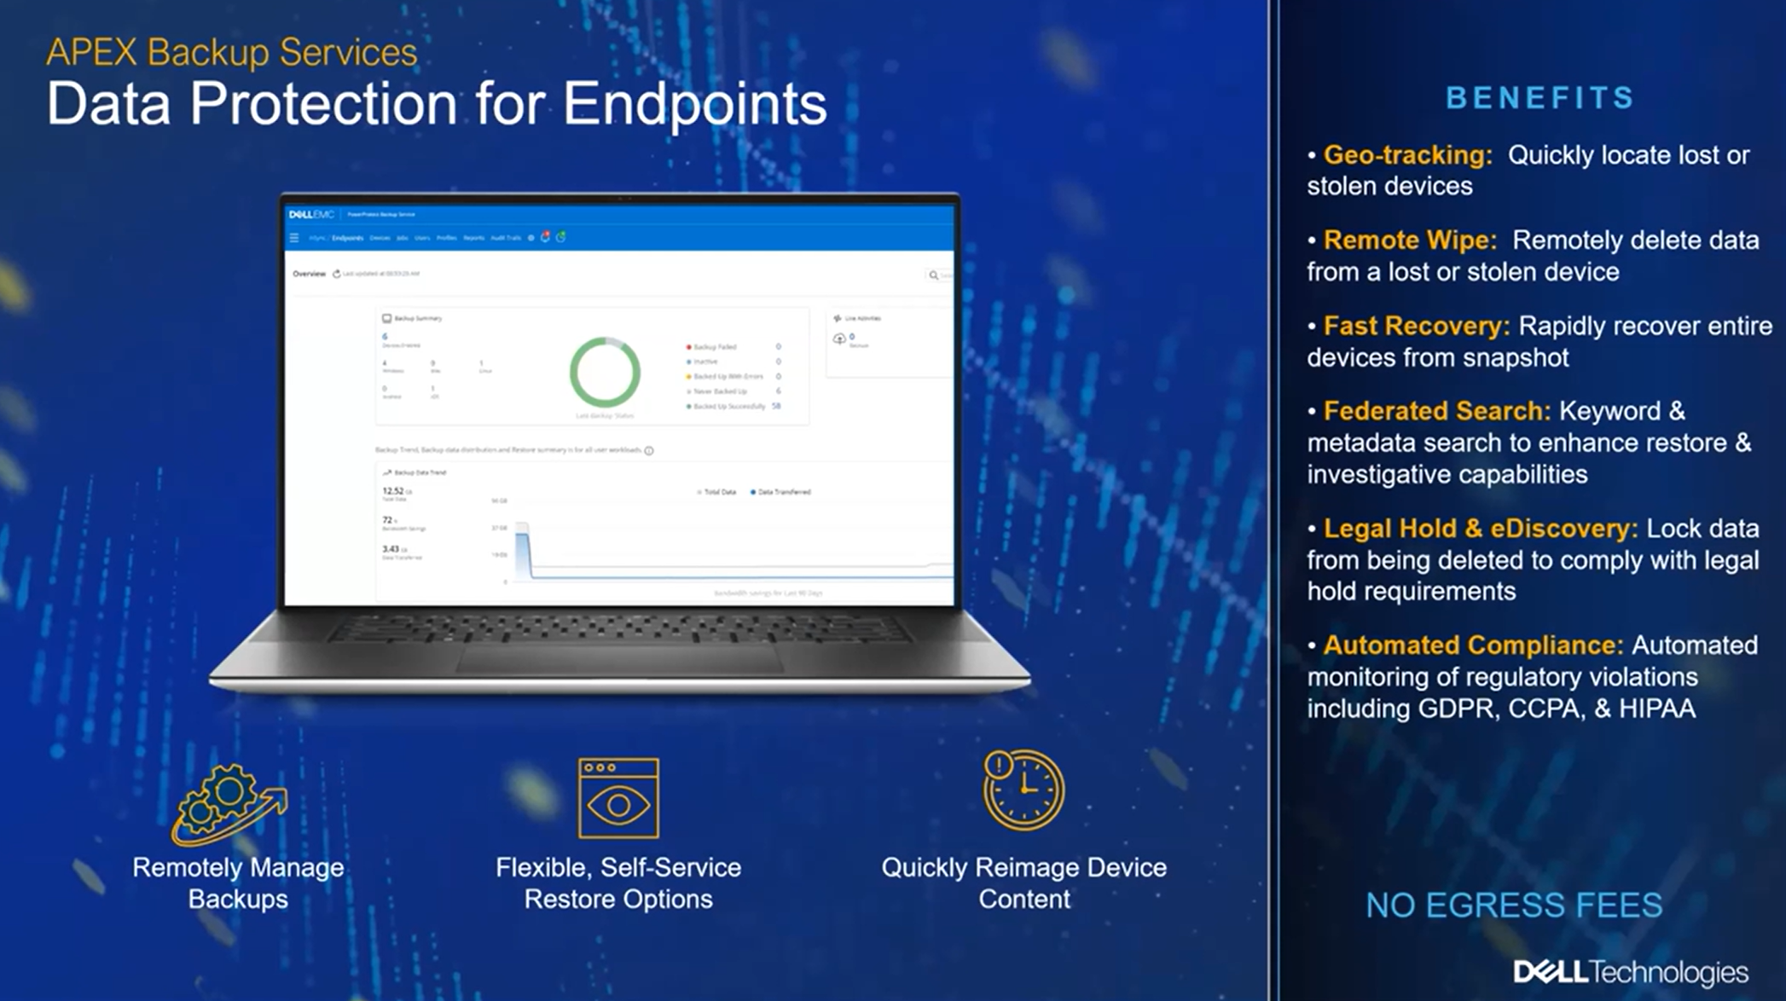

Slide 57
APEX Backup Services for Endpoints
Huge important
Much more than before
Distributed data ecosystem

Slide 58
APEX Backup Services for Endpoints
Laptops
Desktops
Mobile devices
Tablets
Smartphones

Slide 59
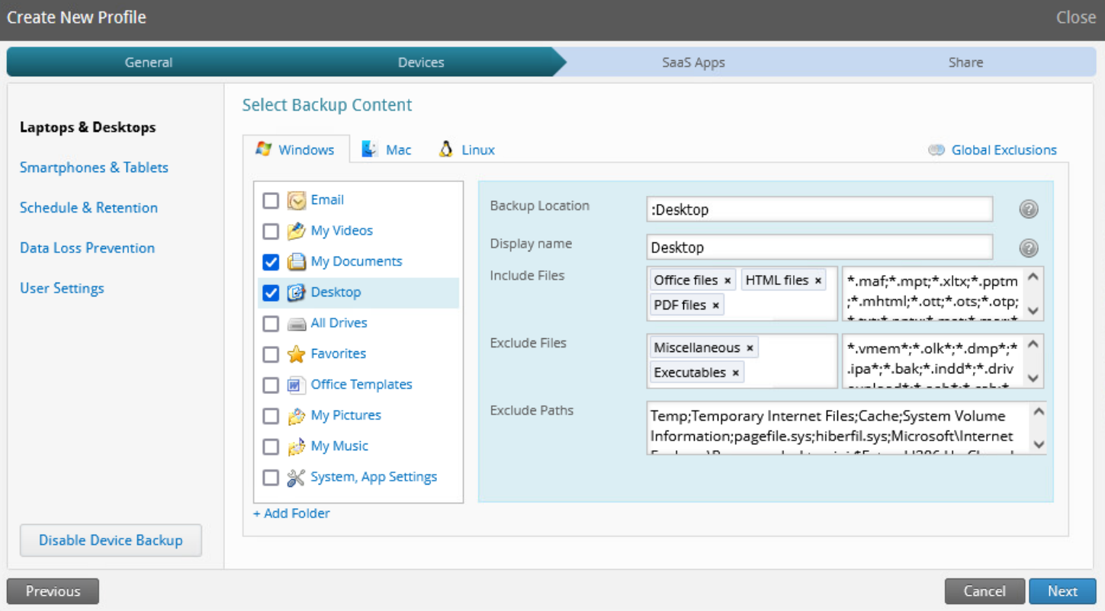
Laptops / PCs
PowerProtect Backup Service
File type inclusions
Laptops/ Desktops
Exclusions per folder
Paths
Data types
Windows
Linux
Option: User defined data
Mac

Slide 60
Smartphones / Tablets
Option: Force data nework
PowerProtect Backup Service
Phones / tablets
Android
iOS

Slide 61
Protection -> Laptops / Smartphones
Single port: 443
Easy
Frequency
Even every 5 minutes
Password protection / Single Sign On
Quota
Location -> per profile

Slide 62
Protection -> Laptops
Logoff / shutdown backups
Backup Window / Silent Window
Max resources limit
Bandwidth
Processor
Retention
Grandfather / father / son

Slide 63
Protection -> Laptops
No load

Slide 64
Protection -> Smartphones
Wifi backup only
Contacts backup
Any folder backup
Predefined folders

Slide 65
Data Loss Prevention
Device trace
Alert if device is not backed up
Encryption
Removing data

Slide 66
Settings that user CAN have access
Schedule
Backup window
Adding data to backup
Notifications
Adding devices
Frequency

Slide 67
What can we do with laptops backup / recovery?
Confidentiality
Automated compliance
Legal hold,
Federated search
Reporting

Slide 68
Restore
By user / By admin
We can block admin restore
Dedicated portal for user
Can be blocked
Laptop agent
Mobile app

Slide 69
Restore
Easy
Search
To oryginal location / dedicated folder
Password / Single Sign On authentication
Restore OndeDrive / Exchange / Smartphone / Laptop data from any device

Slide 70
Geo tracking – value of Endpoints backup / recovery
APEX Backup Services for endpoints offers geo-tracking of mobile devices and DT/LT with the ability to remote wipe mobile devices (Android and iOS). There is also the option to remotely delete data from DT/LTs. A use case for these features is when endpoint devices are lost or stolen. These features can only be performed by an IT admin.
Locate devices any time – important if device is stolen
Remotetly delete if defined as stolen

Slide 71
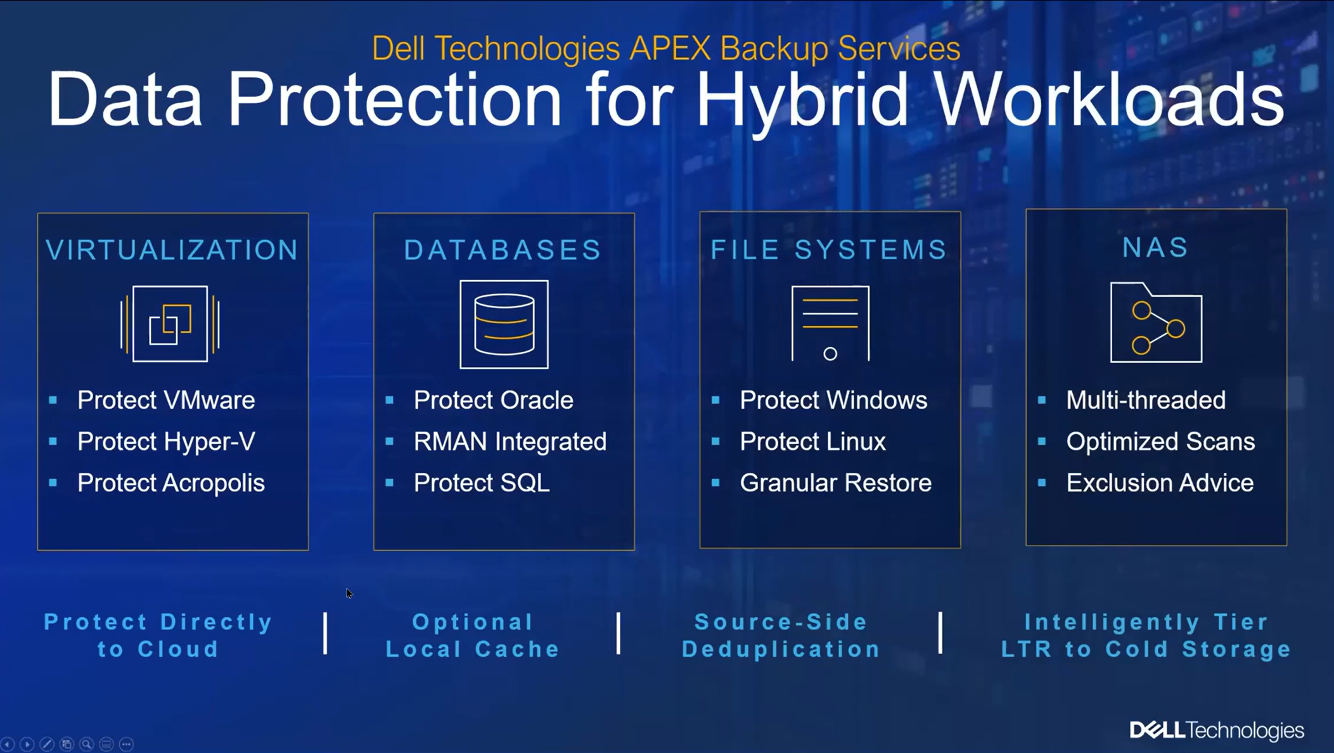

Slide 72
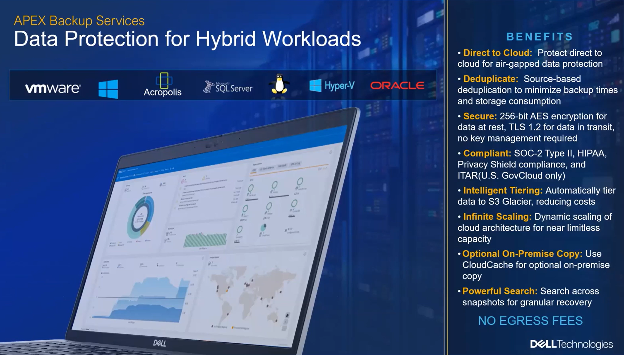

Slide 73
Remote offices
As a services
Good for multiple sites
Removing hardware / maintenance / manual workload
Good moment if renewal is considered

Slide 74
Why APEX Backup Services?
Simple
Top features
Fast

Slide 75
Cloud cache
Local copy
On premise cache, than replicate to cloud
7 days / 14 / 30 days local copy
Protects against issues with bandwidth

Slide 76
Intelligent tiering
Normally backups are kept on S3 in AWS
APEX Backup Services can move tham to Glacier
There is cost reduction in licensing
It is possible here to reduce cost here because it licensed by backend
SaaS is licensed per user

Slide 77
De-duplicated data
License per real usage of backend
Data are de-duplicated on source
Of course, on backed there are kept de-duplicated data
Only data changed since last backup are sent to APEX Baclup Services and put on storage

Slide 78
What do we get with source de-duplication?
Small cost
Small bandwidth
Speed

Slide 79
Value of APEX Backup Services for Hybrid Workloads
Disaster recovery
Long-term retention
Storage insights
Reporting

Slide 80
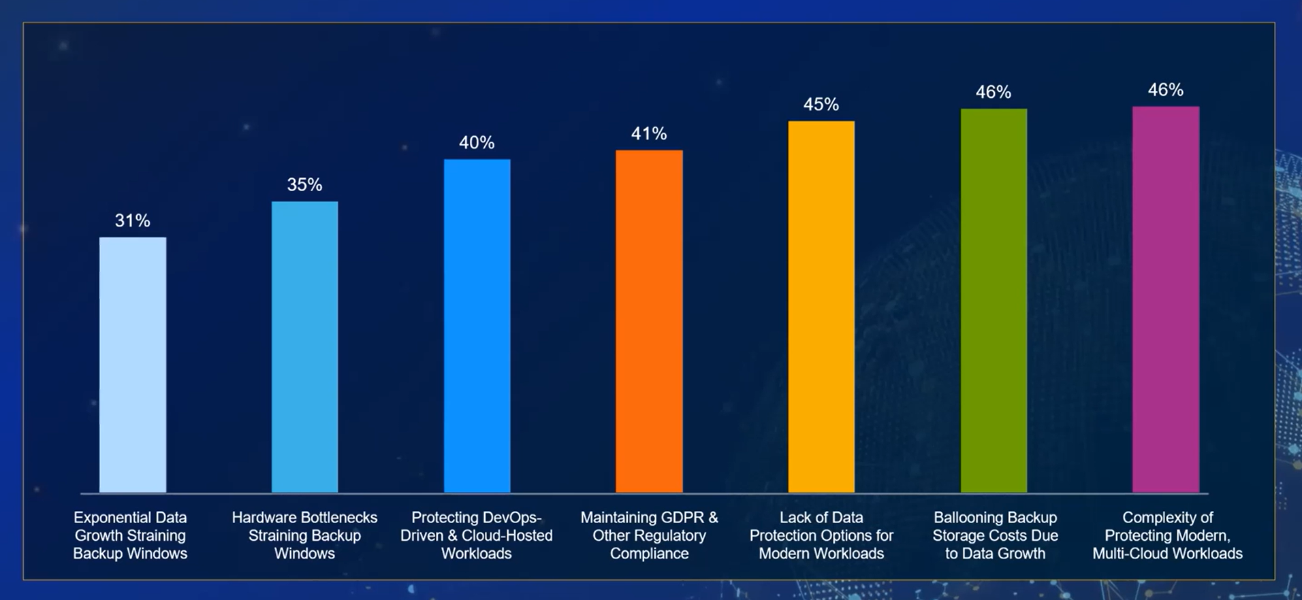
Why APEX Backup Services?

Slide 81
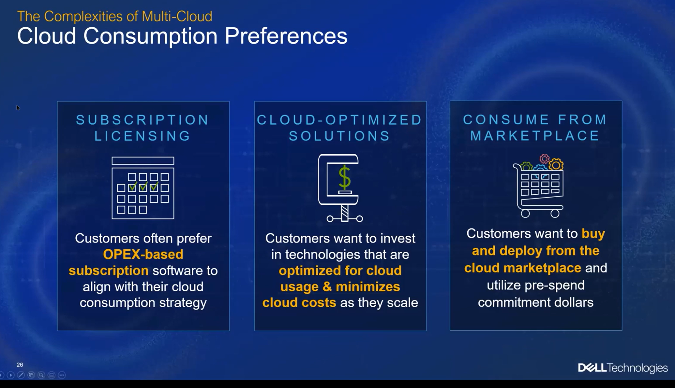

Slide 82
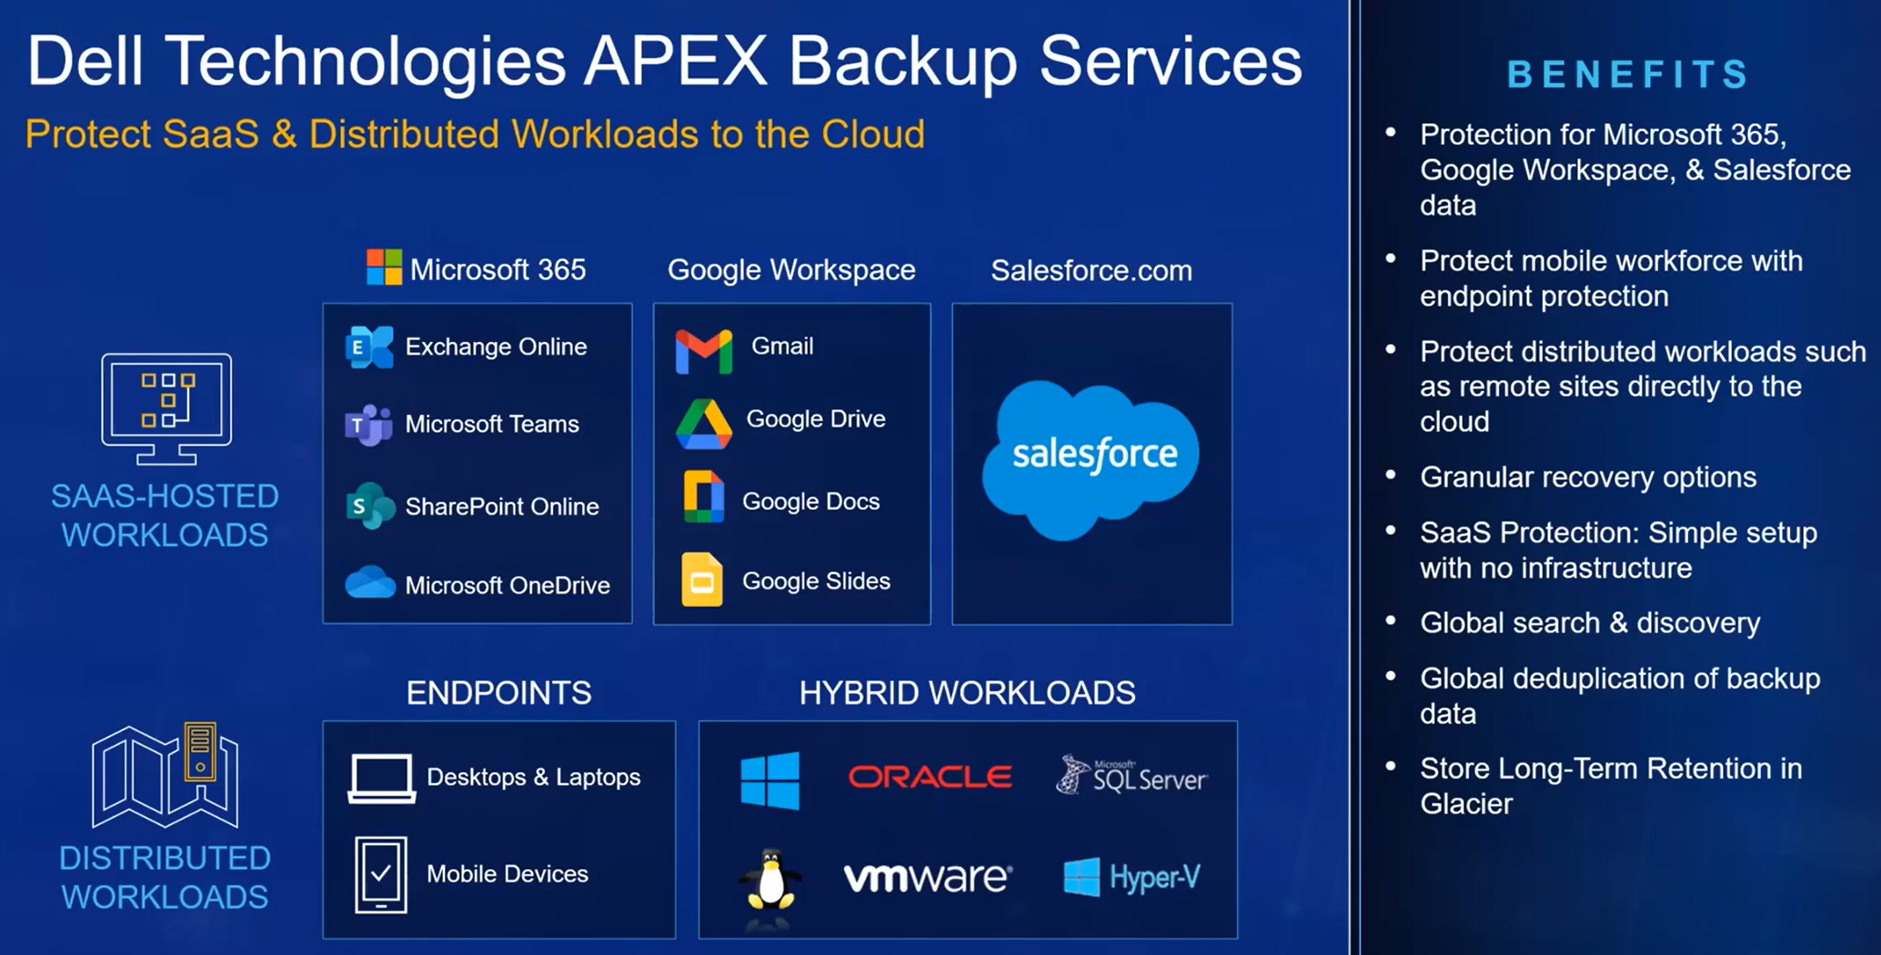

Slide 83
Why APEX Backup Services?
Over 4000 customers
Over 200PT of backup data

Slide 84
Certifications
FedRAMP
FIPS
HIPAA
Socs 2
Turste an ISAE 3000 Type II
Skyhigh Enterprise-Ready

Slide 85
Security APEX Backup Service?

Slide 86
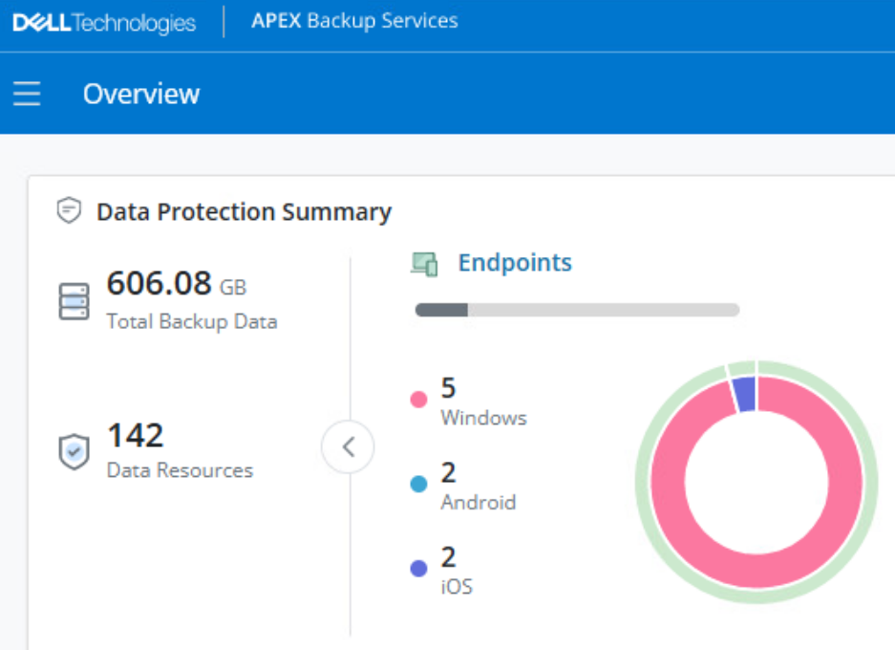
Cloud protection
Security
PowerProtect Backup Service
Preserve
users
Encryption
Encryption
Laptops
Only user restore
Mobile Devices

Slide 87
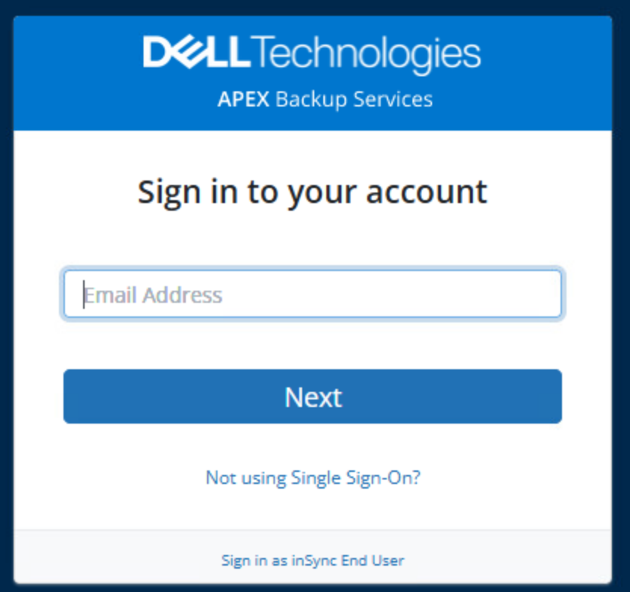
Administrator

Slide 88
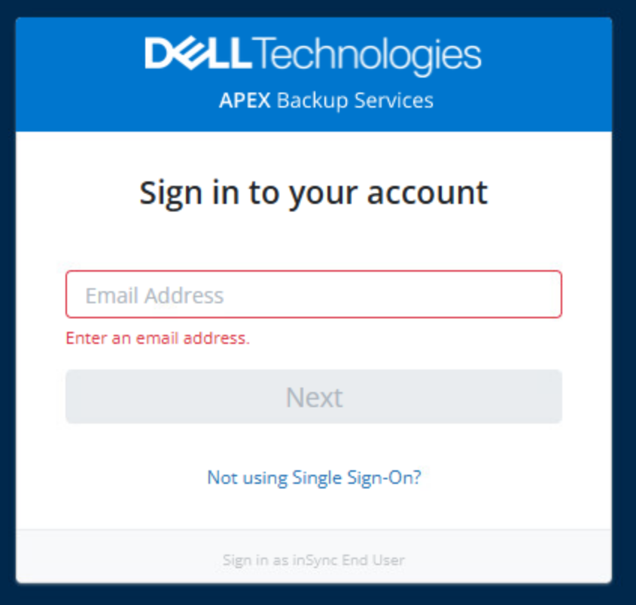
Administrator
User

Slide 89
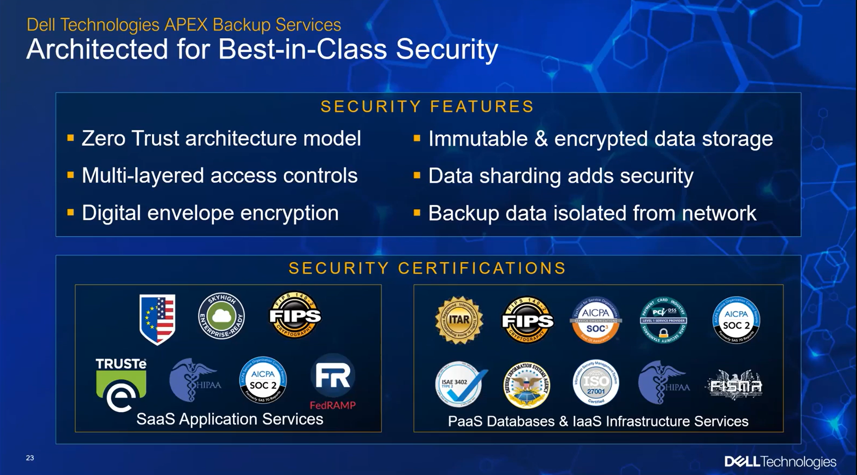

Slide 90
Security
3 copies / 3 data centers / 3 locations
Encryption on fly with key owned by customer
No access to data by Dell or anyone apart from customer
Backup is physically separated from our production data: M365 / Laptops / Remote Offices
Backup is logically separated from our production data: M365 / Laptops / Remote Offices

Slide 91
Security
Ransomware cannot access APEX Backup Services to encrypt / delete / change data
There is no possibility to run any program within backup enviornment – data are seprated
No one can run anything in APEX Backup Services
In case of password stolen – Data Lock / compliance
Data in APEX Backup Services are immutable
Delayed deletion – 7 days

Slide 92
Security
MFS - Multi-factor authentication
Range of allowed IPs (Geofencing)
Confidentiality 2 types of policies
Admin canNOT restore users data to other destination than original location of data
Admin can restore users data

Slide 93
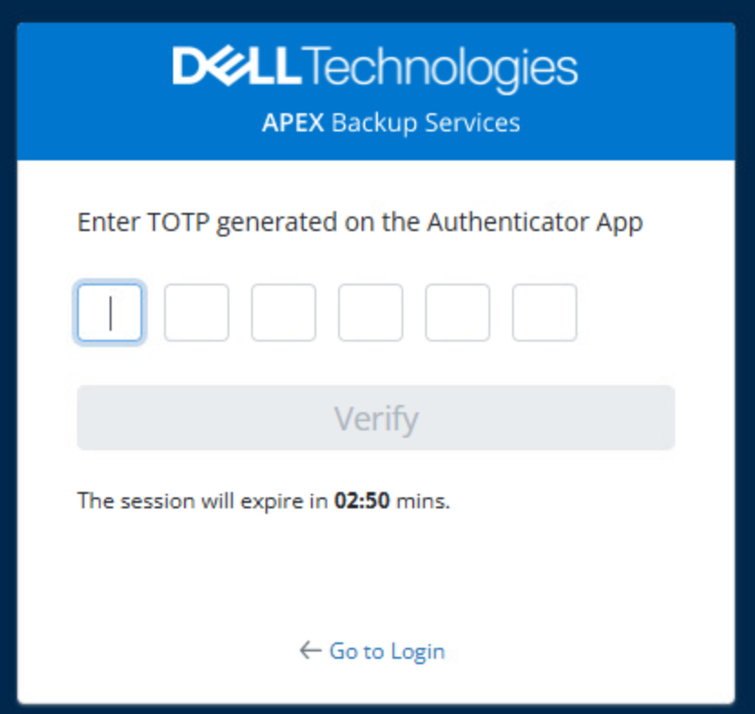

Slide 94
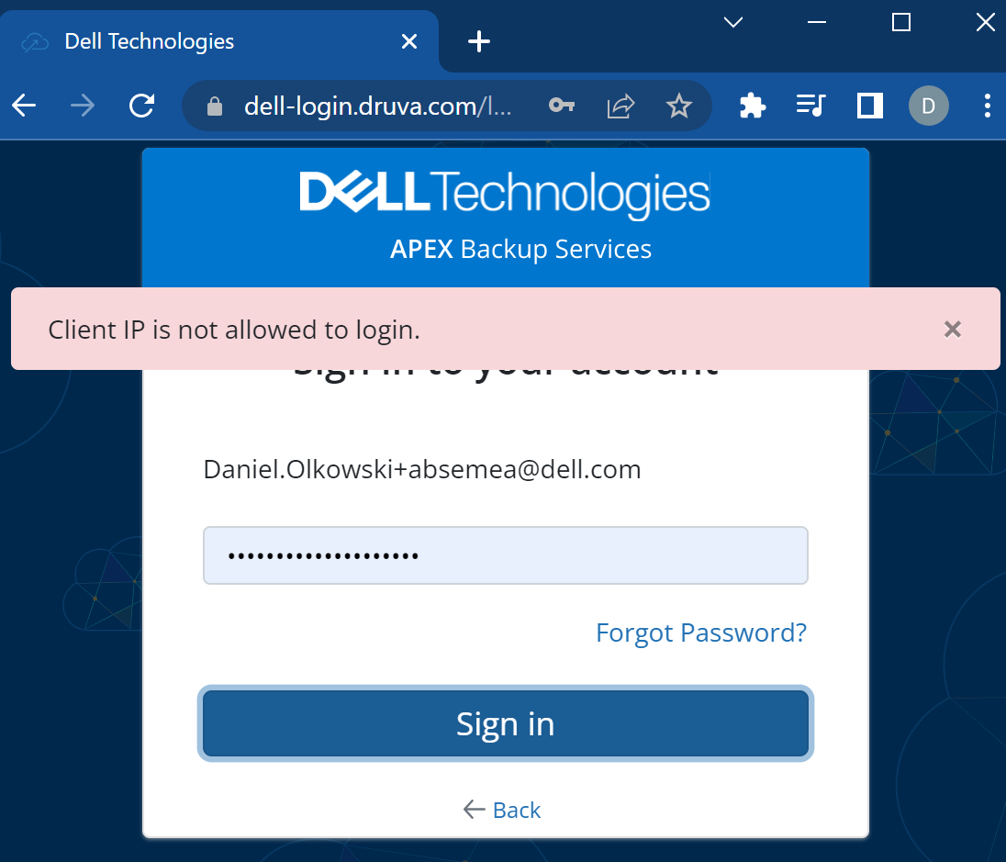

Slide 95
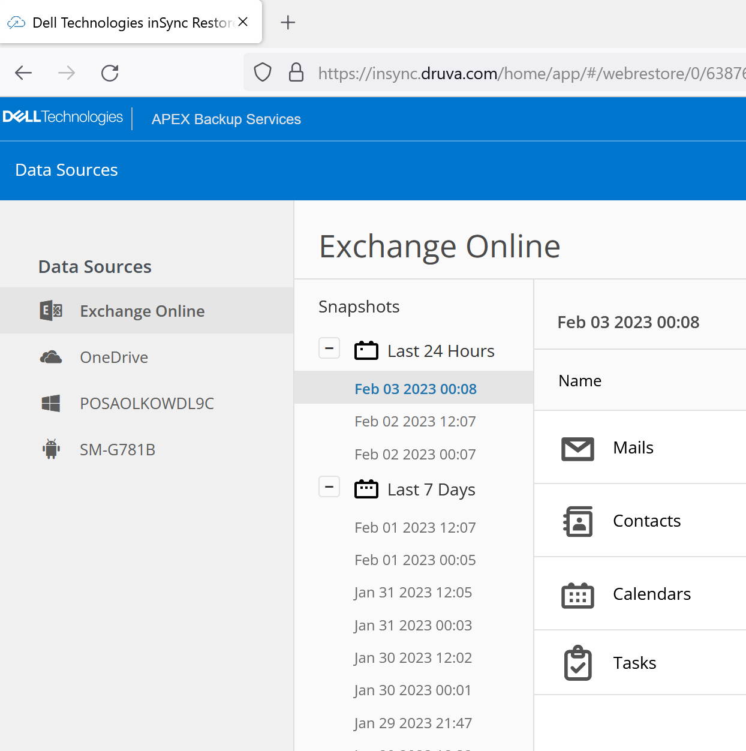
APEX Backup Services
Administrator
User
Laptops
Mobile Devices

Slide 96
APEX Backup Services – Data Centers
US East (N. Virginia)
US West (N. California)
US West (Oregon)
Asia Pacific (Mumbai)
Asia Pacific (Singapore)
Asia Pacific (Sydney)
Asia Pacific (Tokyo)
Canada (Central)
Europe (Frankfurt)
Europe (Ireland)
Europe (London)
Europe (Paris)
South America (Sao Paulo)
AWS GovCloud (US-West)

Slide 97
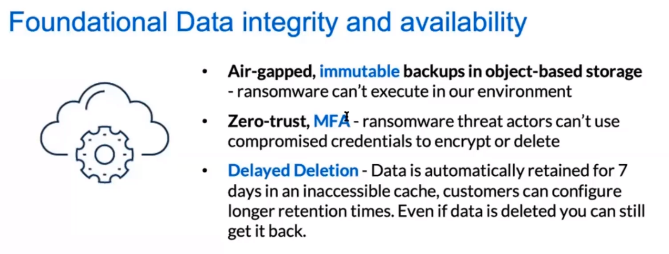

Slide 98
Delayed deletion
Requires special request
No admin access in case of password stolen to change settings
Real case where OneDrive / Backups where deleted Data in real recovered from cache

Slide 99
Security
Vertrax case study: https://www.druva.com/customers/vertrax-replaces-veeam-to-achieve-ransomware-protection-for-microsoft-365-and-endpoint-data

Slide 100
Azure / AWS
Cloud native

Slide 101
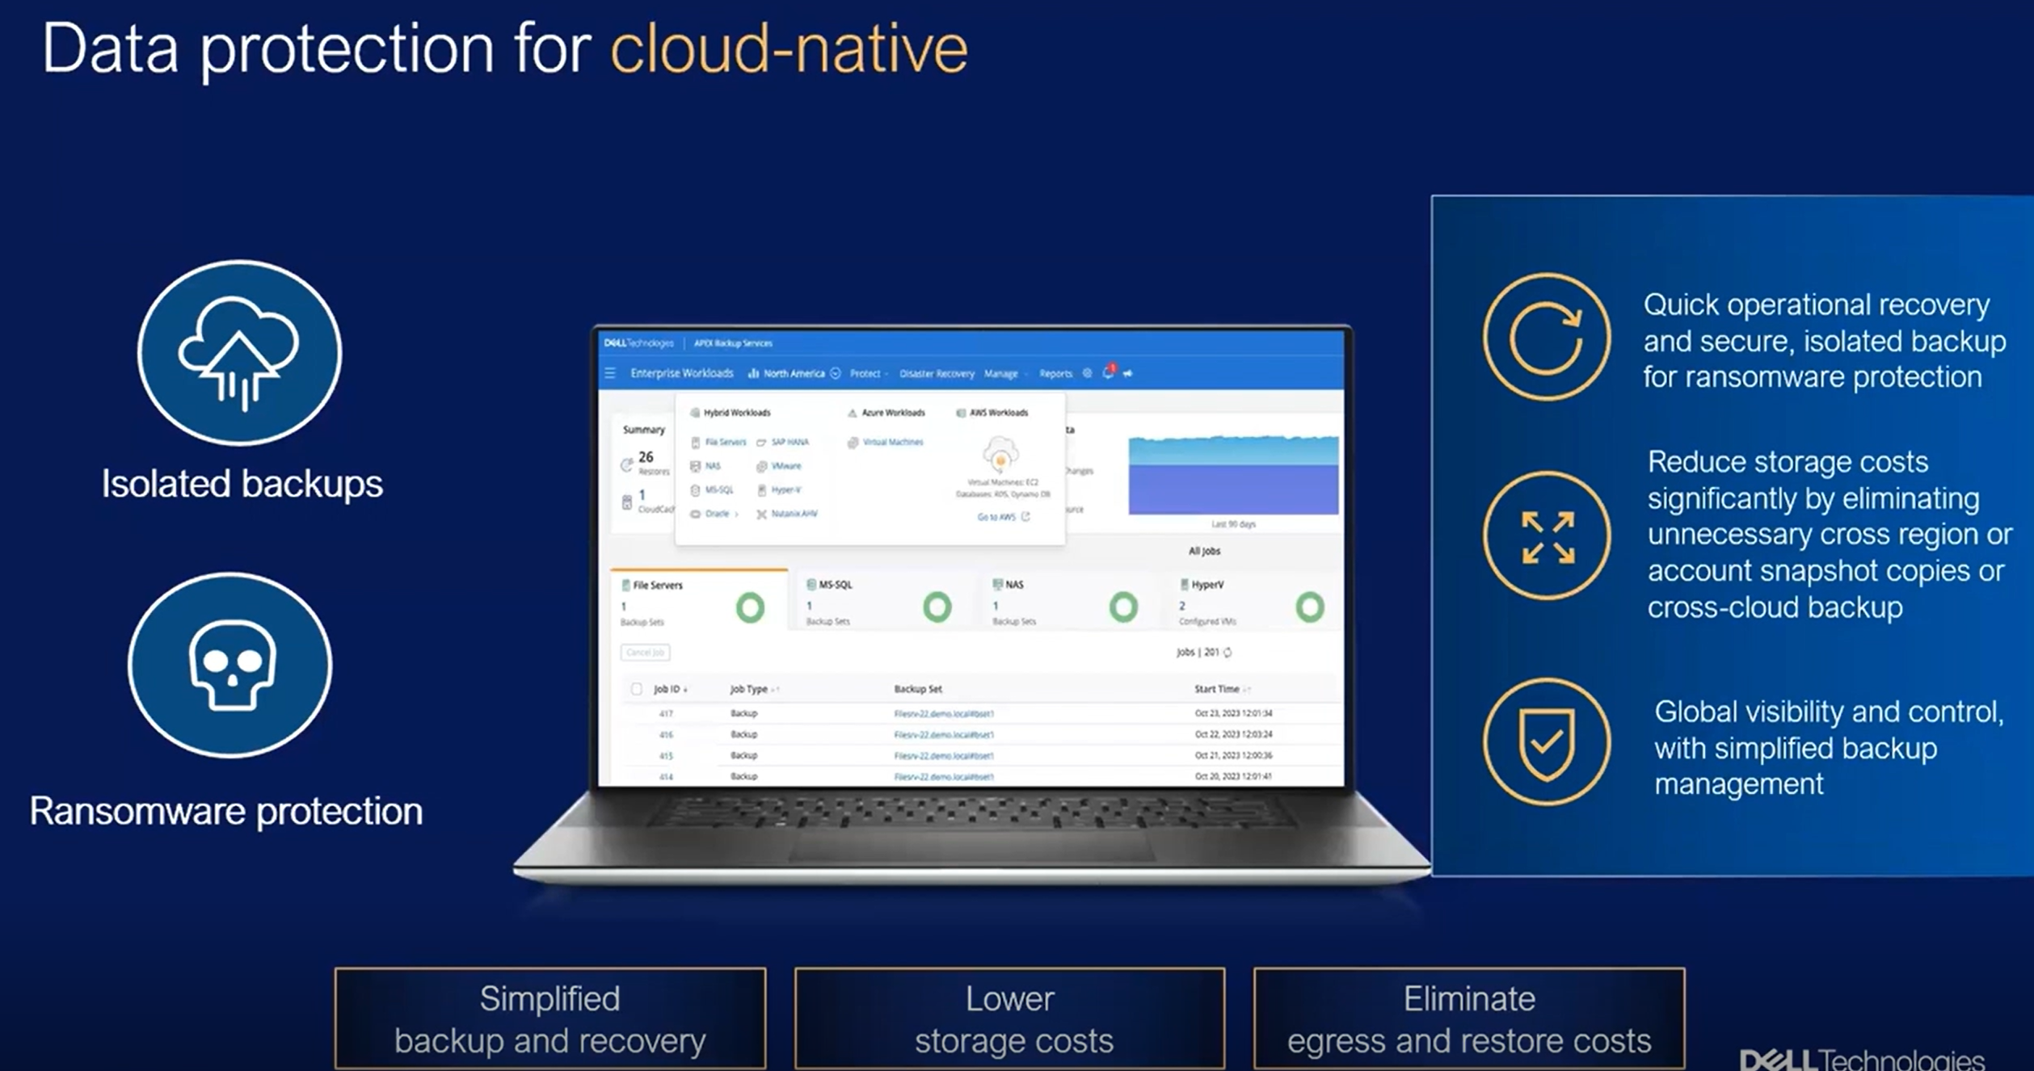

Slide 102
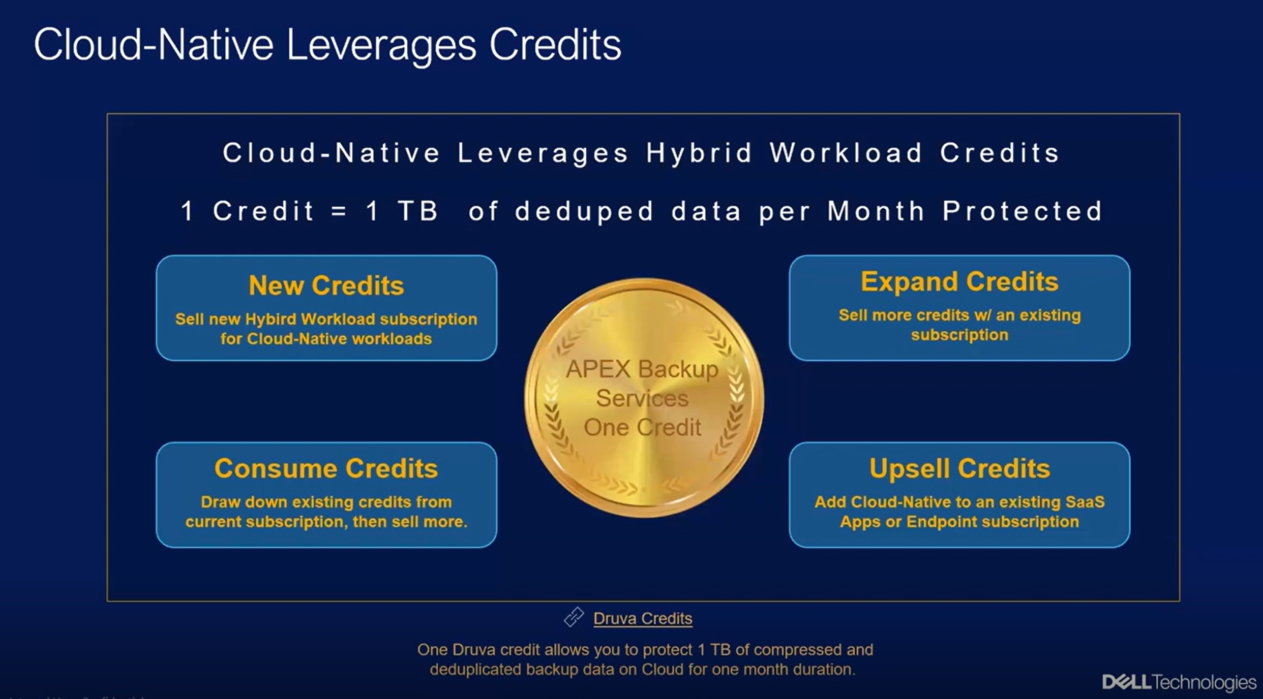

Slide 103
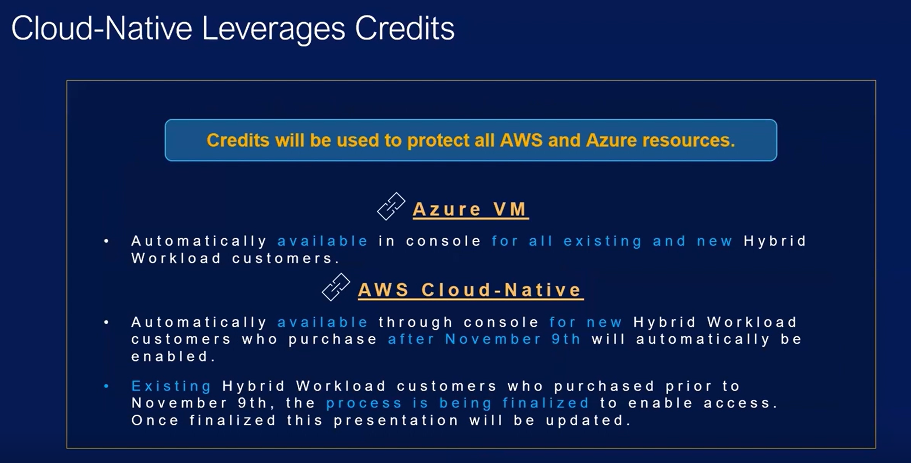

Slide 104
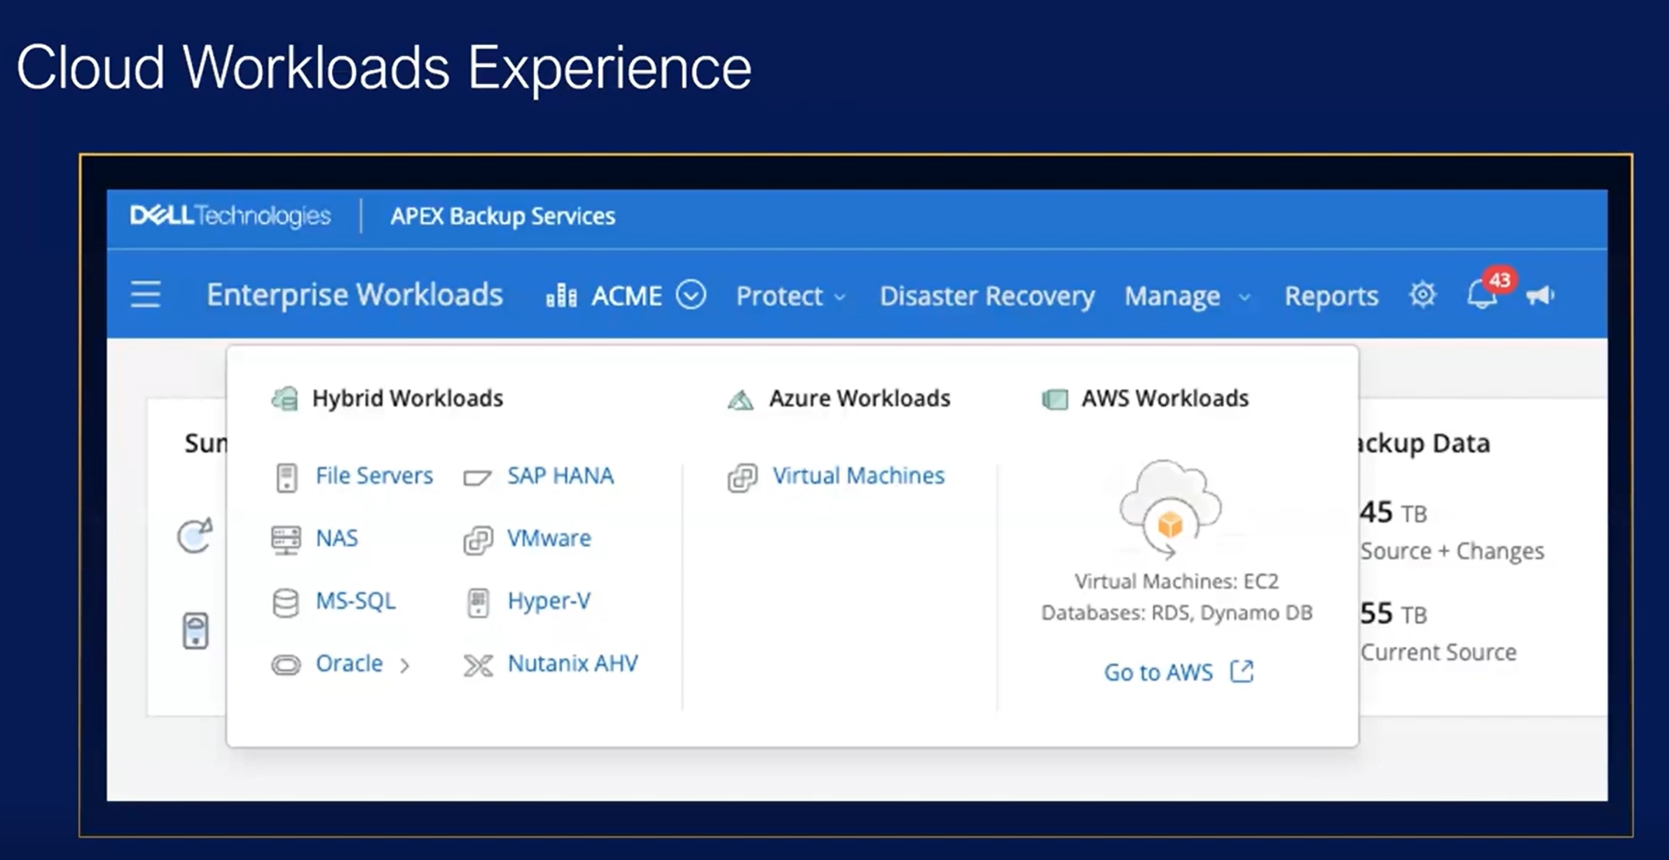

Slide 105
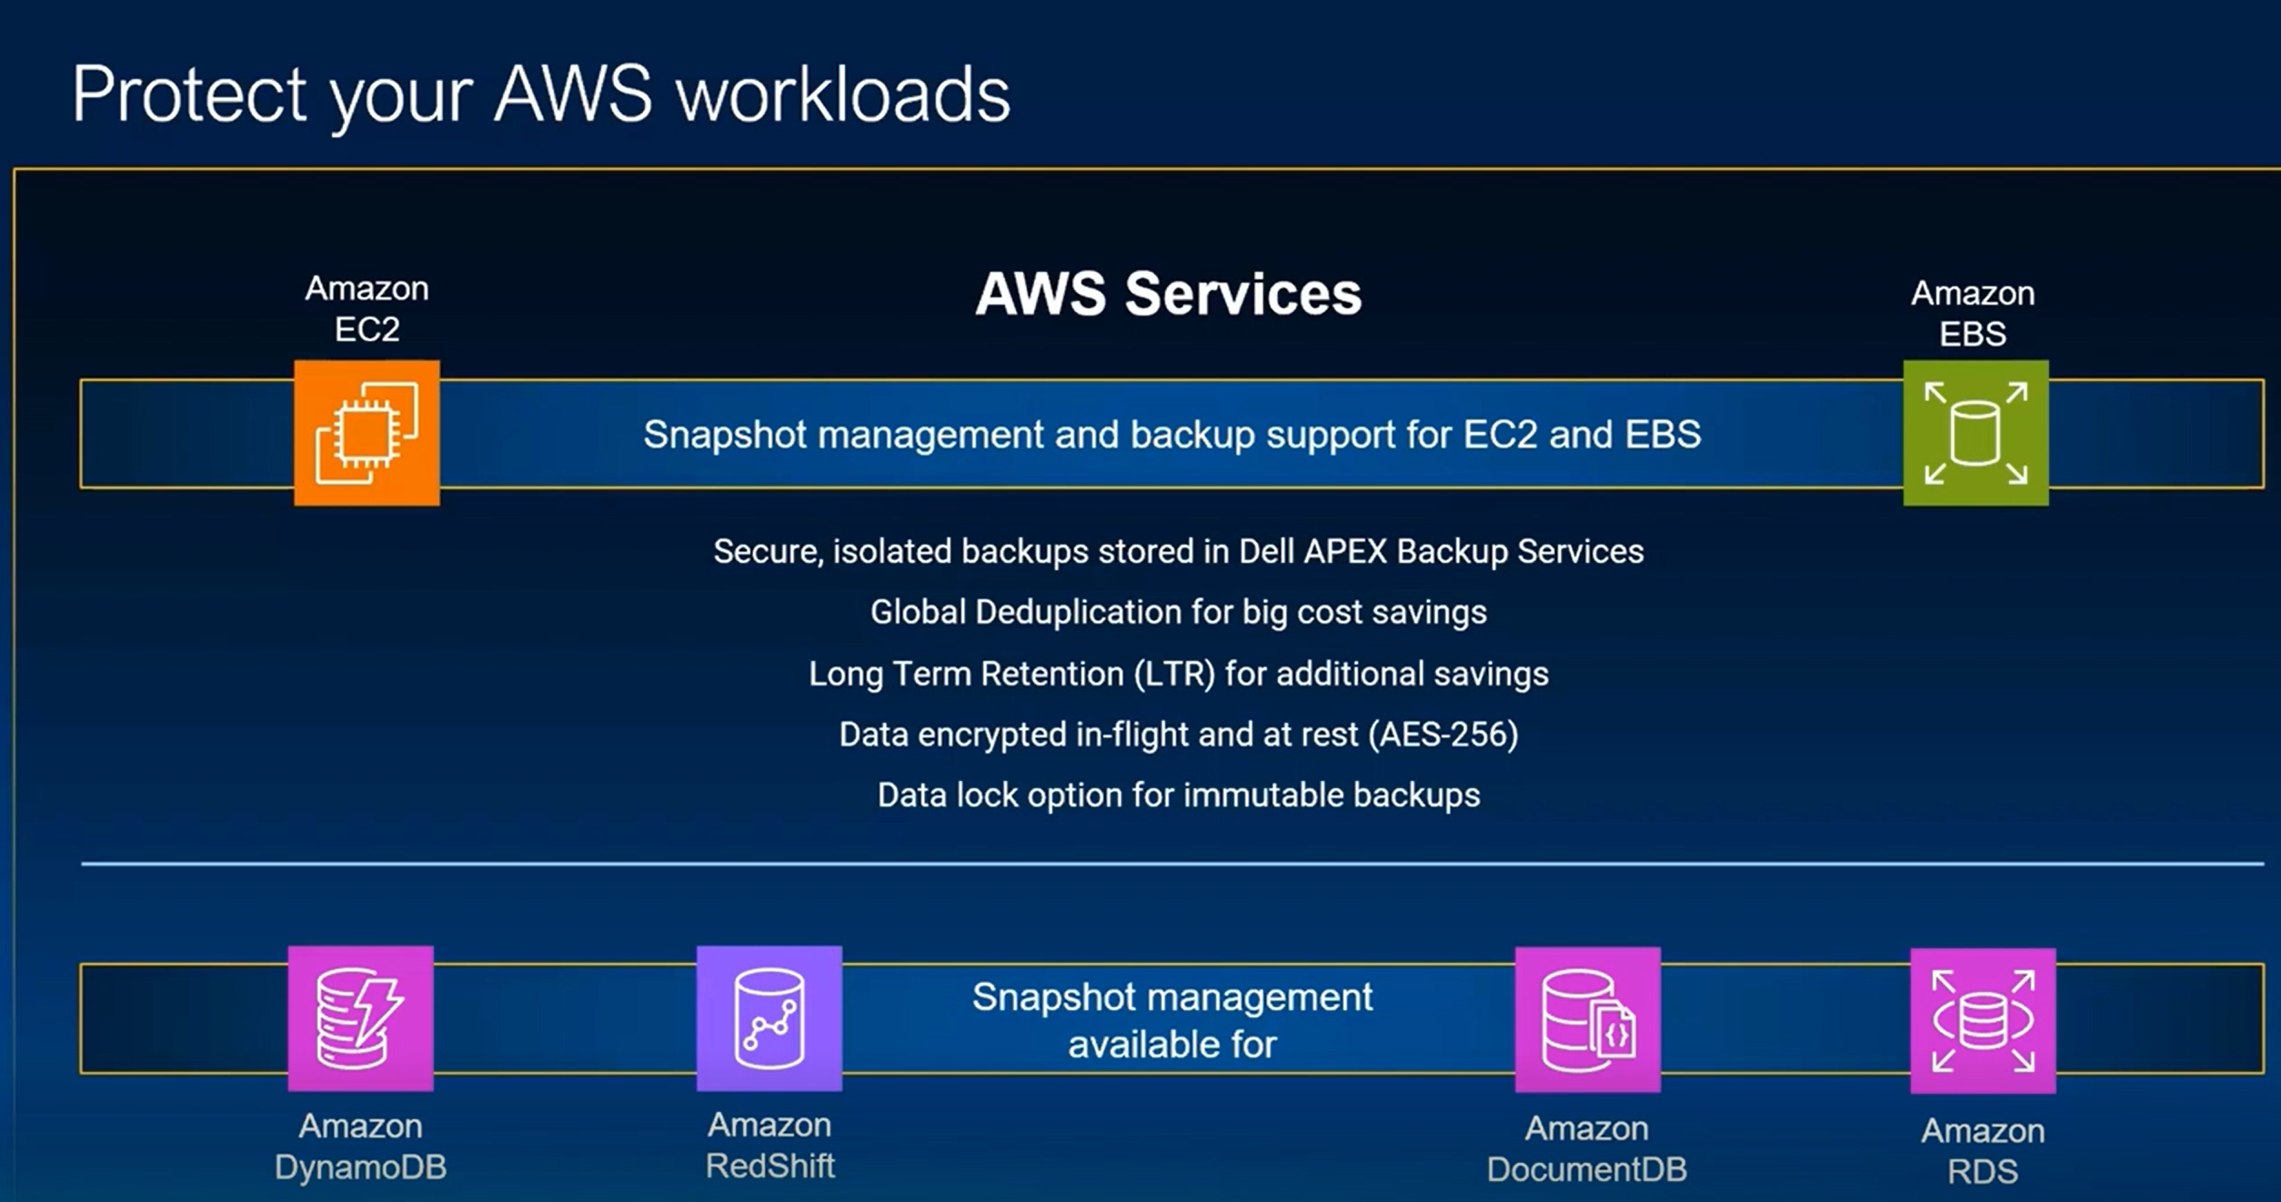

Slide 106


Slide 107


Slide 108



Slide 109


Slide 110


Slide 111


Slide 112


Slide 113


Slide 114


Slide 115


Slide 116


Slide 117


Slide 118


Slide 119



Slide 120


Slide 121


Slide 122


Slide 123



Slide 124


Slide 125



Slide 126


Slide 127


Slide 128
RDS (Relational Database Service)
Usługa która daje dostęp / przykrywa / zarządza MySQL, PostgreSQL, MariaDB, Oracle Database i SQL Server
Amazon Redshift Hurtownia
DynamoDB NoSQL

Slide 129
Apex Backup Services
Just storage cost
No egress cost
Global de-duplication
AWS/Azure/Hybrid
Separated backup from production
S3 is in the same Zone if hacker gets in
Checking
Advanced features

Slide 130
Pre/post scripts
DB consistent
Organizations

Slide 131
AWS
Snapshot management
Fast recovery
EC2/EBS/RDB/Amazon DB / RedShift/RDS/Document DB
File search ECS/EBS
b. Backup to APEX Backup Services
Separated from EBS/EC2
EC2/EBS

Slide 132
AWS
Restore file / disk / VM

Slide 133


Slide 134


Slide 135


Slide 136


Slide 137




Slide 138
Azure Synthetic Full always!
Sending delta only
We have all full backups!

Slide 139
One snapshot/backup kept in Azure
For sending data to ABS
Azure Synthetic Full always!
Sending delta only
We have all full backups!
Agentless
No Egress cost
No implementation / No agent

Slide 140
Azure
Ransomware / air gapped protection
Encrypted customer key
Agentless
No complexity
Single console for all workloads
Cheaper than snapshots in Azure
Global de-dup

Slide 141
Data Lock APEX Backup Services

Slide 142


Slide 143
Why Data Lock?
What if someone
deleted data
has access to APEX Backup Services
deletes backups there?
We have 7 days deletion delay, but…

Slide 144


Slide 145
Data Lock
Backups / Snapshots are protected against deletion by administrator or someone who tooked the password of administrator
We prevent data loss of organization by accidential or by purpose deletion od data in backup repo
We protect against accidenttial deleteion / ransomware attack

Slide 146
Data Lock
No chance to change or delete the data in APEX Backup Services
Laptops / M365 / Google Workspace backups
Addional layer of security

Slide 147


Slide 148


Slide 149


Slide 150


Slide 151


Slide 152


Slide 153


Slide 154

We cannot remove Data Lock or change Retention

Slide 155


Slide 156

We cannot remove users from profiles with Data Lock. The same we cannot remove license because it stop backups of this user. We can also not move user to another profile

Slide 157


Slide 158

We cannot delete devices from profiles with Data Lock.

Slide 159

We cannot delete snapshots from profiles with Data Lock.

Slide 160



Slide 161


Slide 162

We can delete the file from the device but not from the backup.

Slide 163
Setup Data Lock for Sharepoint and Teams
It is per site collection
We cannot setup DataLock for the whole Sharepoint Teams to setup autmatically – tough to remove it

Slide 164


Slide 165


Slide 166


Slide 167


Slide 168


Slide 169

We cannot change the retention

Slide 170

What if we want to delete the device via API?
We will get the message as below

Slide 171


Slide 172


Slide 173


Slide 174


Slide 175



Slide 176


Slide 177


Slide 178


Slide 179


Slide 180


Slide 181
Ransomware protection APEX Backup Services

Slide 182
Where can we use?
All use cases
SaaS apps
Endpoints
Hybrid workloads
Exeception: Salesforce

Slide 183
Important
Most of attacks are from endpoints
APEX Backup Services Vulnerability is minimal
No local presence of backup servers / proxies, installations

Slide 184


Slide 185


Slide 186


Slide 187


Slide 188


Slide 189


Slide 190


Slide 191


Slide 192


Slide 193


Slide 194


Slide 195


Slide 196


Slide 197

Examples:
System learns user behaviour f.e. in specific folders there are daily 5 new files
If something unsual happens we are informed – graph and alerts f.e a lot of files change, moved, modified, created

Slide 198


Slide 199


Slide 200
No access to data
No ftp / ssh / GUI / …
Only
Backup / Recovery
Admin access
REST API GETs

Slide 201


Slide 202


Slide 203


Slide 204


Slide 205

Scans for
Hash
Entrophy
We can provide our own hashes for viruses to be checked

Slide 206


Slide 207


Slide 208


Slide 209


Slide 210


Slide 211


Slide 212


Slide 213


Slide 214


Slide 215


Slide 216
Disaster Recovery as a Service

Slide 217
DRaaS
Requires Proxy
We need to have access
Visible to ABS Hybrid

Slide 218


Slide 219


Slide 220


Slide 221


Slide 222


Slide 223


Slide 224


Slide 225


Slide 226


Slide 227


Slide 228


Slide 229


Slide 230


Slide 231
Licensing APEX Backup Services

Slide 232
Cost approach
Any start time
No investment
Any stop time
Clear cost

Slide 233
All inlcusive license
All costs of backup transfer -> Azure / AWS
All costs of restore transfer -> Azure / AWS
There are no egress charges Market unique!
Space for keeping backups
All software hardware / components
Upgrades
New features

Slide 234
Licensing
All inclusive
Backups
Recoveries
Data transfer
….

Slide 235


Slide 236


Slide 237


Slide 238


Slide 239


Slide 240


Slide 241


Slide 242




APEX Backup Services Ransomware Overview
PROTECTION
READINESS
RECOVERY
Data Integrity & Availability
Operational Security
Core Ransomware Protection
Advanced Ransomware Prot. & Recovery
Ransomware is deleting backup data, destroying the last line of defense
Attackers gain access through vulnerable backup systems
New “Security Starter” SKU
Recovery is a long, manual process that may not restore complete/clean data
You will always have protected backup data you can use for recovery
SaaS solution delivers 24x7x365 fully-managed security operations
Includes Pre-attack features & shows cyber value immediately
Stop the spread and quickly recover clean, comprehensive data sets
Data Lock
Air-gapped backups
Zero trust architecture
TOTP App/SMS-based MFA
Encryption in-flight & at-rest
Leverage AWS Cloud for DR
Vulnerability Scans
CVE Patching & Upgrades
Pen Testing
Continuous Monitoring
Controlled Developer Access
Security Dashboard (Security Command Center)
Unusual Data Activity
SIEM Integrations
Rollback Actions
Security Events
Quarantine
Malicious File Scans
Curated Snapshots
SOAR Automation (Recovery Playbooks)
Sandbox Recovery for VMware VMs
Core & Advanced Ransomware are not supported in GovCloud
Notes:
Security Events shows who is accessing the backup environment, where are they coming from, what are they trying to do
Security Dashboard shows a central dashboard for the APEX Backup Service environment to display key security risks that can remediated by customers
- The Security Command Center shows 4 risks:
Posture Security Risks
Data Protection Risks
Data-Centric Security Risks
Data Access Risks
SIEM – Security Information and Event Management
SOAR - Security Orchestration, Automation and Response
CVE - Common Vulnerabilities and Exposures

Slide 243

Cyber Resiliency: Supported / Planned Workloads
 | Unusual Data Activity (Core) | Quarantine (Advanced) | Malicious File Scan (Advanced) | Curated Snapshot (Advanced) | Data Lock (Foundational)
Endpoints (DT/LT) | ✅ | ✅ | ✅ | ✅ | ✅
NAS | ✅ | ✅ | ✅ | ✅ | ✅
Windows & Linux FS | ✅ | ✅ | ✅ | ✅ | ✅
VMware VM Image | ✅ | ✅ | ✅ | ❌ | ✅
SQL / Oracle / SAP HANA | ❌ | ❌ | ❌ | ❌ | ✅ *
Hyper-V / Azure Stack / AHV | ❌ | ❌ | ❌ | ❌ | ✅
Google Workspace | ❌ | ✅ | ❌ | ❌ | ✅
Microsoft 365 | ✅ ** | ✅ |  | ✅ ** | ✅
Salesforce | ❌ | ❌ | ❌ | ❌ | ❌
✅
Available today
Under development
❌
Not available
* SAP HANA does not currently support Data Lock
** Scheduled for August Cloud Pushes
Ransomware Recovery Add-ons not available in GovCloud

Slide 244
Licensing
50GB / user
300GB / user
10TB Storage packs

Slide 245
Licensing
Preserved users
10% free
Special low price for additional ones
Shared mailboxes
50% free

Slide 246
Premium subscriptions have no equivalent at market. Premium gives the following:
Legal hold (data analysis and classification for legal purposes) usually customer need to pay an option with Microsoft Exchange plan to get this.
Federated search (cross search if you have also purchased the End Point solution)
Right to forget (ability to delete specific data form backups) (ex. GDPR rule) This last point is however questionable as the GDPR right to forget impacts production data, usually not emails. Companies usually do not store employee private data on Microsoft 365, and if they do, they should remove it from production, then backup would not copy them.

Slide 247
Licensing - explanation
50 Front End GB per inSync user (including M365, Google Workspace and Salesforce) is included.
Capacity is shared and managed across all users.
For example: 1000 users would include 50TB Front End.
50 Front End GB per inSync Endpoint user is included.
User capacity is for all user devices. User can protect unlimited devices.
Capacity is shared and managed across all users. For example, 1000 users would include 50 TB Front En

Slide 248
Licensing - explanation
We as Customer, we see all capacity of all workloads and we can share tchem as we want across users

Slide 249
Average storage usage
For Cloud Apps average storage usage is less than 10GB per user

Slide 250
Sensitive data Compliance

Slide 251
Compliance
Defines sensitive data
Scans user data for compliance violations or risks of violations.
Locates end-user data that has violated a compliance policy
Generate a non-compliance report
Which regulations has been broken

Slide 252


Slide 253


Slide 254


Slide 255


Slide 256


Slide 257


Slide 258

WhiteList

Slide 259

Critical Violations After

Slide 260

Critical Violations After

Slide 261


Slide 262


Slide 263


Slide 264


Slide 265
Interface APEX Backup Service

Slide 266
Interface
Straight forward
Easy
Even if someone never touched backup can manage
Just clikcing through the options / exploring

Slide 267





Slide 268


851/586 = 1.44
586

Slide 269



Slide 270
Massive Deployment

Slide 271


Slide 272

Instead of manually authenticate agent from GUI, we can create coommand that will authenticate all users
Before there must be installed agent adn users defined – imported from example from AD

Slide 273
Administrator Defining Policy

Slide 274


Slide 275



Slide 276






Slide 277
Preserve users
You can preserve a user in inSync at any point of time. Such users cannot backup any more data. inSync marks the users as preserved using one of the following techniques:
Preserved manually by an administrator.
Preserved automatically through AD/LDAP sync process.
Preserved automatically when a user account is disabled or deleted in the IdP in case of SCIM deployment

Slide 278


Slide 279


Slide 280



Slide 281


Slide 282


Slide 283


Slide 284


Slide 285


Slide 286



Slide 287


Slide 288


Slide 289
Administrator Add user

Slide 290


Slide 291




Slide 292
User Data recovery

Slide 293


Slide 294


Slide 295



Slide 296


Slide 297



Slide 299


Slide 300


Slide 301


Slide 302


Slide 303


Slide 304
Audit trail

Slide 305


Slide 307


Slide 308
Monitoring Jobs

Slide 309



Slide 310
Workshop

Slide 311
Workshop
https://apex-backup-services.syskonf.pl
Opis / zaproszenie internetowe: https://www.linkedin.com/feed/update/urn%3Ali%3Aactivity%3A7024671221233401857

Slide 312
Questions
Daniel.Olkowski@dell.com

