Slide 1
NetWorker in my environment
Speed /
Security /
Single console
Why? / Architecture / Value
The most fresh version of this document, you will find at: http://backuprecoveryguy.blogspot.com/2022/07/backup-and-recovery-materials.html
Materiały dotyczące NetWorker-a po polsku: https://backuprecoveryman.pl/networker-materialy/
Daniel.Olkowski@dell.com

Slide 2
NetWorker

Slide 3
NetWorker
Any environment
Security
Performance
Restore to very recent point
Immediate recovery
Self backup infrastructure
Backup of any database

Slide 4
Architecture

Slide 5
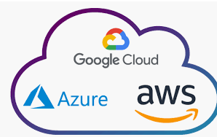
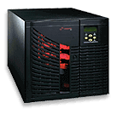
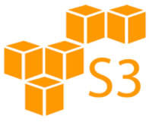
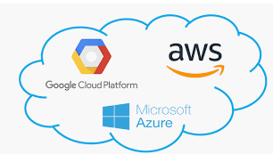
Site A
Site B
Linux, UNIX, Windows
Applications,
Databases,
Linux, UNIX, Windows
Applications,
Databases,
LAN
LAN
VM
DBs
App
VM
DBs
App
NetWorker
Server
SAN
SAN
Tape
library
Data Domain
Disk
system
Tape
library
Data Domain
Disk
system

Slide 6
Single console for entire envrionment

Slide 7
Site A
Site B
Linux, UNIX, Windows
Applications,
Databases,
Linux, UNIX, Windows
Applications,
Databases,
LAN
LAN
VM
DBs
App
VM
DBs
App
NetWorker
Server
SAN
SAN
Tape
library
Data Domain
Disk
system
Tape
library
Data Domain
Disk
system

Slide 8
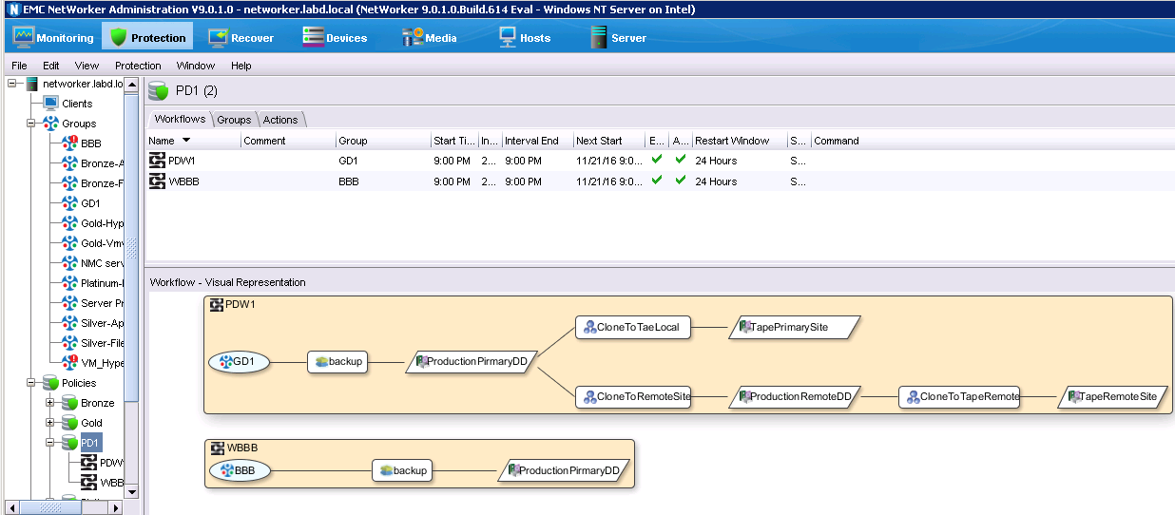

Slide 9
Client direct LAN / FC / WAN

Slide 10
Site A
Site B
Linux, UNIX, Windows
Applications,
Databases,
Linux, UNIX, Windows
Applications,
Databases,
LAN
LAN
VM
DBs
App
VM
DBs
App
NetWorker
Server
SAN
SAN
Tape
library
Data Domain
Disk
system
Tape
library
Data Domain
Disk
system

Slide 11
Site A
Site B
Linux, UNIX, Windows
Applications,
Databases,
Linux, UNIX, Windows
Applications,
Databases,
LAN
LAN
VM
DBs
App
VM
DBs
App
NetWorker
Server
SAN
SAN
Tape
library
Data Domain
Disk
system
Tape
library
Data Domain
Disk
system

Slide 12
Every asset backups directly to media
Site A
Site B
Linux, UNIX, Windows
Applications,
Databases,
Linux, UNIX, Windows
Applications,
Databases,
No Media Servers
Fast
LAN
LAN
VM
DBs
App
VM
DBs
App
Cost effective
Simple architecture
NetWorker
Server
SAN
SAN
No additional licenses
Higher security
Tape
library
Data Domain
Disk
system
Tape
library
Data Domain
Disk
system

Slide 13
Source de-duplication LAN / FC / WAN

Slide 14
Site A
Site B
Linux, UNIX, Windows
Applications,
Databases,
Linux, UNIX, Windows
Applications,
Databases,
LAN
LAN
VM
DBs
App
VM
DBs
App
NetWorker
Server
SAN
SAN
Tape
library
Data Domain
Disk
system
Tape
library
Data Domain
Disk
system

Slide 15
Site A
Site B
Linux, UNIX, Windows
Applications,
Databases,
Linux, UNIX, Windows
Applications,
Databases,
Source
de-duplication
100
GB
BOOST
LAN
LAN
VM
DBs
App
VM
DBs
App
NetWorker
Server
100
GB
1
GB
SAN
SAN
1
GB
Data Domain
Data Domain

Slide 16
Site A
Site B
Linux, UNIX, Windows
Security No access to data from ransomware (BOOST)
Applications,
Databases,
Linux, UNIX, Windows
Applications,
Databases,
Source
de-duplication
100
GB
BOOST
LAN
LAN
Cost effective
VM
DBs
App
VM
DBs
App
NetWorker
Server
100
GB
Fast
1
GB
LAN / WAN / SAN
SAN
SAN
1
GB
No load of protected machines
No CIFS/NFS/VTL
Data Domain
Data Domain

Slide 17
Security Ransomware hacker protection
Speed

Slide 18
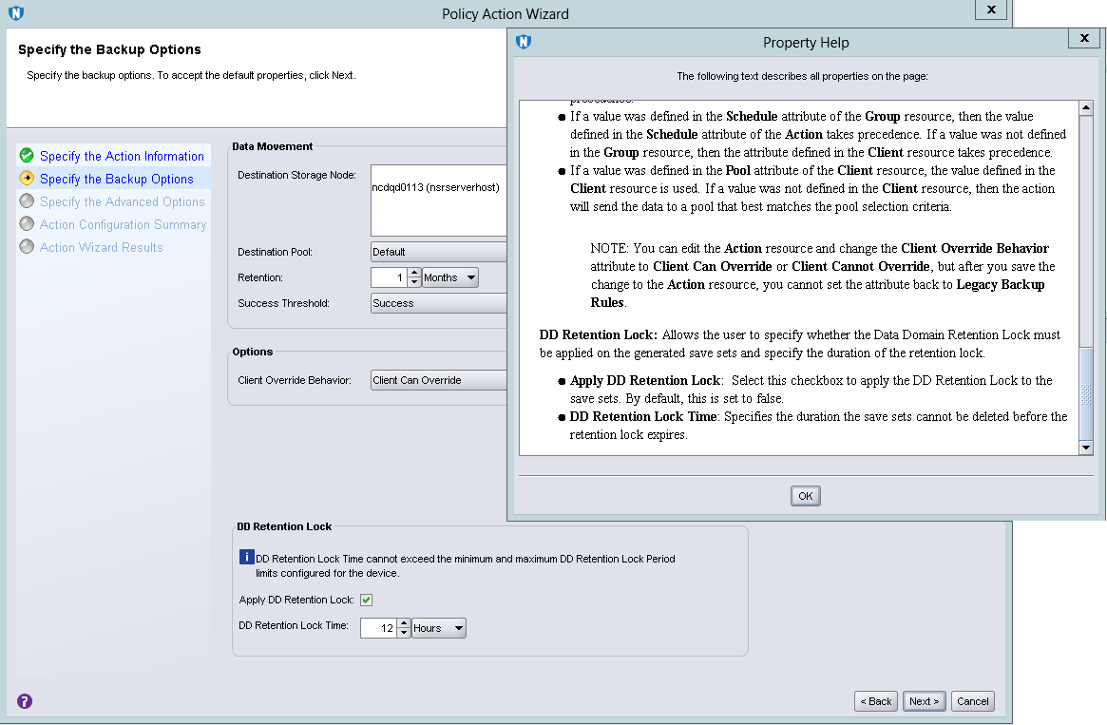
NetWorker VMware Protection against ransomware / hacker
Regular retention like in every backup software
During the period specified here (usually 2 weeks) none can delete / change backups
Ransomware
Hacker (Even if has highest level login/password)
Thus, in case of hacker / ransomware atttack, we can always restore!

Slide 19
NetWorker VMware Protection against ransomware / hacker
Backup solutions guarantees recovery after
ransomware / hacker
attack
Regular retention like in every backup software
During the period specified here (usually 2 weeks) none can delete / change backups
Ransomware
Hacker (Even if has highest level login/password)
Thus in case of hacker / ransomware atttack, we can always restore!

Slide 20
Immediate recovery Starting VMs with 20000 - 80000 IOps from backup

Slide 21
NetWorker VMware Use cases
Disaster Recovery with no need to recover data
We just start from SSD Data Domain disks
Immediate testing with no resources required
Starting production from Data Domain SSD disks

Slide 22
Scenario 1
Application guy wants to run the database A sitting on VM_A as it was last Tuesday 2:00pm. This is because users claim that Tuesday 2:00pm databases behaved in strange way.
Scenario 2
The Virtual Machine has been deleted. We need to immediately start it as this is critical Virtual Machine.
Scenario 3
We have Disaster Recovery site. All Virtual Machines are replicated to another site.
Primary sites fails. We need to immediately start production in the Disaster Recovery location.

Slide 23
Scenario 4
I have Kubernetes cluster. Anyhow my storage failed. What now?
Scenario 5
My application corrputs data quite often. How can I protect?

Slide 24
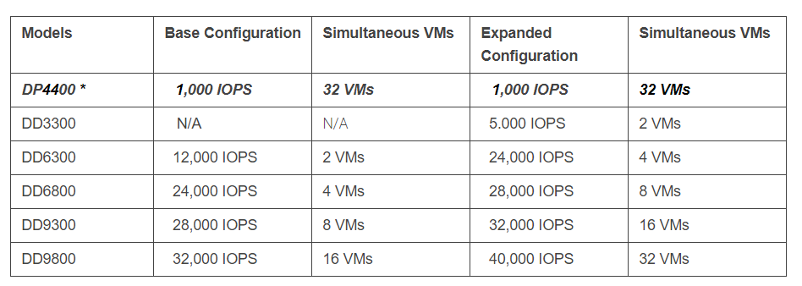
VMware – Restore without recovery with SSD speed!

Slide 25
VMware – Restore without recovery with SSD speed!

Slide 26
Data Domain – going above backup/recovery

Slide 27
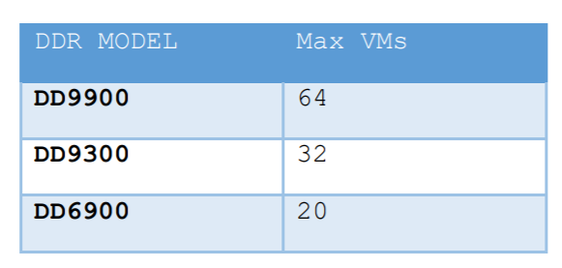
Data Domain – going above backup/recovery
Following tables shows the supported capacity of different platforms to spin off multiple VMs
in parallel. Each VM is assumed to be 100 GB in size.

Slide 28
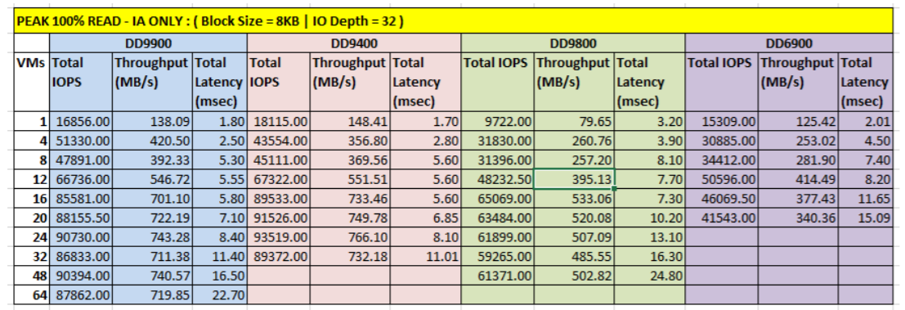
VMware – Restore without recovery with SSD speed!

Slide 29
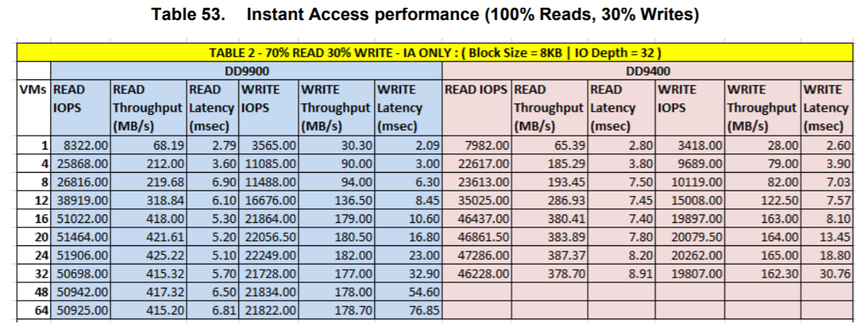
VMware – Restore without recovery with SSD speed!

Slide 30
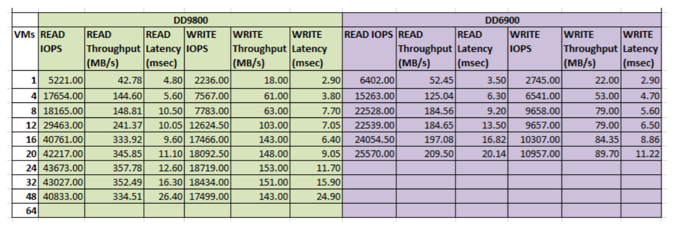
VMware – Restore without recovery with SSD speed!
Random I/O Performance

Slide 31
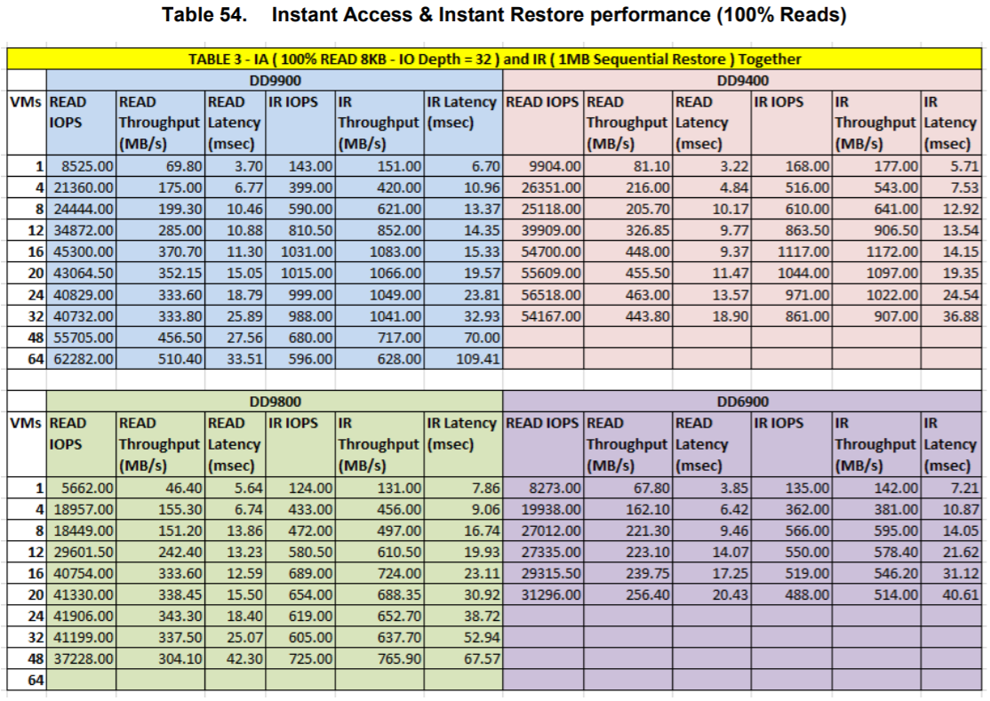

Slide 32
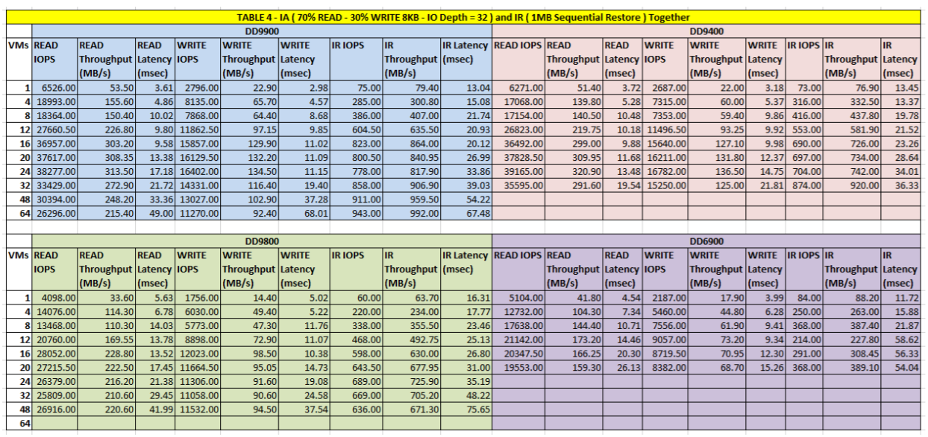

Slide 33
VMware – Restore without recovery with SSD speed!
Data Domain:
system show performance
Reporting sequential/random read/write throughput/latency/IOPS and stream type.
--------------------------------------------------------------------------------------------------------------------------------------------
Time Stamp |Throughput |IOPS |Protocol Latency |Streams
|read write repl-in repl-out|total read write | avg read write | read write
Date Time | | seq/rand seq/rand | seq/rand seq/rand | seq/rand seq/rand
YYYY-MM-DD HH:MM:SS|MiB/s MiB/s MiB/s MiB/s|ops/s ops/s ops/s | ms ms ms | # #
-------------------------------------------------------------------------------------------------------------------------------------------
2016-05-17 06:08:00 110.2 5.9 82.45 0.44 503 205/7698 19/146 62.5 75.2/95.3 8.9/22.4 0/301 6/1
2016-05-17 06:18:00 112.7 1.8 84.13 0.40 494 83/11482 3/60 34.7 53.9/65.1 3.0/7.8 39/249 0/42
2016-05-17 06:28:00 114.2 5.6 65.46 0.36 1034 182/8876 280/357 18.7 54.5/61.0 0.5/2.7 49/231 0/91
2016-05-17 06:38:00 113.1 4.1 84.81 0.45 732 202/8175 213/71 27.6 56.6/61.7 0.5/4.2 15/286 1/0
2016-05-17 06:48:00 115.7 4.4 82.03 0.39 585 93/11558 69/206 31.7 55.7/69.8 0.7/7.9 39/248 2/31

Slide 34
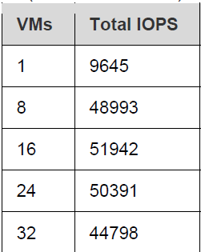
DD9800 Instant Access details

Slide 35
VMware – Restore without recovery with SSD speed!
Another Use Case for starting Virtual Machines from Data Domain/SSD is Disaster Recovery.
Our Site A fails and we need to immediately start production in Site B.
We have no time for recovering data!

Slide 36
VMware – Immediate Disaster Recovery!
Site A
Site B
Proxy
Proxy
Proxy
Proxy
Backup
Restore
Backup
Restore
Disaster Recovery
Transfer 1%
Recovery 100% of data
Data Domain
Data Domain

Slide 37
NetWorker VMware – Immediate Disaster Recovery!
Site A
Site B
Proxy
Proxy
Proxy
Proxy
Backup
Restore
Backup
Restore
Disaster Recovery
Transfer 1%
Recovery 100% of data
Data Domain
Data Domain

Slide 38
NetWorker VMware – Immediate Disaster Recovery!
Site A
Site B
Site A fails
How quickly can we starts VMs (critical VMs especially) in Site B?
Proxy
Proxy
Proxy
Proxy
Backup
Restore
Backup
Restore
Disaster Recovery
Transfer 1%
Recovery 100% of data
Data Domain
Data Domain

Slide 39
NetWorker VMware – Immediate Disaster Recovery!
In site B we do not restore anything.
We start Virtual Machines (that were in site A) directly from Data Domain. They work with SSD disks speed!
0 time restoring data!
Site A
Site B
Those VMs work normally.
They are also normally backed up or restored
Proxy
Proxy
Those VMs are from site A.
They use Data Domain SSD disks as the storage.
Proxy
Proxy
Backup
Restore
Backup
Restore
Proxy
Disaster Recovery
Transfer 1%
Recovery 100% of data
Proxy
Data Domain
Data Domain

Slide 40
Virtualisation Speed / automation

Slide 41
NetWorker VMware Simple of automation of any policies
Here we have nicely visualized policy
We run the backup for 2 000 Virtual Machines
Parallel tape-out of all VMS
100 VMs
backed-up in parallel
2-3 min backup time
per VM
All backups are FULL
Parallel Disaster Recovery to remote location
Parallel tape-out of all VMS at remote site

Slide 42
NetWorker VMware Simple of automation of any policies
This policy:
Backups 2 000 Virtual Machines
180 VMs backed up in parallel
We have 4 copies of each of 2 000 VMs performer after backup finishes
Local Data Domain
Remote Data Domain (Disaster Recovery)
Local Tape
Remote Tape
Here we have nicely visualized policy
We run the backup for 2 000 Virtual Machines
Parallel tape-out of all VMS
100 VMs
backed-up in parallel
2-3 min backup time
per VM
All backups are FULL
Parallel Disaster Recovery to remote location
Parallel tape-out of all VMS at remote site

Slide 43
NetWorker VMware Simple of automation of any policies
NetWorker protects 400 – 2000 VMs per hour
Here we have nicely visualized policy
We run the backup for 2 000 Virtual Machines
Parallel tape-out of all VMS
100 VMs
backed-up in parallel
2-3 min backup time
per VM
All backups are FULL
Parallel Disaster Recovery to remote location
Parallel tape-out of all VMS at remote site

Slide 44
LAN / FC All backups are available via any network

Slide 45
Site A
Site B
Linux, UNIX, Windows
Applications,
Databases,
Linux, UNIX, Windows
Applications,
Databases,
LAN
LAN
VM
DBs
App
VM
DBs
App
NetWorker
Server
SAN
SAN
Tape
library
Data Domain
Disk
system
Tape
library
Data Domain
Disk
system

Slide 46
Site A
Site B
Linux, UNIX, Windows
Applications,
Databases,
Linux, UNIX, Windows
Applications,
Databases,
LAN
LAN
VM
DBs
App
VM
DBs
App
NetWorker
Server
SAN
SAN
Tape
library
Data Domain
Disk
system
Tape
library
Data Domain
Disk
system

Slide 47
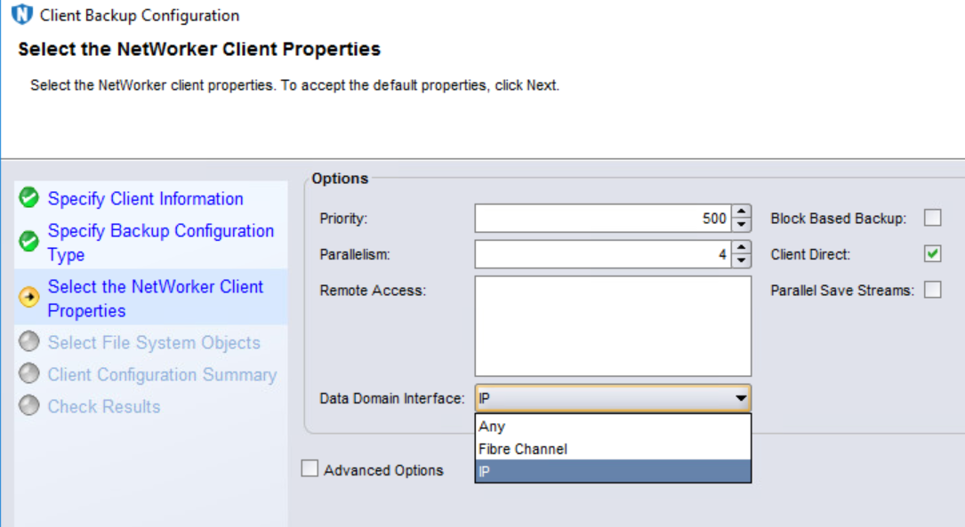

Slide 48
Dynamic network choice – as available:
FC
LAN

Slide 49
Backup through LAN / restore FC
Backup through FC / restore LAN
Backup at the same tive via LAN?FC
Load balancing over LAN
Failover over FC

Slide 50
Source de-duplication S3 storage

Slide 51
Direct Backup to S3 media Can we?
Linux, UNIX, Windows
Applications,
Databases,
Mail
LAN
NetWorker
VMs
DBs
Mails
SAN
Backup media
Disk
system
Tape
library
Data Domain
Notes:
Cloudboost with Client Direct is not new, it has been supported for Linux Clients since 9.0.1. What is new in 9.2 is the ability for Windows Clients to now backup directly to object storage, where the CB appliance manages the object store and its metadata. But NetWorker clients and storage nodes running Windows or Linux can now write data direct to the object store, where only metadata is written to the CloudBoost appliance.
This Client Direct workflow is now enabled by Windows clients using a new CB DLL that is integrated with the NetWorker Client, enabling them to perform CB client side deduplication, compression and encryption.
This improves overall NetWorker Cloudboost performance by about 3X (CB using ‘proxy’ or appliance based IO gets ~200 MB/sec, Client Direct gets ~650 MB/sec per appliance because of distributed IO). If the infrastructure permits, additional performance can be gained by adding multiple CB appliances.
PSR results show that Windows and Linux CB Direct Clients perform at nearly the same speeds.
As a reminder, backups go direct to object storage. In the case of AWS we go direct to S3, and can scale to 6 PB of storage per appliance, giving you excellent deployment flexibility for lift and shift or in-cloud work-loads.
This is a great deployment flexibility option for any customer looking at CB for LTR, direct writes to object storage for backup, or cloning workflows to cloud. As well as in-cloud deployments at Amazon or Azure for example. We are also seeing accelerated adoption of CB by Virtustream customers as well as on premise ECS.

Slide 52
Direct Backup to S3 media Can we?
Can we backup directly to S3 storage?
Can we use source de-duplication?
What are pluses / minuses?
Linux, UNIX, Windows
Applications,
Databases,
Mail
LAN
NetWorker
VMs
DBs
Mails
SAN
Backup media
Disk
system
Tape
library
Data Domain
Notes:
Cloudboost with Client Direct is not new, it has been supported for Linux Clients since 9.0.1. What is new in 9.2 is the ability for Windows Clients to now backup directly to object storage, where the CB appliance manages the object store and its metadata. But NetWorker clients and storage nodes running Windows or Linux can now write data direct to the object store, where only metadata is written to the CloudBoost appliance.
This Client Direct workflow is now enabled by Windows clients using a new CB DLL that is integrated with the NetWorker Client, enabling them to perform CB client side deduplication, compression and encryption.
This improves overall NetWorker Cloudboost performance by about 3X (CB using ‘proxy’ or appliance based IO gets ~200 MB/sec, Client Direct gets ~650 MB/sec per appliance because of distributed IO). If the infrastructure permits, additional performance can be gained by adding multiple CB appliances.
PSR results show that Windows and Linux CB Direct Clients perform at nearly the same speeds.
As a reminder, backups go direct to object storage. In the case of AWS we go direct to S3, and can scale to 6 PB of storage per appliance, giving you excellent deployment flexibility for lift and shift or in-cloud work-loads.
This is a great deployment flexibility option for any customer looking at CB for LTR, direct writes to object storage for backup, or cloning workflows to cloud. As well as in-cloud deployments at Amazon or Azure for example. We are also seeing accelerated adoption of CB by Virtustream customers as well as on premise ECS.

Slide 53
NetWorker power with S3 storage media
Here we discuss great features of NetWorker that can allows us
Backup files / databases directly to S3 storage media
Perform source de-duplication and achieve savings in
Network traffic
Space on S3 storage

Slide 54
NetWorker power with S3 storage media
That gives:
Extremely cost effective solution
Flexible
Covering all data
Easy to manage
Here we discuss great features of NetWorer that can allows us
Backup files / databases directly to S3 storage media
De-duplicate data with variable length
Perform source de-duplication

Slide 55
NetWorker CloudBoost Architecture
Linux, Windows
Oracle, SQL, …
Exchange, SAP,…
Files
CloudBoost
MetaData
NetWorker
LAN
Object Storage
S3 storage
ECS
Notes:
Cloudboost with Client Direct is not new, it has been supported for Linux Clients since 9.0.1. What is new in 9.2 is the ability for Windows Clients to now backup directly to object storage, where the CB appliance manages the object store and its metadata. But NetWorker clients and storage nodes running Windows or Linux can now write data direct to the object store, where only metadata is written to the CloudBoost appliance.
This Client Direct workflow is now enabled by Windows clients using a new CB DLL that is integrated with the NetWorker Client, enabling them to perform CB client side deduplication, compression and encryption.
This improves overall NetWorker Cloudboost performance by about 3X (CB using ‘proxy’ or appliance based IO gets ~200 MB/sec, Client Direct gets ~650 MB/sec per appliance because of distributed IO). If the infrastructure permits, additional performance can be gained by adding multiple CB appliances.
PSR results show that Windows and Linux CB Direct Clients perform at nearly the same speeds.
As a reminder, backups go direct to object storage. In the case of AWS we go direct to S3, and can scale to 6 PB of storage per appliance, giving you excellent deployment flexibility for lift and shift or in-cloud work-loads.
This is a great deployment flexibility option for any customer looking at CB for LTR, direct writes to object storage for backup, or cloning workflows to cloud. As well as in-cloud deployments at Amazon or Azure for example. We are also seeing accelerated adoption of CB by Virtustream customers as well as on premise ECS.

Slide 56
NetWorker CloudBoost Architecture
Linux, Windows
Oracle, SQL, …
Exchange, SAP,…
Files
CloudBoost
MetaData
NetWorker
100
GB
Source
de-duplication
Client direct
1%
LAN
Object Storage
S3 storage
ECS
Notes:
Cloudboost with Client Direct is not new, it has been supported for Linux Clients since 9.0.1. What is new in 9.2 is the ability for Windows Clients to now backup directly to object storage, where the CB appliance manages the object store and its metadata. But NetWorker clients and storage nodes running Windows or Linux can now write data direct to the object store, where only metadata is written to the CloudBoost appliance.
This Client Direct workflow is now enabled by Windows clients using a new CB DLL that is integrated with the NetWorker Client, enabling them to perform CB client side deduplication, compression and encryption.
This improves overall NetWorker Cloudboost performance by about 3X (CB using ‘proxy’ or appliance based IO gets ~200 MB/sec, Client Direct gets ~650 MB/sec per appliance because of distributed IO). If the infrastructure permits, additional performance can be gained by adding multiple CB appliances.
PSR results show that Windows and Linux CB Direct Clients perform at nearly the same speeds.
As a reminder, backups go direct to object storage. In the case of AWS we go direct to S3, and can scale to 6 PB of storage per appliance, giving you excellent deployment flexibility for lift and shift or in-cloud work-loads.
This is a great deployment flexibility option for any customer looking at CB for LTR, direct writes to object storage for backup, or cloning workflows to cloud. As well as in-cloud deployments at Amazon or Azure for example. We are also seeing accelerated adoption of CB by Virtustream customers as well as on premise ECS.

Slide 57
NetWorker CloudBoost Architecture
NetWorker provides source de-duplication when backup to S3 storage media
Linux, Windows
Oracle, SQL, …
Exchange, SAP,…
Files
CloudBoost
MetaData
NetWorker
100
GB
Source
de-duplication
Client direct
1%
LAN
Object Storage
S3 storage
ECS
Notes:
Cloudboost with Client Direct is not new, it has been supported for Linux Clients since 9.0.1. What is new in 9.2 is the ability for Windows Clients to now backup directly to object storage, where the CB appliance manages the object store and its metadata. But NetWorker clients and storage nodes running Windows or Linux can now write data direct to the object store, where only metadata is written to the CloudBoost appliance.
This Client Direct workflow is now enabled by Windows clients using a new CB DLL that is integrated with the NetWorker Client, enabling them to perform CB client side deduplication, compression and encryption.
This improves overall NetWorker Cloudboost performance by about 3X (CB using ‘proxy’ or appliance based IO gets ~200 MB/sec, Client Direct gets ~650 MB/sec per appliance because of distributed IO). If the infrastructure permits, additional performance can be gained by adding multiple CB appliances.
PSR results show that Windows and Linux CB Direct Clients perform at nearly the same speeds.
As a reminder, backups go direct to object storage. In the case of AWS we go direct to S3, and can scale to 6 PB of storage per appliance, giving you excellent deployment flexibility for lift and shift or in-cloud work-loads.
This is a great deployment flexibility option for any customer looking at CB for LTR, direct writes to object storage for backup, or cloning workflows to cloud. As well as in-cloud deployments at Amazon or Azure for example. We are also seeing accelerated adoption of CB by Virtustream customers as well as on premise ECS.

Slide 58
NetWorker CloudBoost Architecture
NetWorker provides source de-duplication when backup to S3 storage media
Linux, Windows
Oracle, SQL, …
Exchange, SAP,…
Files
CloudBoost
MetaData
NetWorker
100
GB
Source
de-duplication
Client direct
1%
LAN
CloudBoost appliance keeps information what chunks are stored on S3 storage
Object Storage
S3 storage
ECS
Notes:
Cloudboost with Client Direct is not new, it has been supported for Linux Clients since 9.0.1. What is new in 9.2 is the ability for Windows Clients to now backup directly to object storage, where the CB appliance manages the object store and its metadata. But NetWorker clients and storage nodes running Windows or Linux can now write data direct to the object store, where only metadata is written to the CloudBoost appliance.
This Client Direct workflow is now enabled by Windows clients using a new CB DLL that is integrated with the NetWorker Client, enabling them to perform CB client side deduplication, compression and encryption.
This improves overall NetWorker Cloudboost performance by about 3X (CB using ‘proxy’ or appliance based IO gets ~200 MB/sec, Client Direct gets ~650 MB/sec per appliance because of distributed IO). If the infrastructure permits, additional performance can be gained by adding multiple CB appliances.
PSR results show that Windows and Linux CB Direct Clients perform at nearly the same speeds.
As a reminder, backups go direct to object storage. In the case of AWS we go direct to S3, and can scale to 6 PB of storage per appliance, giving you excellent deployment flexibility for lift and shift or in-cloud work-loads.
This is a great deployment flexibility option for any customer looking at CB for LTR, direct writes to object storage for backup, or cloning workflows to cloud. As well as in-cloud deployments at Amazon or Azure for example. We are also seeing accelerated adoption of CB by Virtustream customers as well as on premise ECS.

Slide 59
NetWorker CloudBoost Architecture
Linux, Windows
Databases,
Applications,
Files
Guest level backup
CloudBoost
MetaData
NetWorker
Object Storage
S3 storage
ECS
Notes:
Cloudboost with Client Direct is not new, it has been supported for Linux Clients since 9.0.1. What is new in 9.2 is the ability for Windows Clients to now backup directly to object storage, where the CB appliance manages the object store and its metadata. But NetWorker clients and storage nodes running Windows or Linux can now write data direct to the object store, where only metadata is written to the CloudBoost appliance.
This Client Direct workflow is now enabled by Windows clients using a new CB DLL that is integrated with the NetWorker Client, enabling them to perform CB client side deduplication, compression and encryption.
This improves overall NetWorker Cloudboost performance by about 3X (CB using ‘proxy’ or appliance based IO gets ~200 MB/sec, Client Direct gets ~650 MB/sec per appliance because of distributed IO). If the infrastructure permits, additional performance can be gained by adding multiple CB appliances.
PSR results show that Windows and Linux CB Direct Clients perform at nearly the same speeds.
As a reminder, backups go direct to object storage. In the case of AWS we go direct to S3, and can scale to 6 PB of storage per appliance, giving you excellent deployment flexibility for lift and shift or in-cloud work-loads.
This is a great deployment flexibility option for any customer looking at CB for LTR, direct writes to object storage for backup, or cloning workflows to cloud. As well as in-cloud deployments at Amazon or Azure for example. We are also seeing accelerated adoption of CB by Virtustream customers as well as on premise ECS.

Slide 60
NetWorker CloudBoost Architecture
Linux, Windows
Databases,
Applications,
Files
Guest level backup
CloudBoost
MetaData
NetWorker
500
GB
Source
de-duplication
Client direct
1%
Object Storage
S3 storage
ECS
Notes:
Cloudboost with Client Direct is not new, it has been supported for Linux Clients since 9.0.1. What is new in 9.2 is the ability for Windows Clients to now backup directly to object storage, where the CB appliance manages the object store and its metadata. But NetWorker clients and storage nodes running Windows or Linux can now write data direct to the object store, where only metadata is written to the CloudBoost appliance.
This Client Direct workflow is now enabled by Windows clients using a new CB DLL that is integrated with the NetWorker Client, enabling them to perform CB client side deduplication, compression and encryption.
This improves overall NetWorker Cloudboost performance by about 3X (CB using ‘proxy’ or appliance based IO gets ~200 MB/sec, Client Direct gets ~650 MB/sec per appliance because of distributed IO). If the infrastructure permits, additional performance can be gained by adding multiple CB appliances.
PSR results show that Windows and Linux CB Direct Clients perform at nearly the same speeds.
As a reminder, backups go direct to object storage. In the case of AWS we go direct to S3, and can scale to 6 PB of storage per appliance, giving you excellent deployment flexibility for lift and shift or in-cloud work-loads.
This is a great deployment flexibility option for any customer looking at CB for LTR, direct writes to object storage for backup, or cloning workflows to cloud. As well as in-cloud deployments at Amazon or Azure for example. We are also seeing accelerated adoption of CB by Virtustream customers as well as on premise ECS.

Slide 61
NetWorker CloudBoost Architecture
Linux, Windows
Databases,
Applications,
Files
Guest level backup
CloudBoost
MetaData
NetWorker
500
GB
Source
de-duplication
Client direct
1%
We can backup Virtual Machines to S3 storage with source de-duplication using NetWorker agents (guest level)
Object Storage
S3 storage
ECS
Notes:
Cloudboost with Client Direct is not new, it has been supported for Linux Clients since 9.0.1. What is new in 9.2 is the ability for Windows Clients to now backup directly to object storage, where the CB appliance manages the object store and its metadata. But NetWorker clients and storage nodes running Windows or Linux can now write data direct to the object store, where only metadata is written to the CloudBoost appliance.
This Client Direct workflow is now enabled by Windows clients using a new CB DLL that is integrated with the NetWorker Client, enabling them to perform CB client side deduplication, compression and encryption.
This improves overall NetWorker Cloudboost performance by about 3X (CB using ‘proxy’ or appliance based IO gets ~200 MB/sec, Client Direct gets ~650 MB/sec per appliance because of distributed IO). If the infrastructure permits, additional performance can be gained by adding multiple CB appliances.
PSR results show that Windows and Linux CB Direct Clients perform at nearly the same speeds.
As a reminder, backups go direct to object storage. In the case of AWS we go direct to S3, and can scale to 6 PB of storage per appliance, giving you excellent deployment flexibility for lift and shift or in-cloud work-loads.
This is a great deployment flexibility option for any customer looking at CB for LTR, direct writes to object storage for backup, or cloning workflows to cloud. As well as in-cloud deployments at Amazon or Azure for example. We are also seeing accelerated adoption of CB by Virtustream customers as well as on premise ECS.

Slide 62
NetWorker CloudBoost Architecture
CloudBoost
MetaData
NetWorker
LAN
AIX, Solaris, HP-UX
Files
Databases
Applications
Object Storage
S3 storage
ECS
Notes:
Cloudboost with Client Direct is not new, it has been supported for Linux Clients since 9.0.1. What is new in 9.2 is the ability for Windows Clients to now backup directly to object storage, where the CB appliance manages the object store and its metadata. But NetWorker clients and storage nodes running Windows or Linux can now write data direct to the object store, where only metadata is written to the CloudBoost appliance.
This Client Direct workflow is now enabled by Windows clients using a new CB DLL that is integrated with the NetWorker Client, enabling them to perform CB client side deduplication, compression and encryption.
This improves overall NetWorker Cloudboost performance by about 3X (CB using ‘proxy’ or appliance based IO gets ~200 MB/sec, Client Direct gets ~650 MB/sec per appliance because of distributed IO). If the infrastructure permits, additional performance can be gained by adding multiple CB appliances.
PSR results show that Windows and Linux CB Direct Clients perform at nearly the same speeds.
As a reminder, backups go direct to object storage. In the case of AWS we go direct to S3, and can scale to 6 PB of storage per appliance, giving you excellent deployment flexibility for lift and shift or in-cloud work-loads.
This is a great deployment flexibility option for any customer looking at CB for LTR, direct writes to object storage for backup, or cloning workflows to cloud. As well as in-cloud deployments at Amazon or Azure for example. We are also seeing accelerated adoption of CB by Virtustream customers as well as on premise ECS.

Slide 63
NetWorker CloudBoost Architecture
CloudBoost
MetaData
NetWorker
LAN
1%
200
GB
Storage Node
de-duplication
AIX, Solaris, HP-UX
Files
Databases
Applications
Linux
Storage Node
Object Storage
S3 storage
ECS
Notes:
Cloudboost with Client Direct is not new, it has been supported for Linux Clients since 9.0.1. What is new in 9.2 is the ability for Windows Clients to now backup directly to object storage, where the CB appliance manages the object store and its metadata. But NetWorker clients and storage nodes running Windows or Linux can now write data direct to the object store, where only metadata is written to the CloudBoost appliance.
This Client Direct workflow is now enabled by Windows clients using a new CB DLL that is integrated with the NetWorker Client, enabling them to perform CB client side deduplication, compression and encryption.
This improves overall NetWorker Cloudboost performance by about 3X (CB using ‘proxy’ or appliance based IO gets ~200 MB/sec, Client Direct gets ~650 MB/sec per appliance because of distributed IO). If the infrastructure permits, additional performance can be gained by adding multiple CB appliances.
PSR results show that Windows and Linux CB Direct Clients perform at nearly the same speeds.
As a reminder, backups go direct to object storage. In the case of AWS we go direct to S3, and can scale to 6 PB of storage per appliance, giving you excellent deployment flexibility for lift and shift or in-cloud work-loads.
This is a great deployment flexibility option for any customer looking at CB for LTR, direct writes to object storage for backup, or cloning workflows to cloud. As well as in-cloud deployments at Amazon or Azure for example. We are also seeing accelerated adoption of CB by Virtustream customers as well as on premise ECS.

Slide 64
NetWorker CloudBoost Architecture
For Unix machine we need Linux storage node, where the de-dupliction will take place
CloudBoost
MetaData
NetWorker
LAN
1%
200
GB
Storage Node
de-duplication
AIX, Solaris, HP-UX
Files
Databases
Applications
Linux
Storage Node
Object Storage
S3 storage
ECS
Notes:
Cloudboost with Client Direct is not new, it has been supported for Linux Clients since 9.0.1. What is new in 9.2 is the ability for Windows Clients to now backup directly to object storage, where the CB appliance manages the object store and its metadata. But NetWorker clients and storage nodes running Windows or Linux can now write data direct to the object store, where only metadata is written to the CloudBoost appliance.
This Client Direct workflow is now enabled by Windows clients using a new CB DLL that is integrated with the NetWorker Client, enabling them to perform CB client side deduplication, compression and encryption.
This improves overall NetWorker Cloudboost performance by about 3X (CB using ‘proxy’ or appliance based IO gets ~200 MB/sec, Client Direct gets ~650 MB/sec per appliance because of distributed IO). If the infrastructure permits, additional performance can be gained by adding multiple CB appliances.
PSR results show that Windows and Linux CB Direct Clients perform at nearly the same speeds.
As a reminder, backups go direct to object storage. In the case of AWS we go direct to S3, and can scale to 6 PB of storage per appliance, giving you excellent deployment flexibility for lift and shift or in-cloud work-loads.
This is a great deployment flexibility option for any customer looking at CB for LTR, direct writes to object storage for backup, or cloning workflows to cloud. As well as in-cloud deployments at Amazon or Azure for example. We are also seeing accelerated adoption of CB by Virtustream customers as well as on premise ECS.

Slide 65
NetWorker CloudBoost Architecture
Linux, Windows
Databases,
Applications,
Files
Guest level backup
Linux, Windows
Oracle, SQL, …
Exchange, SAP,…
Files
CloudBoost
MetaData
NetWorker
100
GB
500
GB
Source
de-duplication
Client direct
Source
de-duplication
Client direct
1%
LAN
1%
1%
200
GB
Storage Node
de-duplication
AIX, Solaris, HP-UX
Files
Databases
Applications
Linux
Storage Node
Object Storage
S3 storage
ECS
Notes:
Cloudboost with Client Direct is not new, it has been supported for Linux Clients since 9.0.1. What is new in 9.2 is the ability for Windows Clients to now backup directly to object storage, where the CB appliance manages the object store and its metadata. But NetWorker clients and storage nodes running Windows or Linux can now write data direct to the object store, where only metadata is written to the CloudBoost appliance.
This Client Direct workflow is now enabled by Windows clients using a new CB DLL that is integrated with the NetWorker Client, enabling them to perform CB client side deduplication, compression and encryption.
This improves overall NetWorker Cloudboost performance by about 3X (CB using ‘proxy’ or appliance based IO gets ~200 MB/sec, Client Direct gets ~650 MB/sec per appliance because of distributed IO). If the infrastructure permits, additional performance can be gained by adding multiple CB appliances.
PSR results show that Windows and Linux CB Direct Clients perform at nearly the same speeds.
As a reminder, backups go direct to object storage. In the case of AWS we go direct to S3, and can scale to 6 PB of storage per appliance, giving you excellent deployment flexibility for lift and shift or in-cloud work-loads.
This is a great deployment flexibility option for any customer looking at CB for LTR, direct writes to object storage for backup, or cloning workflows to cloud. As well as in-cloud deployments at Amazon or Azure for example. We are also seeing accelerated adoption of CB by Virtustream customers as well as on premise ECS.

Slide 66
NetWorker CloudBoost Architecture
Pros
Cost effective
Reasonable backup performance
Source de-duplication
Remote backup (requires proper sizing)
Linux, Windows
Databases,
Applications,
Files
Guest level backup
Linux, Windows
Oracle, SQL, …
Exchange, SAP,…
Files
CloudBoost
MetaData
NetWorker
100
GB
500
GB
Source
de-duplication
Client direct
Source
de-duplication
Client direct
1%
LAN
1%
1%
200
GB
Source
de-duplication
AIX, Solaris, HP-UX
Files
Databases
Applications
Linux
Storage Node
Object Storage
S3 storage
ECS
Notes:
Cloudboost with Client Direct is not new, it has been supported for Linux Clients since 9.0.1. What is new in 9.2 is the ability for Windows Clients to now backup directly to object storage, where the CB appliance manages the object store and its metadata. But NetWorker clients and storage nodes running Windows or Linux can now write data direct to the object store, where only metadata is written to the CloudBoost appliance.
This Client Direct workflow is now enabled by Windows clients using a new CB DLL that is integrated with the NetWorker Client, enabling them to perform CB client side deduplication, compression and encryption.
This improves overall NetWorker Cloudboost performance by about 3X (CB using ‘proxy’ or appliance based IO gets ~200 MB/sec, Client Direct gets ~650 MB/sec per appliance because of distributed IO). If the infrastructure permits, additional performance can be gained by adding multiple CB appliances.
PSR results show that Windows and Linux CB Direct Clients perform at nearly the same speeds.
As a reminder, backups go direct to object storage. In the case of AWS we go direct to S3, and can scale to 6 PB of storage per appliance, giving you excellent deployment flexibility for lift and shift or in-cloud work-loads.
This is a great deployment flexibility option for any customer looking at CB for LTR, direct writes to object storage for backup, or cloning workflows to cloud. As well as in-cloud deployments at Amazon or Azure for example. We are also seeing accelerated adoption of CB by Virtustream customers as well as on premise ECS.

Slide 67
NetWorker CloudBoost Architecture
Linux, Windows
Databases,
Applications,
Files
Guest level backup
Cons
Poor restore performance
More complicated implementation than Data Domain
Linux, Windows
Oracle, SQL, …
Exchange, SAP,…
Files
CloudBoost
MetaData
NetWorker
100
GB
500
GB
Source
de-duplication
Client direct
Source
de-duplication
Client direct
1%
LAN
1%
1%
200
GB
Source
de-duplication
AIX, Solaris, HP-UX
Files
Databases
Applications
Linux
Storage Node
Object Storage
S3 storage
ECS
Notes:
Cloudboost with Client Direct is not new, it has been supported for Linux Clients since 9.0.1. What is new in 9.2 is the ability for Windows Clients to now backup directly to object storage, where the CB appliance manages the object store and its metadata. But NetWorker clients and storage nodes running Windows or Linux can now write data direct to the object store, where only metadata is written to the CloudBoost appliance.
This Client Direct workflow is now enabled by Windows clients using a new CB DLL that is integrated with the NetWorker Client, enabling them to perform CB client side deduplication, compression and encryption.
This improves overall NetWorker Cloudboost performance by about 3X (CB using ‘proxy’ or appliance based IO gets ~200 MB/sec, Client Direct gets ~650 MB/sec per appliance because of distributed IO). If the infrastructure permits, additional performance can be gained by adding multiple CB appliances.
PSR results show that Windows and Linux CB Direct Clients perform at nearly the same speeds.
As a reminder, backups go direct to object storage. In the case of AWS we go direct to S3, and can scale to 6 PB of storage per appliance, giving you excellent deployment flexibility for lift and shift or in-cloud work-loads.
This is a great deployment flexibility option for any customer looking at CB for LTR, direct writes to object storage for backup, or cloning workflows to cloud. As well as in-cloud deployments at Amazon or Azure for example. We are also seeing accelerated adoption of CB by Virtustream customers as well as on premise ECS.

Slide 68
ECS / S3 as backup media with source de-deduplication
NetWorker treats S3 backup media as any other
Data Domain
Disk
Tape
We can clone
S3 backups to other media (Data Domain, disk, tape)
Any other backups to S3 media

Slide 69
Block Based Backup Files / HyperV / Exchange

Slide 70
A method of backup and recovery for millions of files in seconds / minutes
NetWorker
Block Based Backup

Slide 71
NetWorker Block Based Backup What environment was backuped?
Type of protected data: Files
Number of files: 10 millions
Size of single file: 1024 bytes
Size of all files (10mln): 10 GB
Size of protected disk: 60 GB
Content of each file: Random text

Slide 72
NetWorker Block Based Backup First backup results
Protected data: Files Number of files: 10 millions Size of single file: 1024 bytes Size of all files (10mln): 10 GB Size of protected disk 60 GB Content of each file: Random text
Full backup results:
Backup time: 11 min 54 sec (714 sec)
Backuped data: 60 GB
Backup speed: 84 MB/s
Backup limitation: disk speed of protected machine

Slide 73
NetWorker Block Based Backup 2nd and further backup results
Protected data: Files Number of files: 10 millions Size of single file: 1024 bytes Size of all files (10mln): 10 GB Size of protected disk 60 GB Content of each file: Random text
Second and further backups results after modifying 30 000 files : 56 sec

Slide 74
NetWorker Block Based Backup 2nd and further backup results
Protected data: Files Number of files: 10 millions Size of single file: 1024 bytes Size of all files (10mln): 10 GB Size of protected disk 60 GB Content of each file: Random text
Immediate backup
No load of protected machine
No performance limitations
Second and further backup results after modifying 30 000 files : 56 sec

Slide 75
NetWorker Block Based Backup Full system recovery results
Protected data: Files Number of files: 10 millions Size of single file: 1024 bytes Size of all files (10mln): 10 GB Size of protected disk 60 GB Content of each file: Random text
Full system recovery results:
Recovery time: 16 min 40 sec (1000 sec)
Recovered data: 60 GB
Recovery speed: 60 MB/s
Recovery limitation: disk at target Data Domain model

Slide 76
NetWorker Block Based Backup Full system recovery results
Protected data: Files Number of files: 10 millions Size of single file: 1024 bytes Size of all files (10mln): 10 GB Size of protected disk 60 GB Content of each file: Random text
Single file recovery results:
Recovery time: 9 seconds
Recovery limitation: no limitation

Slide 77
NetWorker Block Based Backup Full system recovery results
Protected data: Files Number of files: 10 millions Size of single file: 1024 bytes Size of all files (10mln): 10 GB Size of protected disk 60 GB Content of each file: Random text
Immediate recovery
No bottleneck
Recovery
Full file system
Single file
Single file recovery results:
Recovery time: 9 seconds
Recovery limitation: no limitation

Slide 78
First backup
NetWorker sends
to Data Domain device
only new, de-duplicated data
Data
Domain
Backup
Device
NetWorker
Client
1
GB
During the full backup
NetWorker reads
the whole disk:
block after block
In this example
NetWorker reads
whole 60GB in disk E:\
or
60
GB
Disk
Backup
Device
NetWorker sends
to disk device
all data
60
GB
File system on disk E:\ divided for blocks
Number of files does not matter
Protected file system

Slide 79
After each backup
NetWorker zeros CBT bitmap kept in memory
It means all the blocks on disk are clean, not changed since the last backup
File system on disk E:\ divided for blocks
Number of files does not matter
Protected file system
0
0
0
0
0
0
0
0
0
0
0
0
0
0
0
0
CBT bit map of disk blocks in memory

Slide 80
During normal work of file system on disk E:\
If block on disk is changed, NetWorker also changes corresponding bit in CBT bit map in memory
File system on disk E:\ divided for blocks
Number of files does not matter
Protected file system
0
0
0
1
0
0
0
1
1
0
0
0
0
0
1
0
CBT bit map of disk blocks in memory

Slide 81
Incremental backup
2nd and further
backups
NetWorker sends
to Data Domain device
only new, de-duplicated data
Data
Domain
Backup
Device
NetWorker
Client
1
GB
or
During the incremental backup
NetWorker reads
only changed blocks
since last backup
In the example below
NetWorker reads
grey (changed) blocks
3
GB
Disk
Backup
Device
NetWorker sends
to disk device
all data
3
GB
Disk E:\ divided for blocks
Number of files does not matter
Protected file system
0
0
0
1
0
0
0
1
1
0
0
0
0
0
1
0
CBT bit map of disk blocks in memory

Slide 82
2nd and further
backups
NetWorker sends
to Data Domain device
only new, de-duplicated data
Data
Domain
Backup
Device
NetWorker
Client
1
GB
or
During the incremental backup
NetWorker reads
only changed blocks
since last backup
In the example below
NetWorker reads
grey (changed) blocks
Every backup is FULL!
3
GB
Disk
Backup
Device
NetWorker sends
to disk device
all data
3
GB
Disk E:\ divided for blocks
Number of files does not matter
Protected file system
0
0
0
1
0
0
0
1
1
0
0
0
0
0
1
0
CBT bit map of disk blocks in memory

Slide 83
NetWorker What can I expect?

Slide 84
Speed
400 – 2000 VMs FULL backup per hour
6TB/h per hour from single server at my customer
Starting VMs with speed 20 000 to 80 000 IOps

Slide 85
Security
Lock backups for defined time
Ransmoware/hacker protection
Cyber Security

Slide 86
Easy management
Any media
Any number of backup copies
Different retention per copy
Single policy
Restore from any copy

Slide 87
MS SQL
MSSQL – NetWorker admin co-operation
MSSQL admin can
Additionally backup
Restore any time
Restore database
Restore table
FULL MSSQL GUI

Slide 88
Centralised management
Single backup server
Recommended VM
Easy fail-over using Virtualisation tools
Single console

Slide 89
Security
Self-described media
If we have media we can always restore

Slide 90
Freedom
Any architecture
Small / large environment
Any database /
application

Slide 91
Offer Details

Slide 92
Site A
Site B
Linux, UNIX, Windows
Applications,
Databases,
Linux, UNIX, Windows
Applications,
Databases,
LAN
LAN
VM
DBs
App
VM
DBs
App
NetWorker
Server
SAN
SAN
Tape
library
Data Domain
Disk
system
Tape
library
Data Domain
Disk
system

Slide 93
Current
Add on
100TB
300TB
100TB to protect
300TB to protect
…
25 servers
50 processors
…
75 servers
150 processors
VMware
Databases
Files
HyperV
Databases
Files
1000 VMs
Oracle
MSSQL
Exchange
MongoDB
Maria
20 mln files
?? VMs
MSSQL
20 mln files

Slide 94
Current
Scenario 1
Extension current DD
NetWorker
100TB
100TB to protect
…
25 servers
50 processors
VMware
Databases
Files
1000 VMs
Oracle
MSSQL
Exchange
MongoDB
Maria
20 mln files

Slide 95
100TB
Site A
Site B
Linux, UNIX, Windows
Applications,
Databases,
Linux, UNIX, Windows
Applications,
Databases,
LAN
LAN
VM
DBs
App
VM
DBs
App
NetWorker
Server
SAN
SAN
180TB
163TiB
180TB
163TiB
Data Domain
DD 6300
Data Domain

Slide 96
Current
Scenario 2
DD Virtual/physical
NetWorker
100TB
100TB to protect
…
25 servers
50 processors
VMware
Databases
Files
1000 VMs
Oracle
MSSQL
Exchange
MongoDB
Maria
20 mln files

Slide 97
100TB
Site A
Site B
Linux, UNIX, Windows
Applications,
Databases,
Linux, UNIX, Windows
Applications,
Databases,
LAN
LAN
VM
DBs
App
VM
DBs
App
NetWorker
Server
SAN
SAN
132TB
120TiB
DDVE
132TB
120TiB
DDVE
Data Domain
Data Domain

Slide 98
Current
Add on
100TB
300TB
100TB to protect
300TB to protect
…
25 servers
50 processors
…
75 servers
150 processors
VMware
Databases
Files
HyperV
Databases
Files
Scenario 3
DD Virtual/physical
NetWorker
1000 VMs
Oracle
MSSQL
Exchange
MongoDB
Maria
20 mln files
?? VMs
MSSQL
20 mln files

Slide 99
100TB
Site A
Site B
Linux, UNIX, Windows
Applications,
Databases,
Linux, UNIX, Windows
Applications,
Databases,
LAN
LAN
VM
DBs
App
VM
DBs
App
NetWorker
Server
SAN
SAN
400TB
400TB
6300/6990
DD6300/6900
DDVE
DDVE

Slide 100
Current
Add on
100TB
300TB
100TB to protect
300TB to protect
…
25 servers
50 processors
…
75 servers
150 processors
Scenario 4
DD Virtual/physical
Archive ECS
NetWorker
VMware
Databases
Files
HyperV
Databases
Files
1000 VMs
Oracle
MSSQL
Exchange
MongoDB
Maria
20 mln files
?? VMs
MSSQL
20 mln files

Slide 101
100TB
Site A
Site B
Linux, UNIX, Windows
Applications,
Databases,
Linux, UNIX, Windows
Applications,
Databases,
LAN
LAN
VM
DBs
App
VM
DBs
App
NetWorker
Server
SAN
SAN
400TB
400TB
6300/6990
DD6300/6900
DDVE
DDVE

Slide 102
Current
Add on
100TB
300TB
100TB to protect
300TB to protect
…
25 servers
50 processors
…
75 servers
150 processors
VMware
Databases
Files
HyperV
Databases
Files
Scenario 3
DD Virtual/physical
NetWorker
1000 VMs
Oracle
MSSQL
Exchange
MongoDB
Maria
20 mln files
?? VMs
MSSQL
20 mln files

Slide 103
Backup software
…
25 servers
50 processors
…
75 servers
150 processors
50 processors DPS4VM
150 processors DPS4VM

Slide 104
Current
100TB
100TB to protect
Backup media
DD6300 132TB
lub
DDVE 96TB
2 kopie

Slide 105
Current
Add on
100TB
300TB
100TB to protect
300TB to protect
Backup media
DD9400 480TB
lub
DDVE 5*96TB
2 kopie

Slide 106
Daniel.Olkowski@dell.com

