Slide 1
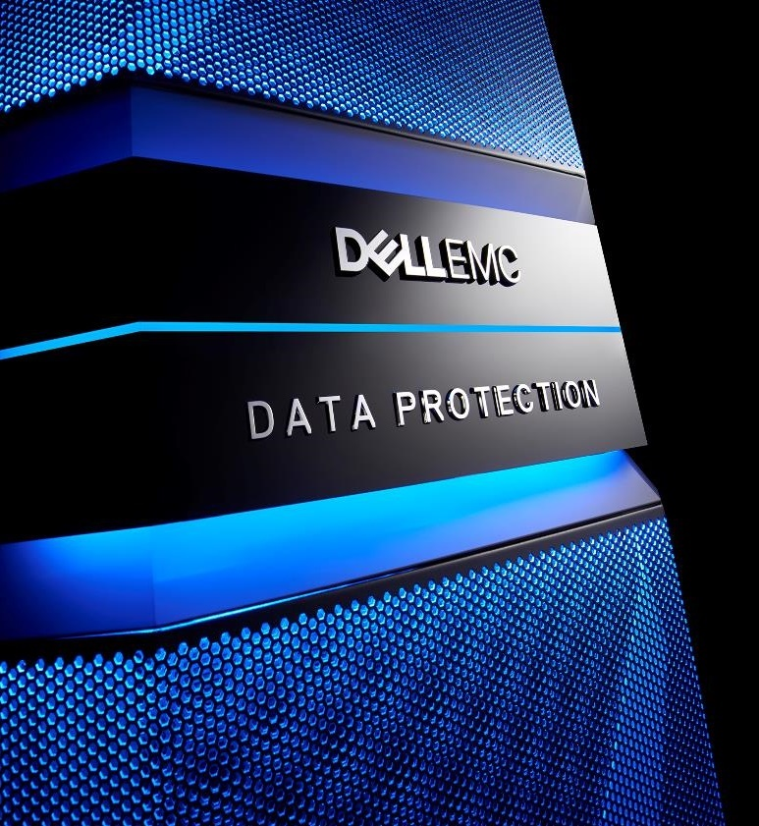
NetWorker & VMware
Functionalities / Licensing
- Architecture
- Value
- Demo
- Licensing
The most fresh version of this document, you will find at: http://backuprecoveryguy.blogspot.com/2022/07/backup-and-recovery-materials.html
Materiały dotyczące NetWorker-a po polsku: https://backuprecoveryman.pl/networker-materialy/
Daniel.Olkowski@dell.com

Slide 2
Agenda
Value
Demo
Licensing
Summary
Additional info

Slide 3
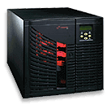
Backup environment
Site A
Site B
Linux, UNIX, Windows,
Applications,
Databases,
Mail
Linux, UNIX, Windows,
Applications,
Databases,
Mail
VM
LAN
VM
DBs
Mails
Backup
Server
Media
agent
SAN
Tape
library
Data Domain
Data Domain
Disk
system
Tape
library
Disk
system

Slide 4
What do we talk about?
Backup / Restore VMware environments
Site A
Linux, UNIX, Windows,
Applications,
Databases,
Mail
LAN
VM
DBs
Mails
Backup
Server
SAN
Tape
library
Data Domain
Disk
system

Slide 5
NetWorker VMware Backup What do we expect?

Slide 6
VMware backup / restore Our expectations
SPEED
Fast backup / restores
Speed
Parallel
Immediate Restore at 0 time

Slide 7
VMware backup / restore Our expectations
SECURITY
Application consistent backups
No single Point of Failure
Protection against ransomware

Slide 8
VMware backup / restore Our expectations
GRANULAR RESTORE from image backups
Restore single file
Restore single email
Restore database / table

Slide 9
VMware backup / restore Our expectations
RESILIENCY
Restore by owner of Virtual Machine
Restore by vCenter admin
Restore by NetWorker admin

Slide 10
VMware backup / restore Our expectations
OTHERS
Simple management
Cost effective licensing

Slide 11
NetWorker VMware Backup Value

Slide 12
NetWorker - VMware backup architecture
NetWorker
Server
Source de-duplication
Virtual Machines
vProxy
1%
data transferred
Mount
CBT
Reading only new changed blocks
Data Domain
1GB
. . .
1 TB
1 TB
1 TB
Full
Backup Monday
Full
Backup Tuesday
Full
Backup xxx
Snapshot
1 TB
DataStore

Slide 13
NetWorker – Minimal disk read
Reading only changed data
No load of disk system
No load of VMware environment
Fast backups
Source de-duplication
Virtual Machines
vProxy
1%
data transferred
CBT
Reading only new changed blocks
1GB
Mount
. . .
1 TB
1 TB
1 TB
Full
Backup Monday
Full
Backup Tuesday
Full
Backup xxx
Snapshot
1 TB
DataStore

Slide 14
NetWorker – Source de-duplication - the smallest block
Source de-duplication
Virtual Machines
vProxy
1%
data transferred
CBT
Reading only new changed blocks
Source de-duplication
The smallest variable block (4K – 12K)
Minimal data transfer over the network
1
GB
Mount
. . .
1 TB
1 TB
1 TB
Full
Backup Monday
Full
Backup Tuesday
Full
Backup xxx
Snapshot
1 TB
DataStore

Slide 15
NetWorker – Source de-duplication - the smallest block
Source de-duplication
Virtual Machines
vProxy
1%
data transferred
CBT
Reading only new changed blocks
Source de-duplication
Minimal cost of network
Minimal storage required
Minimal pipe for replication
1
GB
Mount
. . .
1 TB
1 TB
1 TB
Full
Backup Monday
Full
Backup Tuesday
Full
Backup xxx
Snapshot
1 TB
DataStore

Slide 16
NetWorker – Client Direct from VMware to media
Source de-duplication
Virtual Machines
vProxy
1%
data transferred
CBT
Reading only new changed blocks
Client Direct
No additional Media Servers
Simple architecture
1
GB
Mount
. . .
Cost effective
Simple management
Fast
1 TB
1 TB
1 TB
Full
Backup Monday
Full
Backup Tuesday
Full
Backup xxx
Snapshot
1 TB
DataStore

Slide 17
Networker - VMware backup performance
Up to 25 Virtual Machines backed-up in parallel per proxy
1%
data transferred
vProxy
25 streams
. . .
Full
Backup Monday
Full
Backup Tuesday
Full
Backup xxx

Slide 18
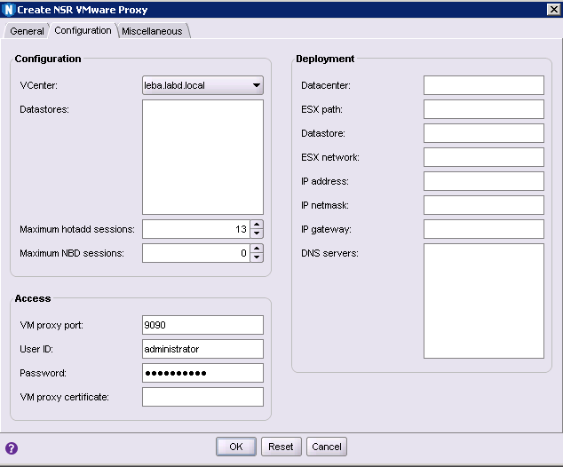
NetWorker - VMware backup performance
Number of Virtual Machines backed-up by single proxy
Maximum value is 25

Slide 19
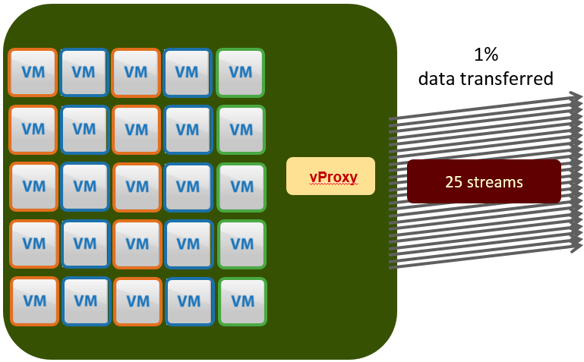
NetWorker - VMware backup performance
100 Virtual Machines backed up in parallel
3 – 10 minutes to backup 100 Virtual Machines
Every backup is full backup
. . .
Full
Backup Monday
Full
Backup Tuesday
Full
Backup xxx

Slide 20
NetWorker - VMware backup performance
Data Domain model determines number of streams
. . .
Full
Backup Monday
Full
Backup Tuesday
Full
Backup xxx

Slide 21
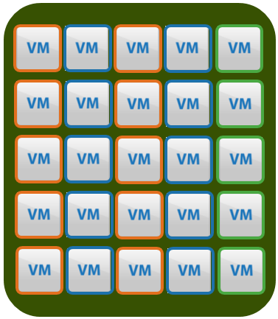
NetWorker - VMware backup performance
Any of the proxy can backup any Virtual Machines from the same ESX server or from any other one
. . .
Full
Backup Monday
Full
Backup Tuesday
Full
Backup xxx

Slide 22
NetWorker - VMware backup performance
On the picture left
We have 200 VMs
We have 4 vProxy
Up to 100 VMs are backed up in Parallel
Any of 100 VMs finished the backup, the next VM backup starts
We can expect 50VMs – 200VMs FULL BACKUP in 10 minutes
. . .
Full
Backup Monday
Full
Backup Tuesday
Full
Backup xxx

Slide 23
NetWorker - VMware backup performance Heavy tests
Change between backups is much bigger than in reality.
Usually VM changes 0,5% to 2% between backups
In this test the change was almost 5%.
Thus in reality you see much better performance!
Change rate has huge impact on performance. Thus in real environment we can expect even better performance

Slide 24
NetWorker - VMware backup flexibility
All the proxies can be on single ESX or on different ESX servers
It does not matter
. . .
Full
Backup Monday
Full
Backup Tuesday
Full
Backup xxx

Slide 25
NetWorker VMware – Load balancing
Full
Backup Monday
Full
Backup Tuesday
Full
Backup xxx
. . .
NetWorker automatically perform load balancing between vProxies
Here we have 2 vProxies. Every vProxy can perform backup of 25 Virtual Machines in parallel.
But here, we have only 24 Virtual Machines to backup. And NetWorker backups 24 VMs at the same time, placing them (load balancing) between all 2 possible proxies.
So in this particular case, each vProxy backups simultaneously 12 VMWare Virtual Machines.
12 Virtual Machines
backuped by the proxy
1% data transferred
12 Virtual Machines
backuped by the proxy
1% data transferred
vProxy
vProxy
24 Virtual Machines in the environment

Slide 26
NetWorker VMware – Load balancing
Full
Backup Monday
Full
Backup Tuesday
Full
Backup xxx
. . .
12 Virtual Machines
backuped by the proxy
1% data transferred
12 Virtual Machines
backuped by the proxy
1% data transferred
NetWorker automatically performance load balancing between vProxy
Here we 2 vProxy, every vProxy can perform backup of 25 Virtual Machines in parallel.
But we have only 24 jobs and NetWorker load balanced them between all (2) possible vProxies. Each vProxy has 12 jobs.
vProxy
vProxy
24 Virtual Machines in the environment
NetWorker automatically provides load balancing among all available proxy Virtual Machines

Slide 27
NetWorker VMware – Load balancing
Full
Backup Monday
Full
Backup Tuesday
Full
Backup xxx
. . .
24 Virtual Machines
backuped by the proxy
1% data transferred
Failure of vProxy
vProxy
vProxy
24 Virtual Machines in the environment

Slide 28
NetWorker VMware – Load balancing
Full
Backup Monday
Full
Backup Tuesday
Full
Backup xxx
. . .
24 Virtual Machines
Backed-up by the proxy
1% data transferred
Failure of vProxy
vProxy
vProxy
24 Virtual Machines in the environment
If any proxies fails, jobs are distributed between available vProxies

Slide 29
NetWorker VMware – Flexible / automated
Full
Backup Monday
Full
Backup Tuesday
Full
Backup xxx
. . .
Backup
1% data transferred
vProxy
vProxy

Slide 30
NetWorker VMware – Flexible / automated
Full
Backup Monday
Full
Backup Tuesday
Full
Backup xxx
. . .
Restore
vProxy
vProxy
Restore is performed through optimal vProxy
It does need to be the same vProxy as backup one

Slide 31
NetWorker VMware – Flexible / automated
NetWorker automatically chooses best / fastest proxy for backup / restore
We can add / remove proxies any time -> NetWorker will adjust its behavior immediately for the new environment
For example we want to improve performance. We add vProxy and we have more backups simultaneously, the backup windows shortens automatically
Full
Backup Monday
Full
Backup Tuesday
Full
Backup xxx
. . .
Restore
vProxy
vProxy

Slide 32
NetWorker VMware – Flexible / automated
Adding proxy is 5 minutes process
Import VM in VMware vCenter
Add to NetWorker Console
Full
Backup Monday
Full
Backup Tuesday
Full
Backup xxx
. . .
Restore
vProxy
vProxy

Slide 33
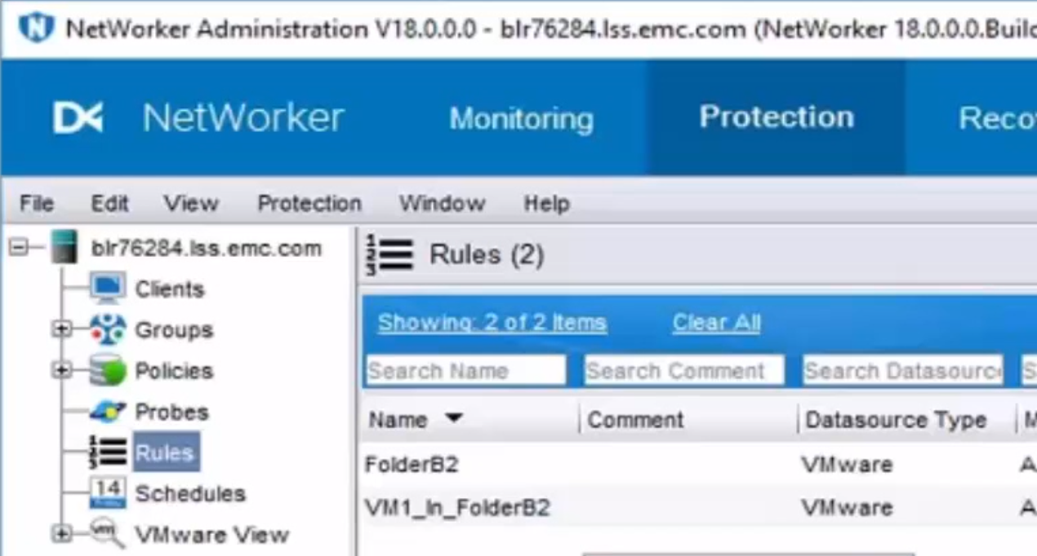
NetWorker 18.1: Dynamic Policy for VMware VMs
Increase Operational Efficiency for VMs Protection
Dynamic Policy: Increase Operational efficiency by applying protection to VMs, vApps, containers with certain properties via NMC
Tags
Vmfolder
Notes:
Overview: Very large virtualized enterprises and service providers manage 1000’s of virtual machines. One of the key challenges with this growth is onboarding VMs into protection policies. Dynamic Policy Enhancements provides the ability to dynamically and automatically protecting all VMs which follow defined rules without the need of changing the policy or manually apply the policy to the new VMs.
Admins create rules on a set of objects from the vSphere inventory. These rules can be applied to the object which has certain properties or attributes. Starting with vSphere 6.0, VMware introduces a concept of a tag which allows identification of a set of VMs. If the objects is a container, or in other words a folder, we can apply the rule against that folder as well.
The behavior of this dynamic policy will be that a backup scheduler reads the rule and dynamically determines which clients will be entered into a backup queue.
Supported Attributes:
VMTags
VMfolder
IMPORTANT: If rules are changed, the VM’s protected in the next backup scheduled day may change.

Slide 34
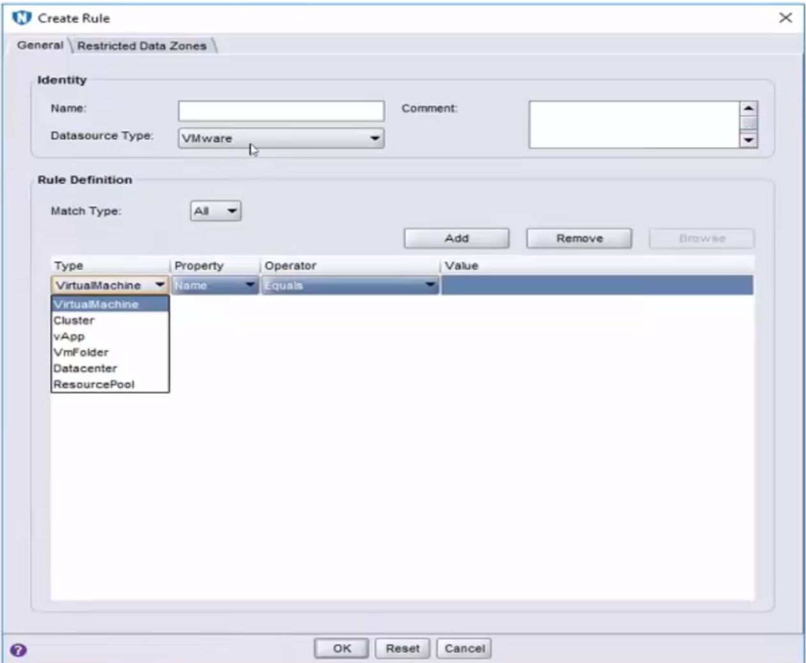
NetWorker 18.1: Dynamic Policy
Manage Data Growth with Dynamic Policy
Dynamic Policy: Increase operational efficiency by applying data protection rules to certain type of object with certain properties
Rules are created and managed via NMC
Notes:
This slide shows the screenshot of NetWorker Management Console where you can create rules against VMware Datasource. Within the VMware DataSource, we can apply rules for different types shown on the right hand screenshot such as VM, cluster, vApp, Vmfolder, Datacenter, ResourcePool. For each type, we can apply the property, and the operation for that property, for example shown here any VM that is equal to. Let’s look at various combinations of type, property, supported in NetWorker 18.1 in the next slide.

Slide 35
NetWorker 18.1: Dynamic Policy for VMware VMs
Increase Operational Efficiency for VMs Protection
Increase operational efficiency by applying data protection rules to various types of vSphere objects with certain properties
 | Name | Tag | Path
Datacenter | √ | √ | √
Vmfolder | √ | √ | √
ResourcePool |  | √ | √
Cluster/Host |  | √ | √
vApp | √ | √
VirtualMachine | √ | √
Property
Type
Notes:
This slide shows various Vmware types and the property that NetWorker 18.1 supports. For example, for Vmfolder, we can apply a rule for the folder with certain name, or tag, or with certain path. Anoher example would be apply a protection rule for those VM with certain names, or has certain tag.

Slide 36
NetWorker 9 Server Scalability – VMware VMs
Software That Grows With Your Business
Description | Pre-9.1 | 9.1 | 9.2 | 18.1 | Comments
# of VMs total in a single NW server | 1K | 6K | 7500 | 10,000
# of VMs total in a single NW policy | 200 | 1000 | 1500 | same
# of VMs concurrent/parallel backups with 1 vCenter | 48 | 100* | 180 | same | *Bound by VMware vCenter limitation
# of Proxies required per vCenter | 18 | 8 | same | same | Cuts required number proxies by 1/2
# of Concurrent backups per Proxy | 8 | 25 | same | same | Each proxy can drive 3x more backups; 25 is maximum limit. Ave industry: 12
# of Concurrent IA/IR sessions | 4 | 32 | same | same | Leveraging DDOS6.0 with SSD and FSS
# of Files in Single FLR session | 5K | 20K | same | same | 4x more files in single session
# of Concurrent Image Recovery sessions | 16 | 50 | same | same | 3x more VMs concurrently recovered

Slide 37
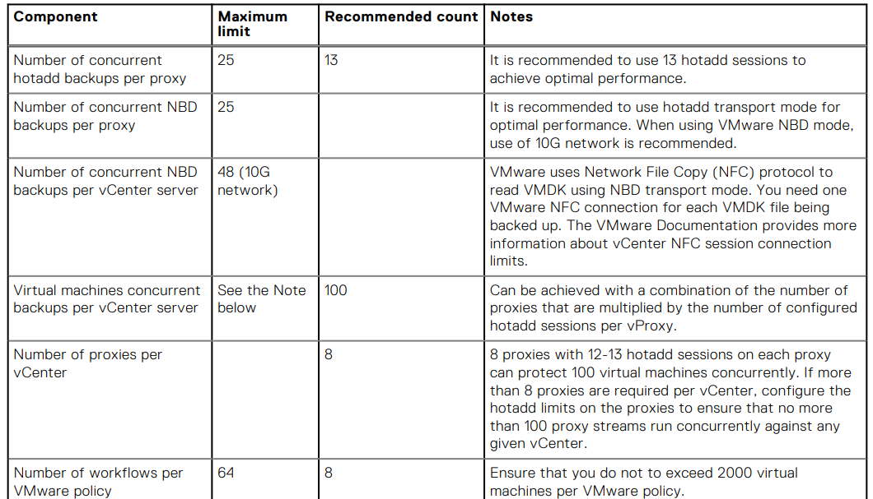

Slide 38
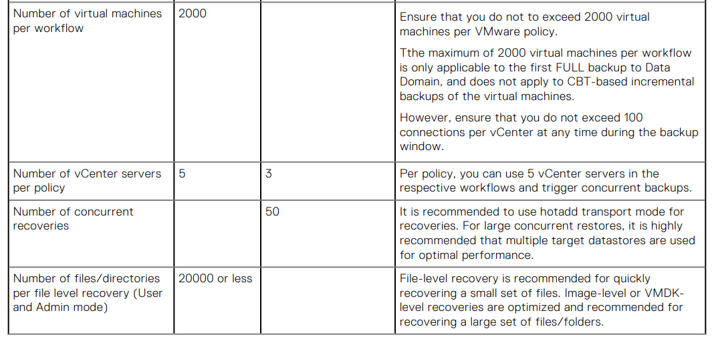

Slide 39
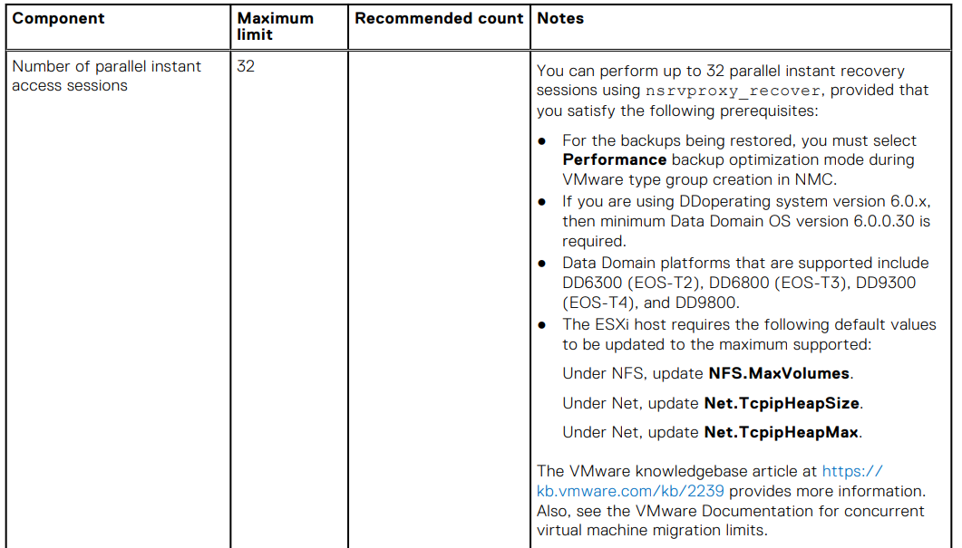

Slide 41
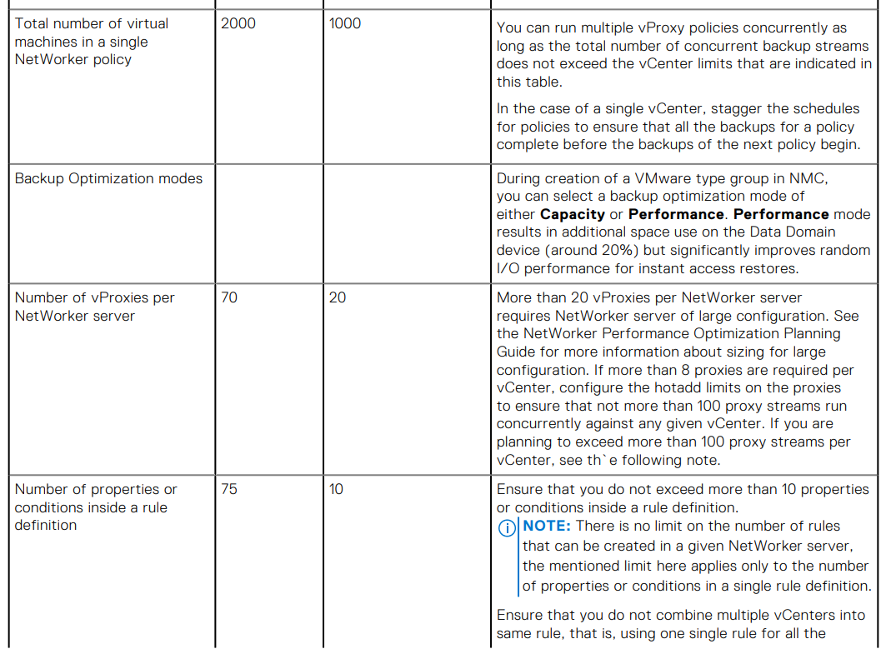

Slide 42
NetWorker VMware – Immediate repairing
Full
Backup Monday
Full
Backup Tuesday
Full
Backup xxx
. . .
1 TB
1 TB
1 TB
Restore to exisiting Virtual Machine
1% data transferred
vProxy
vProxy
1 TB

Slide 43
NetWorker VMware – Immediate repairing
We upgrade 1TB VM with SQL.
NetWorker performs full backup in 2 minutes, so before upgrade we backup this VM via NetWorker.
The upgrade fails.
No problem.
NetWorker restores (more accurate: repairs) just destroyed blocks (data) on the Virtual Machine. It will takes about 2 minutes!
We will not restore the whole 1TB Virtual Machine that can take a long time…
Full
Backup Monday
Full
Backup Tuesday
Full
Backup xxx
. . .
1 TB
1 TB
1 TB
Restore to exisiting Virtual Machine
1% data transferred
vProxy
vProxy
1 TB

Slide 44
NetWorker VMware – the power Repairing (reverting) Virtual Machines

Slide 45
NetWorker VMware – Backup as production!
We need to immediately access some Virtual Machines backed-up to Data Domain from 2pm last Tuesday. We can need to run those VMs for reasons like:
Tests
Disaster Recovery
Do we need to restore the VMs? Restoring consumes:
Time
Resources (disk / network)
Full
Backup Monday
Full
Backup Tuesday
Full
Backup xxx
. . .
1 TB
1 TB
1 TB
vProxy
vProxy
?
1 TB

Slide 46
NetWorker VMware – Backup as production!
A classical situation when we need starting Virtual Machines directly from backup is described below.
Application guy wants to run the database A sitting VM_A from last Tuesday 2:00pm. This is because users claim that Tuesday 2:00pm databases behaved in strange way.
With NetWorker / DD it is not problem. With one click we start the VM on Data Domain from a backup of last Tuesday 2:00pm.
Application guys has this VM at the specified time with SSD disks immediately.
No restore time, no additional resources (disks)!!! Just Data Domain.
If he missed the data and it was Monday, no problem! We can start from DD another VM with from Monday backup!!! And so on…
Full
Backup Monday
Full
Backup Tuesday
Full
Backup xxx
. . .
1 TB
1 TB
1 TB
vProxy
vProxy
?
1 TB

Slide 47
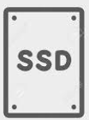
NetWorker VMware – Backup as production!
Full
Backup Monday
Full
Backup Tuesday
Full
Backup xxx
. . .
1 TB
1 TB
1 TB
vProxy
vProxy
We can start our Virtual Machines directly from Data Domain with 1000 IOPS up to 10 000 IOPS

Slide 48
NetWorker VMware – Backup as production!
Full
Backup Monday
Full
Backup Tuesday
Full
Backup xxx
SSD disks only for starting production (Instant Access)
Backup/restore operations do NOT need them!
. . .
1 TB
1 TB
1 TB
vProxy
vProxy
We can start our Virtual Machines directly from Data Domain with 1000 IOPS up to 10 000 IOPS

Slide 49
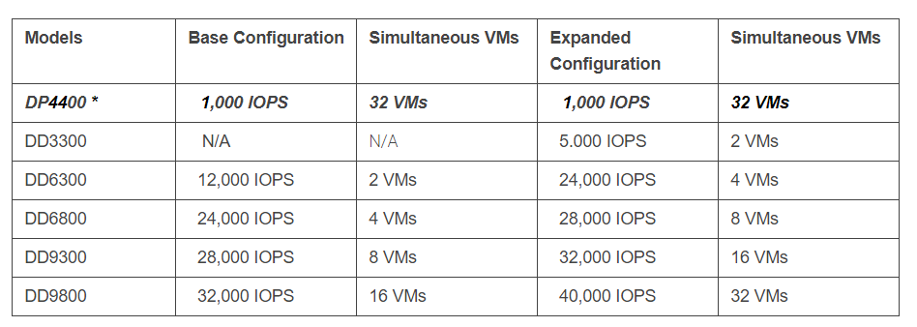
VMware – Restore without recovery with SSD speed!
https://inside.dell.com/people/almeih/blog/2018/09/06/random-io-performance-ddos-612-update#comment-261036

Slide 50
VMware – Restore without recovery with SSD speed!
https://inside.dell.com/people/almeih/blog/2018/09/06/random-io-performance-ddos-612-update#comment-261036

Slide 51
VMware – Restore without recovery with SSD speed!
Data Domain:
system show performance
Reporting sequential/random read/write throughput/latency/IOPS and stream type.
--------------------------------------------------------------------------------------------------------------------------------------------
Time Stamp |Throughput |IOPS |Protocol Latency |Streams
|read write repl-in repl-out|total read write | avg read write | read write
Date Time | | seq/rand seq/rand | seq/rand seq/rand | seq/rand seq/rand
YYYY-MM-DD HH:MM:SS|MiB/s MiB/s MiB/s MiB/s|ops/s ops/s ops/s | ms ms ms | # #
-------------------------------------------------------------------------------------------------------------------------------------------
2016-05-17 06:08:00 110.2 5.9 82.45 0.44 503 205/7698 19/146 62.5 75.2/95.3 8.9/22.4 0/301 6/1
2016-05-17 06:18:00 112.7 1.8 84.13 0.40 494 83/11482 3/60 34.7 53.9/65.1 3.0/7.8 39/249 0/42
2016-05-17 06:28:00 114.2 5.6 65.46 0.36 1034 182/8876 280/357 18.7 54.5/61.0 0.5/2.7 49/231 0/91
2016-05-17 06:38:00 113.1 4.1 84.81 0.45 732 202/8175 213/71 27.6 56.6/61.7 0.5/4.2 15/286 1/0
2016-05-17 06:48:00 115.7 4.4 82.03 0.39 585 93/11558 69/206 31.7 55.7/69.8 0.7/7.9 39/248 2/31

Slide 52
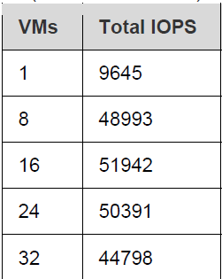
DD9800 Instant Access details

Slide 53
NetWorker VMware – Immediate Disaster Recovery!
Another Use Case for starting Virtual Machines from Data Domain/SSD is Disaster Recovery.
Our Site A fails and we need to immediately start production in Site B.
We have no time for recovering data!

Slide 54
NetWorker VMware – Immediate Disaster Recovery!
Site A
Site B
Proxy
Proxy
Proxy
Proxy
Backup
Restore
Backup
Restore
Disaster Recovery
Transfer 1%
Recovery 100% of data
Data Domain
Data Domain

Slide 55
NetWorker VMware – Immediate Disaster Recovery!
Site A
Site B
Site A fails
How quickly can we starts VMs (critical VMs especially) in Site B?
Proxy
Proxy
Proxy
Proxy
Backup
Restore
Backup
Restore
Disaster Recovery
Transfer 1%
Recovery 100% of data
Data Domain
Data Domain

Slide 56
NetWorker VMware – Immediate Disaster Recovery!
In site B we do not restore anything.
We start Virtual Machines (that were in site A) directly from Data Domain. They work with SSD disks speed!
0 time restoring data!
Site A
Site B
Those VMs work normally.
They are also normally backed up or restored
Proxy
Proxy
Those VMs are from site A.
They use Data Domain SSD disks as the storage.
Proxy
Proxy
Backup
Restore
Backup
Restore
Proxy
Disaster Recovery
Transfer 1%
Recovery 100% of data
Proxy
Data Domain
Data Domain

Slide 57
NetWorker VMware – Classical recovery to new VM
What speed can we achieve with classical backup / recovery approach?

Slide 58
NetWorker VMware Restoring to new Virtual Machine
Up to 15TB/h
Recovery speed!!!
Depends on Data Domain model
1 TB
1 TB
1 TB
vProxy
vProxy
1 TB

Slide 59
NetWorker VMware Restoring to new Virtual Machine

Slide 60
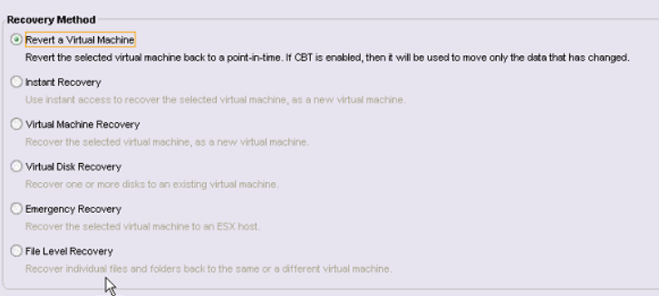
NetWorker VMware Recovery types

Slide 61
NetWorker VMware Type of restores
Recovery without vCenter
Recovery between vCenter
Single file recovery from VMware image backup
VMware / NetWorker admin
Owner of Virtual Machine

Slide 62
NetWorker VMware Recovery between vCenter
If we have 2 vCenters, we can
backup Virtual Machines in vCenter A
restore those Virtual Machines to vCenter B

Slide 63
NetWorker VMware Simple of automation of any policies
The most advanced backup flow is achievable in NetWorker with couple of clicks

Slide 64
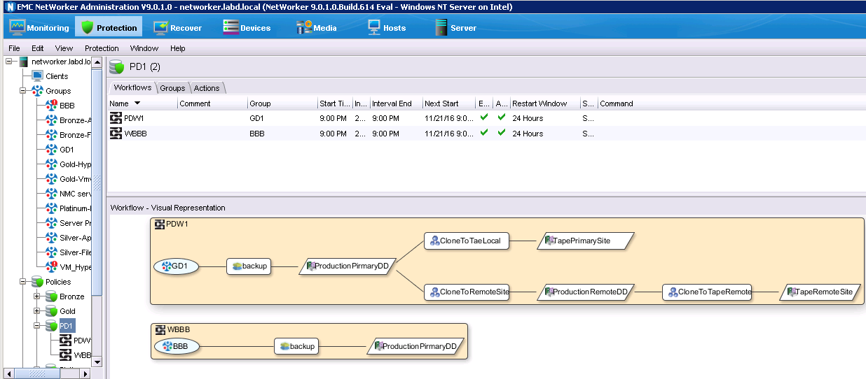
NetWorker VMware Simple of automation of any policies

Slide 65
NetWorker VMware Simple of automation of any policies
Here we have nicely visualized policy
We run the backup for 2 000 Virtual Machines
Parallel tape-out of all VMS
100 VMs
backed-up in parallel
2-3 min backup time
per VM
All backups are FULL
Parallel Disaster Recovery to remote location
Parallel tape-out of all VMS at remote site

Slide 66
NetWorker VMware Simple of automation of any policies
This policy:
Backups 2 000 Virtual Machines
100 VMs backed up in parallel
We have 4 copies of each of 2 000 VMs performer after backup finishes
Local Data Domain
Remote Data Domain (Disaster Recovery)
Local Tape
Remote Tape
We run the backup for 2 000 Virtual Machines
Parallel tape-out of all VMS
100 VMs
backed-up in parallel
2-3 min backup time
per VM
All backups are FULL
Parallel Disaster Recovery to remote location
Parallel tape-out of all VMS at remote site

Slide 67
NetWorker VMware Protection against ransomware / hacker
Does your backup solutions guarantee you recovery after
ransomware / hacker
attack?

Slide 68
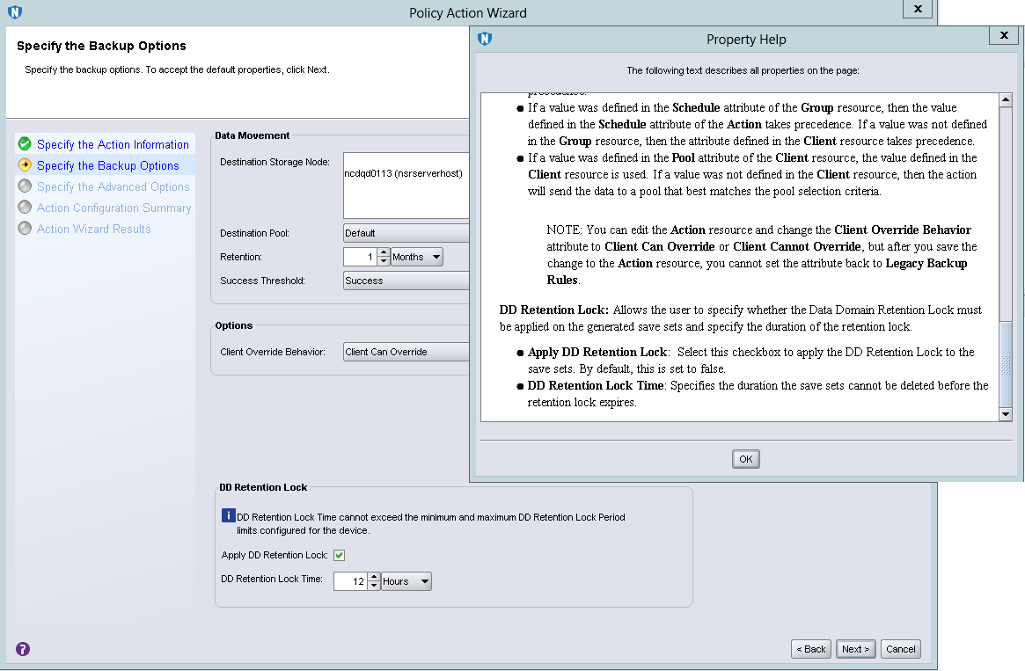
NetWorker VMware Protection against ransomware / hacker
Regular retention like in every backup software
During the period specified here (usually 2 weeks) none can delete / change backups
Ransomware
Hacker (Even if has highest level login/password)
Thus in case of hacker / ransomware atttack, we can always restore!

Slide 69
NetWorker VMware Protection against ransomware / hacker
RANSOMWARE / HACKER
PROTECTION!
During the period specified here none can delete / change backups
Ransomware
Hacker (Even if has highest level login/password)
Thus in case of hacker / ransomware atttack, we can always restore!

Slide 70
OK.
Great features.
Incredible performance.
But
How can NetWorker help me?

Slide 71
NetWorker VMware Use cases
Disaster Recovery with no need to recover data
We just start from SSD Data Domain disks
Immediate testing with no resources required
Starting production from Data Domain SSD disks

Slide 72
NetWorker VMware Use cases
Protection against ransomware / hacker attack
Forcing compliance
For set of backups
For all backups
RPO 1h or even shorter
Backup of single VM is 2 -10 minutes (Full backup)
Why not backup Critical Virtual Machines every 15 minutes!
Migrating VMs between vCenters

Slide 73
NetWorker VMware
NetWorker for VMware
is easy!!!
5 minutes
installation and configuration!

Slide 74
NetWorker VMware Backup Demo

Slide 75
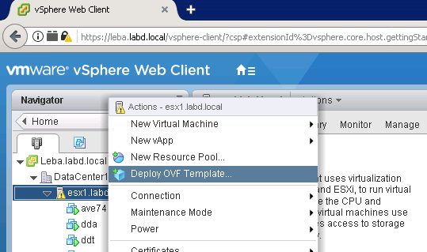
Deploying vProxy

Slide 76
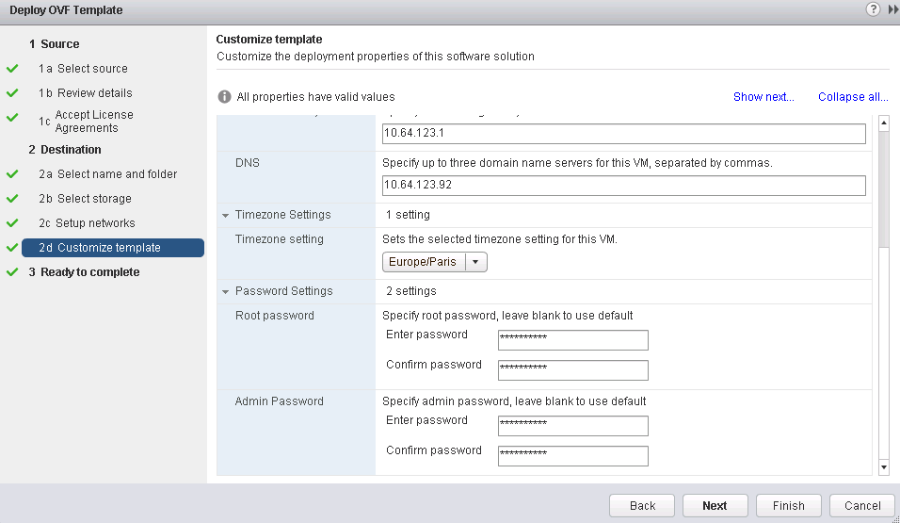
Deploying vProxy

Slide 77
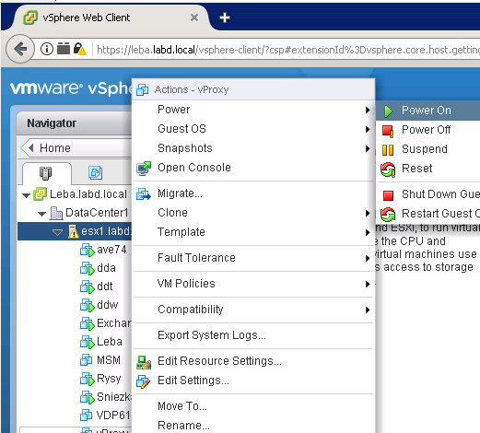
Starting vProxy

Slide 78
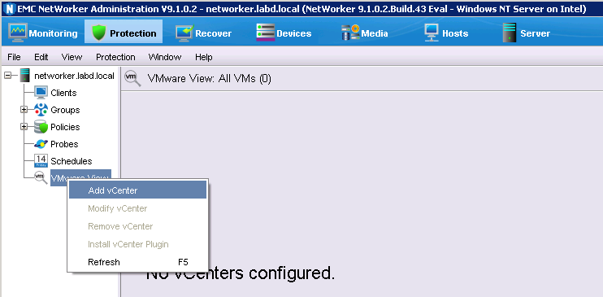
Adding vCenter to NetWorker

Slide 79
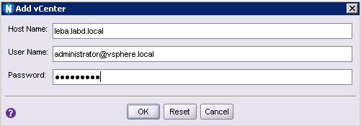
Adding vCenter to NetWorker

Slide 80
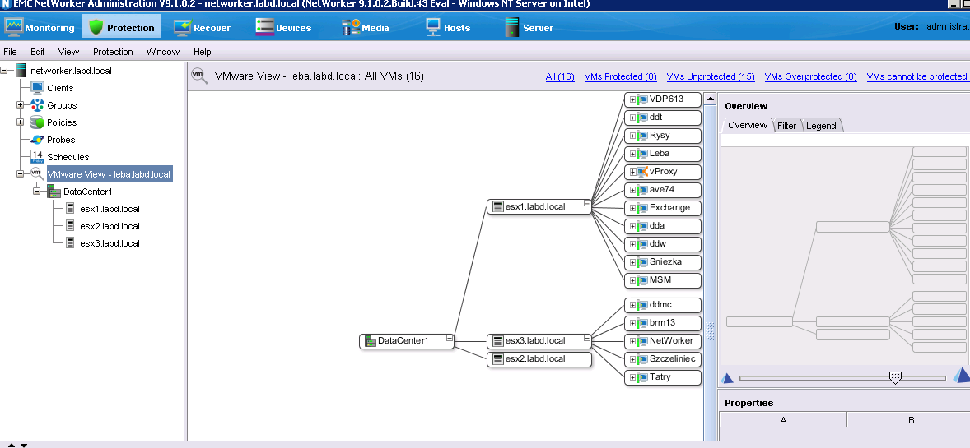
Adding vCenter to NetWorker

Slide 81
Adding vCenter to NetWorker

Slide 82
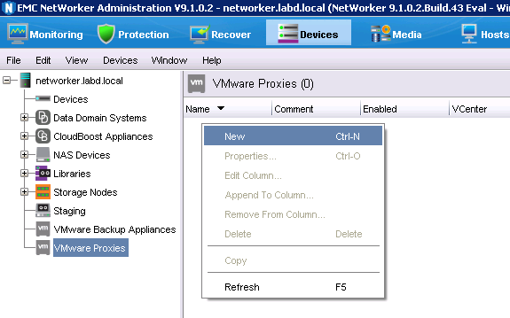
Adding vProxy to NetWorker Console

Slide 83
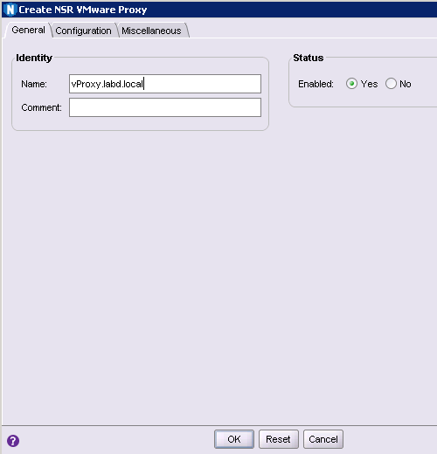
Adding vProxy to NetWorker Console

Slide 84
Adding vProxy to NetWorker Console

Slide 85
Adding vProxy to NetWorker Console

Slide 86
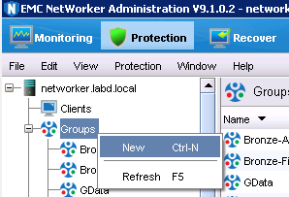
Creating NetWorker Group

Slide 87
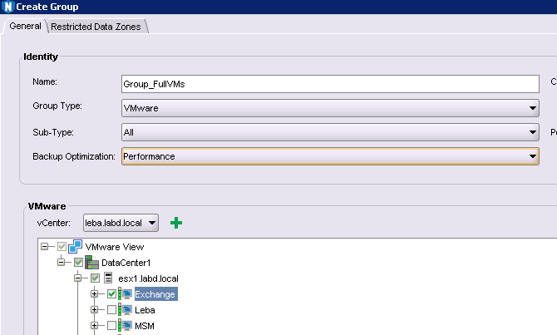
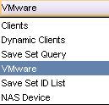
Creating NetWorker Group
Choose VMs that NetWorker shall backup

Slide 88
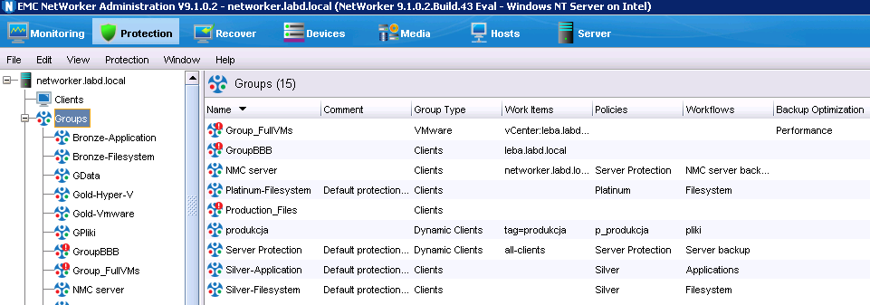
Creating NetWorker Group

Slide 89
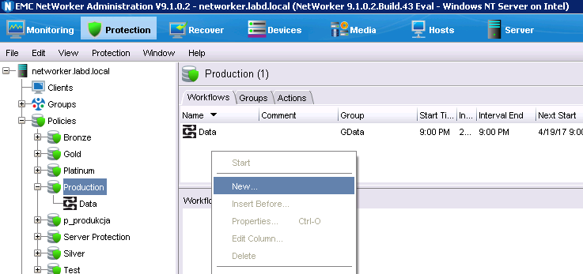
Creating NetWorker VMware Workflow

Slide 90
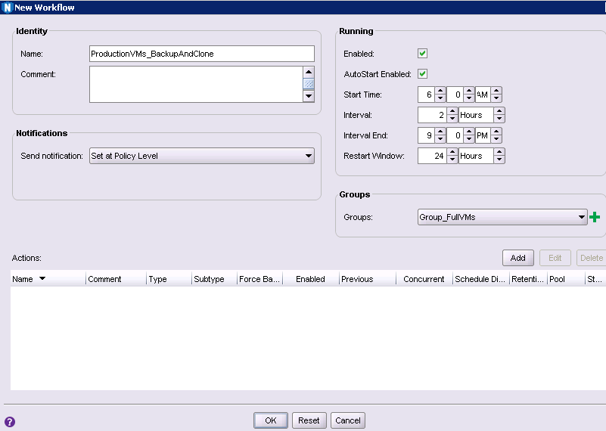
Creating NetWorker VMware Workflow
We define here that we want to backup Virtual Machines from 6:00am to 9:00pm every 2h
We can do this because NetWorker is fast (2-10 minutes to backup 100VMs).
And all backups are full!

Slide 91
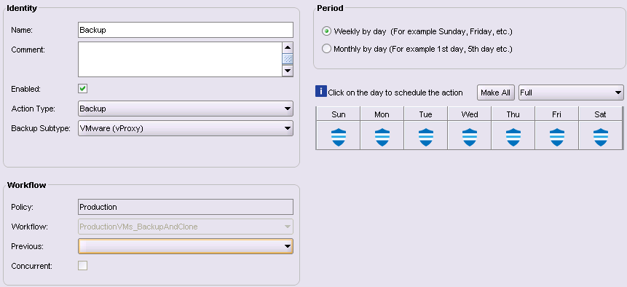
Creating NetWorker VMware Workflow

Slide 92
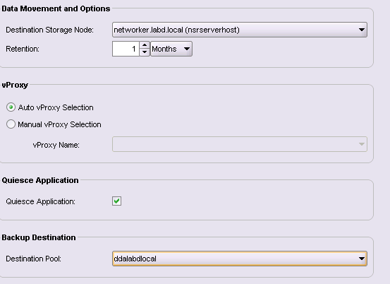
Creating NetWorker VMware Workflow

Slide 93
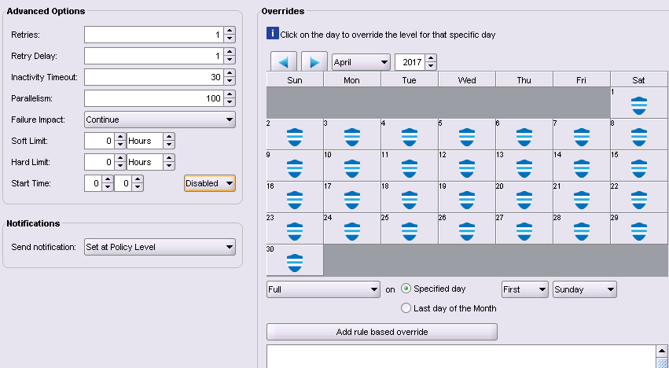
Creating NetWorker VMware Workflow

Slide 94
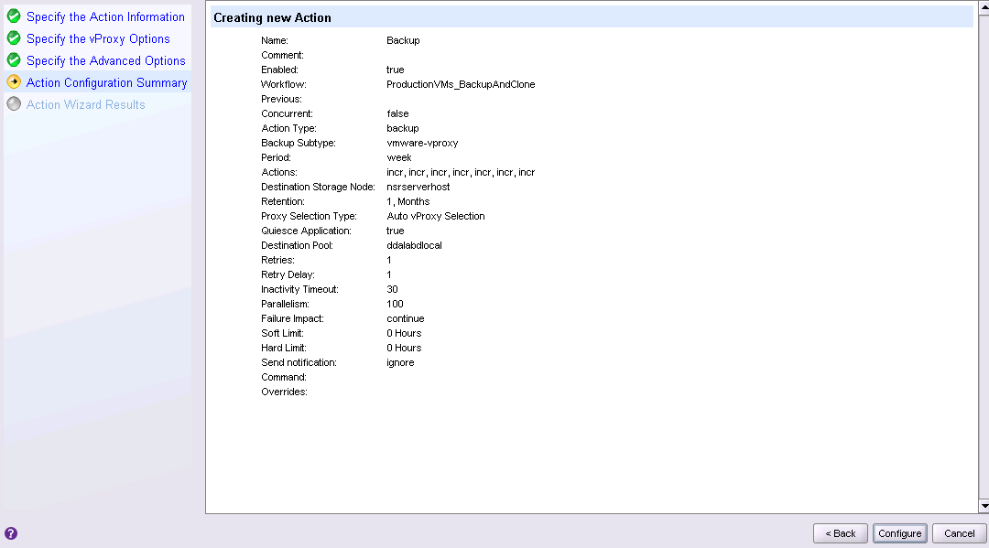
Creating NetWorker VMware Workflow

Slide 95
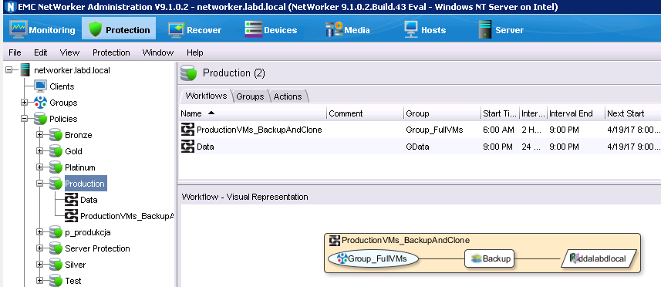
VMware Workflow is ready!

Slide 96
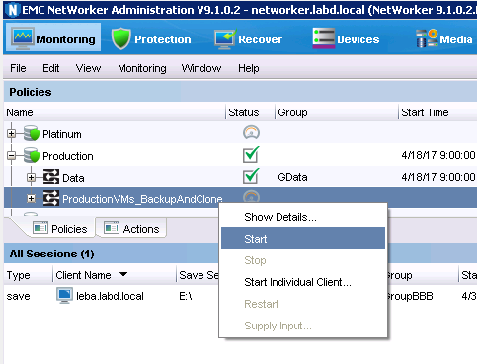
Starting backup

Slide 97
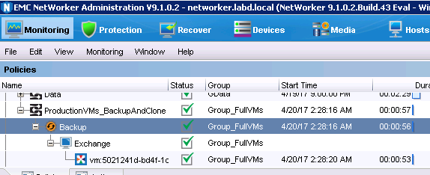
Full backup of VM in less than 1 minute!

Slide 98
Full backup of VM in less than 1 minute!
Wow!!!!
Full backup in less than 1 minute!!!

Slide 99
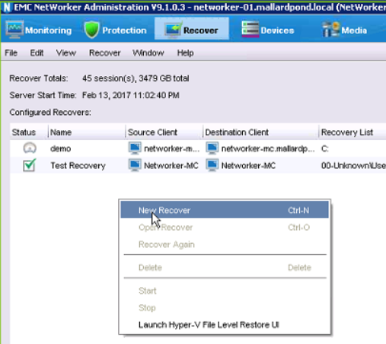
Recovery

Slide 100
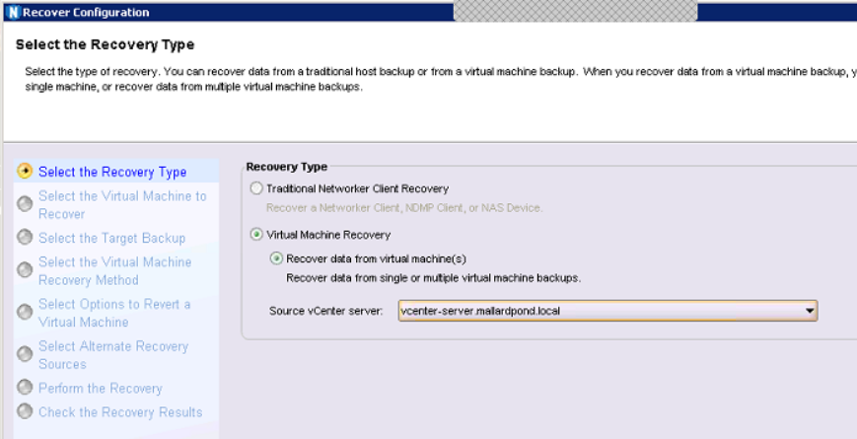
Recovery

Slide 101
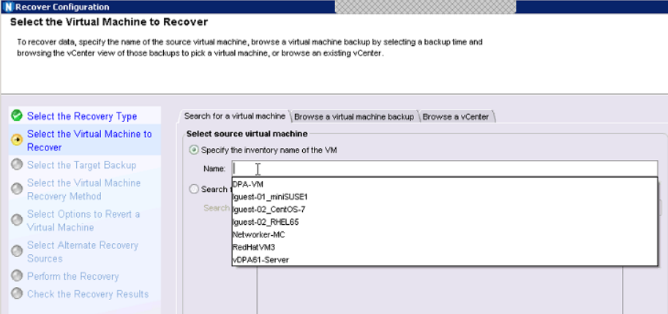
Recovery

Slide 102
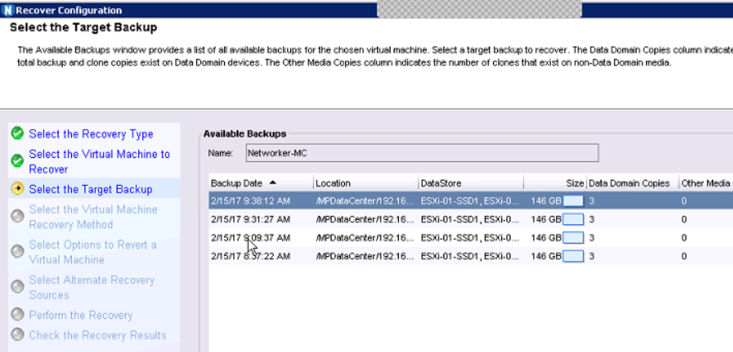
Recovery

Slide 103
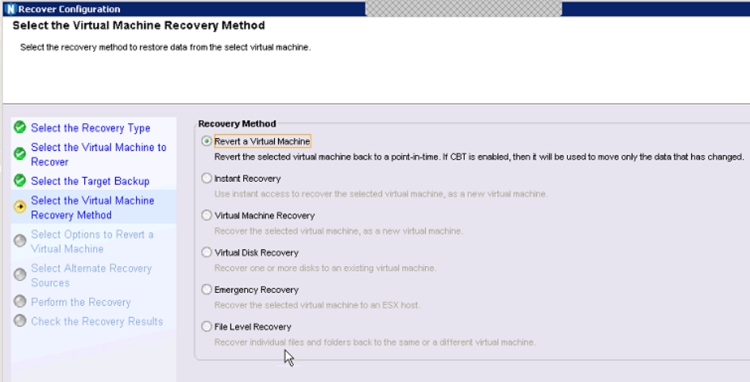
Recovery

Slide 104
NetWorker VMware Backup Licensing

Slide 105
How can we license NetWorker?
Data Protection Suite
Enterprise Edition
Includes:
Avamar
NetWorker
Data Protection Advisor
DD Boost for Enterprise Apps
ProtectPoint
SourceOne
AppSync
RecoverPoint for Virtual Machines
Data Protection Search
CloudBoost
Data Protection Suite For VMware / NetWorker
Includes:
NetWorker
Avamar
Data Protection Advisor
RecoverPoint for VMs
Data Protection Search
Data Protection Central

Slide 106
NetWorker Data Protection Suite for VMware / NetWorker
All functionalities
Unlimited number of protected TBs
Unlimited number of media (Data Domain, disk, tape, S3)

Slide 107
RecoverPoint for Virtual Machines Data Protection Suite for VMware / NetWorker
Easy backup of any VMware environment
Backup/restore of VMs that regular software cannot backup:
Raw Devices
Large Virtual Machines (over 1TB)
Fast changing Virtual Machines (7%+ between backups)
Restore of Virtual Machines to any point in time
Restore of Virtual Machines in seconds
Disaster Recovery of Virtual Environment to any distance Remote Office
More
https://www.youtube.com/watch?v=Dqyqabfg3iM

Slide 108
RecoverPoint for Virtual Machines Data Protection Suite for VMware / NetWorker
Backup
Restore
Disaster Recovery
Any VMware environment
Easy backup of any VMware environment
Backup/restore of VMs that regular software cannot backup:
Raw Devices
Large Virtual Machines (over 1TB)
Fast changing Virtual Machines (7%+ between backups)
Restore of Virtual Machines to any point in time
Restore of Virtual Machines in seconds
Disaster Recovery of Virtual Environment to any distance Remote Office

Slide 109
Search Data Protection Suite for VMware / NetWorker
Searching and browsing Avamar backups
Finding documents in backup repository that contain provided key words
More:
https://youtu.be/JBTDrszoV1Q?t=148

Slide 110
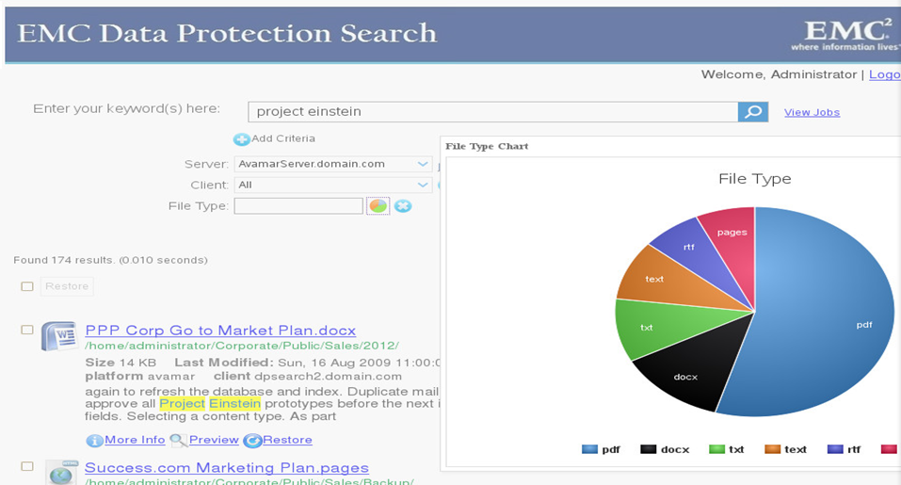

Slide 111
Data Protection Advisor Data Protection Suite for VMware / NetWorker
Monitoring
Reports
From Console
Email
Analysis of failed backups
SLA
Analysis of data lost in case of a disaster
Chargeback
… (over 280 standard reports)
Charts (bars, lines, circles, …)
More
https://youtu.be/8G5I-OzWY-A

Slide 112
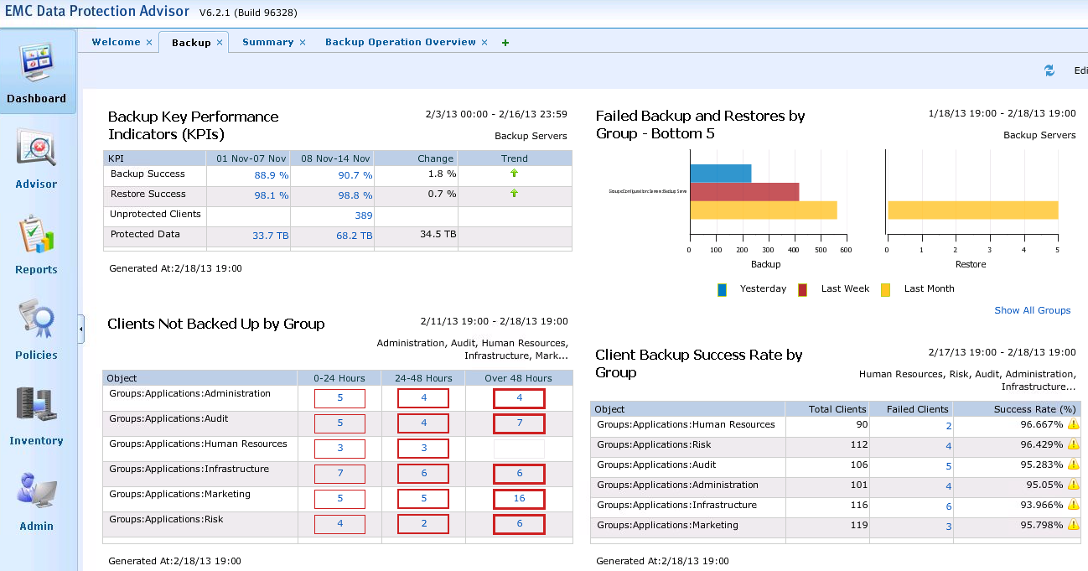

Slide 113
Example of licensing Data Protection Suite for VMware / NetWorker
ABC company has the following environment
VMWare environment
4 ESX servers
Each ESX server has 2 physical processors
Total: 8 physical processors
There are 50 Virtual Machines on 4 ESX servers
5 MSSQL databases, 1 Oracle, 1 Exchange
Standalone, not virtualized servers
2 file servers, 1 processor at each server (2 physical processors altogether)
1 MSSQL server with 2 processors (2 physical processors altogether)

Slide 114
Example of licensing Data Protection Suite for VMware / NetWorker
ABC company has the following environment
VMWare environment
4 ESX servers
Each ESX server has 2 physical servers
Total: 8 physical processors
There are 50 Virtual Machines on 4 ESX servers
5 MSSQL databases, 1 Oracle, 1 Exchange
Standalone, not virtualized servers
2 file servers, 1 processor at each server (2 physical processors altogether)
1 MSSQL server with 2 processors (2 physical processors altogether)
12 physical processors
in the whole environment

Slide 115
Example of licensing Data Protection Suite for VMware / NetWorker
Having
12 licenses of Data Protection Suite for VMware
ABC company can use in an unlimited manner in its whole environment any of the below:
NetWorker
RecoverPoint for Virtual Machines
Data Protection Advisor
Data Protection Search

Slide 116
NetWorker VMware Backup Summary

Slide 117
NetWorker for VMware Performance
100 parallel Virtual Machines backed-up
Easily 1 000 full backups per hour
Immediate repairing
Starting Virtual Machines from Data Domain
1 000 IOPS to 10 000 IOPS
Huge recovery speed to new Virtual Machine with legacy restore

Slide 118
NetWorker for VMware Recovery
Starting Virtual Machines from SSD disks
Repairing Virtual Machine
2-3 mins
100 VMs per 50 min
Up to 15TB/h of recovery to new Virtual Machine

Slide 119
NetWorker for VMware Recovery
Single file recovery
Administrator
Owner of Virtual Machine
Recovery without vCenter
Recovery between vCenters

Slide 120
NetWorker for VMware Load balancing
Automated load balancing
Backup / Recovery between vCenters
Fastest restore
Running VMs directly from DD from SSD disk (without restore)
Protection against ransomware / hacker (9.2)

Slide 121
NetWorker for VMware Load balancing
Immediate reverting / repairing VM to last state.
100 VMs backuped in parallel
100 – 1000VMs full backup per hour (always full backup)
RPO can be reduced to minutes for critical machines
Much cheaper cost than tape

Slide 122
NetWorker for VMware Load balancing
No load of VMware storage
We do not read data
Minimal resources required
Easy Disaster Recovery
Export to ECS / tape

Slide 123
NetWorker for VMware Security
Disaster Recovery
Blocking backups for specific time (Retention Lock)

Slide 124
NetWorker for VMware Ease of use
5 min deployments
Automated execution of any policy's
Local backups
Replications
Tape outs

Slide 125
Strong Development

Slide 126
NetWorker
More info

Slide 127
NetWorker & VMware backup Article
Article describing NetWorker & VMware
http://backuprecoveryguy.blogspot.com/2017/07/networker-vmware-backup-fast-simple.html

Slide 128
NetWorker & VMware backup Video
Video with full NetWorker & VMware explanation
https://www.dellemc.com/en-emea/events/webinar/cee.htm#270019

Slide 129
NetWorker – Additional Materials
NetWorker Proof of Concept package
http://gurago.com/
2nd link from the top
Shows NetWorker features and configuration screen by screen
This ppt is included

Slide 130
NetWorker – Additional Materials
http://gurago.com/

Slide 131
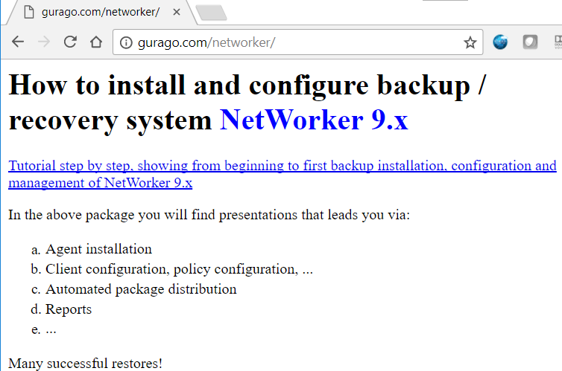
NetWorker – Additional Materials
http://gurago.com/

Slide 132
NetWorker
Informacje po polsku

Slide 133
NetWorker & VMware Artykuł po polsku
Artykuł po polsku opisujący NetWorker & VMware
http://backuprecoveryman.blogspot.com/2017/07/networker-vmware-szybkosc-niezawodnosc.html

Slide 134
NetWorker & VMware Film po polsku
Film po polsku opisujący możliwości NetWorkera w obszarze VMware
http://poland.emc.com/brighttalk-webinar/index.htm?commid=266619

Slide 135
NetWorker – Additional Materials
Pakiet pozwalający samodzielnie zainstalować i skonfigurowac NetWorkera
http://gurago.pl/
Drugi link od góry
Pokazuje funkcjonalności NetWorkera ekran po ekranie
Ta prezentacja jest włączona

Slide 136
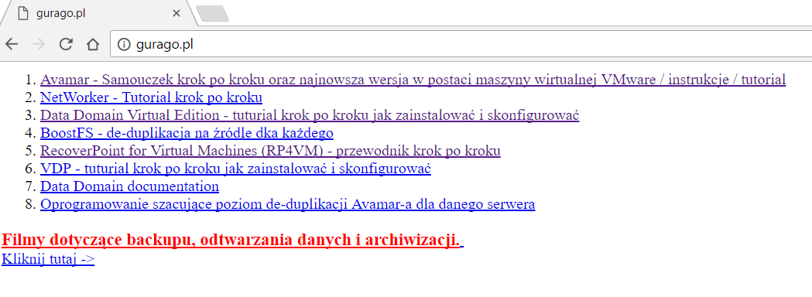
NetWorker – Additional Materials
http://gurago.pl

Slide 137
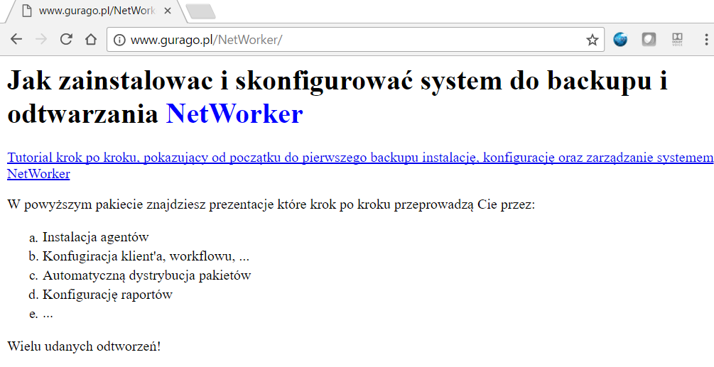
NetWorker – Additional Materials
http://gurago.pl

Slide 138
NetWorker – Całość materiałów
http://backuprecoveryman.blogspot.com/2016/02/przeglad-materiaow-po-polsku.html#NetWorker

Slide 139
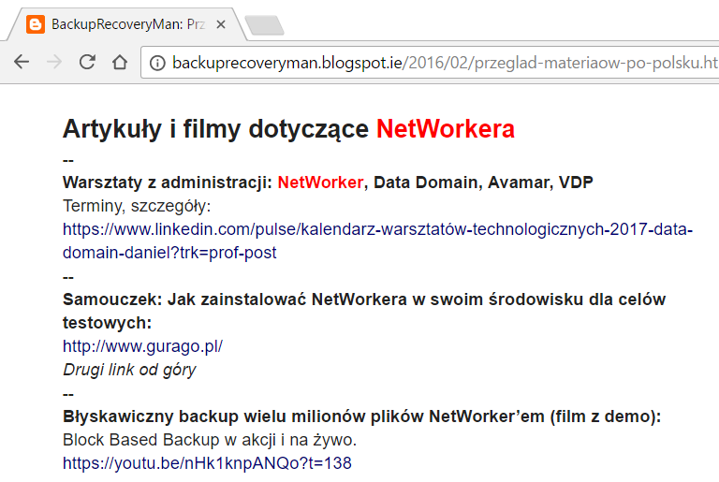

Slide 140
Dell EMC
Internal resources

Slide 141
NetWorker – Additional Materials
NetWorker Proof of Concept package
https://inside.dell.com/docs/DOC-236188
Shows NetWorker features and configuration screen by screen
This ppt is included

Slide 142
Backup & recovery resources CEE
All backup & recovery materials for CEE:
https://inside.dell.com/people/olkowd/blog/2017/05/24/backup-recovery-archive-materials

Slide 143
Questions…
NetWorker
Full backup in less than 1 minute!!!
Daniel.Olkowski@dell.com

