Slide 1
Is my data clean? Cyber Recovery in action
Polish video covering Cyber Recovery: https://youtu.be/SjmM60ZhPHw
All DPS materials: http://backuprecoveryguy.blogspot.com/2022/07/backup-and-recovery-materials.html
The most fresh ppt version of this document, you will find at: http://backuprecoveryguy.blogspot.com/2022/07/backup-and-recovery-materials.html
Daniel.Olkowski@dell.com
Daniel.Olkowski@dell.com

Slide 2
Czy dane w mojej firmie są czyste?
Jak zatrzymać atak hacker / ransomware?
Jak odtworzyć utracone dane?
Dlaczego / Technologia / Demo
Daniel.Olkowski@dell.com

Slide 3
Agenda
Cyber Bunker
What can we do in Cyber Bunker?
What is CyberSense?
What does CyberSense provide?
Why to check data in Cyber Bunker?
CyberSense workflow

Slide 4
Agenda
CyberSense infrastructure
CyberSense unique points
CyberSense Forensic analysis
CyberSense reports
Licensing

Slide 5
Video – CyberSense
CyberSense – How to recover after hacker/ransomware attack? https://youtu.be/ul5PHkq83Nk
CyberSense – Jak się odtworzyć po ataku ransomware/hacker? https://youtu.be/q0qvfbnzXOw

Slide 6
What is Cyber Bunker? Componentes

Slide 7
Cyber Bunker answers for the following questions:
What if I am encrypted?
Am I being encrypted?
Who encrypts me?
How to stop being encrypted?
Which copy to use to recover?
How to recover?

Slide 8
CyberSense part
What if I am encrypted?
Am I being encrypted?
Who encrypts me?
How to stop being encrypted?
Which copy to use to recover?
How to recover?

Slide 9
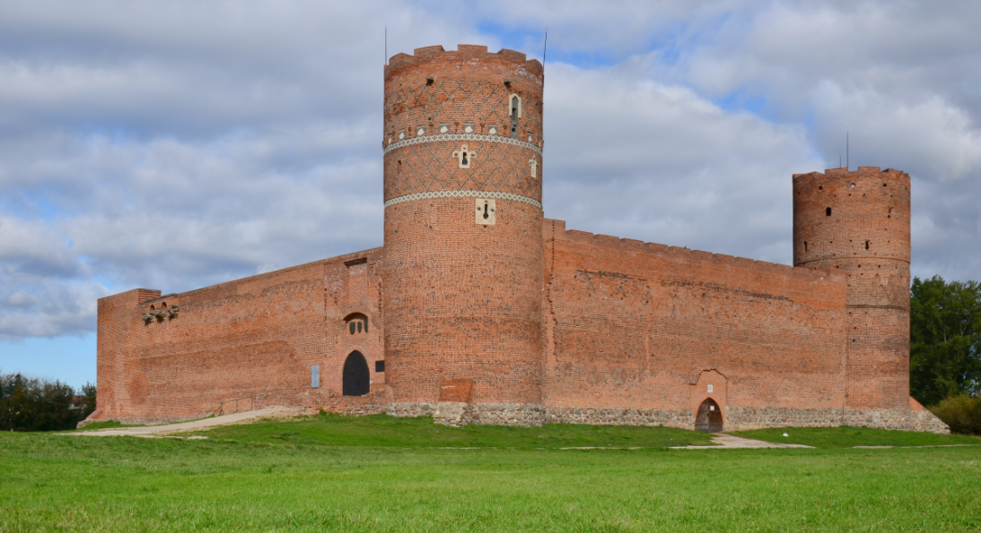
Castle strategy

Slide 10
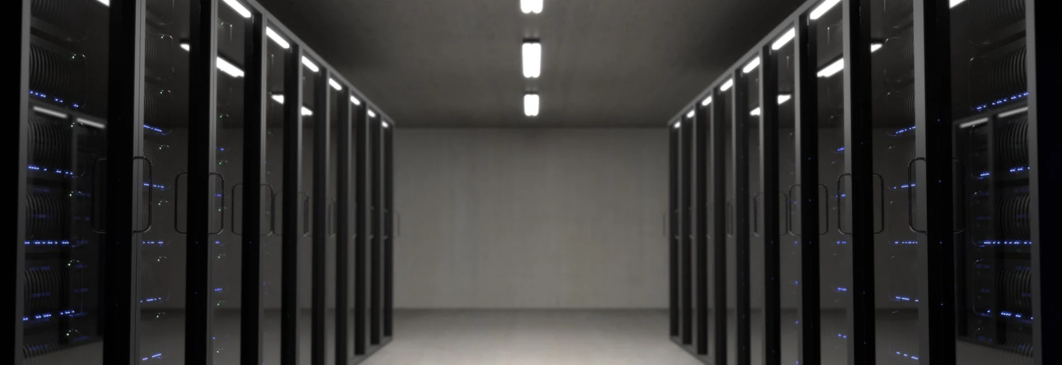
Castle strategy

Slide 11
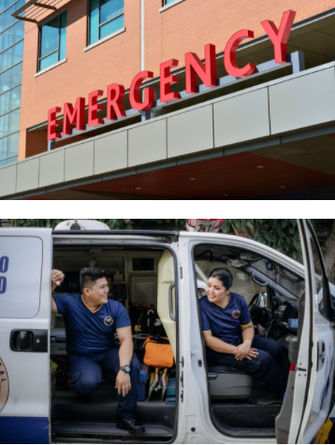
Ambulance
strategy

Slide 12
SITE A
SITE B
IT Infrastructure
Ransomware
protection
IT Infrastructure
Ransomware
protection
Any backup software
Backup
Recovery
Any backup software
Backup
Recovery
Data Domain
Disaster Recovery
Data Domain
1% data transfer
100% recovery
Cyber Bunker
Air Gap
PLAN B – Secure data & Recovery
Separation
from production
Management
and automation
Cyber
Recovery
Data Domain
Cyber
Sense
Checking
ransomware
Secure
Historical
backups
Compliance
No possibility to change data
Recovery
automation
Backup
software
Sandbox
Any tests

Slide 13
What can we do in Cyber Bunker?

Slide 14
We have data
after cyber attack
Restore
Tests
Check data if compromised
…
Cyber Bunker
Air Gap
PLAN B – Secure data & Recovery
Separation
from production
Management
and automation
Cyber
Recovery
Data Domain
Cyber
Sense
Checking
ransomware
Secure
Historical
backups
Compliance
No possibility to change data
Recovery
automation
Backup
software
Sandbox
Any tests

Slide 15
What is CyberSense?

Slide 16
What is CyberSense?
What if I am encrypted?
Am I being encrypted?
Who encrypts me?
How to stop being encrypted?
Which copy to use to recover?
How to recover?

Slide 17
Most common vector attacks
Encryption
Data corruption
Deleting improtant data
...

Slide 18
CyberSense answers the questions:
Are cyber attacks bypass our real time protection?
Can we assure our data’s integrity?
How do we know your data is not already corrupted?
Which copy to use to recover?

Slide 19
Real time ransomware protection
Essential but can be defeated
Attack vector 1
Attack vector 2
Attack vector 3

Slide 20
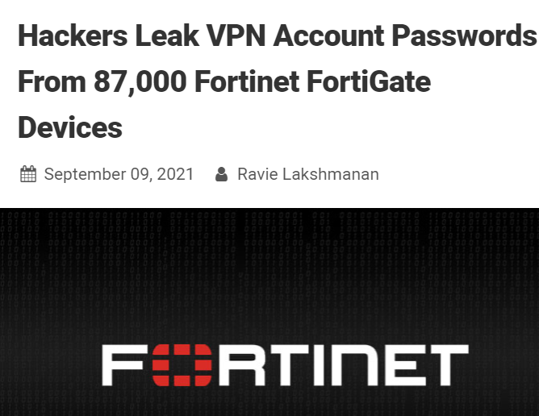
https://thehackernews.com/2021/09/hackers-leak-vpn-account-passwords-from.html?m=1

Slide 21
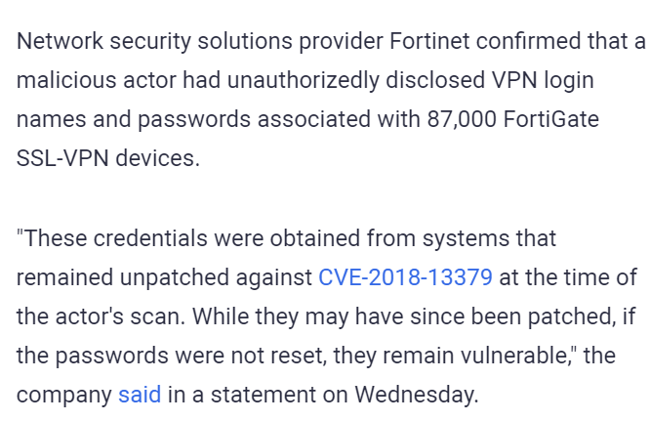
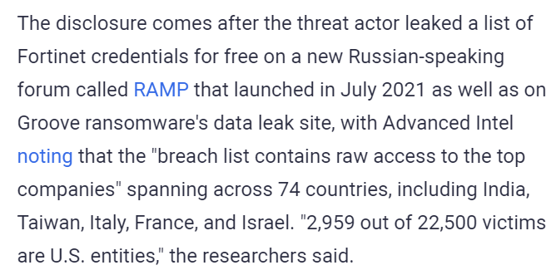
https://thehackernews.com/2021/09/hackers-leak-vpn-account-passwords-from.html?m=1

Slide 22
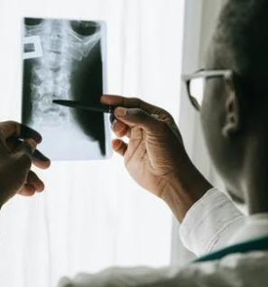
What is CyberSense?
Detects
Diagnose
Allow to
recover

Slide 23
What does CyberSense provide?

Slide 24
Value of CyberSense
All the time monitors data for signs of corruption
Diagnose and Recover
Post attack tools to take action on damage
Checking
data integrity

Slide 25
Why to check data in Cyber Bunker?

Slide 26
Production
Exploit?
Encrypted?
Cyber Bunker
Air Gap
PLAN B – Secure data & Recovery
Separation
from production
Management
and automation
Cyber
Recovery
Data Domain
Cyber
Sense
Checking
ransomware
Secure
Historical
backups
Compliance
No possibility to change data
Recovery
automation
Backup
software
Sandbox
Any tests

Slide 27
SITE A
Why shall we scan data at Cyber Bunker?
IT Infrastructure
Ransomware
protection
Any backup software
Backup
Recovery
Isolation
Out of
criminal eyes
Data Domain
Consistent data
Load
Cyber Bunker
Air Gap
PLAN B – Secure data & Recovery
Separation
from production
Management
and automation
Cyber
Recovery
Data Domain
Cyber
Sense
Checking
ransomware
Secure
Historical
backups
Compliance
No possibility to change data
Recovery
automation
Backup
software
Sandbox
Any tests

Slide 28
SITE A
Why shall we scan data at Cyber Bunker?
Real case
IT Infrastructure
Ransomware
protection
There was a virus, which in specific type of activates (protection software) was moving to somewhere else.
In Cyber Bunker we have a photo. No escape.
Please note that even now, in films – where there super technology – still camera snapshot is used as investigation method. The criminal can not escape, gold ring under the desk cannot be removed and can be proof, source for deduction.
Any backup software
Backup
Recovery
Data Domain
Cyber Bunker
Air Gap
PLAN B – Secure data & Recovery
Separation
from production
Management
and automation
Cyber
Recovery
Data Domain
Cyber
Sense
Checking
ransomware
Secure
Historical
backups
Compliance
No possibility to change data
Recovery
automation
Backup
software
Sandbox
Any tests

Slide 29
CyberSense workflow

Slide 30
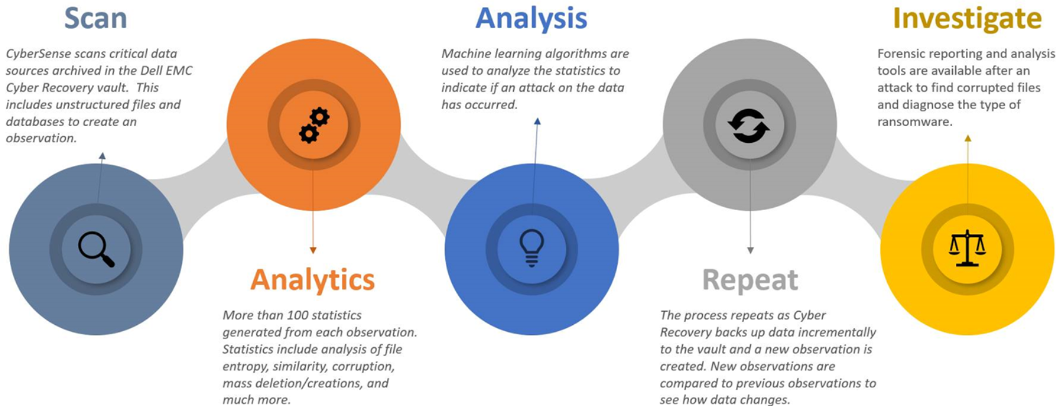
CyberSense Workflow

Slide 31
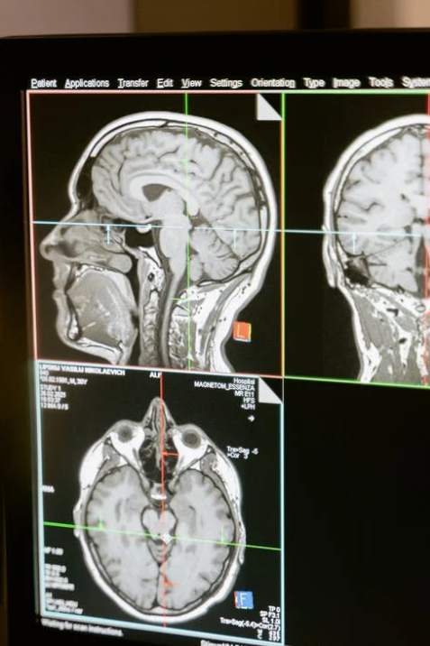
CyberSense scans critical data sources in Cyber Bunker.
1. Scan
What is scanned?
Files
Databases
Metadata
…
The result creates observation

Slide 32
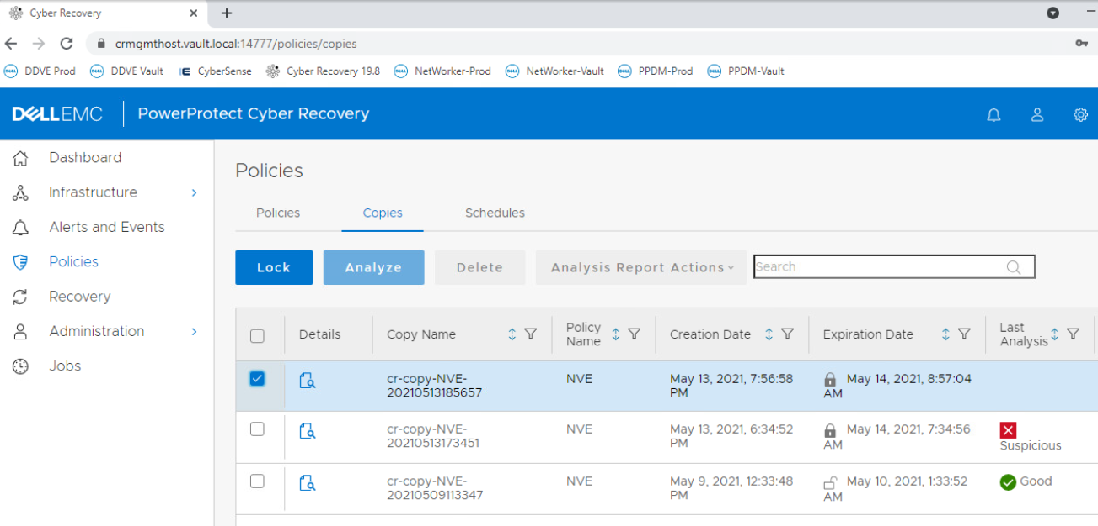
Scanning existing production copies in Cyber Bunker
Status of previous checks

Slide 33
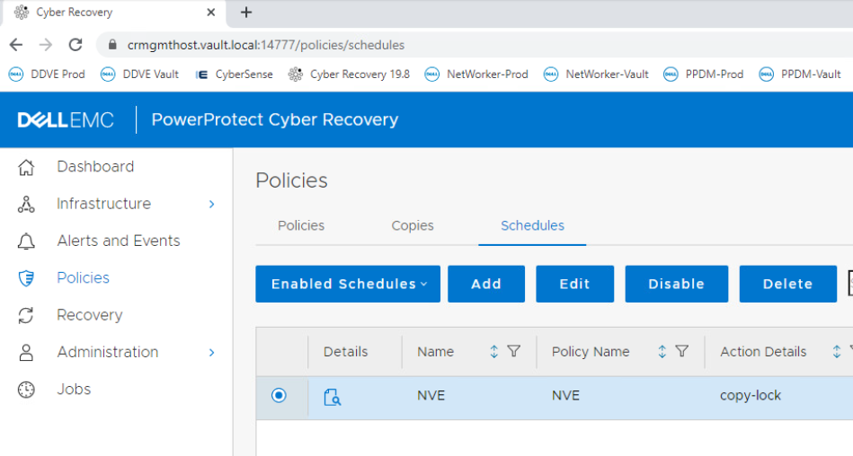

Slide 34
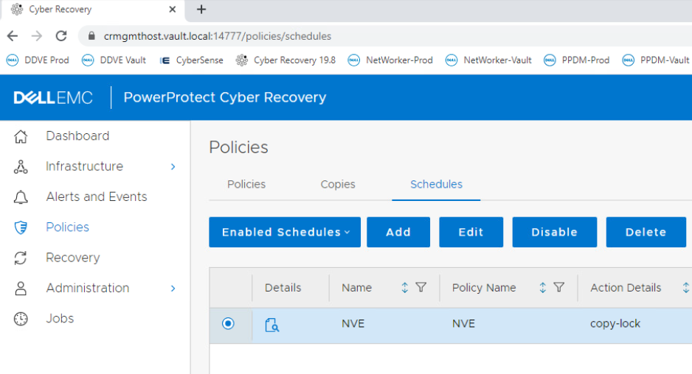
We can schedule scanning

Slide 35
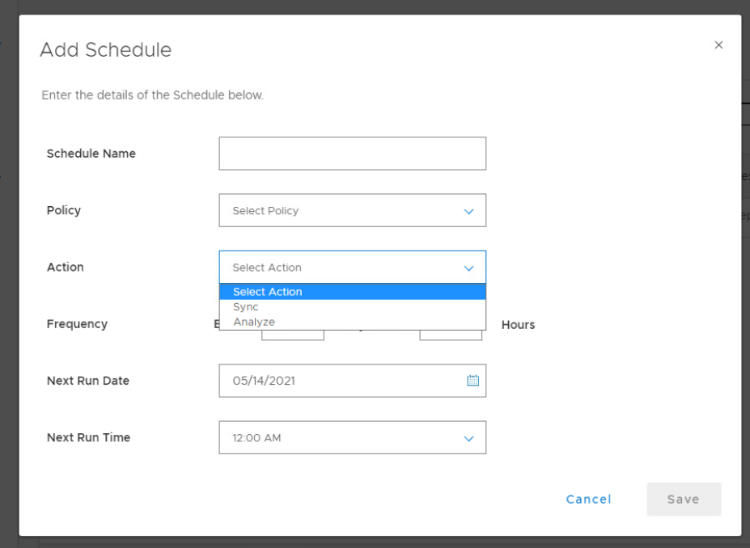

Slide 36
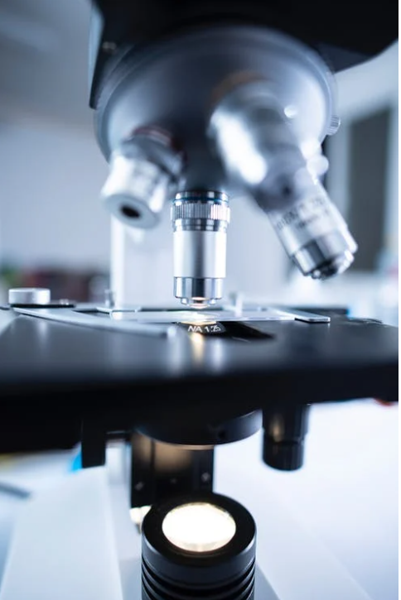
Over 100 stastistcs
based on the observation
2. Analytics
Entropy
Similarity
Corruption
Massive deletion / creation
…

Slide 37
Data types
Databases / App:
Oracle
SQL
DB2
SharePoint
Epic Cache
…
Files
Core Infrastructure:
DNS
Active Directory
LDAP
…

Slide 38
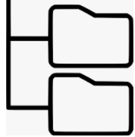
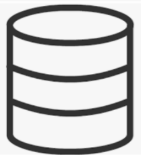
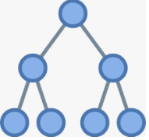
Backup software
Backup format
CyberSense
Filesystems
Databases / Apps
Understands backup application format
AD / LDAP / DNS

Slide 39
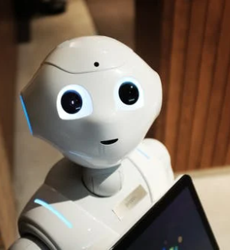
Stastistics are analyzed by Machine Learning
3. Analysis
Indication if a data attack took place
We see results in Cyber Recovery panel

Slide 40
Info from Machine Learning
Status of previous checks

Slide 41
The process repeats:
Cyber Bunker gets new production copies
Statistics -> observation
Machine Learning analysis
Comparison with previous observations to see how data changes
4. Repeat

Slide 42
Anaylysis, reports to
Find corrupted data
Diagnose type of ransomware
Recover
5. Invstigate

Slide 43
CyberSense Infrastructure

Slide 44
CyberSense requirements
Requirements:
6-20 CPUs
128GB-400GB memory
CyberSense
Virtual Machine
or federated
Virtual Machines
Working
together
Sizer:
* Exact specification
* Number of VMs
Depends on
* number of scanned front end data
* change rate
* type of data (databases?)

Slide 45
CyberSense Unique points

Slide 46
Structure of file (document / database)
File Metadata
Name, extensions,
size, time, path, …
Change extension, file size, ..
Document Metadata
Type, Structure
File type mismatch, Corrupt file structure, …
Content
Partial encryption, Corrupted content, …
More
sophisticated
attacks

Slide 47
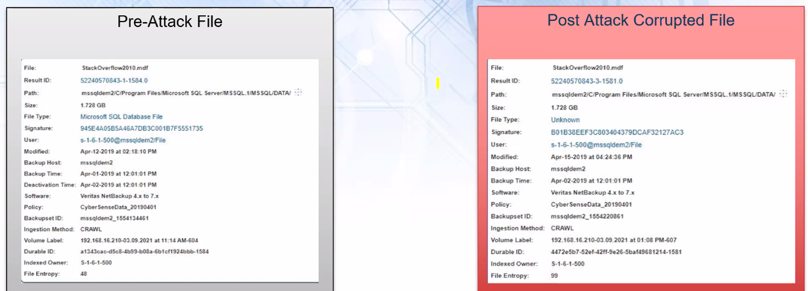
Let’s compare 2 files

Slide 48
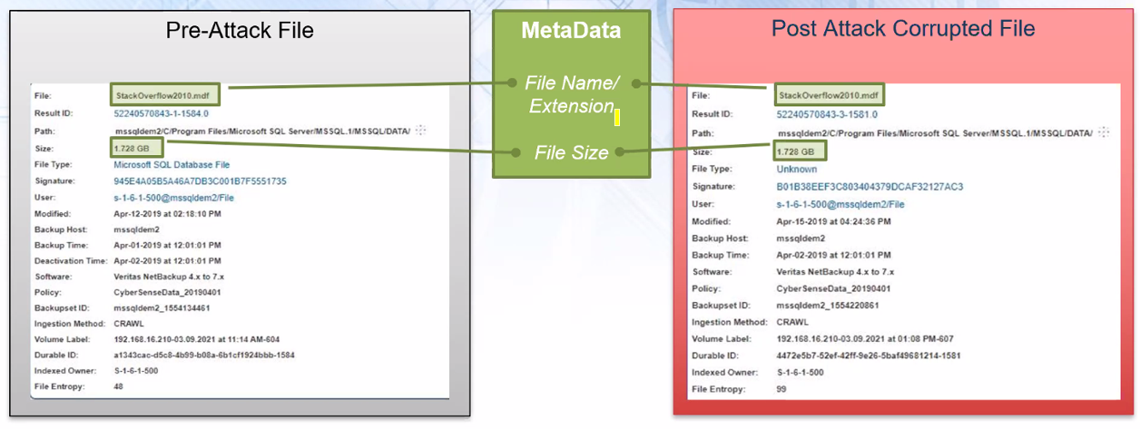
Metadata only analytics will not detect corruption

Slide 49
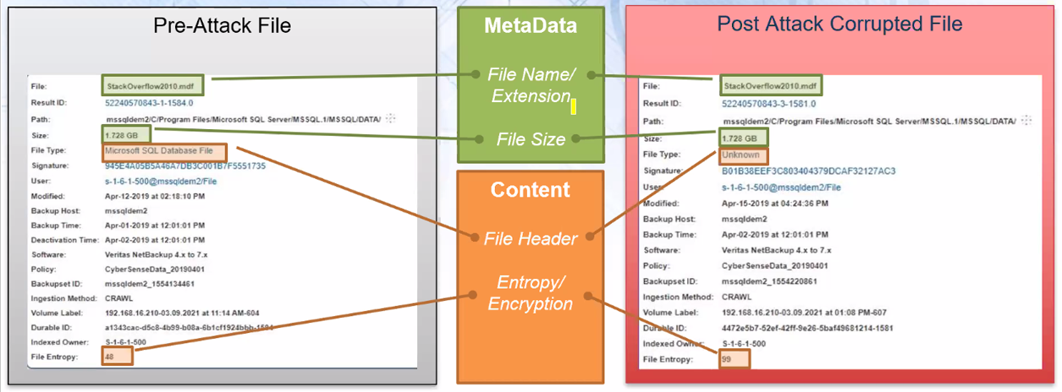
Content analytics detects attack
Requires algorytms and power

Slide 50
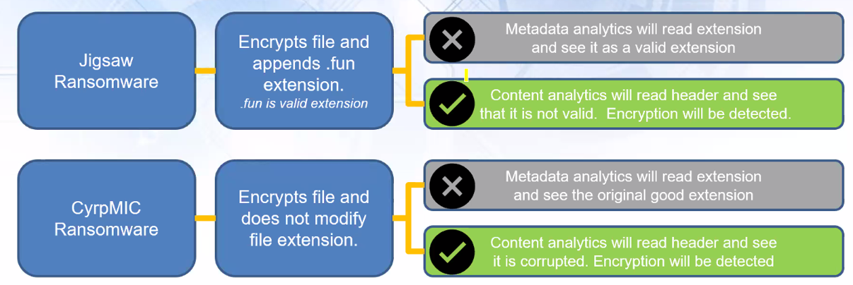
Attack vectors that maintain valid file extensions

Slide 51
CyberSense Forensic analysis

Slide 52
CyberSense Workflow
Security Analytics
100+ statistics indicative of cyber attack
Comprehensive index
Changes on content over time
Machine Learning
Trained against attack vectors

Slide 53
The result of CyberSense job
CyberSense Workflow
Security Analytics
100+ statistics indicative of cyber attack
Attack vector
Comprehensive index
Changes on content over time
Machine Learning
Trained against attack vectors

Slide 54
The result of CyberSense job
CyberSense Workflow
Security Analytics
100+ statistics indicative of cyber attack
Attack vector
Detailed list of corrupted files
Comprehensive index
Changes on content over time
Machine Learning
Trained against attack vectors

Slide 55
The result of CyberSense job
CyberSense Workflow
Security Analytics
100+ statistics indicative of cyber attack
Attack vector
Detailed list of corrupted files
Source of the attack
Comprehensive index
Changes on content over time
Machine Learning
Trained against attack vectors

Slide 56
The result of CyberSense job
CyberSense Workflow
Security Analytics
100+ statistics indicative of cyber attack
Attack vector
Detailed list of corrupted files
Source of the attack
Last good copy
Comprehensive index
Changes on content over time
Machine Learning
Trained against attack vectors

Slide 57
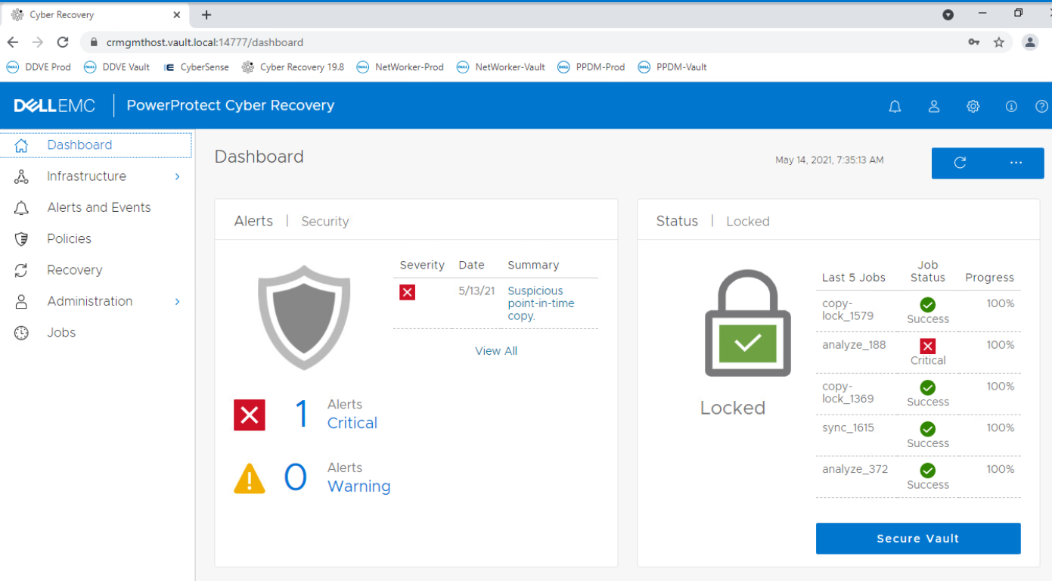
Main page

Slide 58
Info from Machine Learning
Status of previous checks

Slide 59
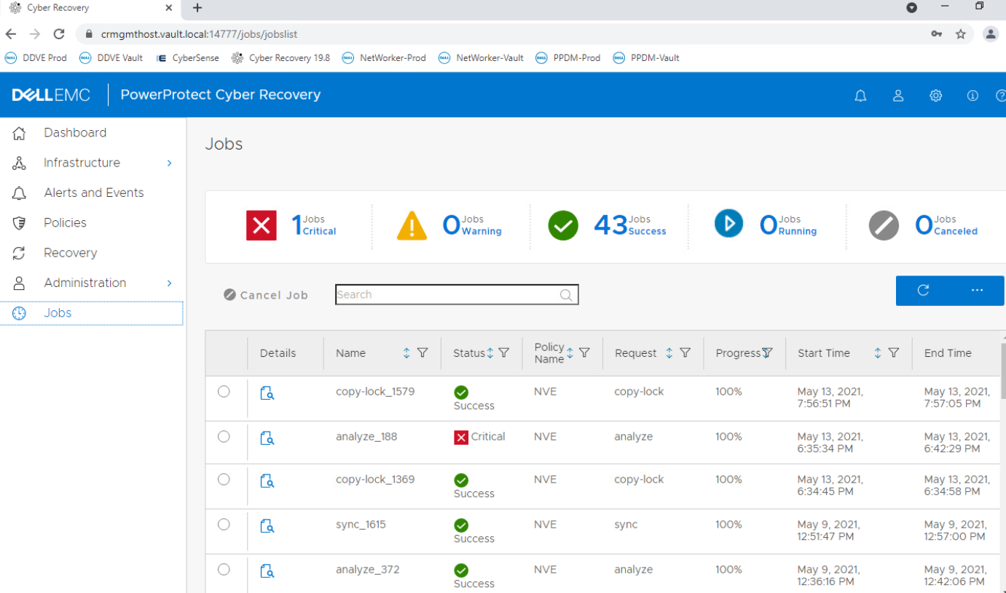
Job status
Last good copy

Slide 60
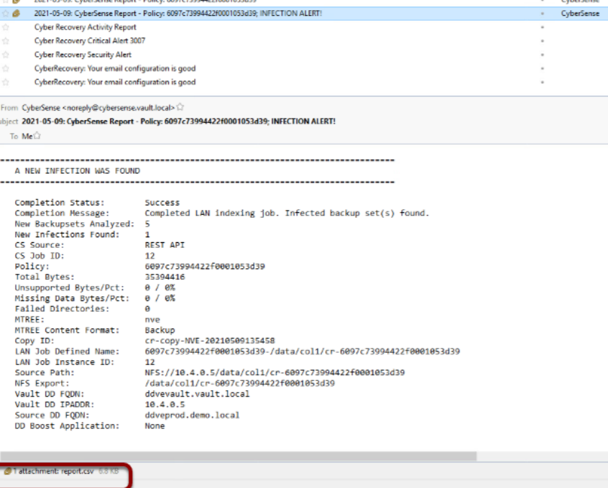
Email notyfication

Slide 61
CyberSense reports

Slide 62
CyberSense detailed reports
Entropy
Similarity
Deletions
Creations
File corruptions
File type mismatch
Ransomware exetensions
…
Statistics
Observations
Machine Learning

Slide 63
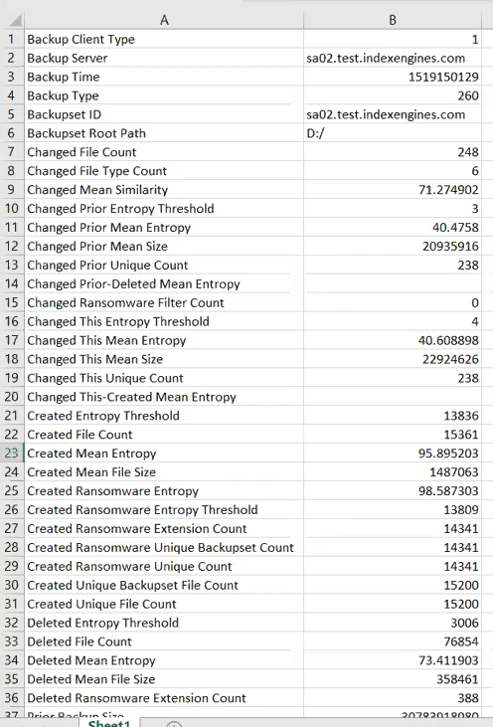
Deleted files entropy count

Slide 64
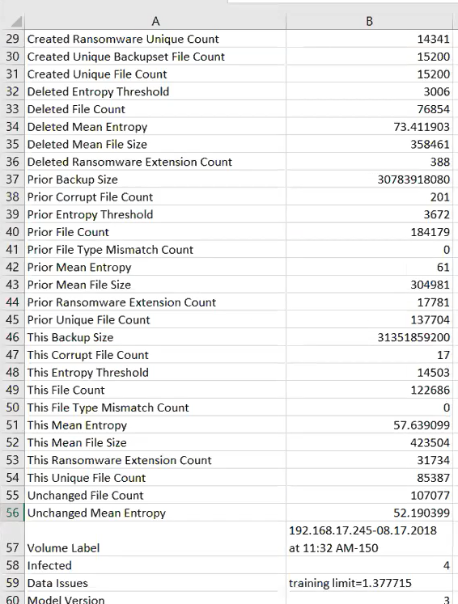
Ransmoware extension count
Backup size comparing to previous backup size (high value means small de-duplication)
File type mismatch count
Enropy scores

Slide 65
We have this report for every observation
Ransmoware extension count
Backup size comparing to previous backup size (high value means small de-duplication)
We do not need to look into that
File type mismatch count
If there is attack, CyberSense analysis all the info and provides deterministic attack vector
Enropy scores

Slide 66
Attack vectors
Strong Encrypt w/ Original Filename
Partial Strong Encrypt w/ Original Filename
RMS/MS_EFS Strong Encrypt
Strong Encrypt w/ New Known Extension
Partial Strong Encrypt w/ New Known Extension
Strong Encrypt w/ Obfuscated Filename
Partial Strong Encrypt w/ Obfuscated Filename,1,"
Individual Archival
Decoy Replacement
Group Archive
Wiper
Attack Raw Disk
Encrypt Database Page
Strong Encrypt w/ Original New File Extension
Obfuscate Filename
Weak Encrypt w/ New File Extension
Weak Encrypt w/ Original Filename
Partial Encrypt w/ Obfuscate Filename
Inside Encrypt w/ Original Filename
Partial Weak Encrypt w/ Original Filename and File Type
Weak Encrypt w/ Obfuscated Filename
Group Archive Maintaining Wiped Original Filename
Strong Encrypt w/ New Known Extension- Wipes Duplicate Files
Zero-fill w/ New Known Extension
Zero-fill w/ Original Filename
Zero-fill w/ Obfuscated Filename
https://indexengines.com/gdpr/8-products#can-cybersense-find-ransomware-executables

Slide 67
Attack vectors
Attack vectors are based on the impact of data:
Encryption
Entropy change
Deletton / creation
File extension change
…
Strong Encrypt w/ Original Filename
Partial Strong Encrypt w/ Original Filename
RMS/MS_EFS Strong Encrypt
Strong Encrypt w/ New Known Extension
Partial Strong Encrypt w/ New Known Extension
Strong Encrypt w/ Obfuscated Filename
Partial Strong Encrypt w/ Obfuscated Filename,1,"
Individual Archival
Decoy Replacement
Group Archive
Wiper
Attack Raw Disk
Encrypt Database Page
Strong Encrypt w/ Original New File Extension
Obfuscate Filename
Weak Encrypt w/ New File Extension
Weak Encrypt w/ Original Filename
Partial Encrypt w/ Obfuscate Filename
Inside Encrypt w/ Original Filename
Partial Weak Encrypt w/ Original Filename and File Type
Weak Encrypt w/ Obfuscated Filename
Group Archive Maintaining Wiped Original Filename
Strong Encrypt w/ New Known Extension- Wipes Duplicate Files
Zero-fill w/ New Known Extension
Zero-fill w/ Original Filename
Zero-fill w/ Obfuscated Filename

Slide 68
The six attack vectors that are the most common
Strong Encrypt w/ Original Filename
Partial Strong Encrypt w/ Original Filename
RMS/MS_EFS Strong Encrypt
Strong Encrypt w/ New Known Extension
Partial Strong Encrypt w/ New Known Extension
Strong Encrypt w/ Obfuscated Filename

Slide 69
The six attack vectors that are the most common
99.5% of the attacks are based on this 6 attack vectors
Strong Encrypt w/ Original Filename
Partial Strong Encrypt w/ Original Filename
RMS/MS_EFS Strong Encrypt
Strong Encrypt w/ New Known Extension
Partial Strong Encrypt w/ New Known Extension
Strong Encrypt w/ Obfuscated Filename
Attack vector 4 numer is the most common
Encryption of file with new file extension

Slide 70
Attack vectors
We have detailed info about the source o the attack
Strong Encrypt w/ Original Filename
Partial Strong Encrypt w/ Original Filename
RMS/MS_EFS Strong Encrypt
Strong Encrypt w/ New Known Extension
Partial Strong Encrypt w/ New Known Extension
Strong Encrypt w/ Obfuscated Filename
Partial Strong Encrypt w/ Obfuscated Filename,1,"
Individual Archival
Decoy Replacement
Group Archive
Wiper
Attack Raw Disk
Encrypt Database Page
Strong Encrypt w/ Original New File Extension
Obfuscate Filename
Weak Encrypt w/ New File Extension
Weak Encrypt w/ Original Filename
Partial Encrypt w/ Obfuscate Filename
Inside Encrypt w/ Original Filename
Partial Weak Encrypt w/ Original Filename and File Type
Weak Encrypt w/ Obfuscated Filename
Group Archive Maintaining Wiped Original Filename
Strong Encrypt w/ New Known Extension- Wipes Duplicate Files
Zero-fill w/ New Known Extension
Zero-fill w/ Original Filename
Zero-fill w/ Obfuscated Filename

Slide 71
Corrupt data report
Corrupted file
vs
Last good copy

Slide 72
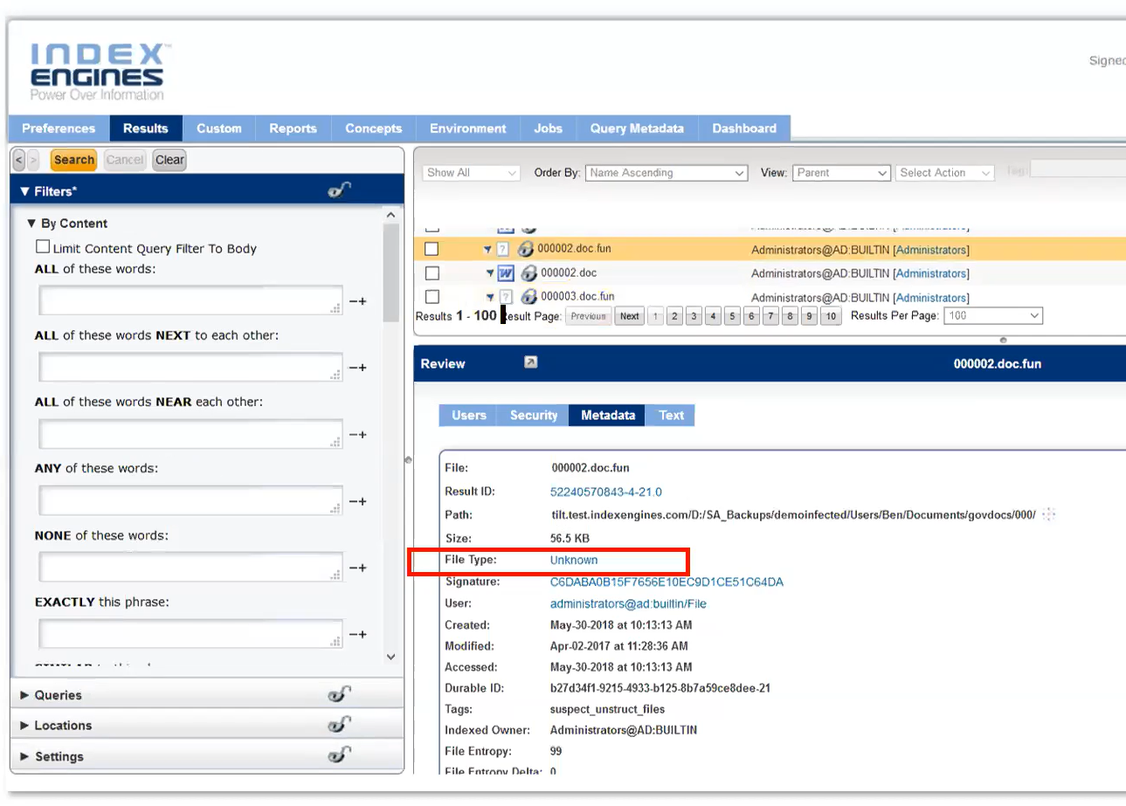
We can dig deeper

Slide 73
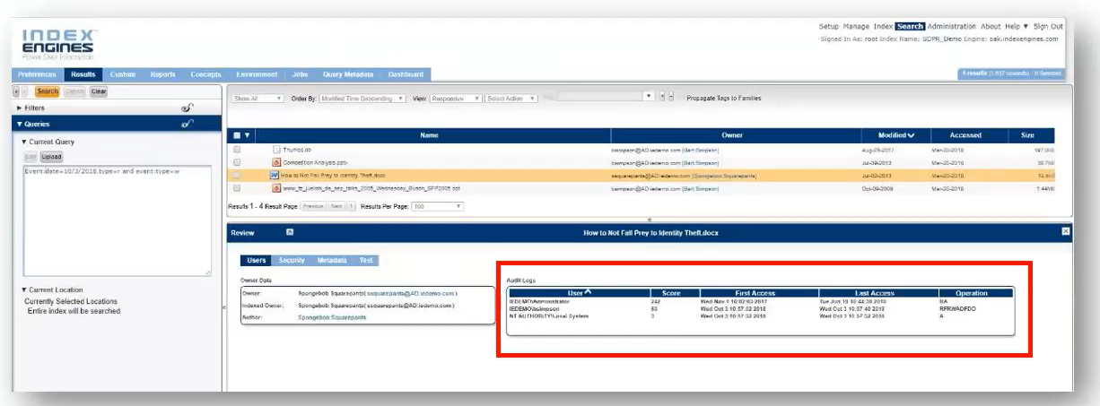
Index Engines report on corrupt data using info from Event Logs

Slide 74
Index Engines report on corrupt data using info from Event Logs
Finds last user to modify corrupted files
Looks for patterns
(f.e. Same user to delete all files)
Identify application that modified the file
Potentially detect and find malware

Slide 75
Licensing

Slide 76
Questions
Daniel.Olkowski@dell.com

