Slide 1
Compliance
Data Domain
Daniel.Olkowski@dell.com

Slide 2
Agenda
Backup trends
Together

Slide 3
How to setup Compliance?
Cyber Protection

Slide 4
https://www.dell.com/support/kbdoc/en-us/000079803/data-domain-retention-lock-frequently-asked-questions-faq

Slide 5
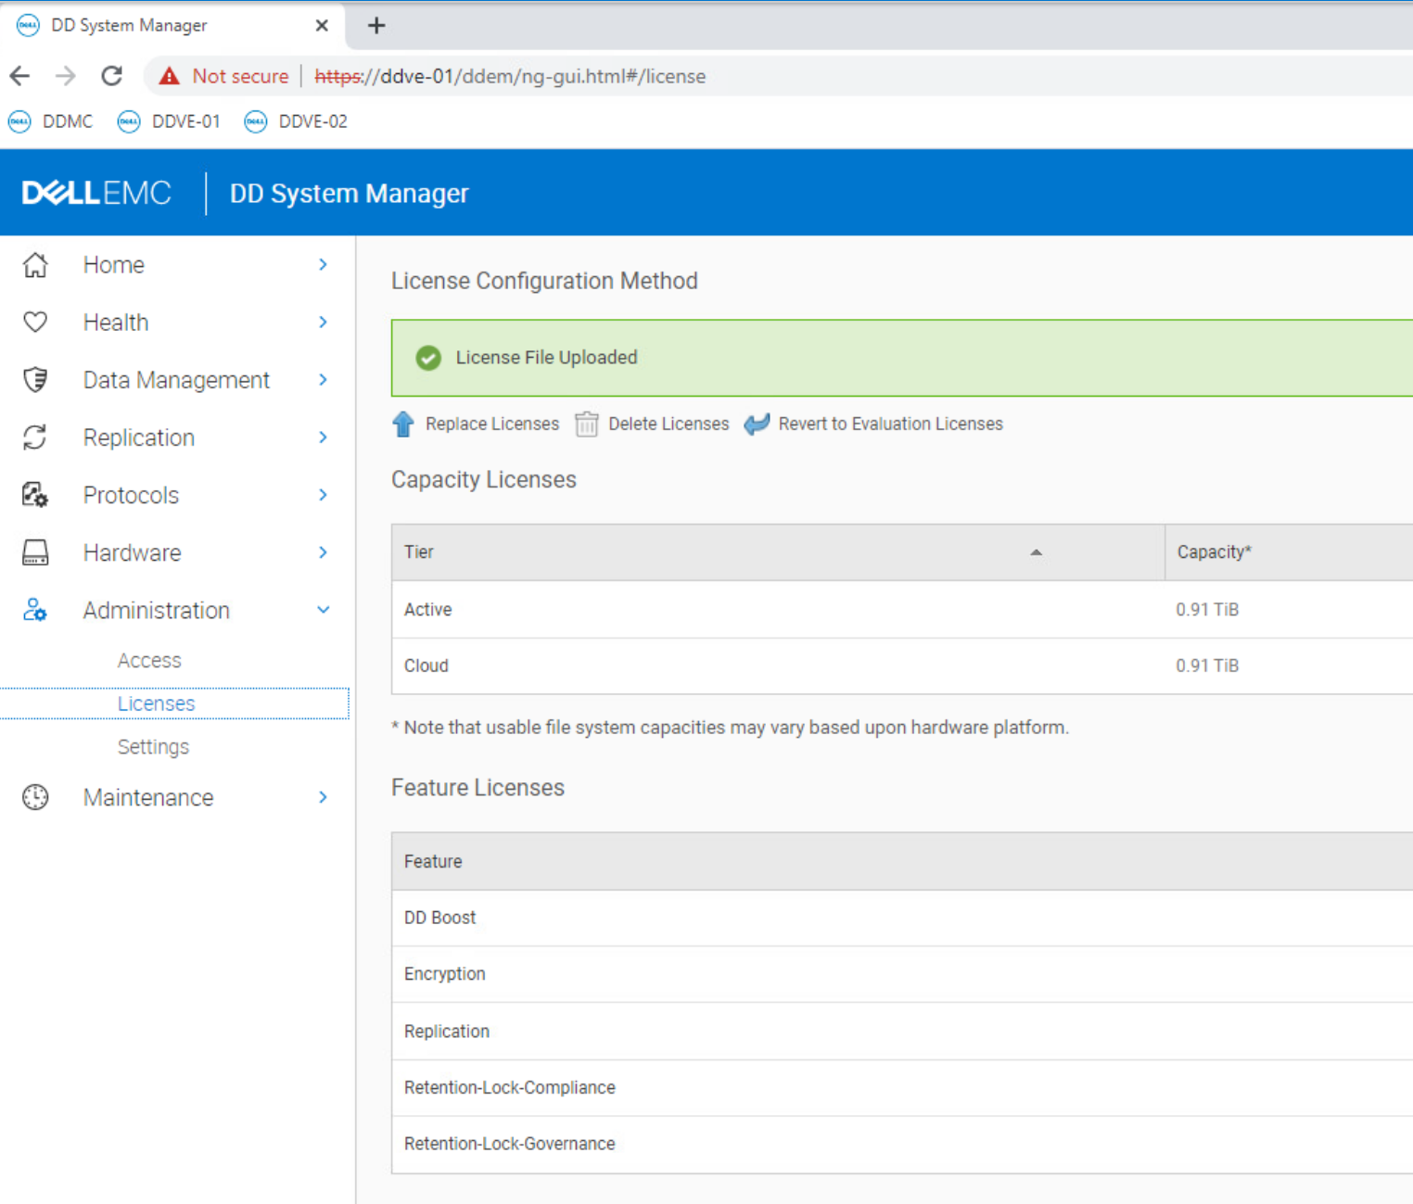

Slide 6
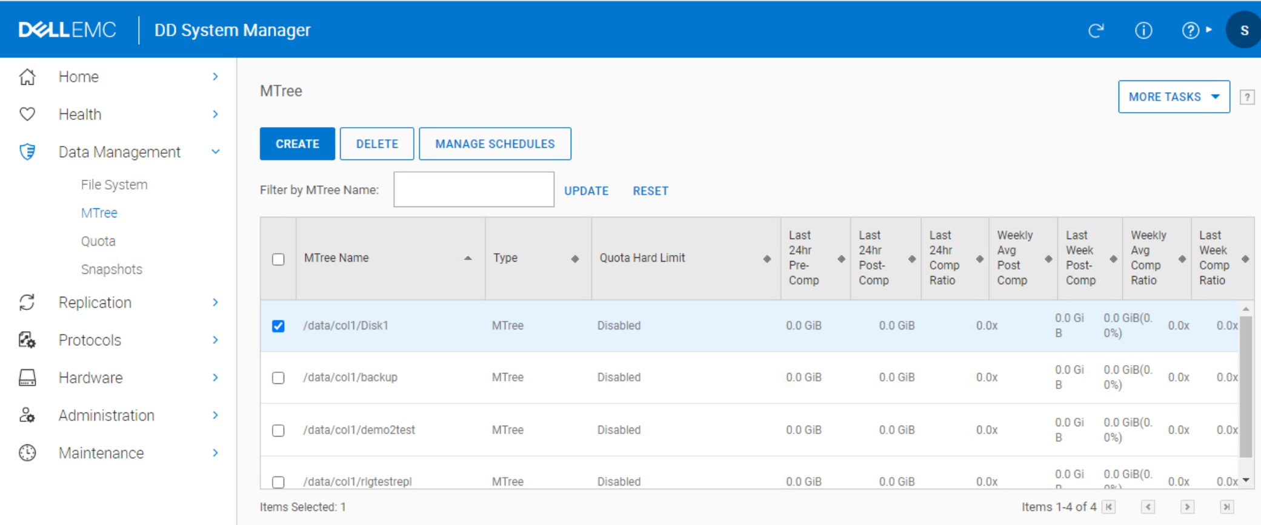

Slide 7
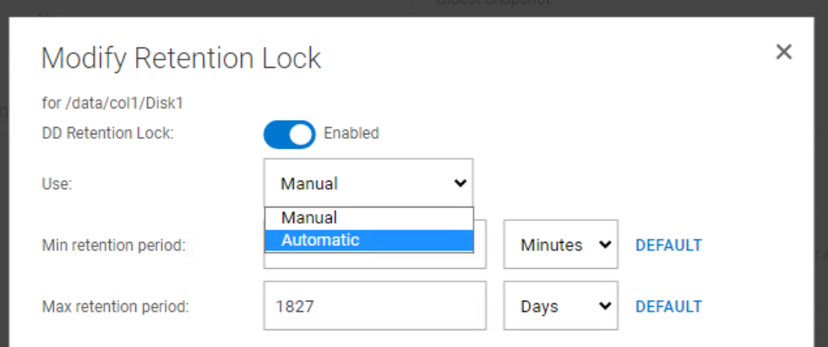
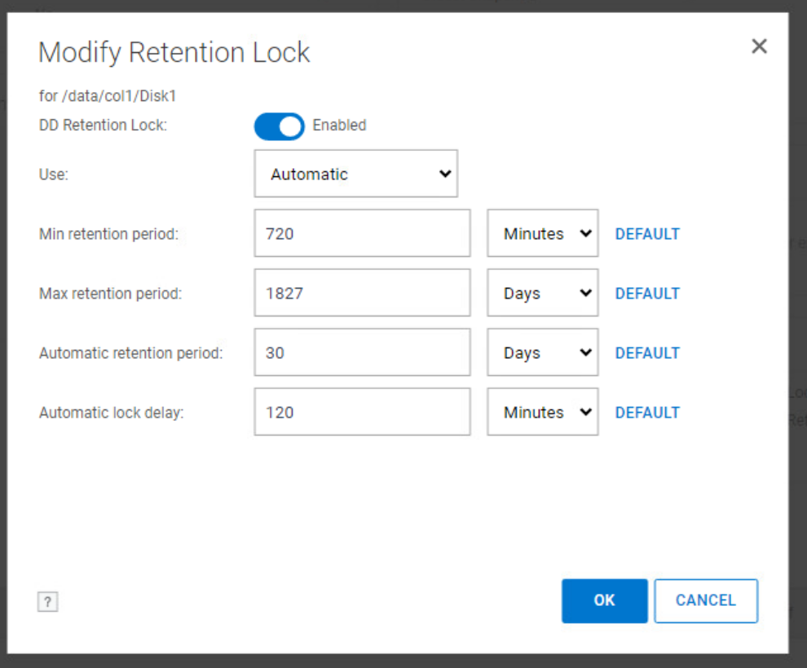

Slide 8
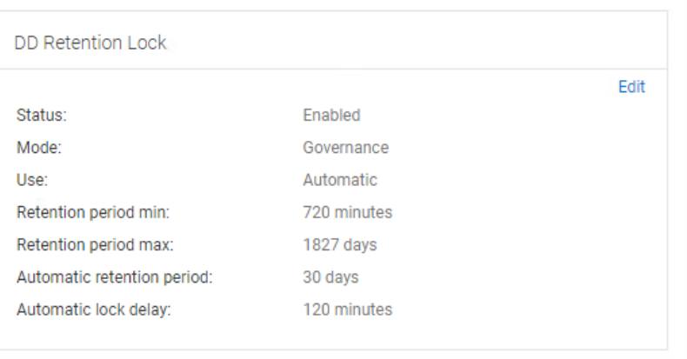

Slide 9
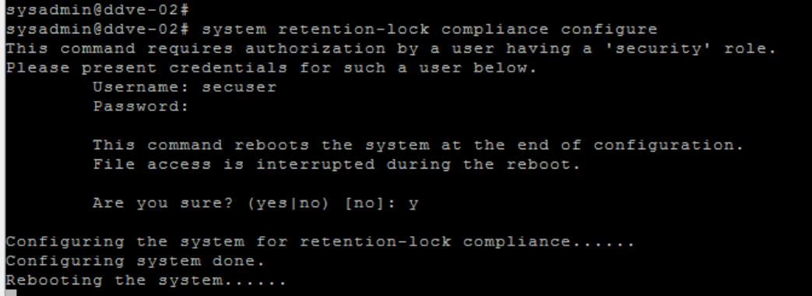
system retention-lock compliance configure
The system should be configured for retention lock compliance mode. Once the following command runs to completion, the system reboots automatically

Slide 10
As we see
Data Domain Compliance
is special mode different to regular Data Domain mode

Slide 11
After reboot

Slide 12
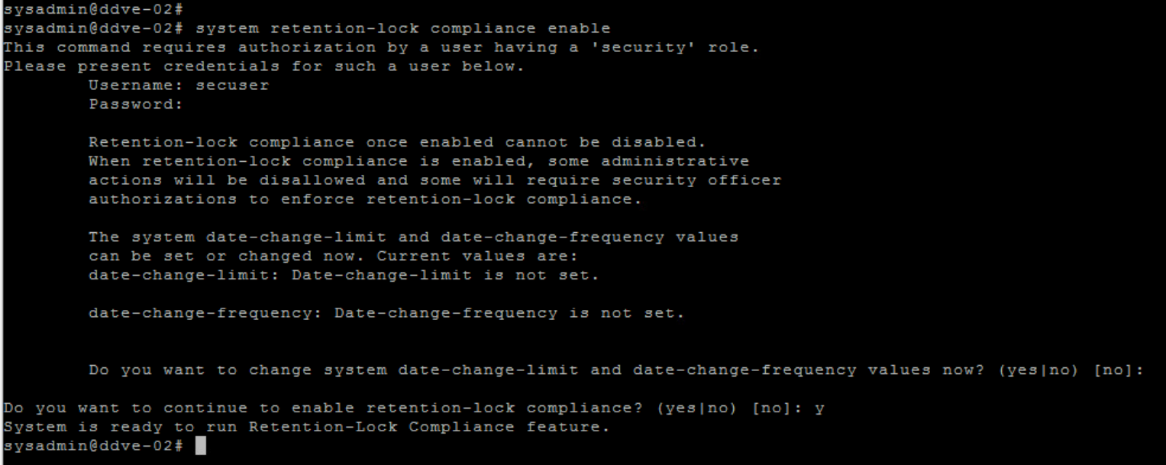
system retention-lock compliance enable
Once the system has rebooted, retention lock compliance mode should be enabled on the system:

Slide 17
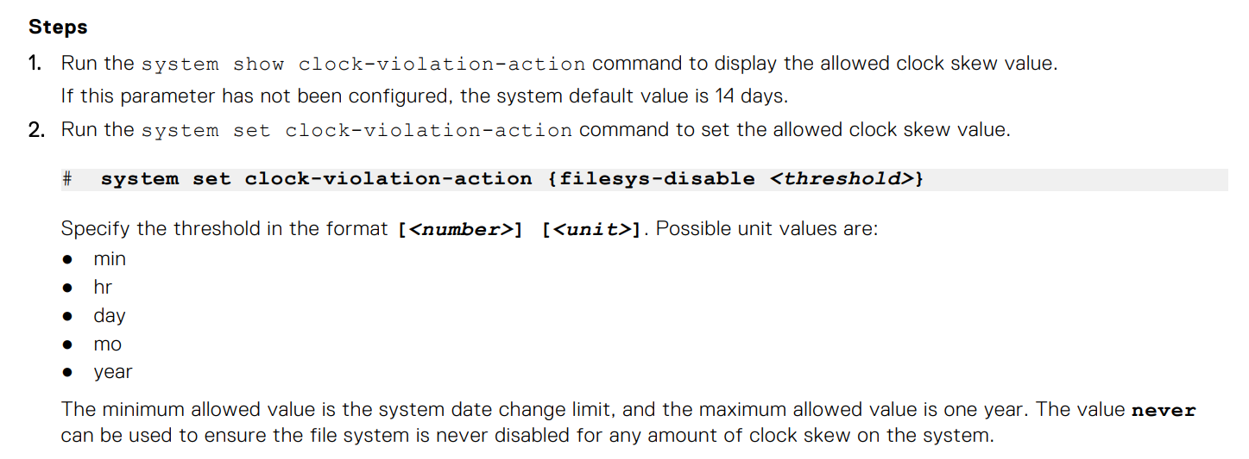

Slide 18
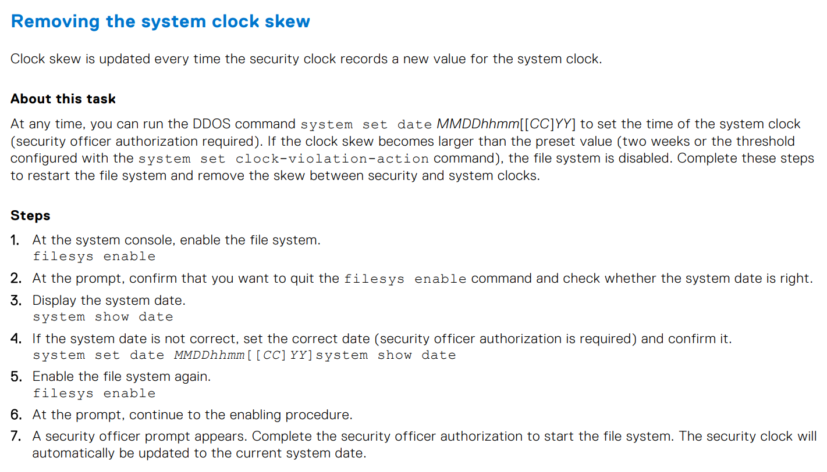

Slide 19
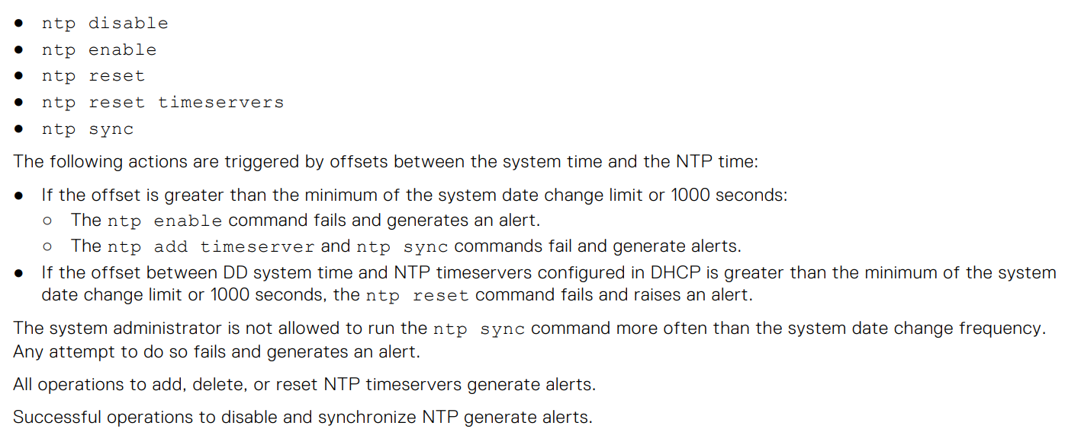

Slide 21
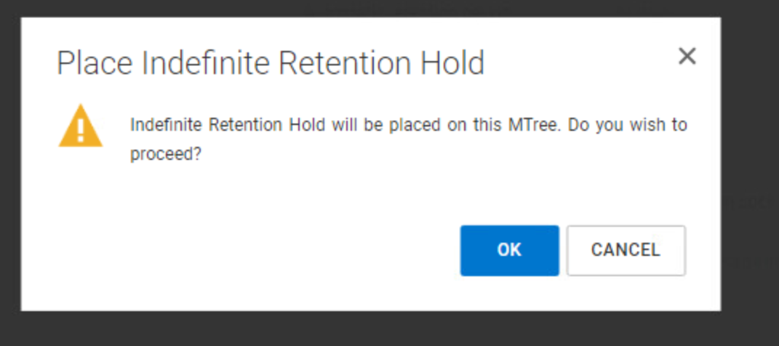

Slide 22
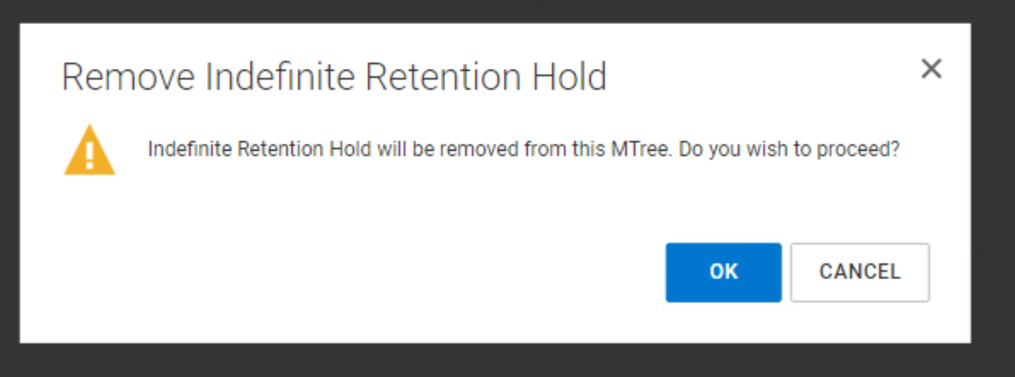

Slide 24
Setup Compliance on mtree

Slide 25
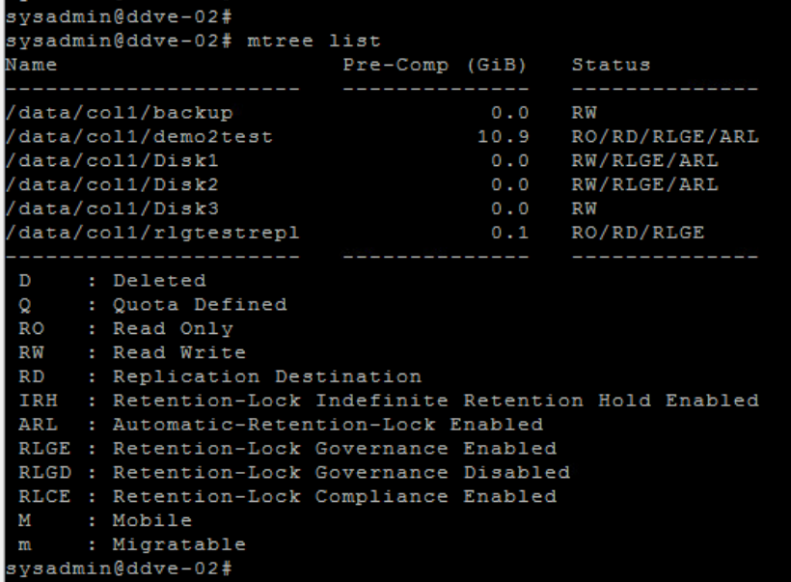
mtree list

Slide 26
mtree retention-lock enable mode compliance mtree /data/col1/Disk3

Slide 27
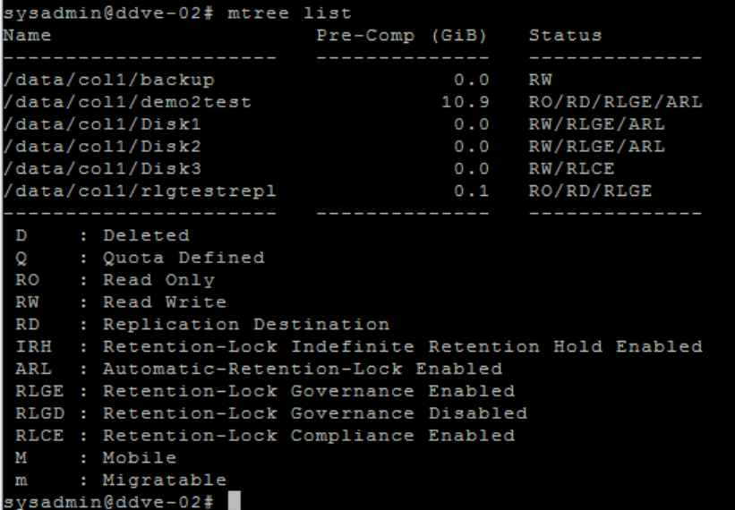
mtree list

Slide 28
mtree retention-lock set automatic-retention-period value mtree /data/col/Disk3

Slide 29
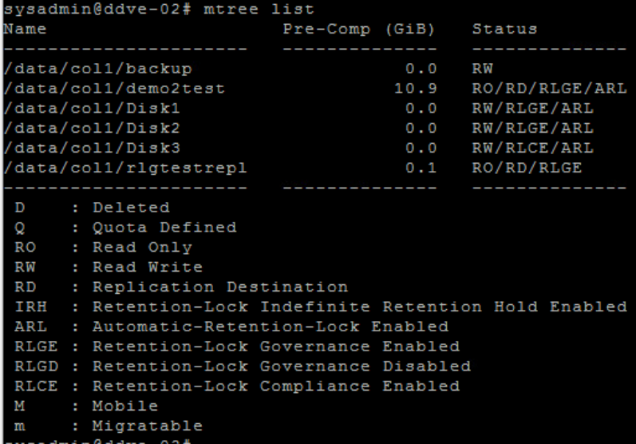
mtree list

Slide 30
Compliance
You CANNOT do in case of Compliance
Remove Compliance
Use iDRAC to manage
Just watch
Change Date/Time
Setup time correctly before enabling Compliance mode
Delete File System
Delete mtree
Booting to single user mode for recovery by technical support without use of a USB drive and physical access to the system.
What you cannot do in case of Compliance turned on

Slide 31
Compliance
You CANNOT do in case of Compliance
Some commands – f.e.
# user reset
# filesys destroy
# mtree delete
# mtree retention-lock reset
# mtree retention-lock disable
# mtree retention-lock revert
What you cannot do in case of Compliance turned on

Slide 32
Compliance
Best practice – MAX retention
Make sure that any Mtree in compliance mode has a MAXIMUM retention period that you could live with in the worst case scenario.
The maximum retention period is a guardrail. It doesn’t lock any files itself.
It’s there to prevent locking files longer than what would be acceptable.
If the data writer is not centrally controlled, then this is especially important.
What you cannot do in case of Compliance turned on

Slide 33
Compliance
Best practice – MAX retention
For example, if you have DBAs writing Oracle backups natively without any constraints, then a shorter maximum would help avoid a situation where the DBAs overrun all the capacity and you now have to wait 7 years for it to expire.
A full DD system with everything locked for 7 years doesn’t serve our needs very well.
What you cannot do in case of Compliance turned on

Slide 34
Compliance vs Governance
Regular vs Compliance vs Governance
General
Time changes requires Security Office confirmation
Cleaning requires Security Office confirmation
Data Deletion Security Office confirmation
Governance:
Deletion / changes of Governance requires Security Office confirmation
Compliance:
Deletion / changes not possible
What you cannot do in case of Compliance turned on

Slide 35
Compliance
Consider Retention Lock Governance on production as minimum
There is nothing to prevent from creating an RLG Mtree on a system that has already been protected using RLC.
What you cannot do in case of Compliance turned on

Slide 36
FAQ
https://www.dell.com/support/kbdoc/en-us/000079803/data-domain-retention-lock-frequently-asked-questions-faq

Slide 37
Compliance
FAQ
Can an MTree with Retention Lock Governance enabled be converted to Retention Lock Compliance?
As stated in the DDOS Administration Guide, this is not possible.
Can an MTree with Retention Lock Compliance enabled be converted to Retention Lock Governance?
As stated in the DDOS Administration Guide, this is not possible.
FAQ

Slide 38
Compliance
FAQ
How are file retention or lock periods set? Once retention lock is enabled against an MTree, a minimum and maximum retention period must be set.
These periods dictate the minimum and maximum time a file within the MTree can be locked for. For example:
mtree retention-lock set min-retention-period [period] mtree [mtree] mtree retention-lock set max-retention-period [period] mtree [mtree]
Periods can be given in various units as follows:
1min / 1hr / 1day / 1mo / 1year
FAQ

Slide 39
Compliance
FAQ
A minimum retention period cannot be less than 12 hours.
A maximum retention period cannot be greater than 70 years.
The minimum retention period must be less than the maximum retention period.
Retention periods for each MTree are set in the same way regardless of the flavor of retention lock being used.
FAQ

Slide 40
Compliance
What can or cannot be done against a locked file?
Retention locked files are read-only and cannot be modified or deleted.
Once a file's retention period expires, it is 'unlocked' - when in an unlocked state the file still cannot be modified however it can be deleted. The DDR does not automatically delete a file when its retention period expires (subsequent deletion has to be performed from a client system or backup application).
Once set the retention period for a specific file cannot be reduced (that is the files atime cannot be brought forwards).
Retention periods can, however, be increased (atime can be increased up to the maximum retention period for the MTree).
FAQ

Slide 41
Compliance
What can or cannot be done against a locked file?
Ownership and permission settings for a file can continue to be modified while the file is locked
It is only possible to rename or delete a directory in a retention lock enabled MTree if that directory contains no files. If the directory contains files (even if these files are not retention locked) the rename, or delete of the directory fails
FAQ

Slide 42
Backup software that can manage Retention Lock
NetWorker
PowerProtect Data Manager
Demo
NetBackup
DataProtector
Avamar (Compliance only)
https://www.dell.com/support/kbdoc/en-us/000214745
Commvault
Veeam
Compliance

Slide 43
Automated Retention Lock
Backup software that does not accept AUTOMATED Retention Lock
ArcServe
…
What is the option?
Snapshot and Lock
IMMUTABLE DATA PROTECTION FOR ANY APPLICATION
https://education.dell.com/content/dam/dell-emc/documents/en-us/2020KS_Steen_Immutable_Data_Protection_for_Any_Application.pdf
Offline Data Domain
Cyber Vault / Cyber Bunker
Compliance

Slide 44
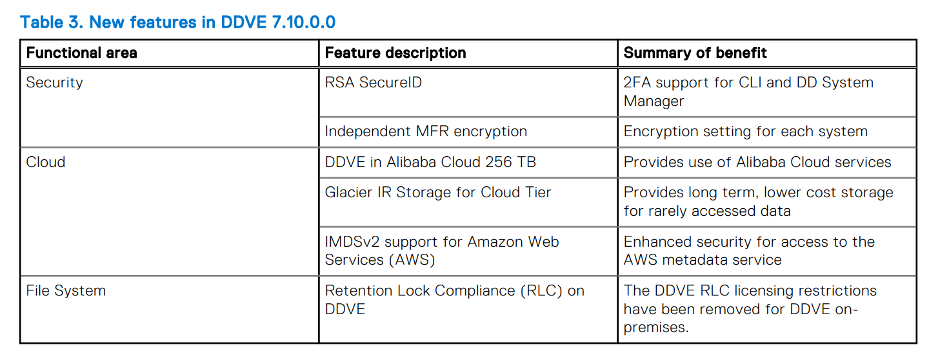
DD models and Compliance
Which Data Domain models have Compliance
All hardware models
DDVE on premise
DDVE/DD3300 does not have certification
Retention Lock

Slide 45
DD models and Compliance
Which Data Domain models have recovery guarantee?
DD6400
DD6900
DD9400
DD9900
Retention Lock

Slide 46
How to provide security for backups on DD?
Cyber Vault
Automatic Restores
Checking if backups are encrypted?
Retention Lock
Compliance
Governance
Security Officer
Boost
Snapshots
Hardening
General discussion

Slide 47
Recomendations
General
In case of Data Domain security does not have to be time consuming
Just set up the below and no additional time effort would be required
Security discussion

Slide 48
Recomendations
Use Compliance always
The constrains that can stop us against using Compliance
Clock changes
Backup software
Security discussion

Slide 49
Recomendations
Why to always use Compliance?
We have great Security
Most restrictions (Security User confirmation) are anyhow in regular mode / Governance lock
The below commands you do not want to use anyhow (Security)
user reset
# filesys destroy
# mtree delete
# mtree retention-lock reset
# mtree retention-lock disable
# mtree retention-lock revert
Security discussion

Slide 50
Recomendations
If not Compliance always use
Governance as minimum
Can be removed by admin but complicated
Setup Security Officer
Security discussion

Slide 51
Recomendations
Perform Boost backups
From Backup application
From SQL/Oracle/…
For ransomware attack this provides security
Our backups are not accessible – user / password is Required to access backup
BoostFS does not provide this security
Security discussion

Slide 52
Recomendations
Perform Snapshots on mtree
Read-only copy
Short retention
7 days
Reasonable frequency
Every hour
Shorted than policy in backup software
No capacity cost
No performance cost
Data Domain support 500 to 750 snapshots per mtree
Be sure that
There is all info to restore your data
For example, backup software catalog
Security discussion

Slide 53
Recomendations
Perform hardening
Limit IP addresses that can contact Storage Unit (Boost Device)
Limit interfaces which one can connect to Data Domain console
Security discussion

Slide 54
Recomendations
Perform hardening - others
Inactivity Timeout
Deny Consecutive Login Attempts
Password Aging/Rotation
Password Complexity
Disable Default Accounts
Communication Port Disable / Change
Restrict hosts access / IP
Use of SSH and Certificates
Disable HTTP, FTP, Telnet, etc.
Disable unused services
Apply Latest Security Patches
Use SYSLOG Server / Prevent Audit Log Roll Over
Review the latest respective Dell EMC Product Security Guides for Hardening Guidelines
Security discussion

Slide 55
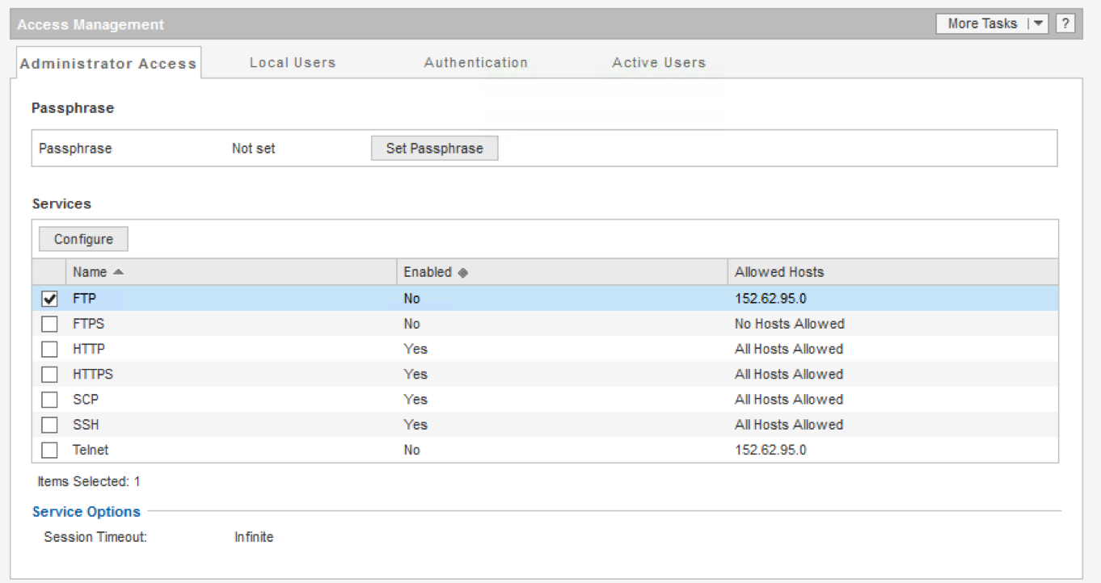
Recomendations
Security discussion

Slide 56
Recomendations
Security discussion
No cost option

Slide 57
Recomendations
Please REMEBER
There must be copy geographically separated
Usually, it means replica of local backups to remote site
At least keeping backups far from production
Possible with Data Domain source de-duplication
Security discussion

Slide 58
End logo slide
Questions
Daniel.Olkowski@dell.com

