Slide 1
Cyber Recovery
Tutorial
Daniel.Olkowski@dell.com

Slide 2
Agenda
Why Vault?
NIS-2
What if everything fails?
Castle vs Ambulance

Slide 3
Agenda
Where the journey starts?
Bunker
Analysis
Test Center

Slide 4
Why Vault?
Detection / CyberSense
What if production is take by court (cour trial) after cyber crime incident?
Hidden
Not connected to the production
Test Center
Flexible production
Any backup software

Slide 5
Why Vault?
Secure Copy
Remote
Change into the stone

Slide 6
To win the cyber war we need
Our production is corrupted?
What do we need?
Data
Information that we are corrupted (CS/DPA)
To STILL have valid copy of good data
Knowing what happened!
Possibility to clean the copy from malware/ransomware

Slide 7
Security journey
Data Domain Compliance
If possible
Vault Base: Data Domain + Golden Copy
Isolated / Far / Change to Stones
Vault Gold
Base + Detection
Recovery Center – extension of Base/Gold

Slide 8
What is Cyber Recovery?
Strategy and technology
Ambulance
Assumpiton:
Production can be destroyed
Production is destroyed
It is different strategy than castle / firewalls
They do not allow to attack / destroy data
But do not provide answer what if attack is successful

Slide 9
Do not allow vs Recover
Both strategies required
They do not compete

Slide 10
Compliance production vs in the bunker Dedicated Data Domain
Production compliance not always possible
Backup software (? / …)
Complicated Not every backup software has built in forcing Compliance (only NetWorker, PPDM, NetBackup). For other required managing mtree retention to be in sync with many backup policies or additional Linux station managing for Snapshot/Compliance forcing
Time – no possibility to change

Slide 11
Compliance production vs in the bunker Dedicated Data Domain
Production compliance not always possible
Security Officer
No remote management
Compliance cannot be switched off
DataDomain filesystem cannot be deleted
Mtree cannot be deleted / remove Compliance if there is any object

Slide 12
Compliance / Immutability
Many cheats on the market
Immutable means no deletion only. Change is possbile
Data Domain offer
No change
No deletion
No any manipulation: time / clock / …

Slide 13
Compliance production vs in the bunker Dedicated Data Domain
We have only site A? Anyhow you need Disaster Recovery – data out of original place for security against war / collapse / flood Why not to have join Cyber and Physical bunker?
We have 2 production sites: A and B?
We can have DR for both of them
If A is DR for B and vice verse – good – fast recovery time Additinal hidden Data Domain is marginal cost

Slide 14
Compliance production vs in the bunker Dedicated Data Domain
Additionally
Bunker is hidden - minimalisation of insider attack Production does not know about the bunker
Possibility to ransomware check – no load of DD in bunker
If bunker is remote, we minimalise also physical attack of insider
Cost is minimal – just simple Data Domain as gold copy
BEST: Compliance on production and in the bunker

Slide 15
Where Cyber Bunker?
Own data center
Mobile container
Service Provider
AWS / Azure / Google

Slide 16
Cyber Bunker – for what?
Function of Cyber Bunker
Gold Copy
Analysis
Recovery center
From very simple and marginal cost and straightforward to advanced

Slide 17
Cyber Bunker – cost
Gold Copy
Data Domain + services
Analysis
Data Domain + CyberSense/server + services
Test Center
Data Domain + opt CyberSense/server + restore environment + services

Slide 18
Recovery
Single item recovery
Within the Cyber Bunker
Whole site recover
Replication back and recovery
Conisder Backup Software
Automation
Licenses
Ease

Slide 19
Retention
CyberSense
Short
Delta analysis
Without CyberSense
3 months+

Slide 20
Cyber Bunker and Cloud?
If all out data in cloud why not have gold copy on premises?
Own
Cheap
Minimal cost
Simple architecture
Easy going of from Cloud -> Test Center
Easy checking the data

Slide 21
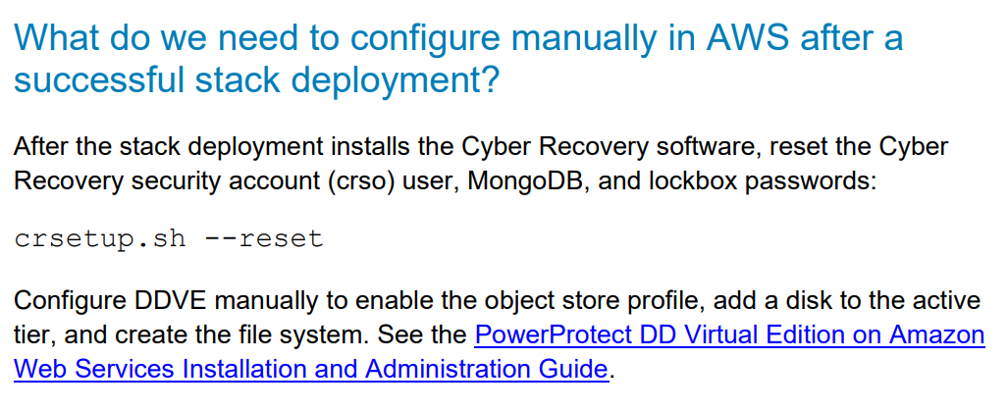
AWS considerations

Slide 22
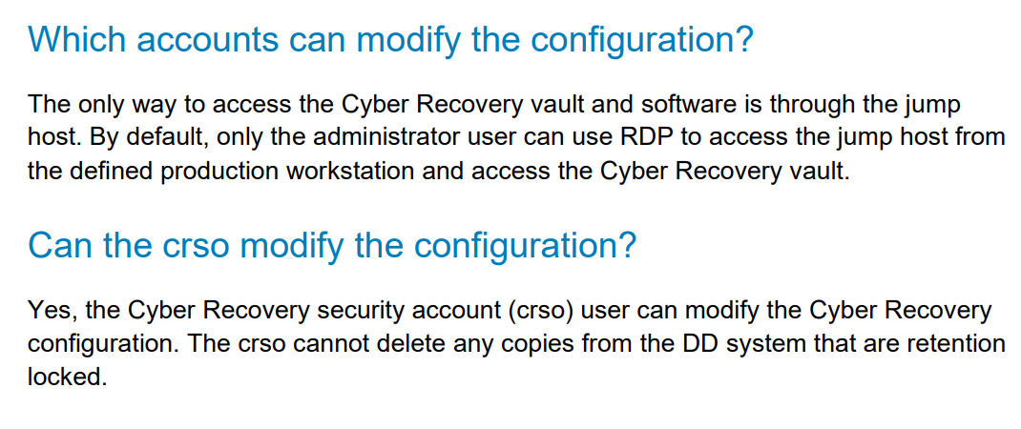
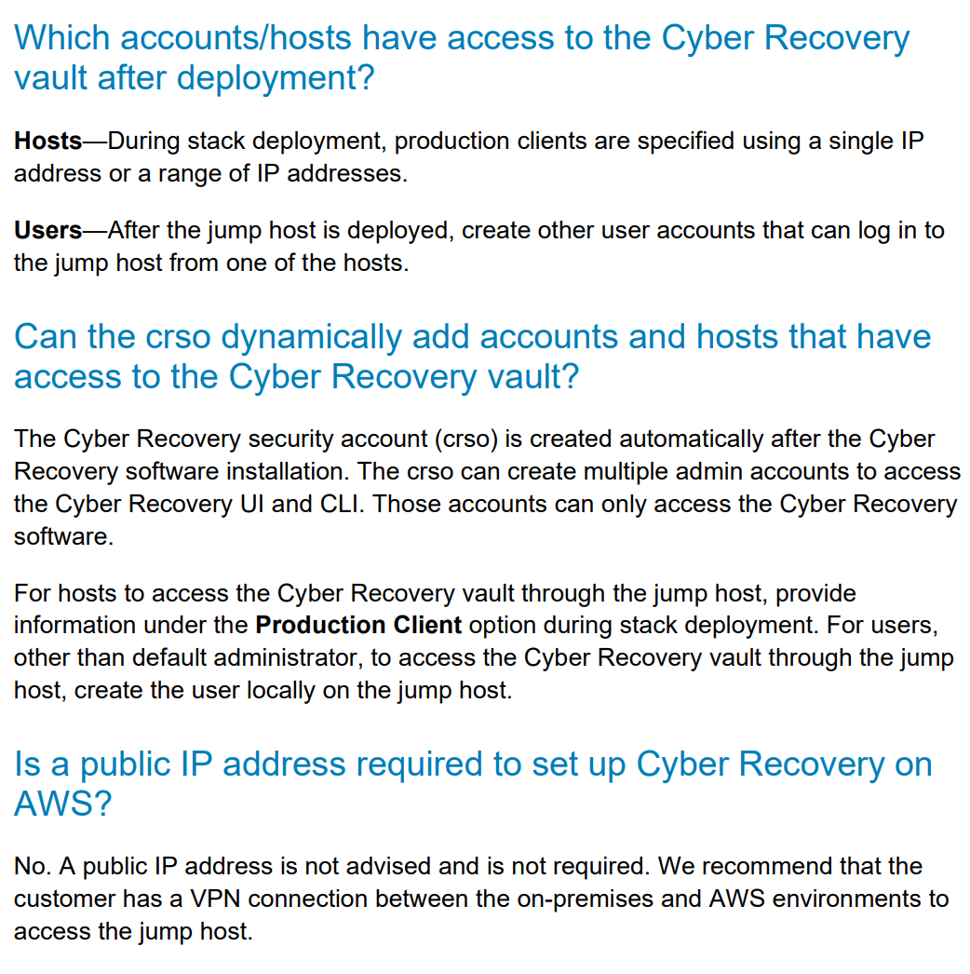
AWS considerations

Slide 23
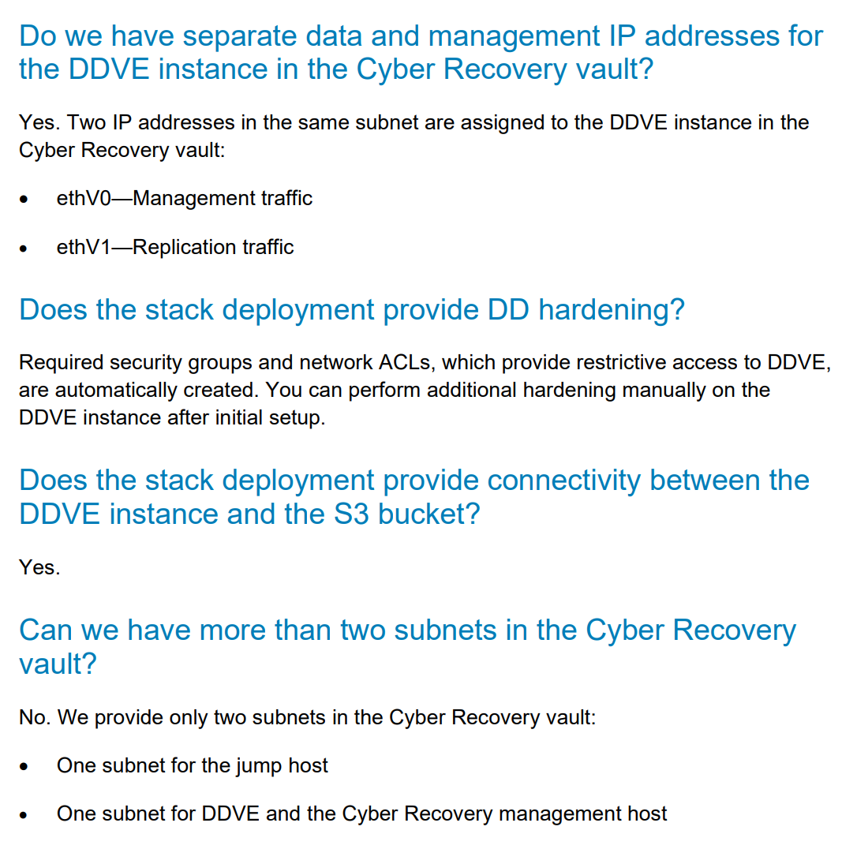
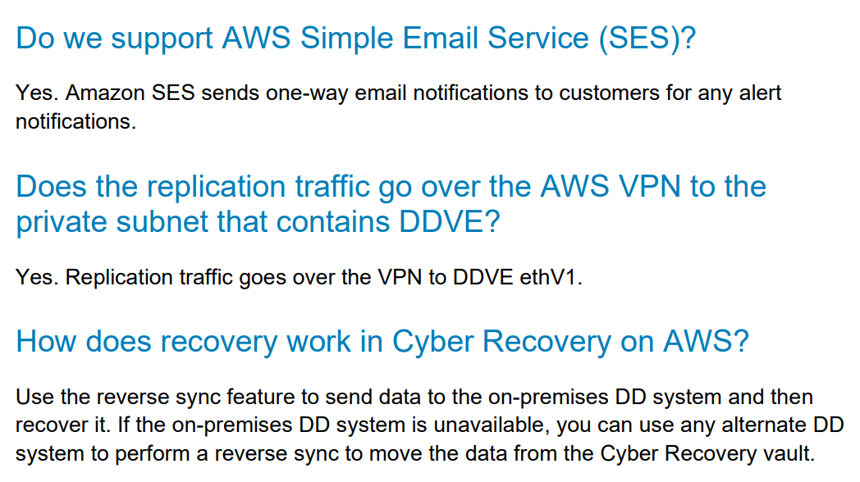
AWS considerations

Slide 25
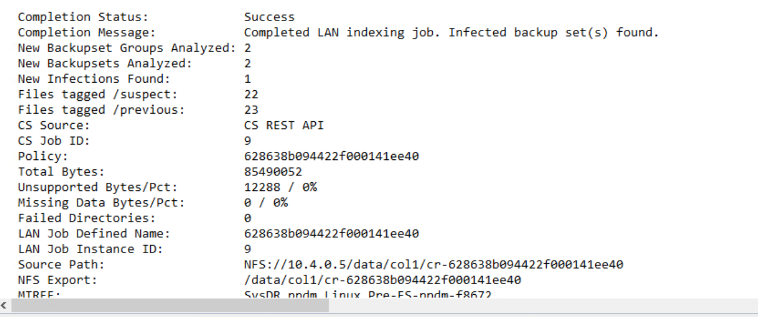
CyberSense
How many backup polices analyzed
How many of them suspicious

Slide 27
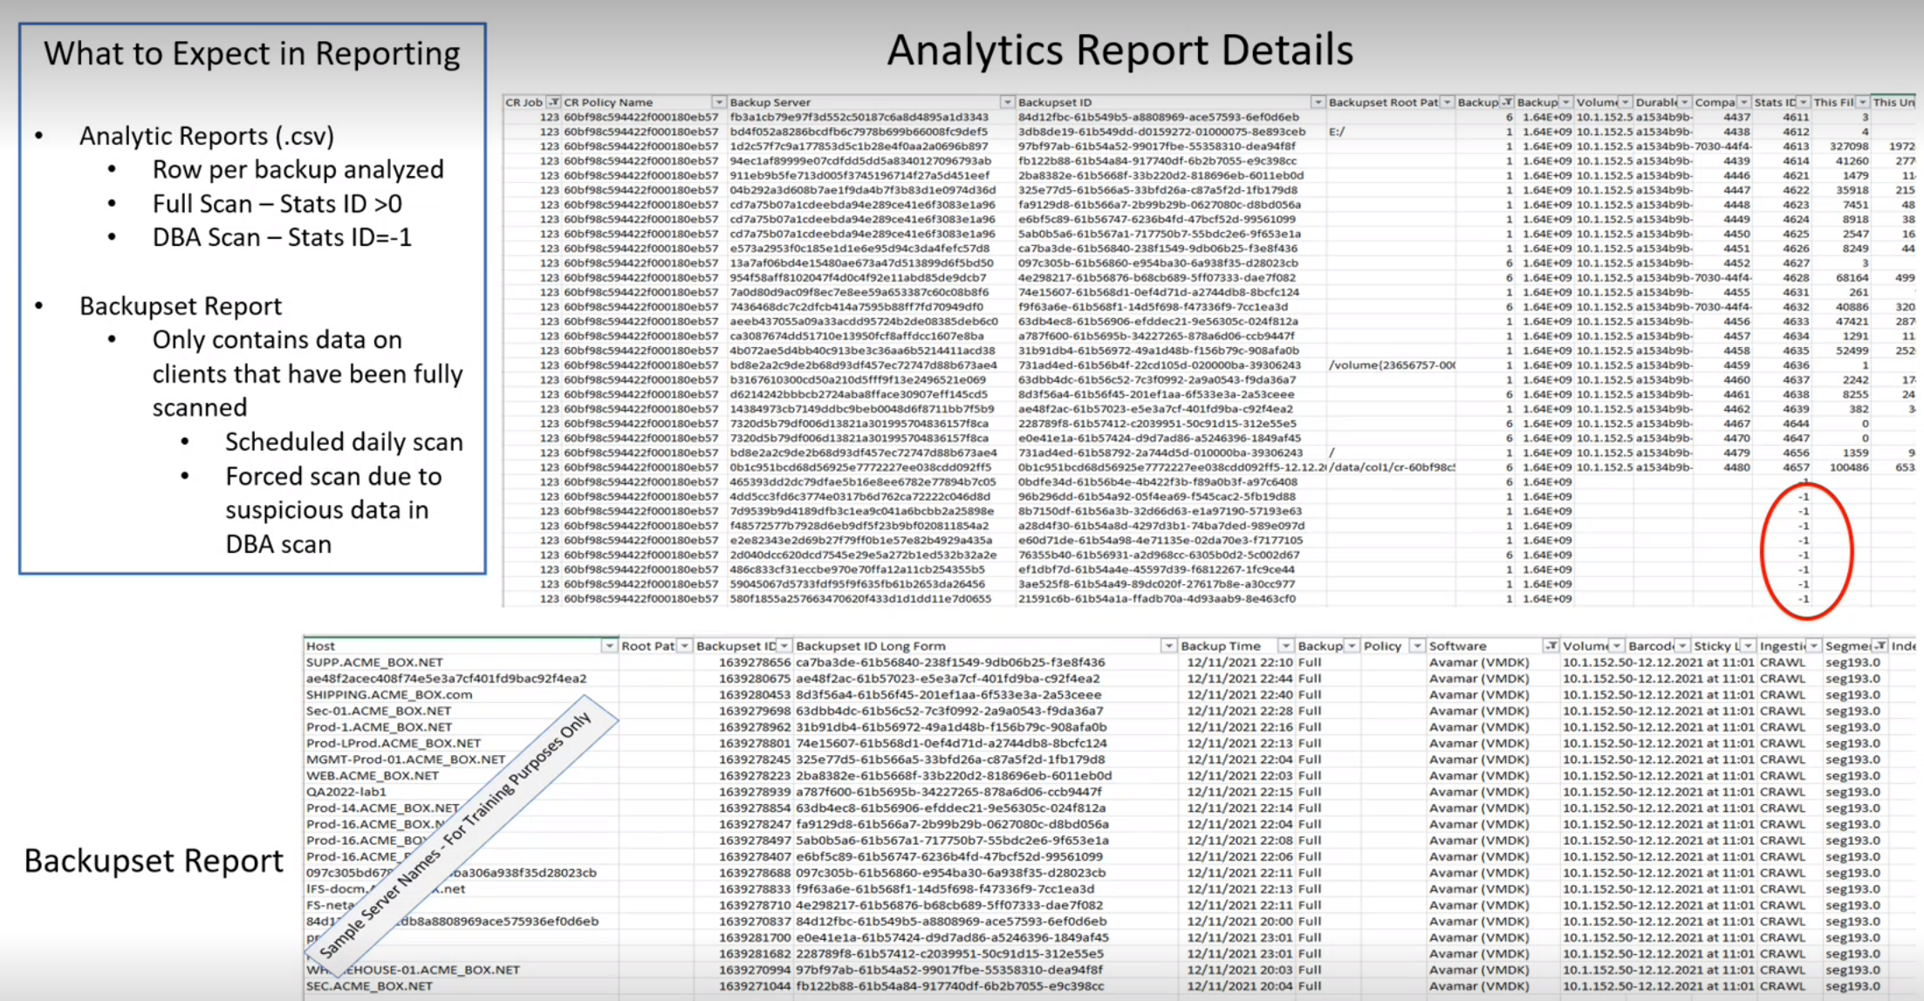
-1 means delta block technology scan

Slide 28
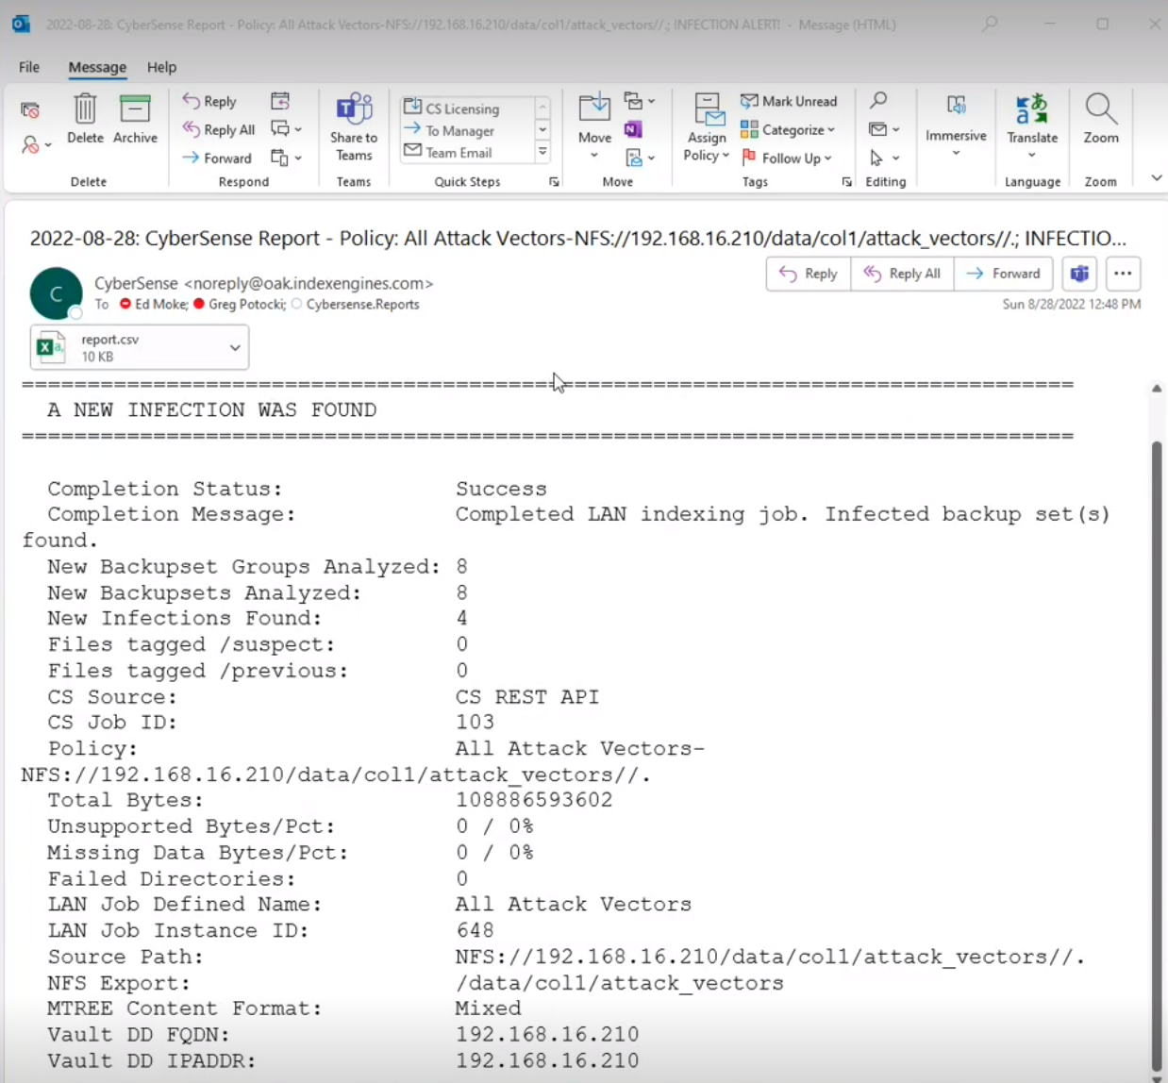
8 backups jobs analyzed
4 backup jobs suspicious

Slide 29
Nothing –ok
Number – vector attack

Slide 30
Anomized data from mail – not useful

Slide 31
Report fromCyberRecovery has all Required data – no anomized
It is powerful info because I can see what is exaclyt infected – which MSSQL server is infected - now who to contact / what to recover.
Very easy!

Slide 33
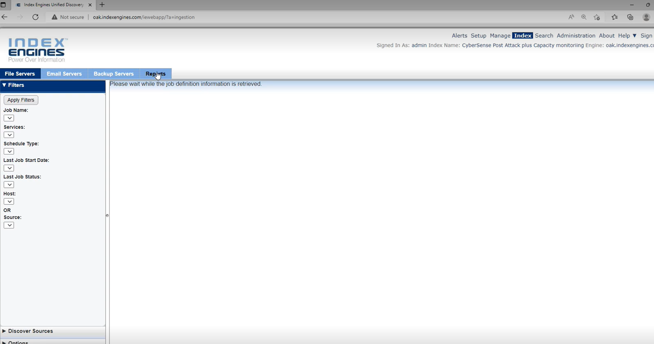

Slide 34
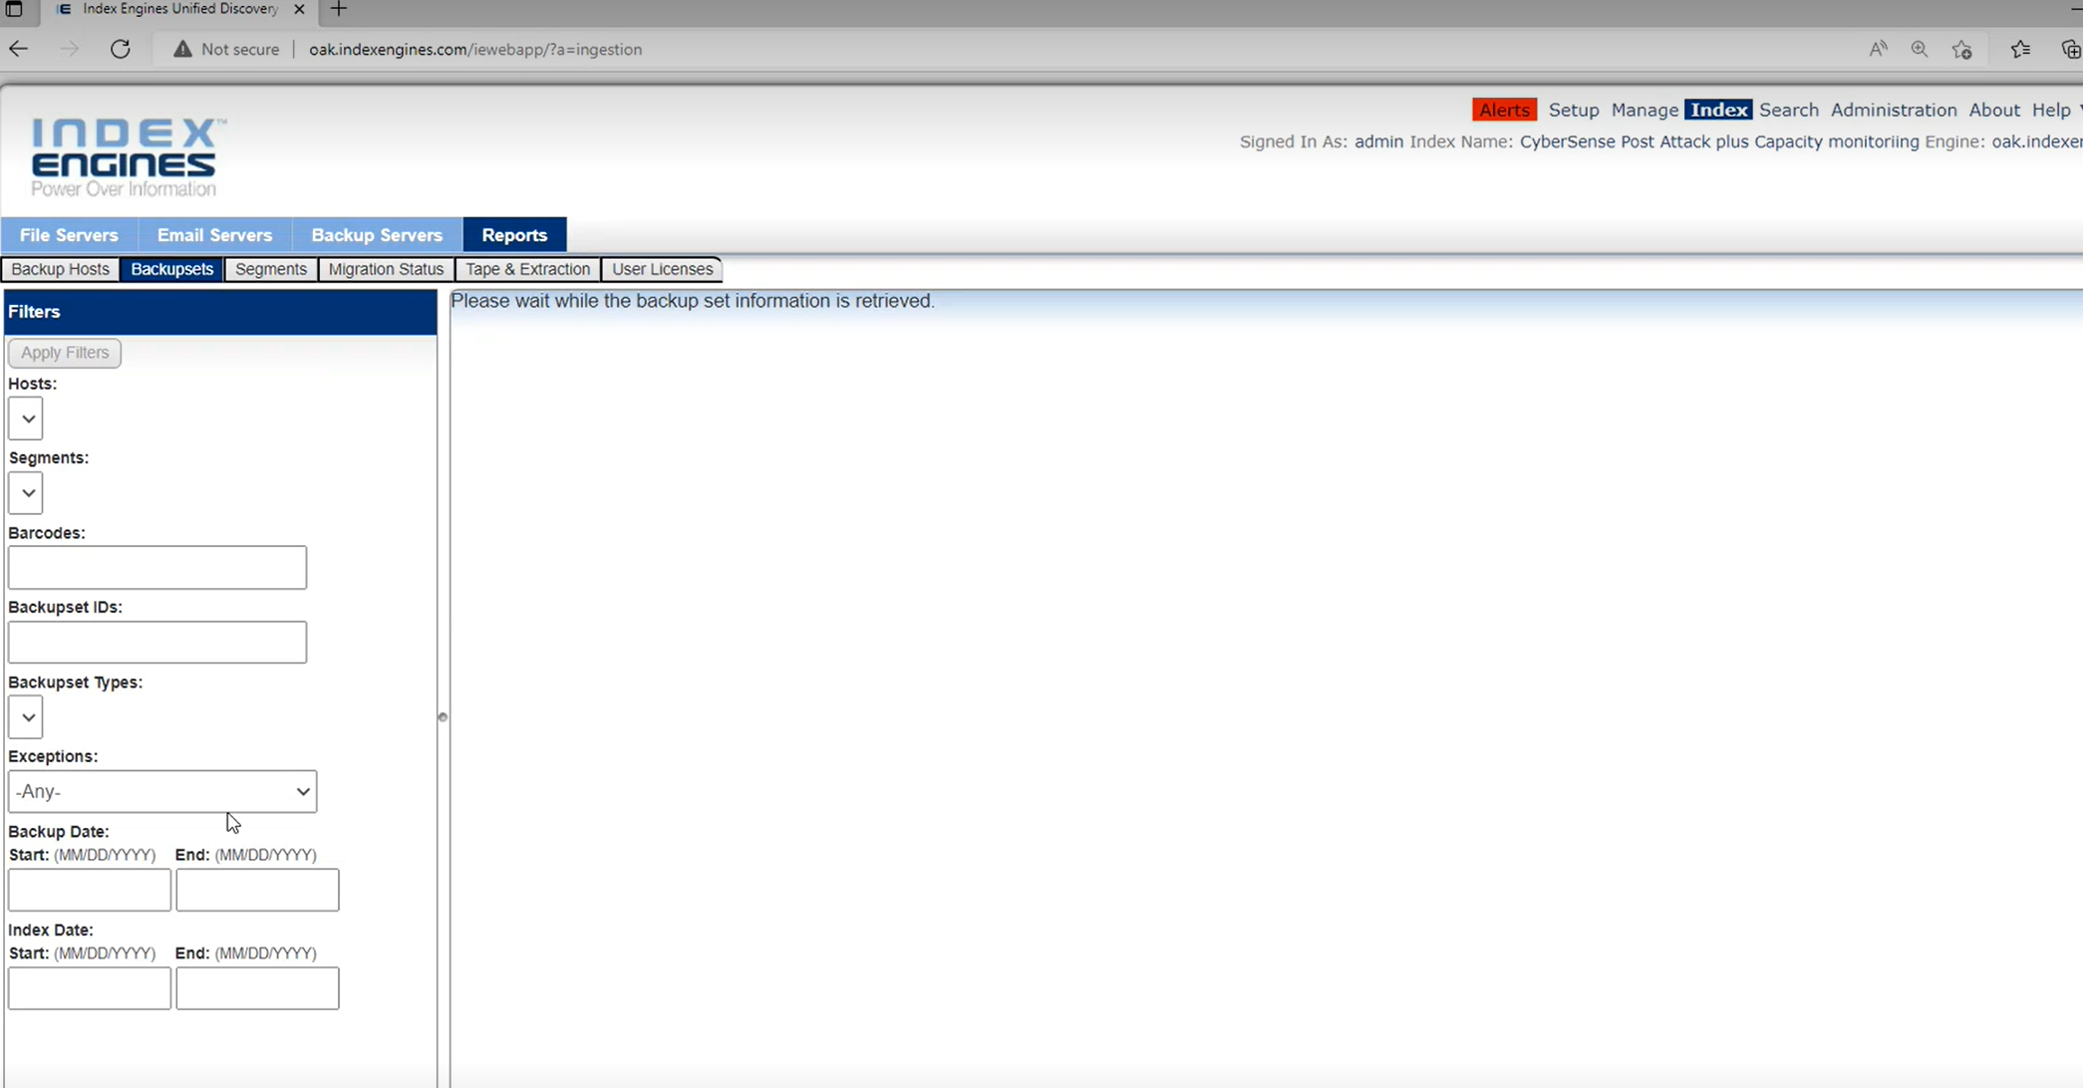

Slide 35
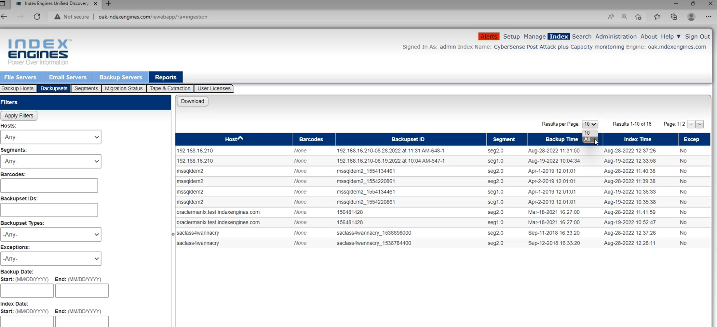
All backups that have been scanned

Slide 36
Decisions to make before Cyber Recovery Design
What Data Domain in Cyber Bunker?
Maybe use existing one, while new one put on the production?
Replication supported between DDOS with no more than 2 version difference
We can deploy DDOS on any supported DD
Anyhow we need supported DD

Slide 37
Decisions to make before Cyber Recovery Design
What bunker Cyber / Physical / Both?
How to check amount of data sent daily? Seprate ppt

Slide 38
Decisions to make before Cyber Recovery Design
Function of the production Data Domain
No lock
Governance
Compliance

Slide 39
Decisions to make before Cyber Recovery Design
Which data do we want to protect?
All
Some
Decision connected with
Cost – less data less Storage / DD required
Risk / Responsibility – what if something is missing

Slide 40
Decisions to make before Cyber Recovery Design
Retention of data
Connecting with potential use of CyberSense We can have shorter retention

Slide 41
Decisions to make before Cyber Recovery Design
How to access / monitor Cyber Bunker?
Physical presence
Diode
Dedicated station in SOC - Security Operations Centre
Camera
Networks / addressing

Slide 42
Decisions to make before Cyber Recovery Design
CyberSense – Do we want to analyze copies?
Vault only
Frequency
Power of computing
Power of restore
We do not send anywhere data (UNIQUE)
Security
Network

Slide 43
Decisions to make before Cyber Recovery Design
CyberSense – Do we want to analyze copies?
Possibility to use new functionalities of CyberSense
Delta analysis
Data
Software

Slide 44
CyberSense – Database analysis
https://www.delltechnologies.com/asset/en-us/products/data-protection/briefs-summaries/cybersense-database-corruption-detection.pdf

Slide 45
CyberSense – Database analysis
Organizations often have a false sense of confidence when it comes to databases and ransomware.
Many believe that when ransomware corrupts a database it will be obvious as the database will cease operations, indicating an attack.
They will then restore the last clean version and resume “normal” operations.

Slide 46
CyberSense – Database analysis
While in the case of full database corruption this may be true, however, bad actors are smarter than that and are deploying more sophisticated attacks that can easily go unnoticed Databses analysis
Databases can continue to run with corrupted pages, so corruption can happen for months without anyone noticing.
Oftentimes, corruption is found only when the database is taken down for routine maintenance, and thousands of records are gone.

Slide 47
CyberSense – Database analysis
Most ransomware can encrypt pages within a database - Mailto, Sodinokibi (REvil), and Ragnar Locker – and destroy the database pages.
This means the slow, unknown encryption of everything from sensitive customer records to critical networks resources including Active Director, DNS and Exchage to life-saving patient health information.

Slide 48
CyberSense – Database analysis
Some vendors claim to validate databases, but only look at the container level - not the individual pages. This puts organizations' valuable data at risk.
Only CyberSense validates if databases are free from signs of ransomware corruption and empowers quick restoration of clean data when an attack is successful.

Slide 49
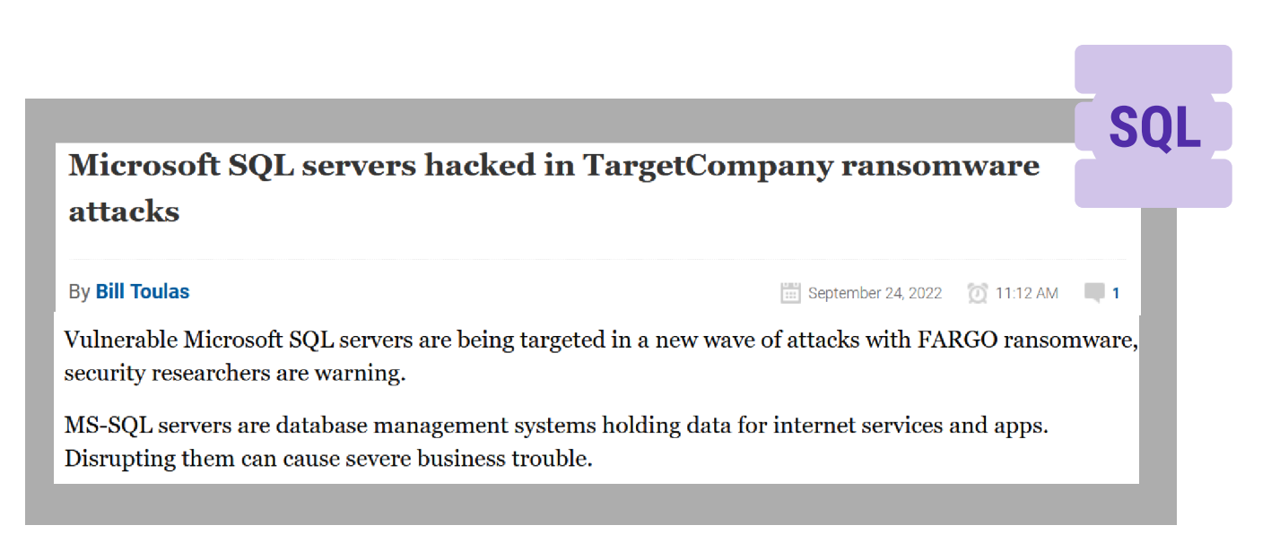

Slide 51
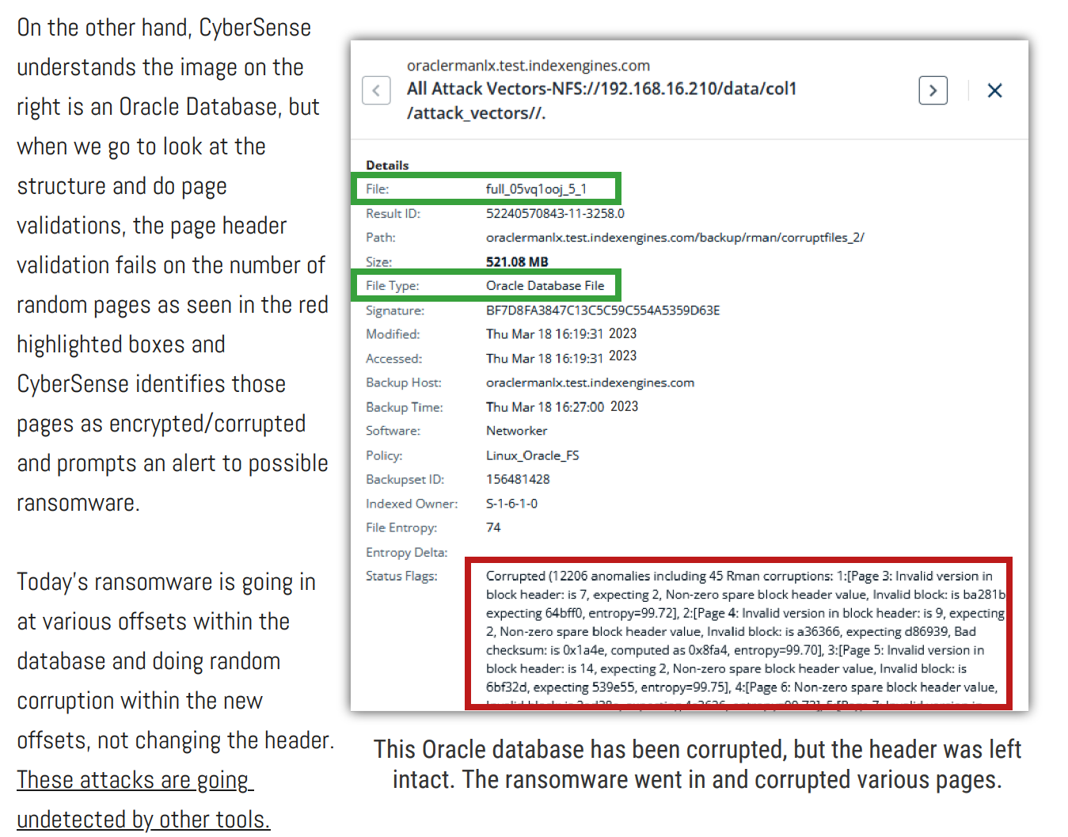

Slide 52
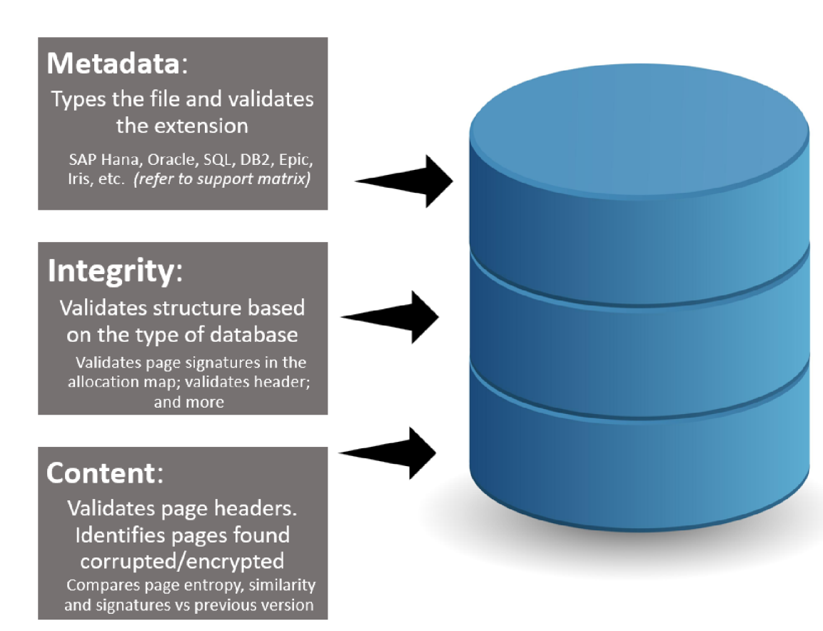

Slide 53
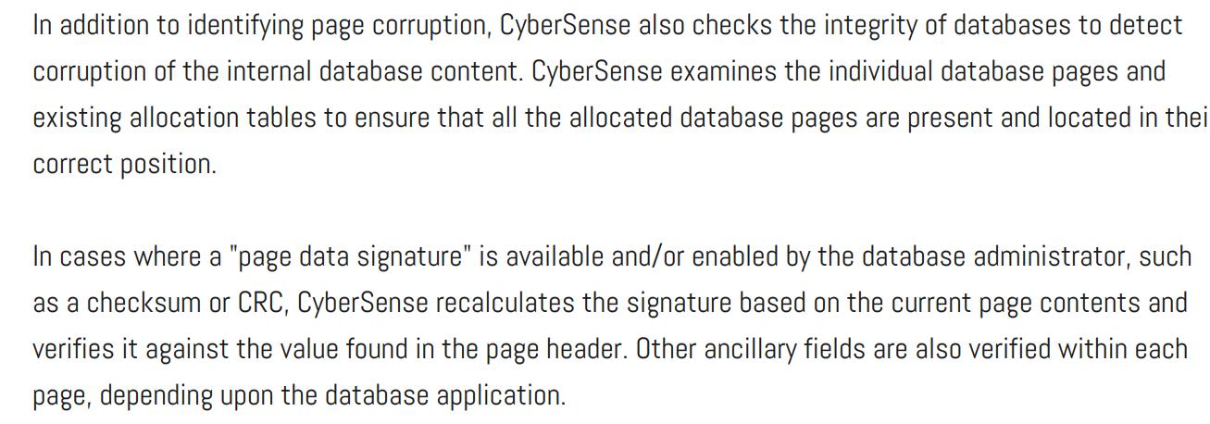

Slide 56
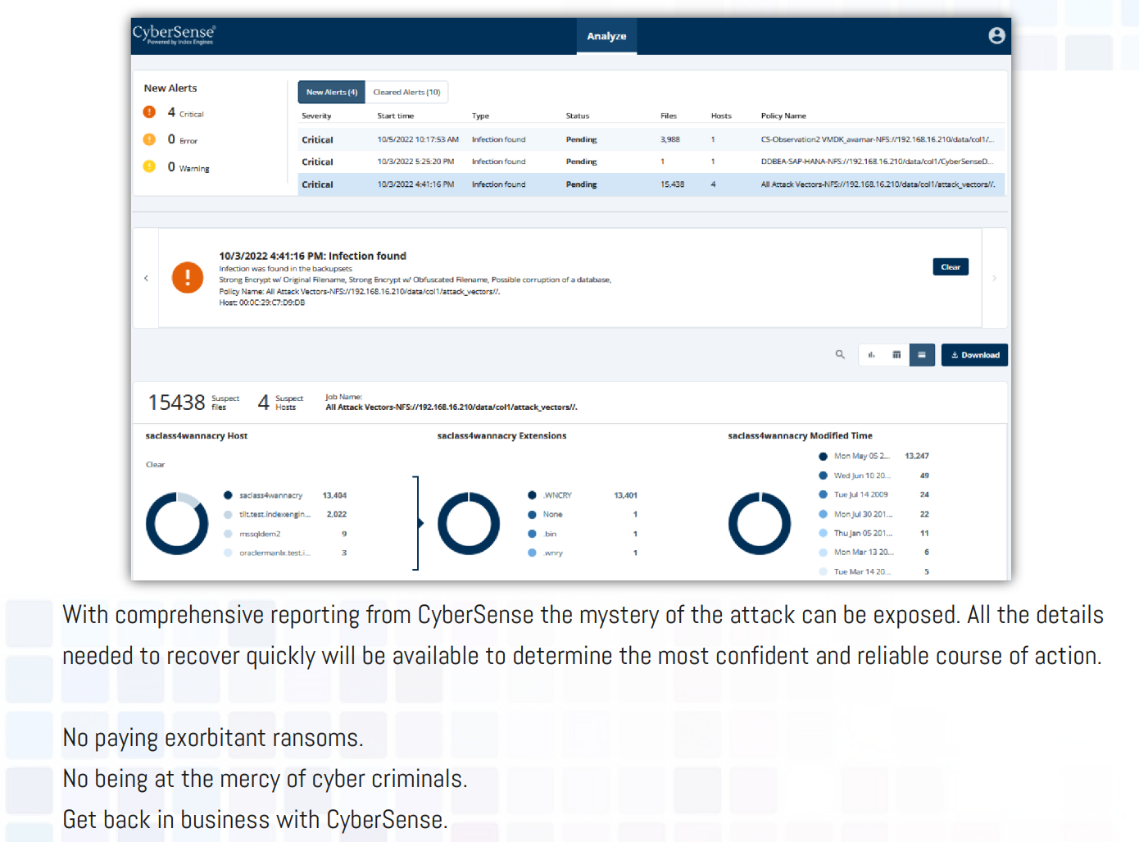

Slide 57
Decisions to make before Cyber Recovery Design
Do we want to test?
Which applications
Infrastructure / VMs / VCenter
Separate data and backup networks?
Do we want to recover?
Partial
Full
How to move data from Bunker to Production

Slide 58
Cyber Bunker components
Data Domain
Air gap – isolation
Network isolation
Port down
Cyber Recovery
Jump Station

Slide 59
Cyber Bunker components
CyberSense
Test environment
Recovery
Backup software – how to attach?
Part of data
All data
How to move data between Cyber Recovery and recovery center?

Slide 60
Cyber Bunker setup
Define mtree on Data Domain to be protected
Define mtree replication: Production -> Bunker
Implement Cyber Recovery appliance in Bunker
Attach DD to Bunker
Define policy on mtree in Bunker
Define schedule

Slide 61
Cyber Bunker – Is there alternative?
Offline media
Frequency
Up to day
Reliability
Is it really doing?

Slide 62
Replication
Classify which data we want to replicate
Installation
Data Domain Production
Data Domain Bunker
Define mtree replication of required data -> mtrees
Backup data
Catalog / databases of backup software

Slide 63
Steps to build Cyber Bunker

Slide 64
A
Cyber Recovery Appliance

Slide 65
Cyber Recovery installation
Download / deploy OVA
IP configuration
There is option for rpm package installation

Slide 66
Cyber Recovery installation
Setup Cyber Recovery appliance
crsetup.sh –deploy
Passwords
Lockbox
Mongo DB password
crso password

Slide 67
A1
Create proper networking between Data Domains between DDProd and DDBunk

Slide 68
DNS: ddp.mc.com 10.66.98.85
SITE A
192.168.15.11
IT Infrastructure
Public network
ddp.mc.com
Backup
Recovery
10.66.98.85
Data Domain
192.168.20.11
192.168.15.12
Air Gap
Access
Station
Backup
software
Hyp
192.168.20.12
cr.bunker.com
Data Domain
192.168.30.12
Cyber
Recovery
DNS
SQL
ddb.bunker.com
192.168.30.11
Cyber
Sense
Cyber Bunker
AD
Oracle
Storage

Slide 69
DNS: ddp.mc.com 10.66.98.85
Those changes made just for ease of PoC
SITE A
192.168.15.11
IT Infrastructure
Public network
Show that remote link is down – managed by CR
ddp.mc.com
Backup
Recovery
10.66.98.85
Data Domain
192.168.20.11
192.168.15.12
Air Gap
Access
Station
Backup
software
Hyp
192.168.20.12
cr.bunker.com
Data Domain
192.168.30.12
Cyber
Recovery
DNS
SQL
ddb.bunker.com
192.168.30.11
Cyber
Sense
Cyber Bunker
AD
Oracle
Storage

Slide 70
A2
Create replication pair

Slide 71
Replication

Slide 72
Replication status
replication status

Slide 73
Replication stats
replication show performance rctx://1
rctx://1 1 – context numer from replication status

Slide 74
Which hosts are added
adminaccess trust show

Slide 75
Replication setup pair

Slide 76
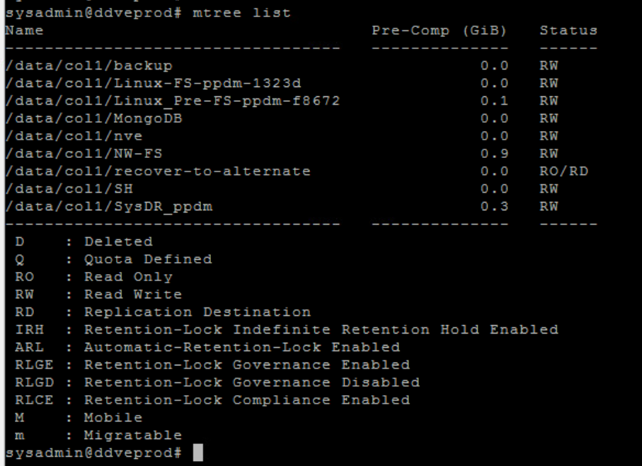
mtree list

Slide 77
Source DD
replication add source mtree://ddveprod.demo.local/data/col1/MongoDB destination mtree://ddveprod.vault.local/data/col1/MongoDBRep
replication status

Slide 78
Source DD
replication modify rctx://8 connection-host 192.168.2.5

Slide 79
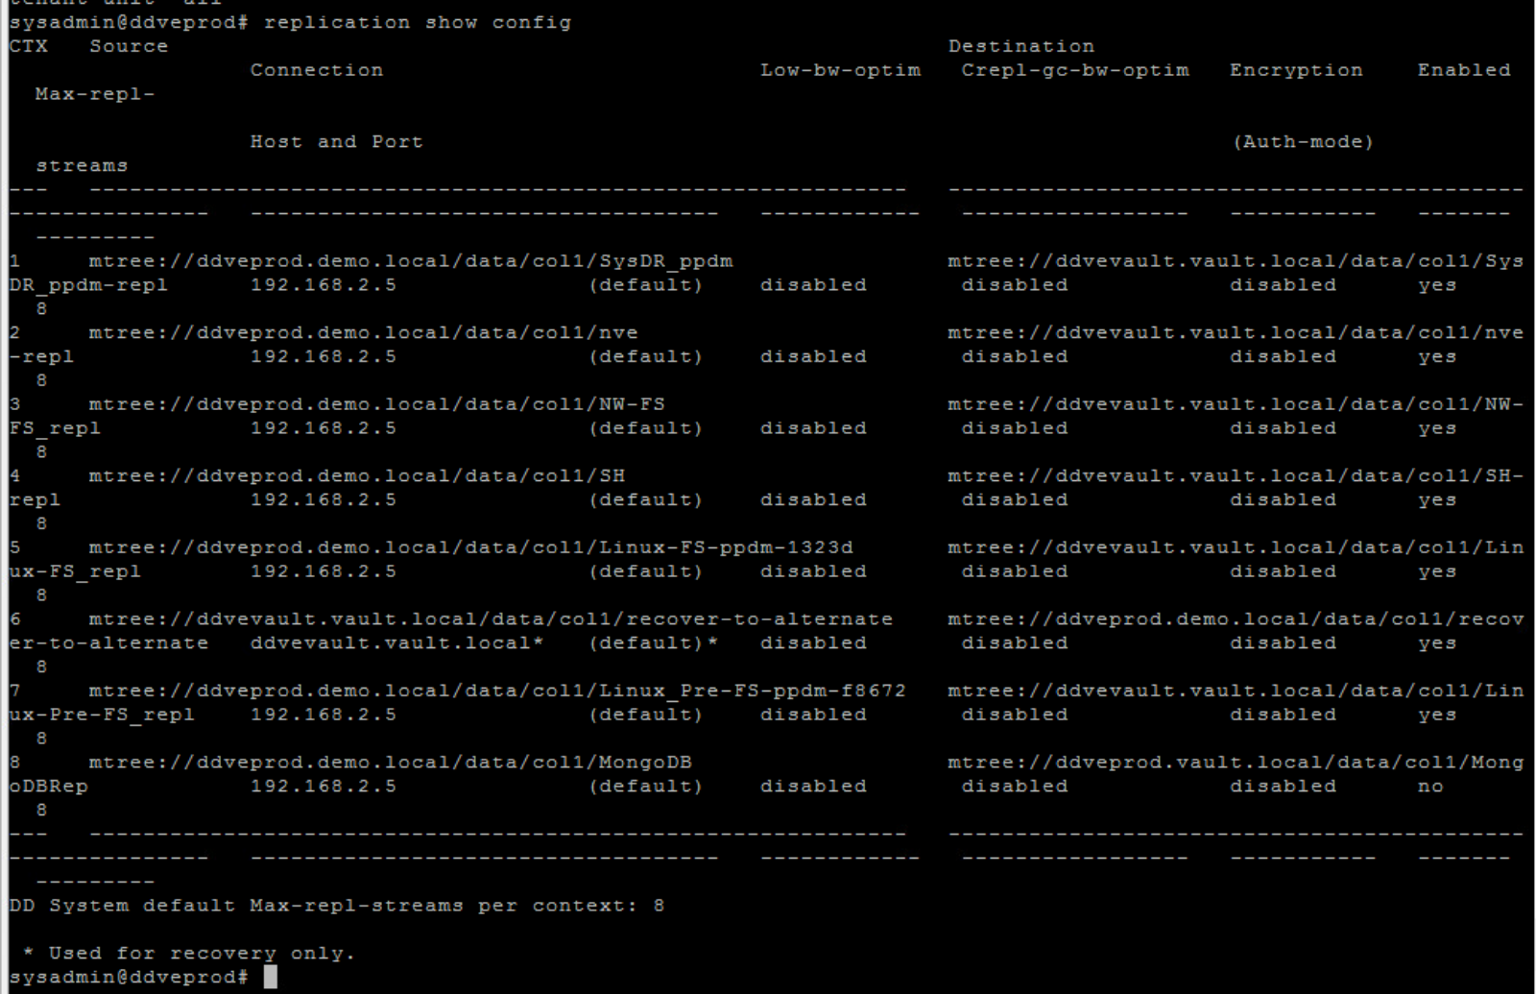
Source DD
replication show config

Slide 80
replication initialize mtree://ddveprod.vault.local/data/col1/MongoDBRep
replication initialize mtree://ddveprod.vault.local/data/col1/MongoDBRep

Slide 81
Destination DD
repliacation status
replication add source mtree://ddveprod.demo.local/data/col1/MongoDB destination mtree://ddveprod.vault.local/data/col1/MongoDBRep
replication status

Slide 82
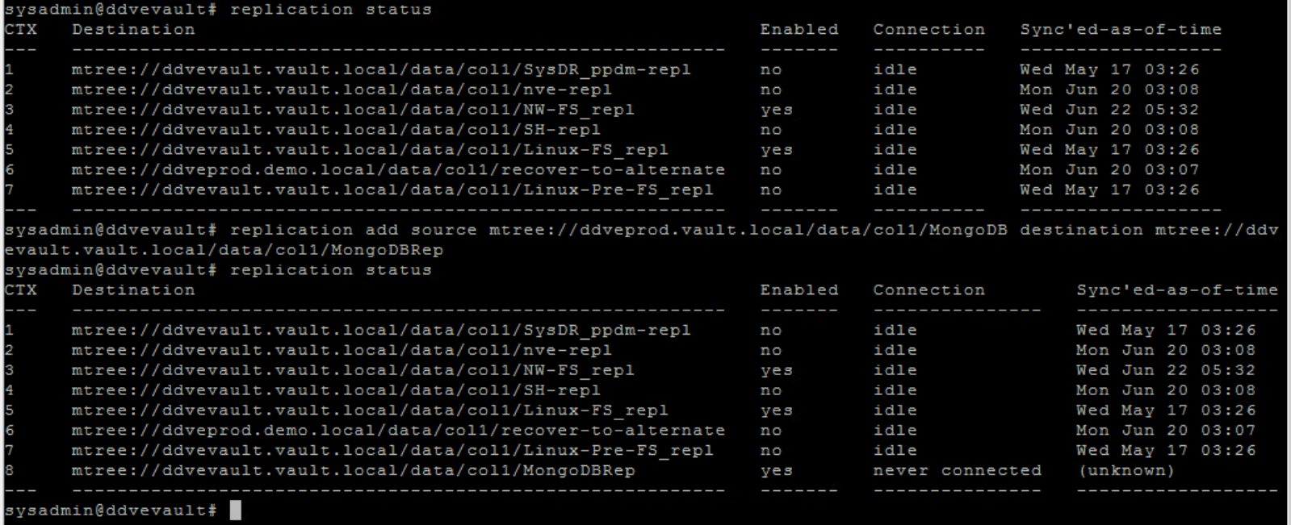
Destination DD

Slide 83
replication initialize mtree://ddveprod.vault.local/data/col1/MongoDBRep

Slide 84
Replication
Classify which data we want to replicate
Installation
Data Domain Production
Data Domain Bunker
Define mtree replication of required data -> mtrees
Backup data
Catalog / databases of backup software

Slide 85
DDVE Prod

Slide 86
DDVE Vault

Slide 87
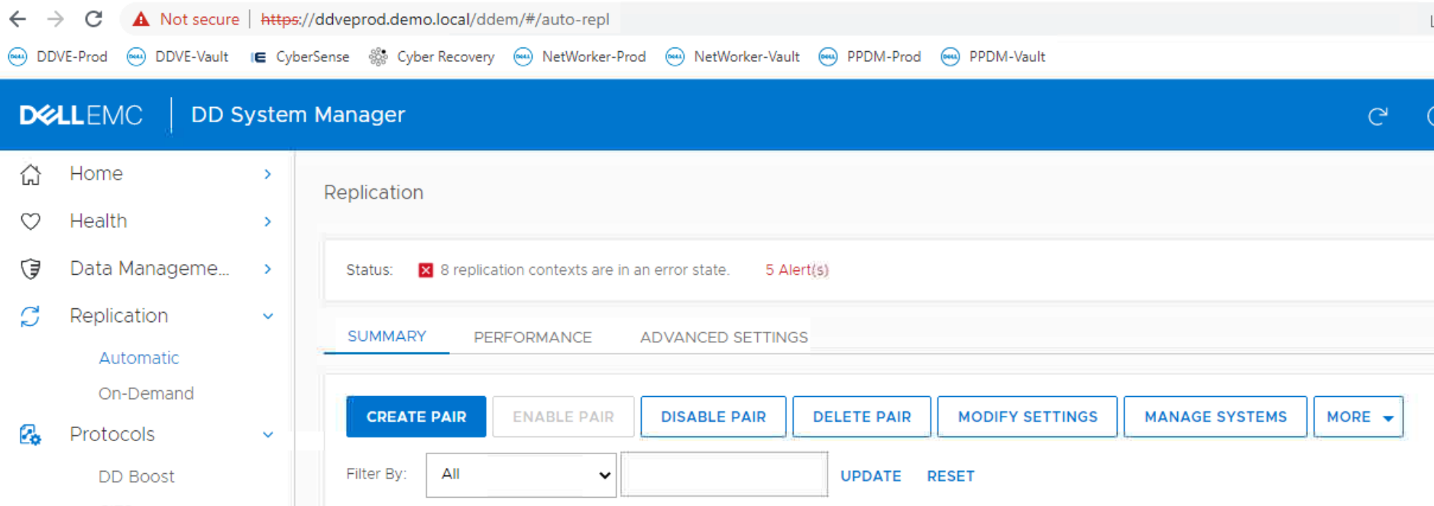

Slide 88
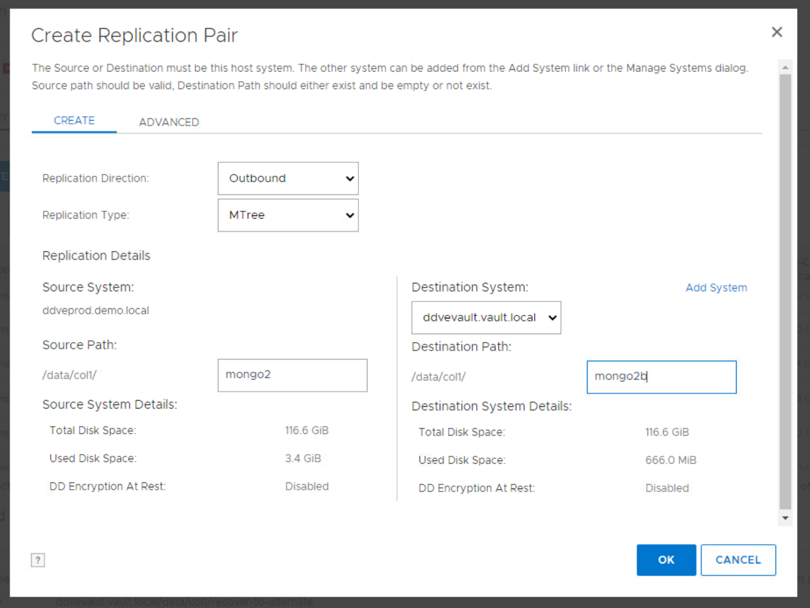

Slide 89
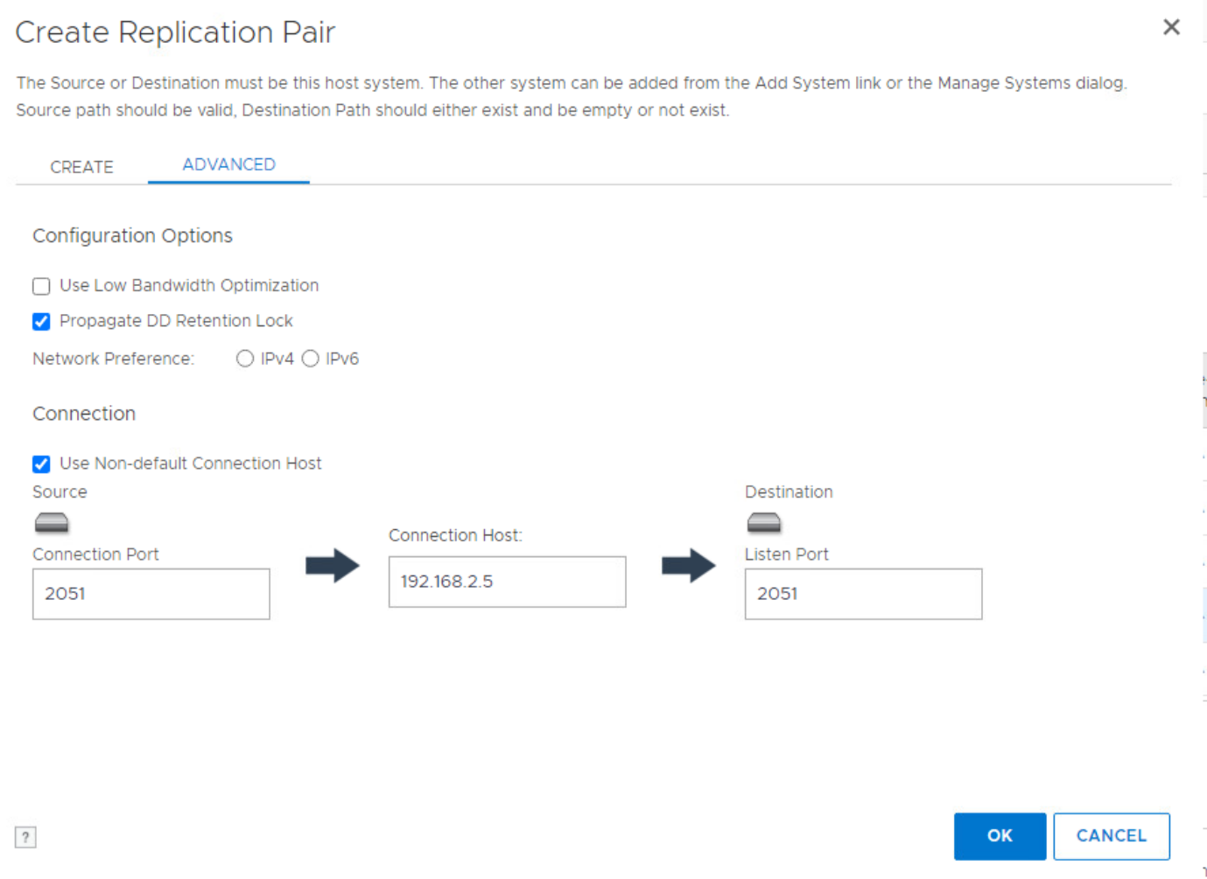
FQDN take from DD is not routable – we need to setup this IP address to which the replication will go – this IP of DD Bunker in internal network

Slide 90
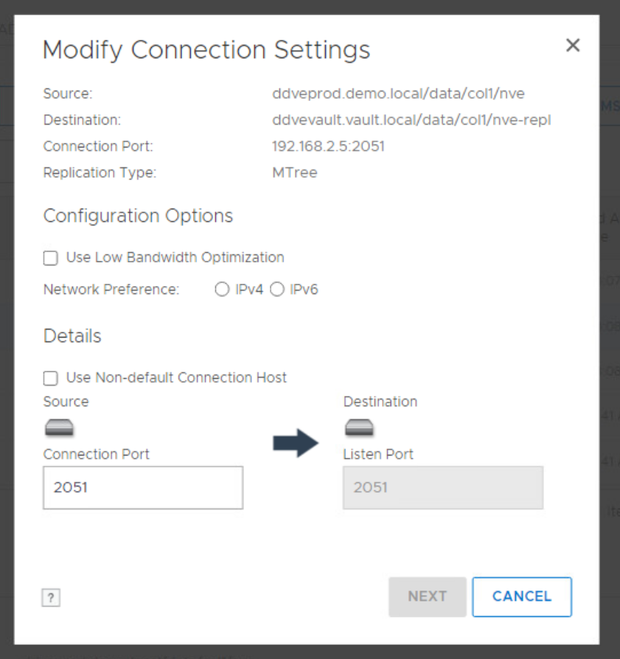
FQDN taken from DD is not routable – we need to setup this IP address

Slide 91
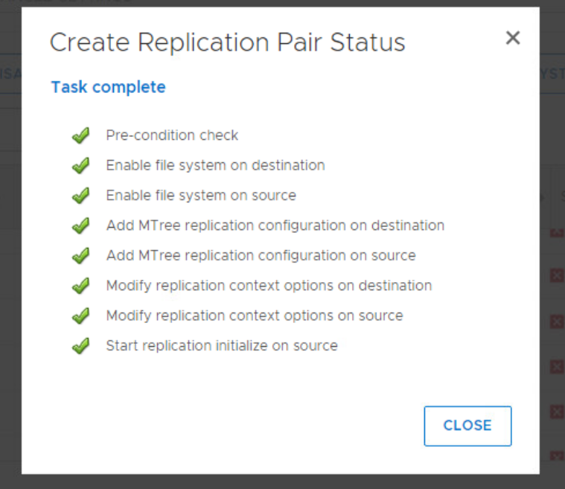

Slide 92
Be sure that the replication is successful!

Slide 93
B1
Attach Data Domain to Cyber Recovery

Slide 94
In Cyber Recovery app we need to add:
a. DD vault
b. CyberSense
c. Recovery applications
d. Sandbox

Slide 95
No we we add Data Domain that is Cyber Bunker

Slide 96
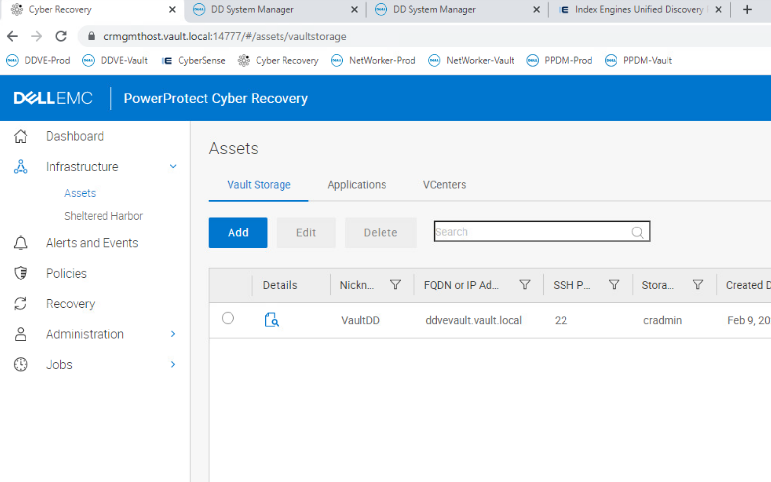
Max number of DD is 5

Slide 97
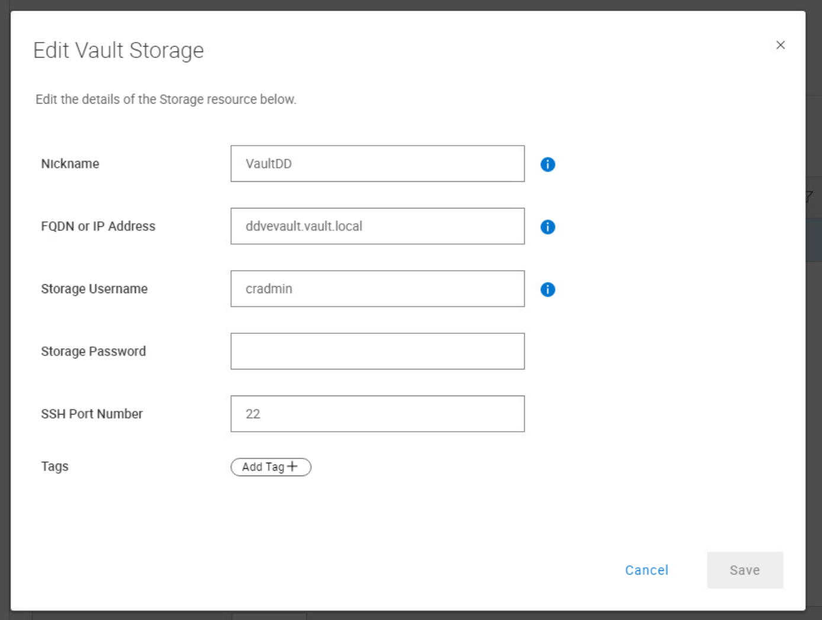
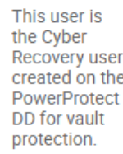
User to perform Operations on Data Domain
This is because you have to have admin rights to turn up and down the network interfaces and replication
Admin level user is needed because CR will issue commands like “net config <NIC> down” and “replication disable rctx://<number>” . These are not allowed by user class (or lower) users.

Slide 98
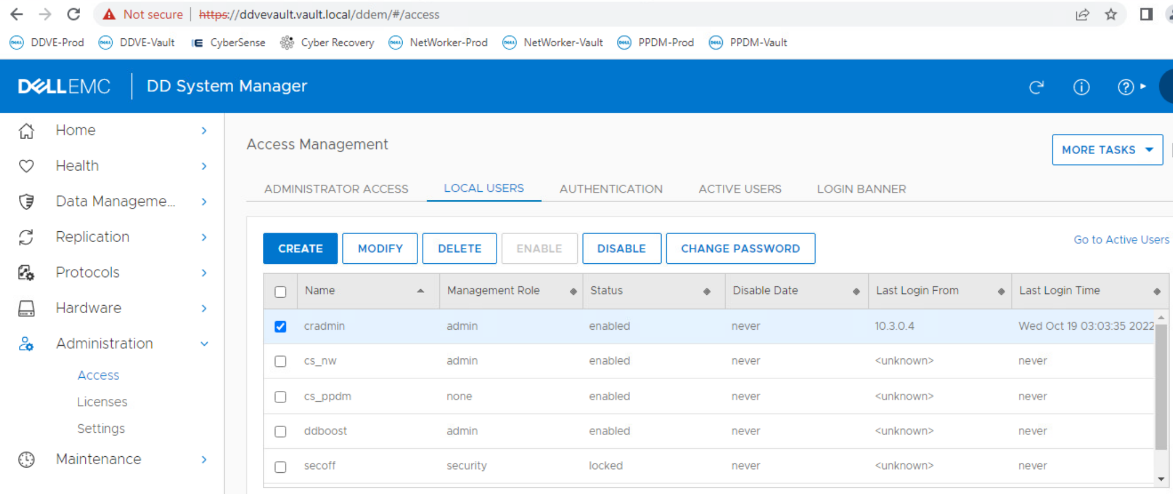
We need to create this user on DDBunker before this operation

Slide 99
B2
Create Policy
Dump to Bunker

Slide 100
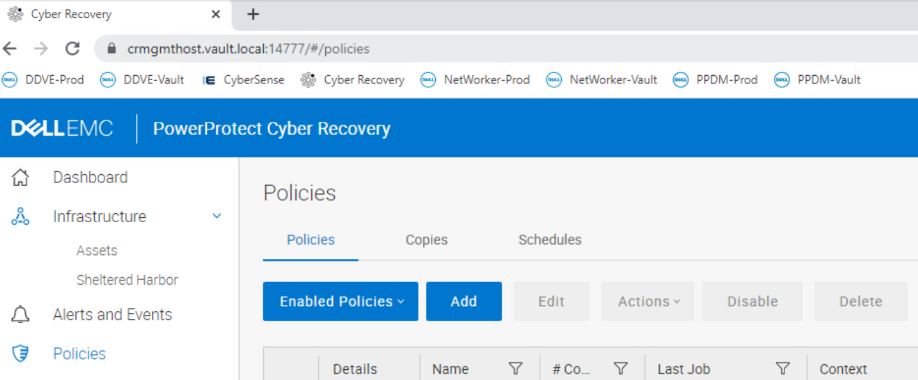
Max number of Policies is 25

Slide 101
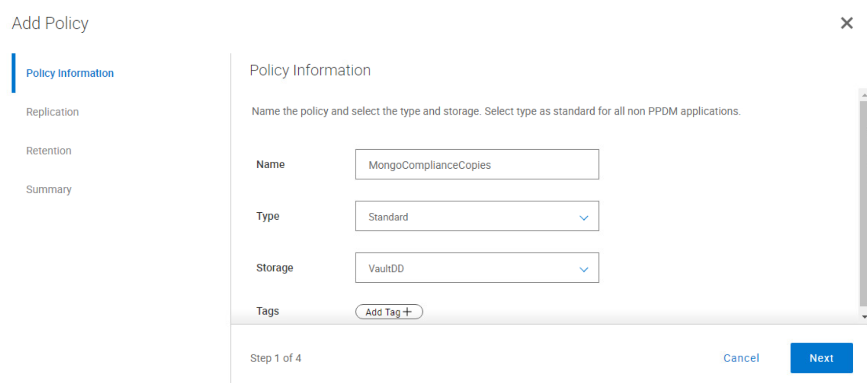
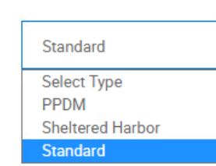
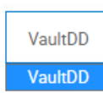

Slide 102
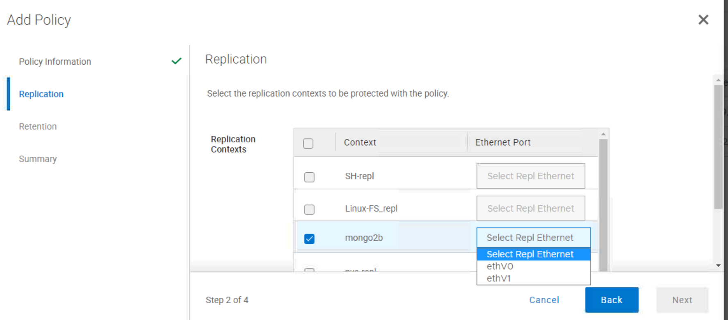
This port will be OFF!

Slide 103
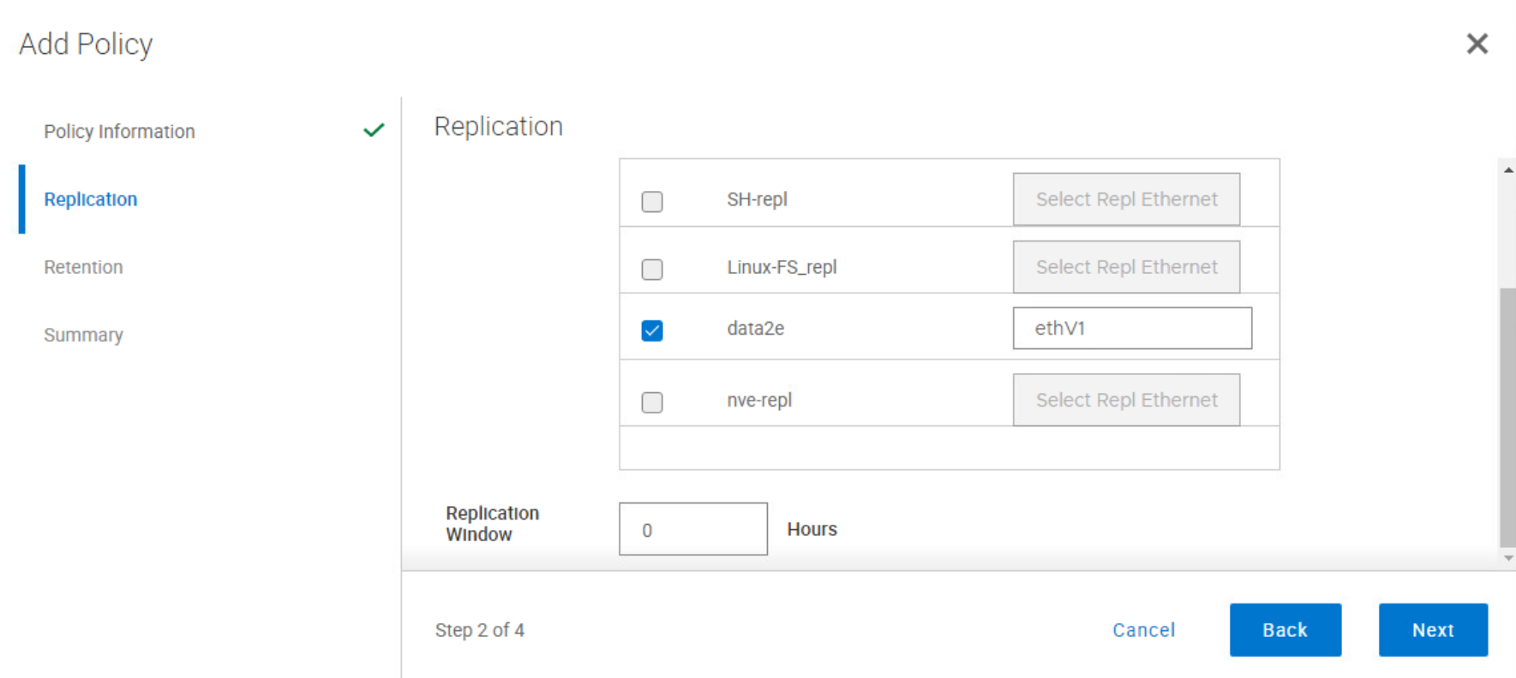

Slide 104
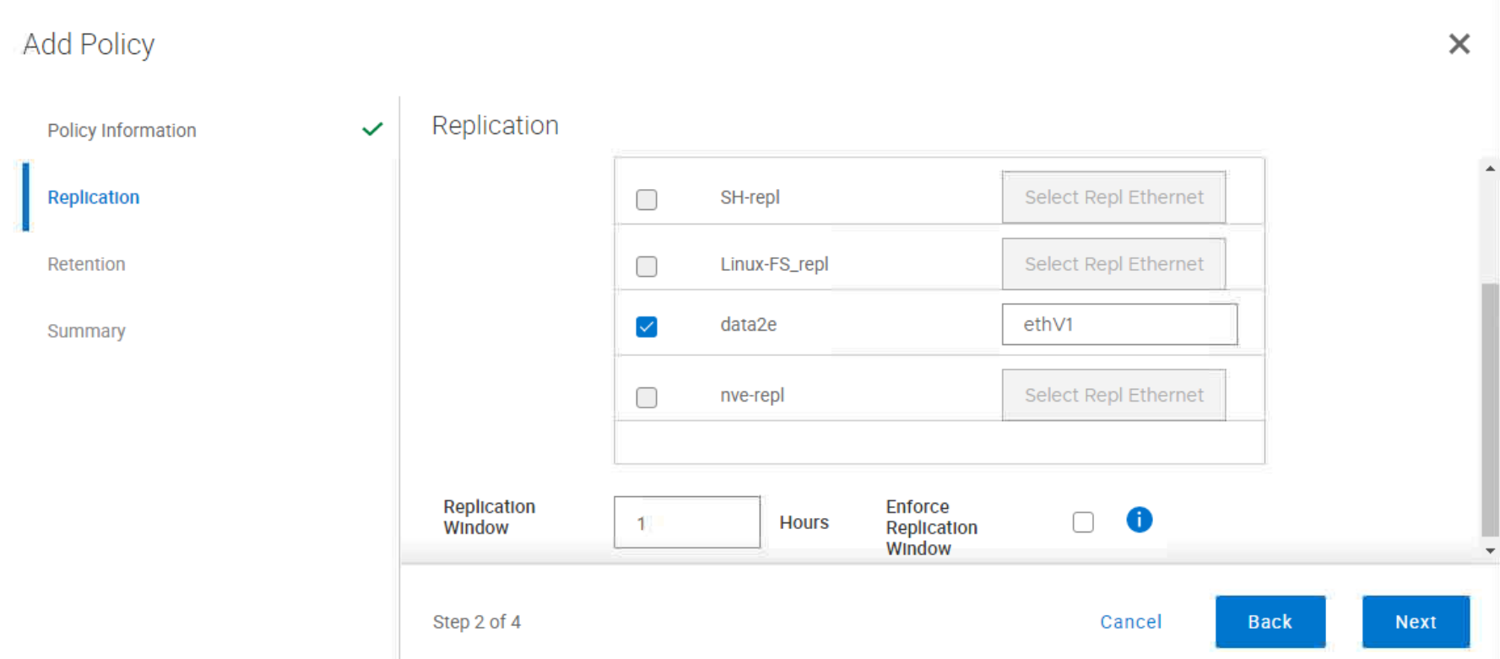

Slide 105
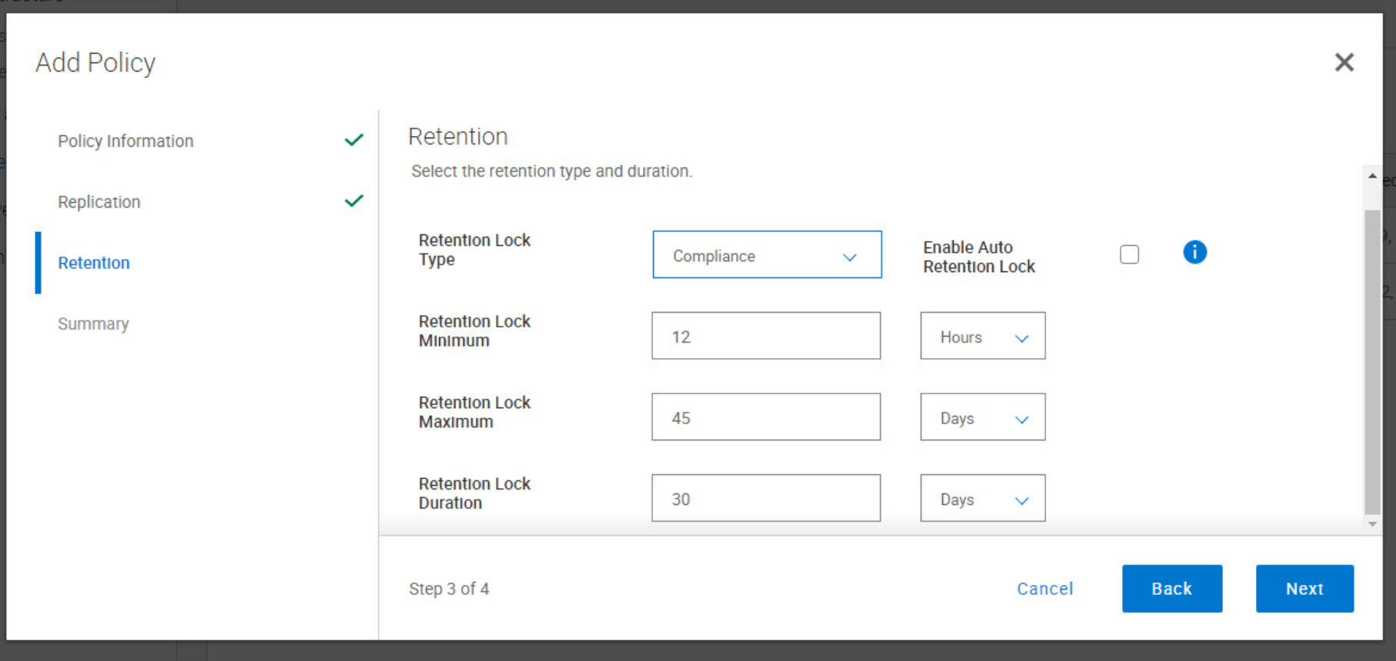
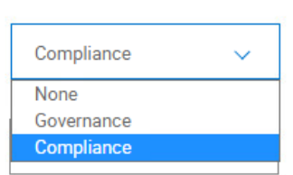

Slide 106
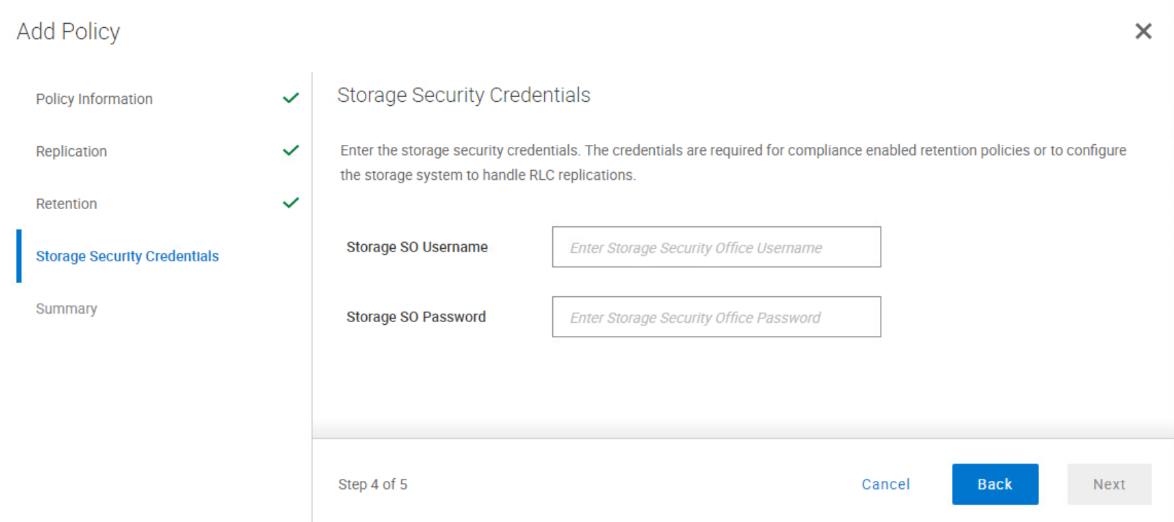
For Compliance required Security Officer creditentials

Slide 107
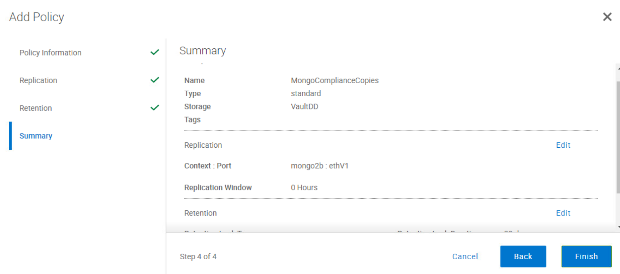

Slide 108
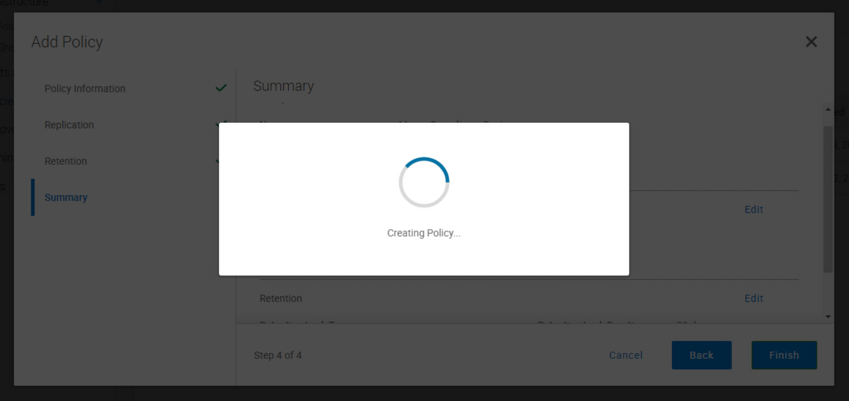

Slide 109
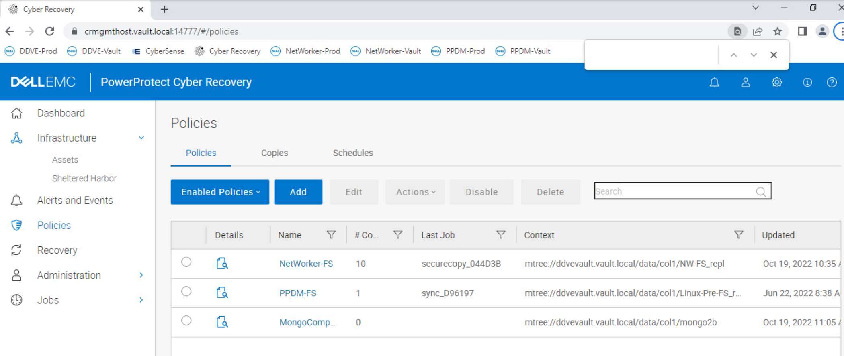

Slide 110
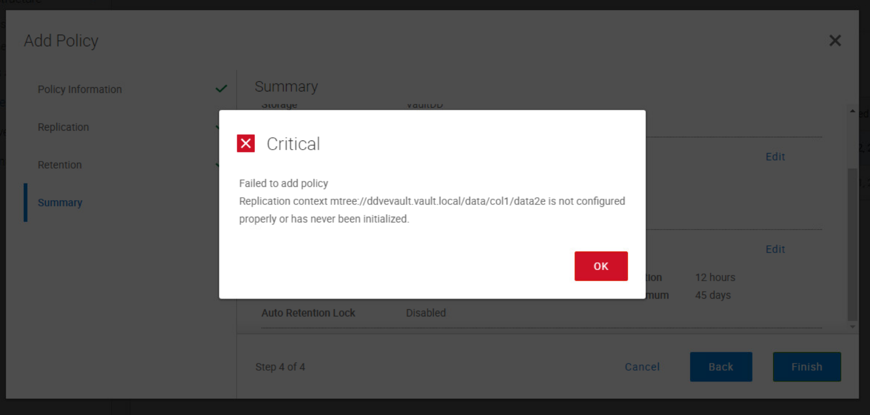

Slide 111
B3
Manually synchronize data

Slide 112
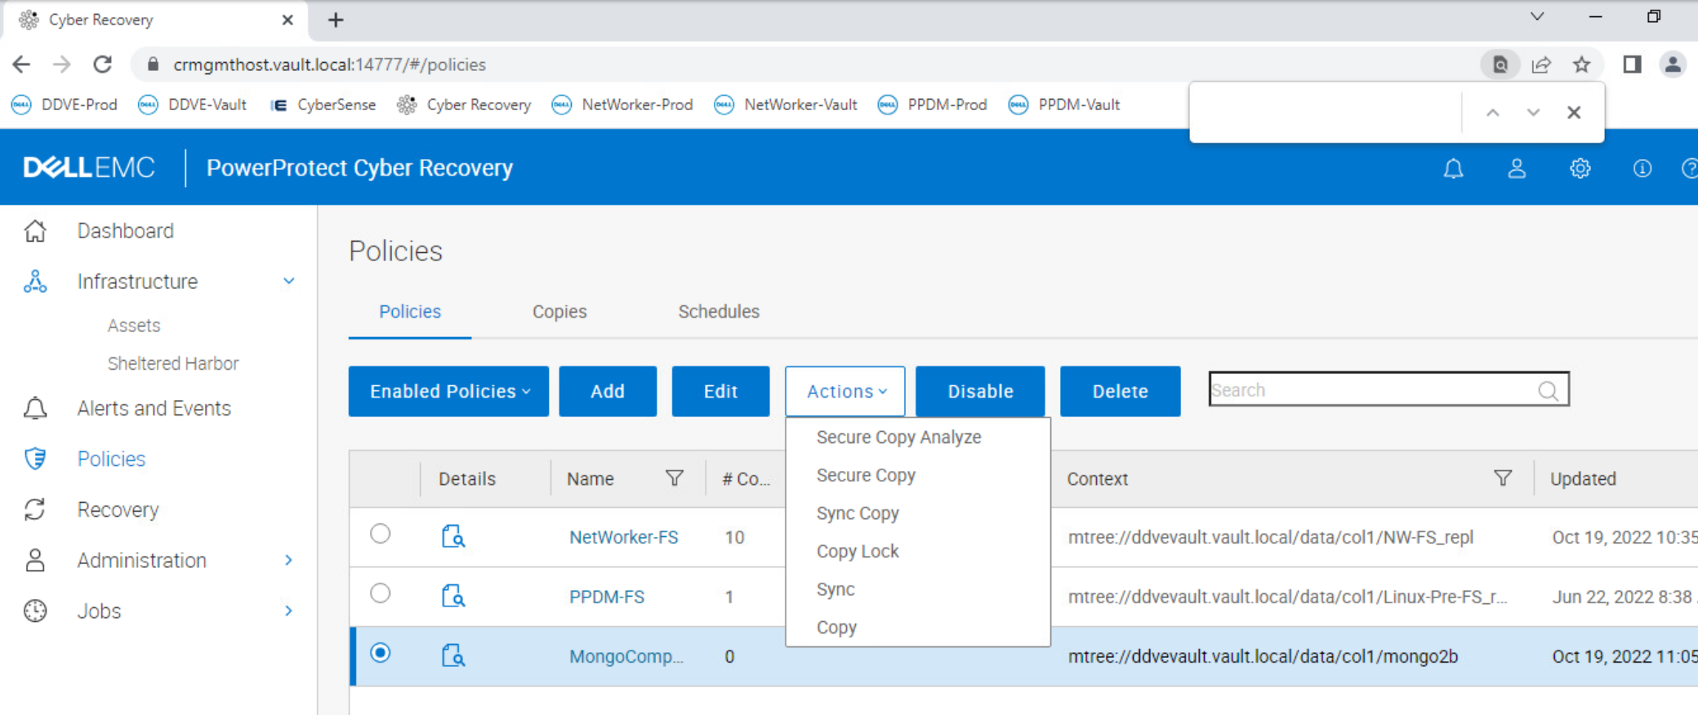

Slide 113
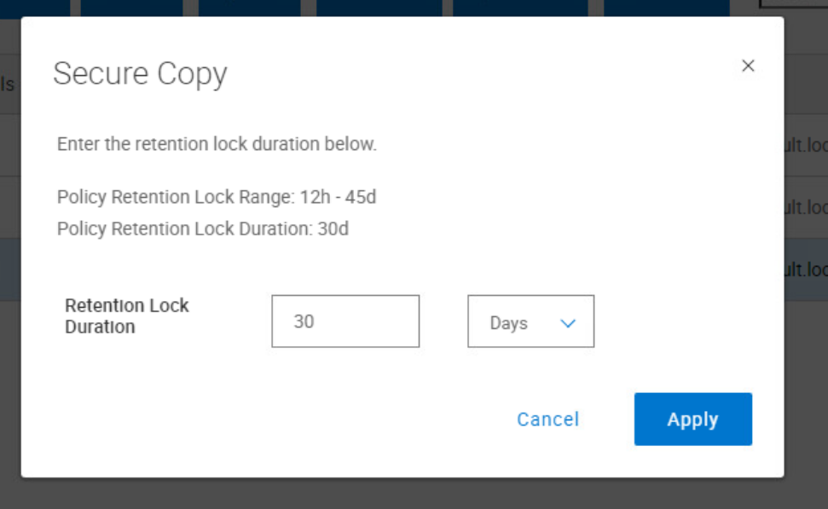
Default retention from policy!

Slide 114
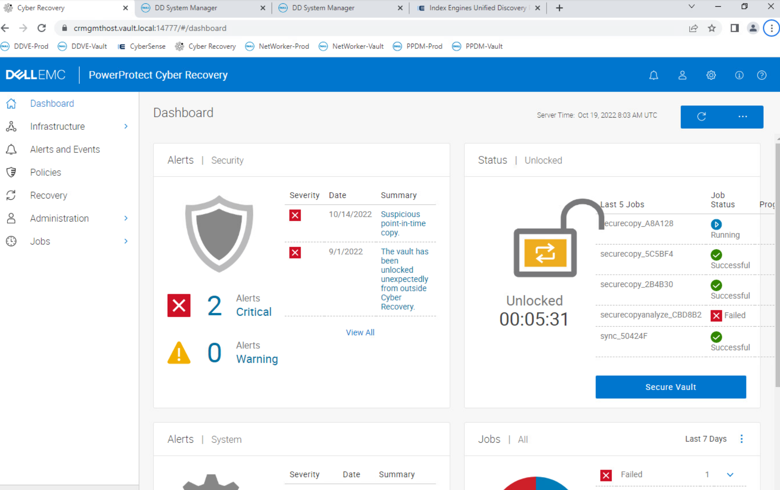

Slide 115
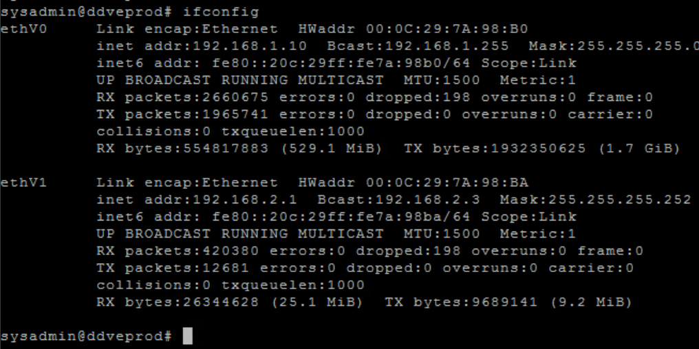

Slide 116
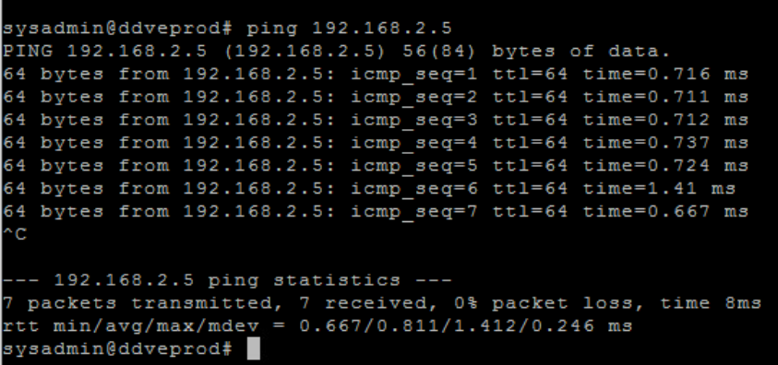

Slide 117
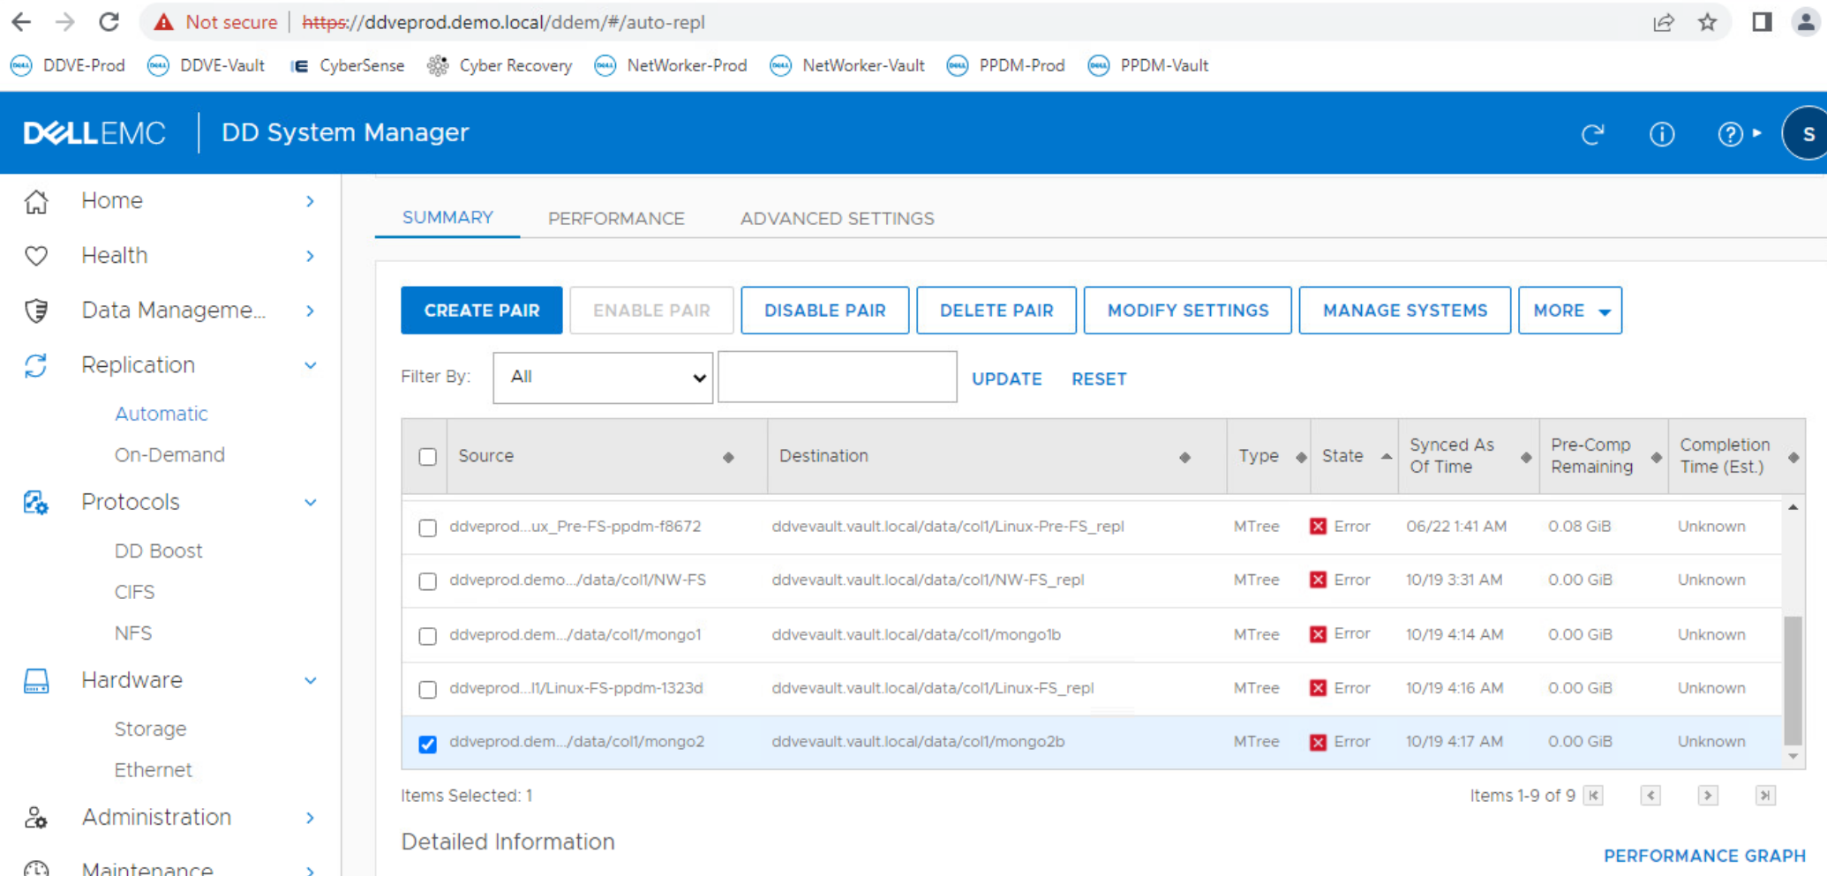

Slide 118
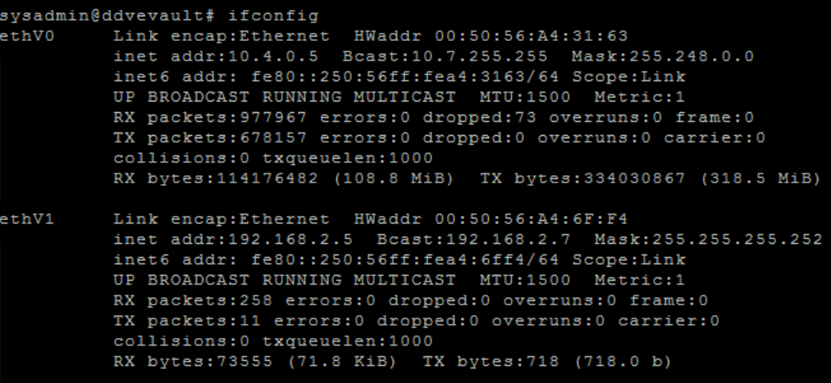

Slide 119
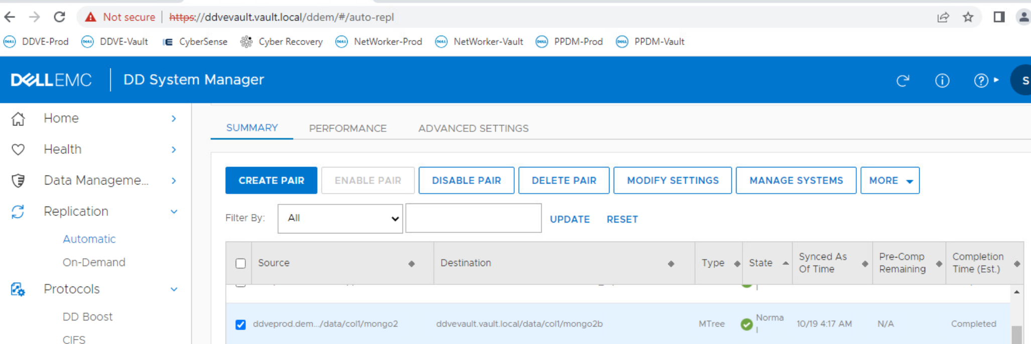

Slide 120
We have secure copy in the Bunker!

Slide 121
Demo of air-gap
No sync
Port is off
Starting replication
Port is on – we can see the ip address

Slide 128
B3a
Net filter

Slide 129
B4
Create Dump Schedule

Slide 135
C1
Add Sandbox
Recovery host

Slide 139
C2
Attaching copy to Sandbox
Recovery host

Slide 140
Sandbox Mtrees copies created for recovery are not retention-locked (compliance or governance). Note though it is possible to replicate a retention-locked Mtree from Prod to Vault, when CR creates a copy in the Vault it does not maintain the retention-lock state of the source Mtree. Instead is applies the retention-lock as per CR policy.

Slide 145
D1
Adding NetWorker

Slide 147
NetWorker operating system creditentials

Slide 148
Production NetWorker administrator creditentials

Slide 150
D2
Recovery NetWorker in Bunker

Slide 153
User with ddboost role on Bunker DD ddvevault.vault.local with the same UID as on Production DD ddveprod.demo.local

Slide 154
DD Production
DD Bunker

Slide 155
E1
Adding PPDM

Slide 158
F1
Recovery to production

Slide 163
Fastcopy of protected selected mtree_s_bunker in the bunker is made to replication pair
You can operate in production on the data mtree_s_bunker

Slide 167
Questions
Daniel.Olkowski@dell.com

