Slide 1
Cyber Bunker
How to build? / Networking / Architecture
The most fresh ppt version of this document: https://inside.dell.com/docs/DOC-501379
Daniel.Olkowski@dell.com

Slide 2
Agenda
Introduction
Components
Let’s build Cyber Bunker
Recovery
Cost
Materials

Slide 3
Why Cyber Bunker?

Slide 4
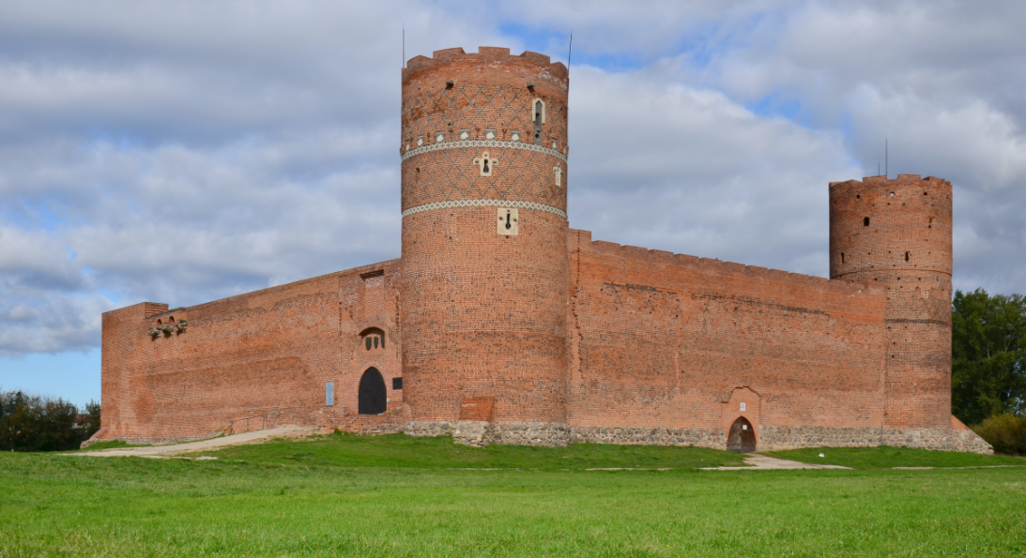
Cyber Bunker – why is important?
Castle strategy

Slide 5
Cyber Bunker – why is important?
Castle strategy
Ambulance strategy

Slide 6
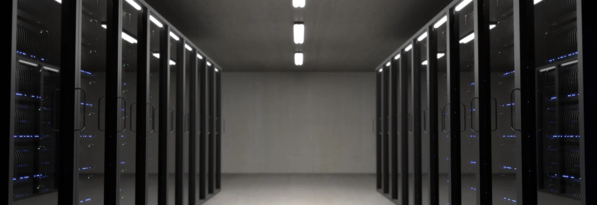
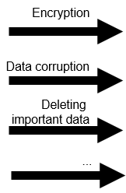
Cyber Bunker – why is important?
Real time
protection

Slide 7
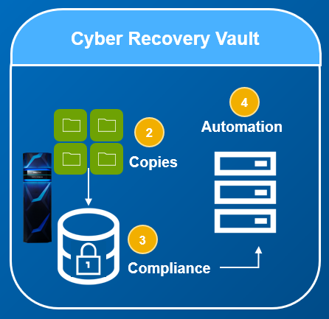
Cyber Bunker – why is important?
Real time
protection
Cyber Bunker

Slide 8
What is Cyber Bunker? Componentes

Slide 9
Cyber Bunker
A complete solution that allows recovery after hacker/ransomware attack.
Isolated from production, with any frequency Cyber Bunker keeps historical snapshots of all data with no possibility to remove, change, encrypt by ransomware/hacker.
All the operations in Cyber Bunker - grabbing data, compliance protection, checking against virus, recovery – are fully automated.
Be safe!

Slide 10
SITE A
SITE B
IT Infrastructure
Ransomware
protection
IT Infrastructure
Ransomware
protection
Any backup software
Backup
Recovery
Any backup software
Data Domain
Disaster Recovery
Data Domain
1% data transfer
100% recovery
Cyber Bunker
Air Gap
PLAN B – Secure data & Recovery
Separation
from production
Management
and automation
Cyber
Recovery
Data Domain
Cyber
Sense
Checking
ransomware
Secure
Historical
backups
Compliance
No possibility to change data
Recovery
automation
Backup
software
Sandbox
Any tests

Slide 11
How to build Cyber Bunker? Networking / Security

Slide 12
We will see the full architecture of the Cyber Bunker from networking/security perspective.

Slide 13
DNS: ddp.mc.com 10.66.98.85
SITE A
IT Infrastructure
Public network
ddp.mc.com
Backup
Recovery
10.66.98.85
Data Domain

Slide 14
DNS: ddp.mc.com 10.66.98.85
SITE A
Our production environment
IT Infrastructure
Public network
ddp.mc.com
Backup
Recovery
Backup device is fully visible.
We can backup/restore/replicate.
10.66.98.85
Data Domain

Slide 15
DNS: ddp.mc.com 10.66.98.85
SITE A
Dumps to Cyber Bunker are invisible, separated, not accessible
IT Infrastructure
Public network
ddp.mc.com
Backup
Recovery
10.66.98.85
No access is allowed:
No graphical interface
No command access
No remote access
No ssh / http / https
No ping
Nothing!
Data Domain
10.10.10.11
10.10.10.12
Compliance
No possibility to change data
Data Domain
Cyber Bunker

Slide 16
DNS: ddp.mc.com 10.66.98.85
SITE A
IT Infrastructure
Public network
ddp.mc.com
Backup
Recovery
10.66.98.85
Data Domain
10.10.10.11
There is only possible to perform Data Domain replication to this physical Ethernet port
10.10.10.12
Compliance
No possibility to change data
Data Domain
Cyber Bunker

Slide 17
DNS: ddp.mc.com 10.66.98.85
SITE A
Public network has no information about Cyber Bunker (DNS/IP)
IT Infrastructure
Public network
ddp.mc.com
Backup
Recovery
There is NO access from public networker to Cyber Bunker
10.66.98.85
Data Domain
10.10.10.11
Only backup media device can contact with Cyber Bunker – still no GUI/CLI/ping
10.10.10.12
Compliance
No possibility to change data
Data Domain
Cyber Bunker

Slide 18
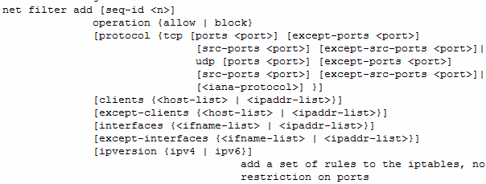

Slide 19
DNS: ddp.mc.com 10.66.98.85
SITE A
Production Data Domain will have replication definition with Cyber Bunker DD – but in failed state
IT Infrastructure
Public network
ddp.mc.com
Backup
Recovery
10.66.98.85
Data Domain
10.10.10.11
10.10.10.12
Compliance
No possibility to change data
Data Domain
Cyber Bunker

Slide 20
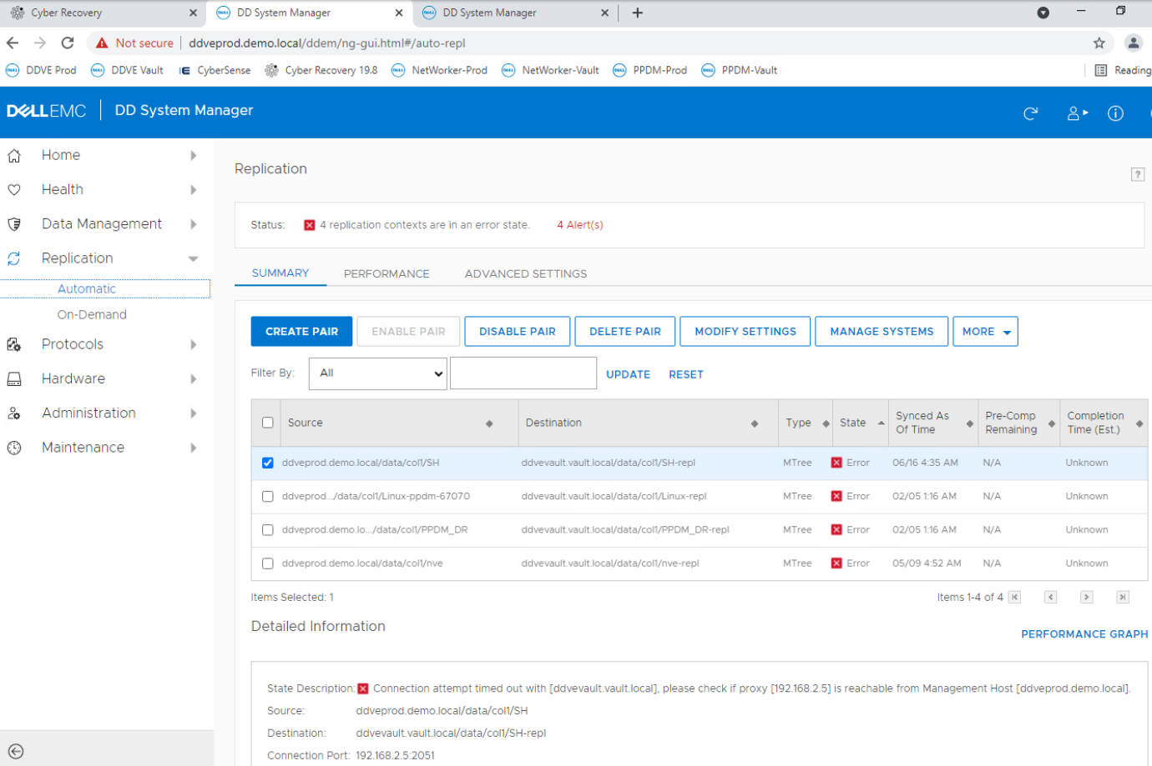
Production DD has defined replication through seprated port to Cyber Bunker DD – failed state

Slide 21
DNS: ddp.mc.com 10.66.98.85
SITE A
If there is NO data dump to Cyber Bunker, Ethernet port of DD in Cyber Bunker is turned off
IT Infrastructure
Public network
ddp.mc.com
Backup
Recovery
10.66.98.85
Data Domain
10.10.10.11
Air Gap
10.10.10.12
Compliance
No possibility to change data
Data Domain
Cyber Bunker

Slide 22
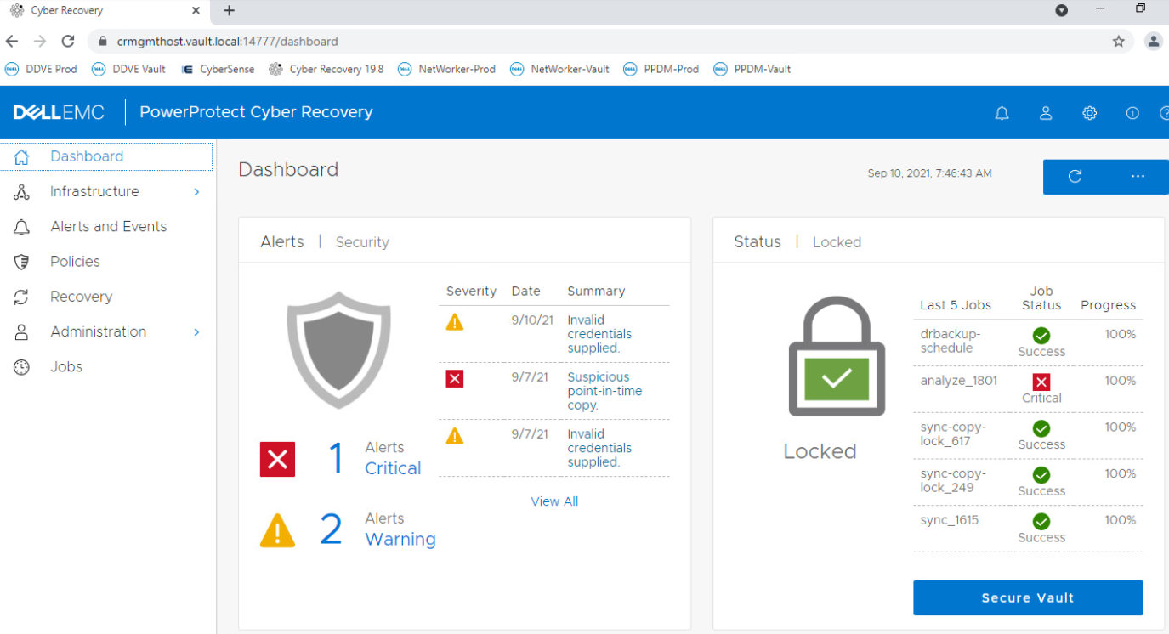
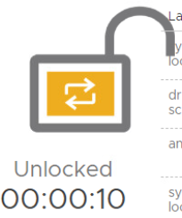
We see all the time if the port of DD in Bunker is off or on.
Even if port is on, there is no chance to perform any activities on DD in Bunker

Slide 23
DNS: ddp.mc.com 10.66.98.85
SITE A
Out Cyber Bunker can just provides us immutable, Compliance copy with FULL automation
IT Infrastructure
Public network
ddp.mc.com
Backup
Recovery
10.66.98.85
Data Domain
20.20.20.11
Air Gap
Access
Station
20.20.20.12
cr.bunker.com
Data Domain
100.100.100.121
Cyber
Recovery
ddb.bunker.com
100.100.100.122
Cyber
Sense
Cyber Bunker

Slide 24
SITE A
Recovery / Test Center
IT Infrastructure
Backup
Recovery
Data Domain
Air Gap
Access
Station
Backup
software
Hyp
Data Domain
Cyber
Recovery
DNS
SQL
Cyber Bunker
Cyber
Sense
AD
Oracle
Storage

Slide 25
DNS: ddp.mc.com 10.66.98.85
SITE A
Cyber Bunker can be the FULL TEST CENTER that:
Verifies production
Provides systematical, periodical restores
IT Infrastructure
Public network
ddp.mc.com
Backup
Recovery
10.66.98.85
Data Domain
20.20.20.11
Air Gap
Access
Station
Backup
software
Hyp
20.20.20.12
cr.bunker.com
Data Domain
100.100.100.121
Cyber
Recovery
DNS
SQL
ddb.bunker.com
100.100.100.122
Cyber
Sense
Cyber Bunker
AD
Oracle
Storage

Slide 26
DNS: ddp.mc.com 10.66.98.85
SITE A
If we anyhow think / have TEST ENVIRONMENT – why not to combine this idea with Cyber Bunker?
IT Infrastructure
Public network
ddp.mc.com
Backup
Recovery
10.66.98.85
Data Domain
20.20.20.11
Air Gap
Access
Station
Backup
software
Hyp
20.20.20.12
cr.bunker.com
Data Domain
100.100.100.121
Cyber
Recovery
DNS
SQL
ddb.bunker.com
100.100.100.122
Cyber
Sense
Cyber Bunker
AD
Oracle
Storage

Slide 27
DNS: ddp.mc.com 10.66.98.85
Cyber Bunker has separated network with own addresses and DNS, AD. Why?
If backup software starts, it shall not see production (backup starts, mess)
DNS is required by backup software
It is difficult to manage more and more VMs without DNS
SITE A
IT Infrastructure
Public network
ddp.mc.com
Backup
Recovery
10.66.98.85
Data Domain
20.20.20.11
Air Gap
Access
Station
Backup
software
Hyp
20.20.20.12
cr.bunker.com
Data Domain
100.100.100.121
Cyber
Recovery
DNS
SQL
ddb.bunker.com
100.100.100.122
Cyber
Sense
Cyber Bunker
AD
Oracle
Storage

Slide 28
DNS: ddp.mc.com 10.66.98.85
SITE A
76.76.76.11
IT Infrastructure
Public network
ddp.mc.com
Backup
Recovery
10.66.98.85
Data Domain
20.20.20.11
76.76.76.12
Air Gap
Access
Station
Backup
software
Hyp
20.20.20.12
cr.bunker.com
Data Domain
100.100.100.121
Cyber
Recovery
DNS
SQL
ddb.bunker.com
100.100.100.122
Cyber
Sense
Cyber Bunker
AD
Oracle
Storage

Slide 29
DNS: ddp.mc.com 10.66.98.85
How to access to Cyber Bunker? Again, we use dedicated network to access station.
The access can be from physical, dedicated laptop/PC/VM.
Or we set it up to group of people, etc.
SITE A
76.76.76.11
IT Infrastructure
Public network
ddp.mc.com
Backup
Recovery
10.66.98.85
Data Domain
20.20.20.11
76.76.76.12
Air Gap
Access
Station
Backup
software
Hyp
20.20.20.12
cr.bunker.com
Data Domain
100.100.100.121
Cyber
Recovery
DNS
SQL
ddb.bunker.com
100.100.100.122
Cyber
Sense
Cyber Bunker
AD
Oracle
Storage

Slide 30
Recovery architecture

Slide 31
Cost

Slide 32
SITE A
Backup
Server
IT Infrastructure
Backup
Recovery
Logical
Data Domain
(mtree)
Replication
on Data Domain level
Air Gap
Management
and automation
Cyber
Recovery
Logical
Data Domain
(mtree)
Cyber
Sense
Checking
ransomware
Backup
software
Recovery
automation
Cyber Bunker
Sandbox
Any tests

Slide 33
Materials

Slide 34
Materials
Cyber Security https://youtu.be/jtgm2WHpFPk
Article: http://backuprecoveryguy.blogspot.com/2020/01/ransomware-attack-how-can-we-recover.html

Slide 35
Materiały
https://backuprecoveryman.pl/cyber-recovery-materialy/

Slide 36
Questions
Daniel.Olkowski@dell.com

