Slide 1
Cyber attack
What after?
Daniel.Olkowski@dell.com

Slide 2



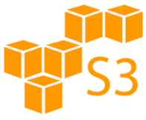


Our environment
Site A
Site B
Linux, UNIX, Windows,
Applications,
Databases,
Mail
Linux, UNIX, Windows,
Applications,
Databases,
Mail
VM
LAN
VM
DBs
Mails
Backup
Server
Media
agent
SAN
Tape
library
Data Domain
Data Domain
Disk
system
Tape
library
Disk
system

Slide 3
Agenda
Threats
DIA
Replication
Compliance
And more!

Slide 4
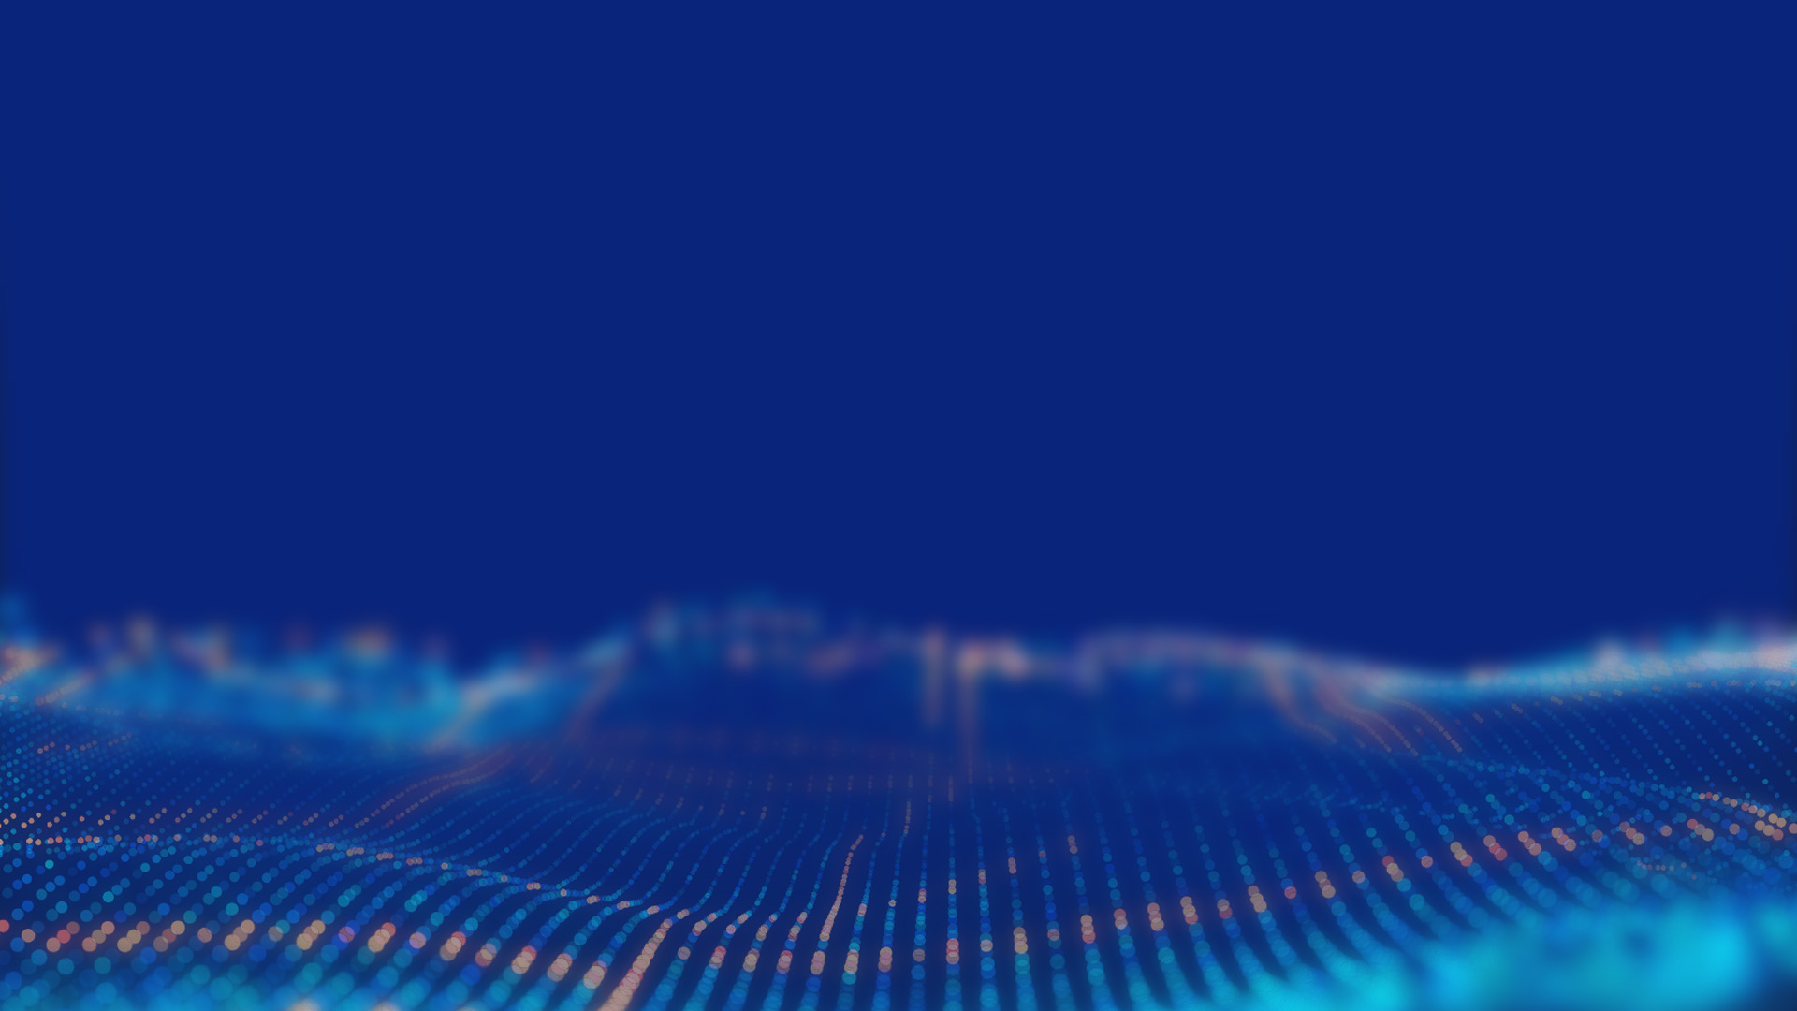
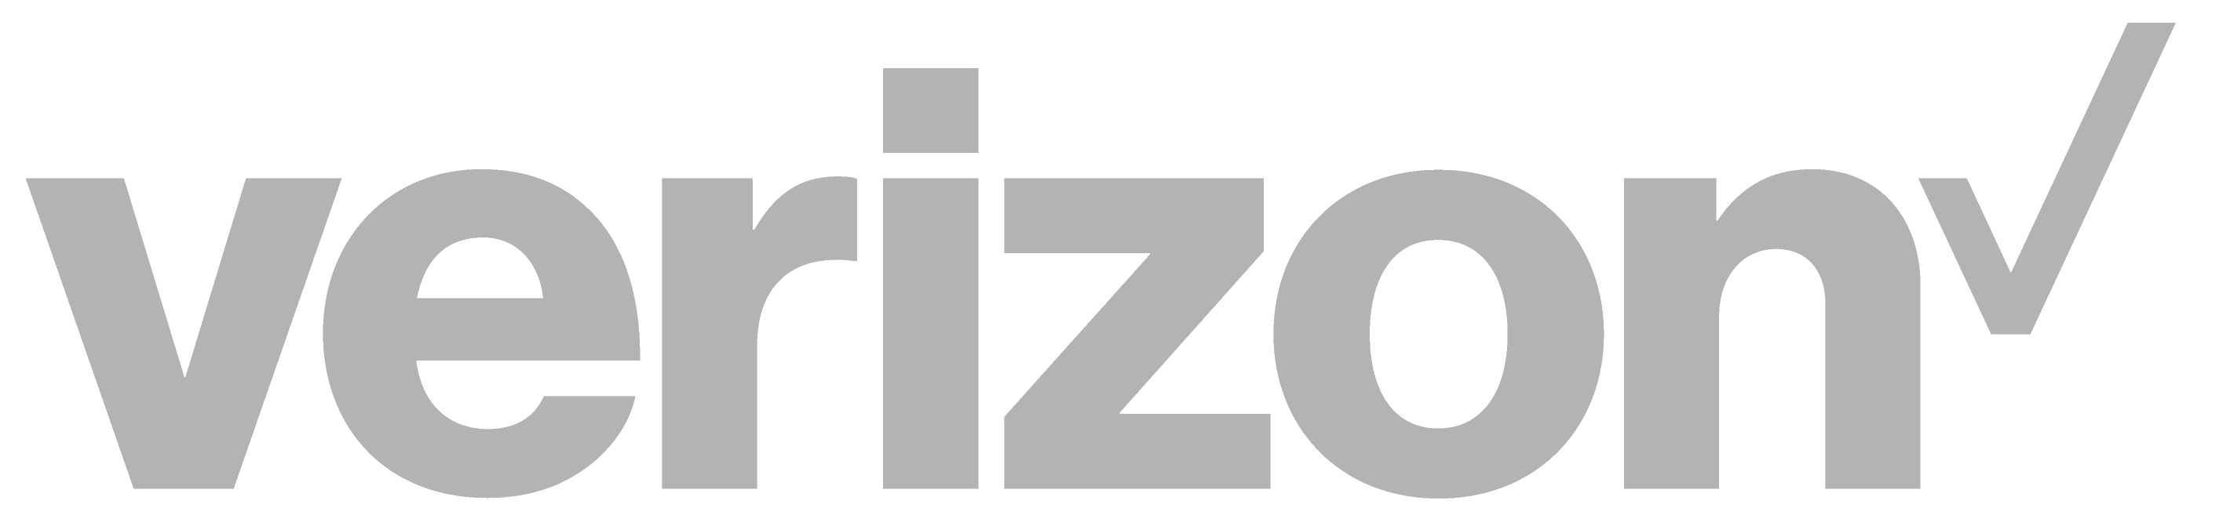


Cyber threats 2021: the facts
Banking | $18.4M
Utilities | $17.8M
Software | $16.0M
Automotive | $15.8M
Insurance | $15.8M
High Tech | $14.7M
Capital Markets | $13.9M
Energy | $13.8M
US Federal | $13.7M
Consumer Goods | $11.9M
Health | $11.9M
Retail | $11.4M
Life Sciences | $10.9M
Media | $9.2M
Travel | $8.2M
Public Sector | $7.9M
Every 11 seconds
a cyber or ransomware attacks occur.*
39s
71%
$13M
$1T
43%
86%
of breaches
are financially motivated.
$24.7M
Avg. cost of cybercrime for an organization.
$6T
Total global impact of cyber crime in 2021.
48%
of breaches involved
small business.
Cybersecurity
Ventures
*Sources: Cybersecurity Ventures:
https://cybersecurityventures.com/global-ransomware-damage-costs-predicted-to-reach-20-billion-usd-by-2021
https://cybersecurityventures.com/cybercrime-damages-6-trillion-by-2021
4
of 16
© Copyright 2021 Dell Inc.
Notes:
Speaker Notes:
Cyber threats don’t cause mere thousands of dollars of loss anymore—the damage is in the trillions. Accenture forecasts over $5T of global value at risk over the next 5 years.
Attacks are virtually non-stop and the cost per attack continues to increase. And while there is a common misconception that only certain sized businesses or industries are attacked, the reality is that nobody is immune. Bad actors target businesses of all sizes, and across all industries.
Additional notes:
– Attackers are able to move along the cutting-edge of accelerated technology transformation, exploiting vulnerabilities as they emerge.
– Attacks are increasing, as it the attack surface, and the potential impacts on business are greater than they have ever been before.
If we consider some of the trends we’ve discussed so far, they are creating great opportunity as we’ve seen…
…but they are also leading to greater potential for cyber attack, with greater potential for damage than ever before.
We’ve seen companies make rapid technology changes during the crisis without considering the security implications.
We’ve seen a huge increase in the number of remote workers, and therefore the surface of potential attack.
There is also a related increased potential for insider threats – for example from disgruntled employees who now have remote access to company servers.
Aside from this, more long-term we’ve seen R&D cycles shorten, driven by customer expectation of product updates, meaning less time to test for vulnerabilities.
And we’ve seen the emergence of companies who rely on their digital platform and data as their very identity. The stakes for them couldn’t be higher.
It’s particularly alarming, then, to read this quote from the World Economic Forum, in assessing the global risks brought by the pandemic:
“According to 38% of the risk experts surveyed, new working patterns leading to cyberattacks and data fraud are the most likely technological fallout risk for the world.”[1]
They report, for example, that phishing scams have increased markedly during the crisis.
Meanwhile, business leaders, of course, are acutely aware of the penalties for a failure to comply with GDPR – a €20m maximum fine, or 4% of global turnover.[2]
And that is aside from the reputational costs already inherent in being breached.
Even before the pandemic outbreak, as many 61% of large businesses had reported an attack in the previous 12months – those are 2019 UK government figures.[3]
And new types of threat are emerging every day of course – and they’re often going undetected.
On average, advanced cyber attacks go undetected for 197 days. [4]
From phishers, to hacktivists, to state-level attackers, criminals are clearly pursuing a cyber arms race with the business world.
So what does the perfect response look like? [Click to next slide]
Sources for Additional Notes: 1 – http://www3.weforum.org/docs/WEF_COVID_19_Risks_Outlook_Special_Edition_Pages.pdf 2 – gdpr.eu/fines 3 – https://assets.publishing.service.gov.uk/government/uploads/system/uploads/attachment_data/file/875799/Cyber_Security_Breaches_Survey_2019_-_Main_Report_-_revised.pdf 4 ­– https://www.delltechnologies.com/en-gb/microsites/connected-cybersecurity.htm#overlay=/content/dam/delltechnologies/assets/microsites/connected-cybersecurity/cyberattack-types.pdf]
Sources of Statistics:
2020 Verizon Data Breach Investigations Report: https://enterprise.verizon.com/resources/reports/2019-data-breach-investigations-report.pdf
2019 Accenture Cost of Cybercrime Study : https://www.accenture.com/us-en/insights/security/cost-cybercrime-study
2020 Accenture Cost of Cybercrime Study : https://www.accenture.com/us-en/insights/security/cost-cybercrime-study
Cyber attack every 11 seconds – Cybersecurity Ventures: https://cybersecurityventures.com/global-ransomware-damage-costs-predicted-to-reach-20-billion-usd-by-2021
$6T total global impact of cyber crime in 2021 - https://cybersecurityventures.com/cybercrime-damages-6-trillion-by-2021
2020 RiskIQ report - $24.7M USD cyber crime costs organizations on average in 2020 - https://www.helpnetsecurity.com/2020/08/28/global-cost-of-cybercrime-per-minute/
NEXT SLIDE

Slide 5
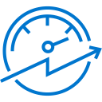


Cyber threats 2021: the facts
Banking | $18.4M
Utilities | $17.8M
Software | $16.0M
Automotive | $15.8M
Insurance | $15.8M
High Tech | $14.7M
Capital Markets | $13.9M
Energy | $13.8M
US Federal | $13.7M
Consumer Goods | $11.9M
Health | $11.9M
Retail | $11.4M
Life Sciences | $10.9M
Media | $9.2M
Travel | $8.2M
Public Sector | $7.9M
a
Every 11 seconds
A cyber or ransomware attacks occur¹
$6T
Total global impact of cyber crime in 2021²
$13M
Average cost of cybercrime for an organization³
*¹Cybersecurity Ventures: https://cybersecurityventures.com/global-ransomware-damage-costs-predicted-to-reach-20-billion-usd-by-2021
https://cybersecurityventures.com/cybercrime-damages-6-trillion-by-2021
²Cybersecurity Ventures: https://cybersecurityventures.com/cybercrime-damages-6-trillion-by-2021
³Accenture Insights, Ninth Annual Cost of Cyber crime Study March , 2019 - https://www.accenture.com/us-en/insights/security/cost-cybercrime-study
5
of 16
© Copyright 2021 Dell Inc.
Notes:
Speaker Notes:
Cyber threats don’t cause mere thousands of dollars of loss anymore—the damage is in the trillions. Accenture forecasts over $5T of global value at risk over the next 5 years.
Attacks are virtually non-stop and the cost per attack continues to increase. And while there is a common misconception that only certain sized businesses or industries are attacked, the reality is that nobody is immune. Bad actors target businesses of all sizes, and across all industries.
Additional notes:
– Attackers are able to move along the cutting-edge of accelerated technology transformation, exploiting vulnerabilities as they emerge.
– Attacks are increasing, as it the attack surface, and the potential impacts on business are greater than they have ever been before.
If we consider some of the trends we’ve discussed so far, they are creating great opportunity as we’ve seen…
…but they are also leading to greater potential for cyber attack, with greater potential for damage than ever before.
We’ve seen companies make rapid technology changes during the crisis without considering the security implications.
We’ve seen a huge increase in the number of remote workers, and therefore the surface of potential attack.
There is also a related increased potential for insider threats – for example from disgruntled employees who now have remote access to company servers.
Aside from this, more long-term we’ve seen R&D cycles shorten, driven by customer expectation of product updates, meaning less time to test for vulnerabilities.
And we’ve seen the emergence of companies who rely on their digital platform and data as their very identity. The stakes for them couldn’t be higher.
It’s particularly alarming, then, to read this quote from the World Economic Forum, in assessing the global risks brought by the pandemic:
“According to 38% of the risk experts surveyed, new working patterns leading to cyberattacks and data fraud are the most likely technological fallout risk for the world.”[1]
They report, for example, that phishing scams have increased markedly during the crisis.
Meanwhile, business leaders, of course, are acutely aware of the penalties for a failure to comply with GDPR – a €20m maximum fine, or 4% of global turnover.[2]
And that is aside from the reputational costs already inherent in being breached.
Even before the pandemic outbreak, as many 61% of large businesses had reported an attack in the previous 12months – those are 2019 UK government figures.[3]
And new types of threat are emerging every day of course – and they’re often going undetected.
On average, advanced cyber attacks go undetected for 197 days. [4]
From phishers, to hacktivists, to state-level attackers, criminals are clearly pursuing a cyber arms race with the business world.
So what does the perfect response look like? [Click to next slide]
Sources for Additional Notes: 1 – http://www3.weforum.org/docs/WEF_COVID_19_Risks_Outlook_Special_Edition_Pages.pdf 2 – gdpr.eu/fines 3 – https://assets.publishing.service.gov.uk/government/uploads/system/uploads/attachment_data/file/875799/Cyber_Security_Breaches_Survey_2019_-_Main_Report_-_revised.pdf 4 ­– https://www.delltechnologies.com/en-gb/microsites/connected-cybersecurity.htm#overlay=/content/dam/delltechnologies/assets/microsites/connected-cybersecurity/cyberattack-types.pdf]
Sources of Statistics:
2020 Verizon Data Breach Investigations Report: https://enterprise.verizon.com/resources/reports/2019-data-breach-investigations-report.pdf
2019 Accenture Cost of Cybercrime Study : https://www.accenture.com/us-en/insights/security/cost-cybercrime-study
2020 Accenture Cost of Cybercrime Study : https://www.accenture.com/us-en/insights/security/cost-cybercrime-study
Cyber attack every 11 seconds – Cybersecurity Ventures: https://cybersecurityventures.com/global-ransomware-damage-costs-predicted-to-reach-20-billion-usd-by-2021
$6T total global impact of cyber crime in 2021 - https://cybersecurityventures.com/cybercrime-damages-6-trillion-by-2021
2020 RiskIQ report - $24.7M USD cyber crime costs organizations on average in 2020 - https://www.helpnetsecurity.com/2020/08/28/global-cost-of-cybercrime-per-minute/
NEXT SLIDE

Slide 6
92%
Organizations cannot detect cyber attack
Average time to detect is 100 days
67%
Organizations had incident within last year within real issues
39%
Yearly detected
ransomware within malware
Copyright © Dell Inc. All Rights Reserved.

Slide 7






Broad spectrum of sophisticated cyber threats
Motivations, Techniques and Goals
Crime
Insider
Espionage
Hacktivism
Terrorism
Warfare
Trusted insiders
steal or extort
for personal, financial, & ideological reasons.
Increasingly targeted because of privileged access to systems
Theft & extortion
for financial
gain
Corporate or Nation-state actors steal valuable data
Advance
political
or social
causes
Sabotage & destruction to instill fear
Nation-state actors
with destructive cyber weapons
(NotPetya)
Notes:
Speaker Notes:
Too often, we see organizations focused on guarding against a very specific type of cyber attack or cyber actor. This narrow focus can put them at risk.
It's important to understand that Cyber attacks take many different forms and the attackers may have a variety of motivations, techniques and even platforms from which to launch their attacks. Thus, for example, organizations cannot count on paying a ransom as a last line of defense. While data may be encrypted and look like a ransomware-based attack, it may have been launched from a Nation state as a weapon, an insider with an ax to grind, or a hacktivist whose agenda is ideologically motivated and not financial. There may be nobody to pay to decrypt the data.
One of the most difficult types of cyber attack to defend against is one launched by an insider (knowingly or unknowingly). They tend to have physical access, full knowledge of the infrastructure and may even have benefitted from privilege creep, giving them access to more systems.
A good cyber recovery strategy takes all of these into account.
NEXT SLIDE
From Deleted Slide:
Main ideas:
– Attackers are able to move along the cutting-edge of accelerated technology transformation, exploiting vulnerabilities as they emerge.
– Attacks are increasing, as it the attack surface, and the potential impacts on business are greater than they have ever been before.
Narrative:
If we consider some of the trends we’ve discussed so far, they are creating great opportunity as we’ve seen…
…but they are also leading to greater potential for cyber attack, with greater potential for damage than ever before.
We’ve seen companies make rapid technology changes during the crisis without considering the security implications.
We’ve seen a huge increase in the number of remote workers, and therefore the surface of potential attack.
There is also a related increased potential for insider threats – for example from disgruntled employees who now have remote access to company servers.
Aside from this, more long-term we’ve seen R&D cycles shorten, driven by customer expectation of product updates, meaning less time to test for vulnerabilities.
And we’ve seen the emergence of companies who rely on their digital platform and data as their very identity. The stakes for them couldn’t be higher.
Attackers are able to move along this cutting-edge of technology transformation, exploiting vulnerabilities.
It’s particularly alarming, then, to read this quote from the World Economic Forum, in assessing the global risks brought by the pandemic:
“According to 38% of the risk experts surveyed, new working patterns leading to cyberattacks and data fraud are the most likely technological fallout risk for the world.”[1]
They report, for example, that phishing scams have increased markedly during the crisis.
Meanwhile, business leaders, of course, are acutely aware of the penalties for a failure to comply with GDPR – a €20m maximum fine, or 4% of global turnover.[2]
And that is aside from the reputational costs already inherent in being breached.
Even before the pandemic outbreak, as many 61% of large businesses had reported an attack in the previous 12months – those are 2019 UK government figures.[3]
And new types of threat are emerging every day of course – and they’re often going undetected.
On average, advanced cyber attacks go undetected for 197 days. [4]
From phishers, to hacktivists, to state-level attackers, criminals are clearly pursuing a cyber arms race with the business world.
So what does the perfect response look like? [Click to next slide]
[Sources: 1 – http://www3.weforum.org/docs/WEF_COVID_19_Risks_Outlook_Special_Edition_Pages.pdf 2 – gdpr.eu/fines 3 – https://assets.publishing.service.gov.uk/government/uploads/system/uploads/attachment_data/file/875799/Cyber_Security_Breaches_Survey_2019_-_Main_Report_-_revised.pdf 4 ­– https://www.delltechnologies.com/en-gb/microsites/connected-cybersecurity.htm#overlay=/content/dam/delltechnologies/assets/microsites/connected-cybersecurity/cyberattack-types.pdf]
From “Backups are Vulnerable” slide notes:
Speaker Notes:
Ransomware and bad actors have learned that they have a better chance of achieving their goal – getting paid a ransom or destroying data – if no backup is available for recovery. This has placed the backup under direct attack. Unfortunately, there are a number of vulnerable points because backups were designed for accessibility, and not necessarily for security:
#1: IT & Backup Admins are main targets for compromise through a variety of attack vectors because their access is trusted and can easily and rapidly become the effective change agent to carry out an attack.
#2: The master server often contains a catalog of data. Encrypting or deleting this data can make a backup take much longer – and in some cases may even keep the backup from being used for recovery
#3: Any system mounted by the media server can be attacked if the media server is compromised
#4: File systems, tape and the cloud may hold backups but are also being targeted. File systems, especially those accessible via CIFS or NFS are often targeted with data being encrypted or deleted. Tapes may be offline, but generally require a catalog for a speedy recovery – which is usually online and subject to deletion (see #1 above). Finally, the cloud is not an inherently secure location for backups – it's just different from the production environment. But data there can usually be deleted immediately by anyone with access privileges, and the cloud is always available for access.

Slide 8
Attack architecture
Avrage time of attacker inside company – over 100 days
Poractive tasks / processes / procedures
Interactive tools
Recognition
Phishing or exploit
First point
Extending
Targeting: Critical systems / backup
Attack
Prevention and monitoring
Detection and answer
Restore
Fast reaction reduces range and time to detect attack
Notes:
To nie jest tak, że schemat jest zawsze ten sam – zaszyfrują – zapłacimy. Może nie chodzić o okup.
Zbyt często widzimy organizacje skoncentrowane na ochronie przed bardzo specyficznym rodzajem cyberataku lub cyberprzestępcą. To wąskie skupienie może narazić ich na ryzyko.
Ważne jest, aby zrozumieć, że cyberataki przybierają wiele różnych form, a atakujący mogą mieć różne motywacje, techniki, a nawet platformy, z których mogą przeprowadzać ataki. Tak więc, na przykład, organizacje nie mogą liczyć na zapłacenie okupu jako ostatniej linii obrony. Chociaż dane mogą być zaszyfrowane i wyglądać jak atak oparty na ransomware, Może nie być nikogo, kto chce okupu za odszyfrowanie danych.
Jednym z najtrudniejszych rodzajów cyberataków do obrony jest ten przeprowadzony przez insidera (świadomie lub nieświadomie). Mają zwykle fizyczny dostęp, pełną wiedzę na temat infrastruktury, a nawet mogli skorzystać z pełzania przywilejów, dając im dostęp do większej liczby systemów.
Dobra strategia odzyskiwania cybernetycznego uwzględnia wszystkie te kwestie.
Vide Estonia 2007 – wojna cybernetyczna (Rosja)
Wikileak! Assange

Slide 9
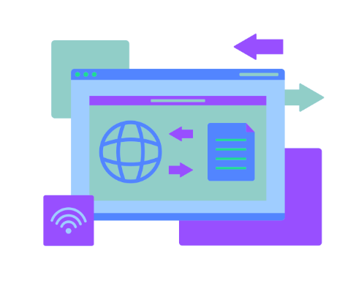
Who can protect me against Cyber Atack?
Software
Hardware

Slide 10
Backup environment
Site A
Site B
Linux, UNIX, Windows,
Applications,
Databases,
Mail
Linux, UNIX, Windows,
Applications,
Databases,
Mail
VM
LAN
VM
DBs
Mails
Backup
Server
Media
agent
SAN
Tape
library
Data Domain
Data Domain
Disk
system
Tape
library
Disk
system

Slide 11


DIA – Data Invulnerability Architecture
Mainframe Gateways
Data Domain
8KB
12KB
6KB
10KB
8KB
11KB
D
8KB
8KB
5KB
IP/FC
LAN-based Clients
NDMP Storage
D
D
D
D
D
a
b
A
D
D
D
B
D
D
D
D
D
d
c
D
D
D
D
D
C
D
Additional
compression
De-Duplicated Data
4,5MB container
SAN-attached Clients
D

Slide 12

Site A
Site B
Databases
Virtualization
Applications
Servers
Remote offices
Laptops
Any backup
software
Backup
Restore
Disaster Recovery
Transfer 1%
Recovery 100% of data
Data Domain
Data Domain

Slide 13
Site A
Site B
Databases
Virtualization
Applications
Servers
Remote offices
Laptops
Backup
Restore
Any backup
software
Disaster Recovery
Transfer 1%
Recovery 100% of data
Data Domain
Data Domain

Slide 14
Site A
Site B
Databases
Virtualization
Applications
Servers
Remote offices
Laptops
Databases
Virtualization
Applications
Servers
Remote offices
Laptops
Any backup
software
Backup
Restore
Backup
Restore
Any backup
software
Disaster Recovery
Transfer 1%
Recovery 100% of data
Data Domain
Data Domain

Slide 15
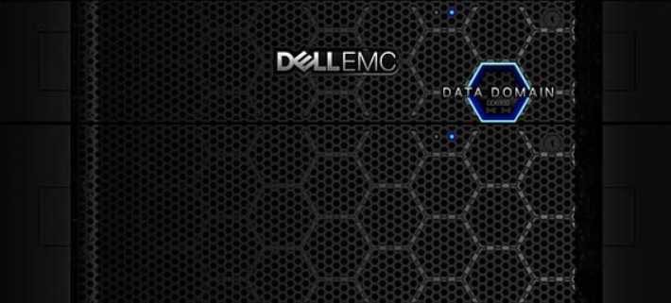
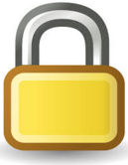
Data Domain can lock (compliance) data.
No one can modify / delete file
Backup
system
#1
Backup
system
#2
Backup
system
#3
Backup
system
#4
Backup1
30 days
Backup1
30 days
Backup1
20 days
Backup1
60 days
Backup3
Backup3
Backup3
Backup3
90 days
15 days
20 days
30 days
Backup3
Backup3
Backup3
Backup3
60 days
15 days
10 days
30 days

Slide 17
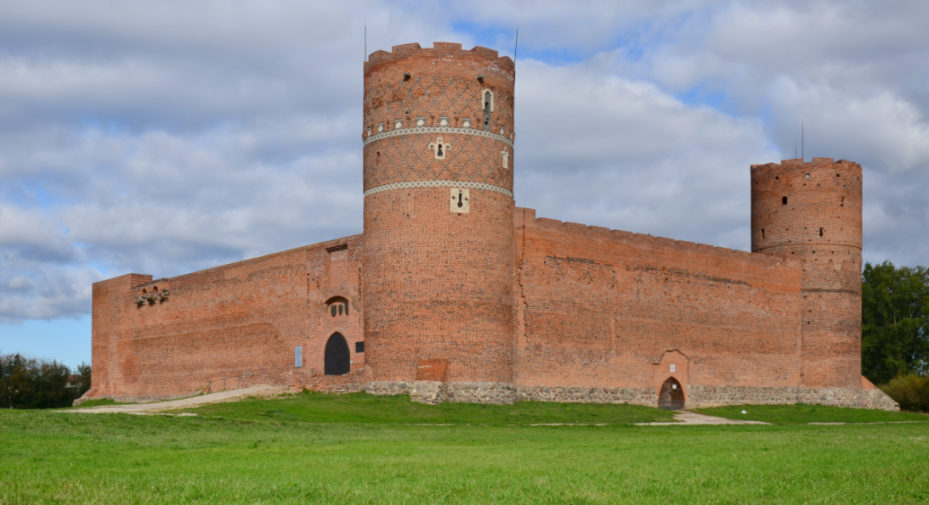
Castle strategy

Slide 18
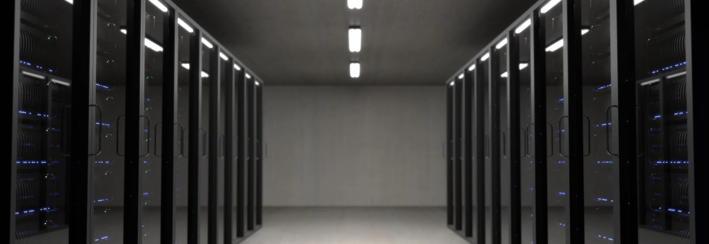
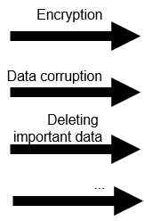
Real time
protection
Castle strategy

Slide 19

Ambulance
strategy

Slide 20
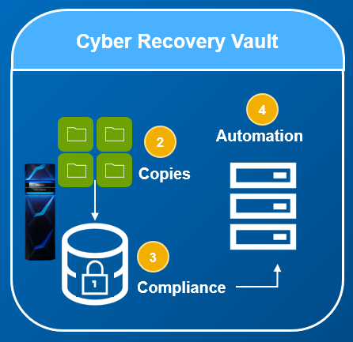
Ambulance
strategy
Cyber Bunker

Slide 21
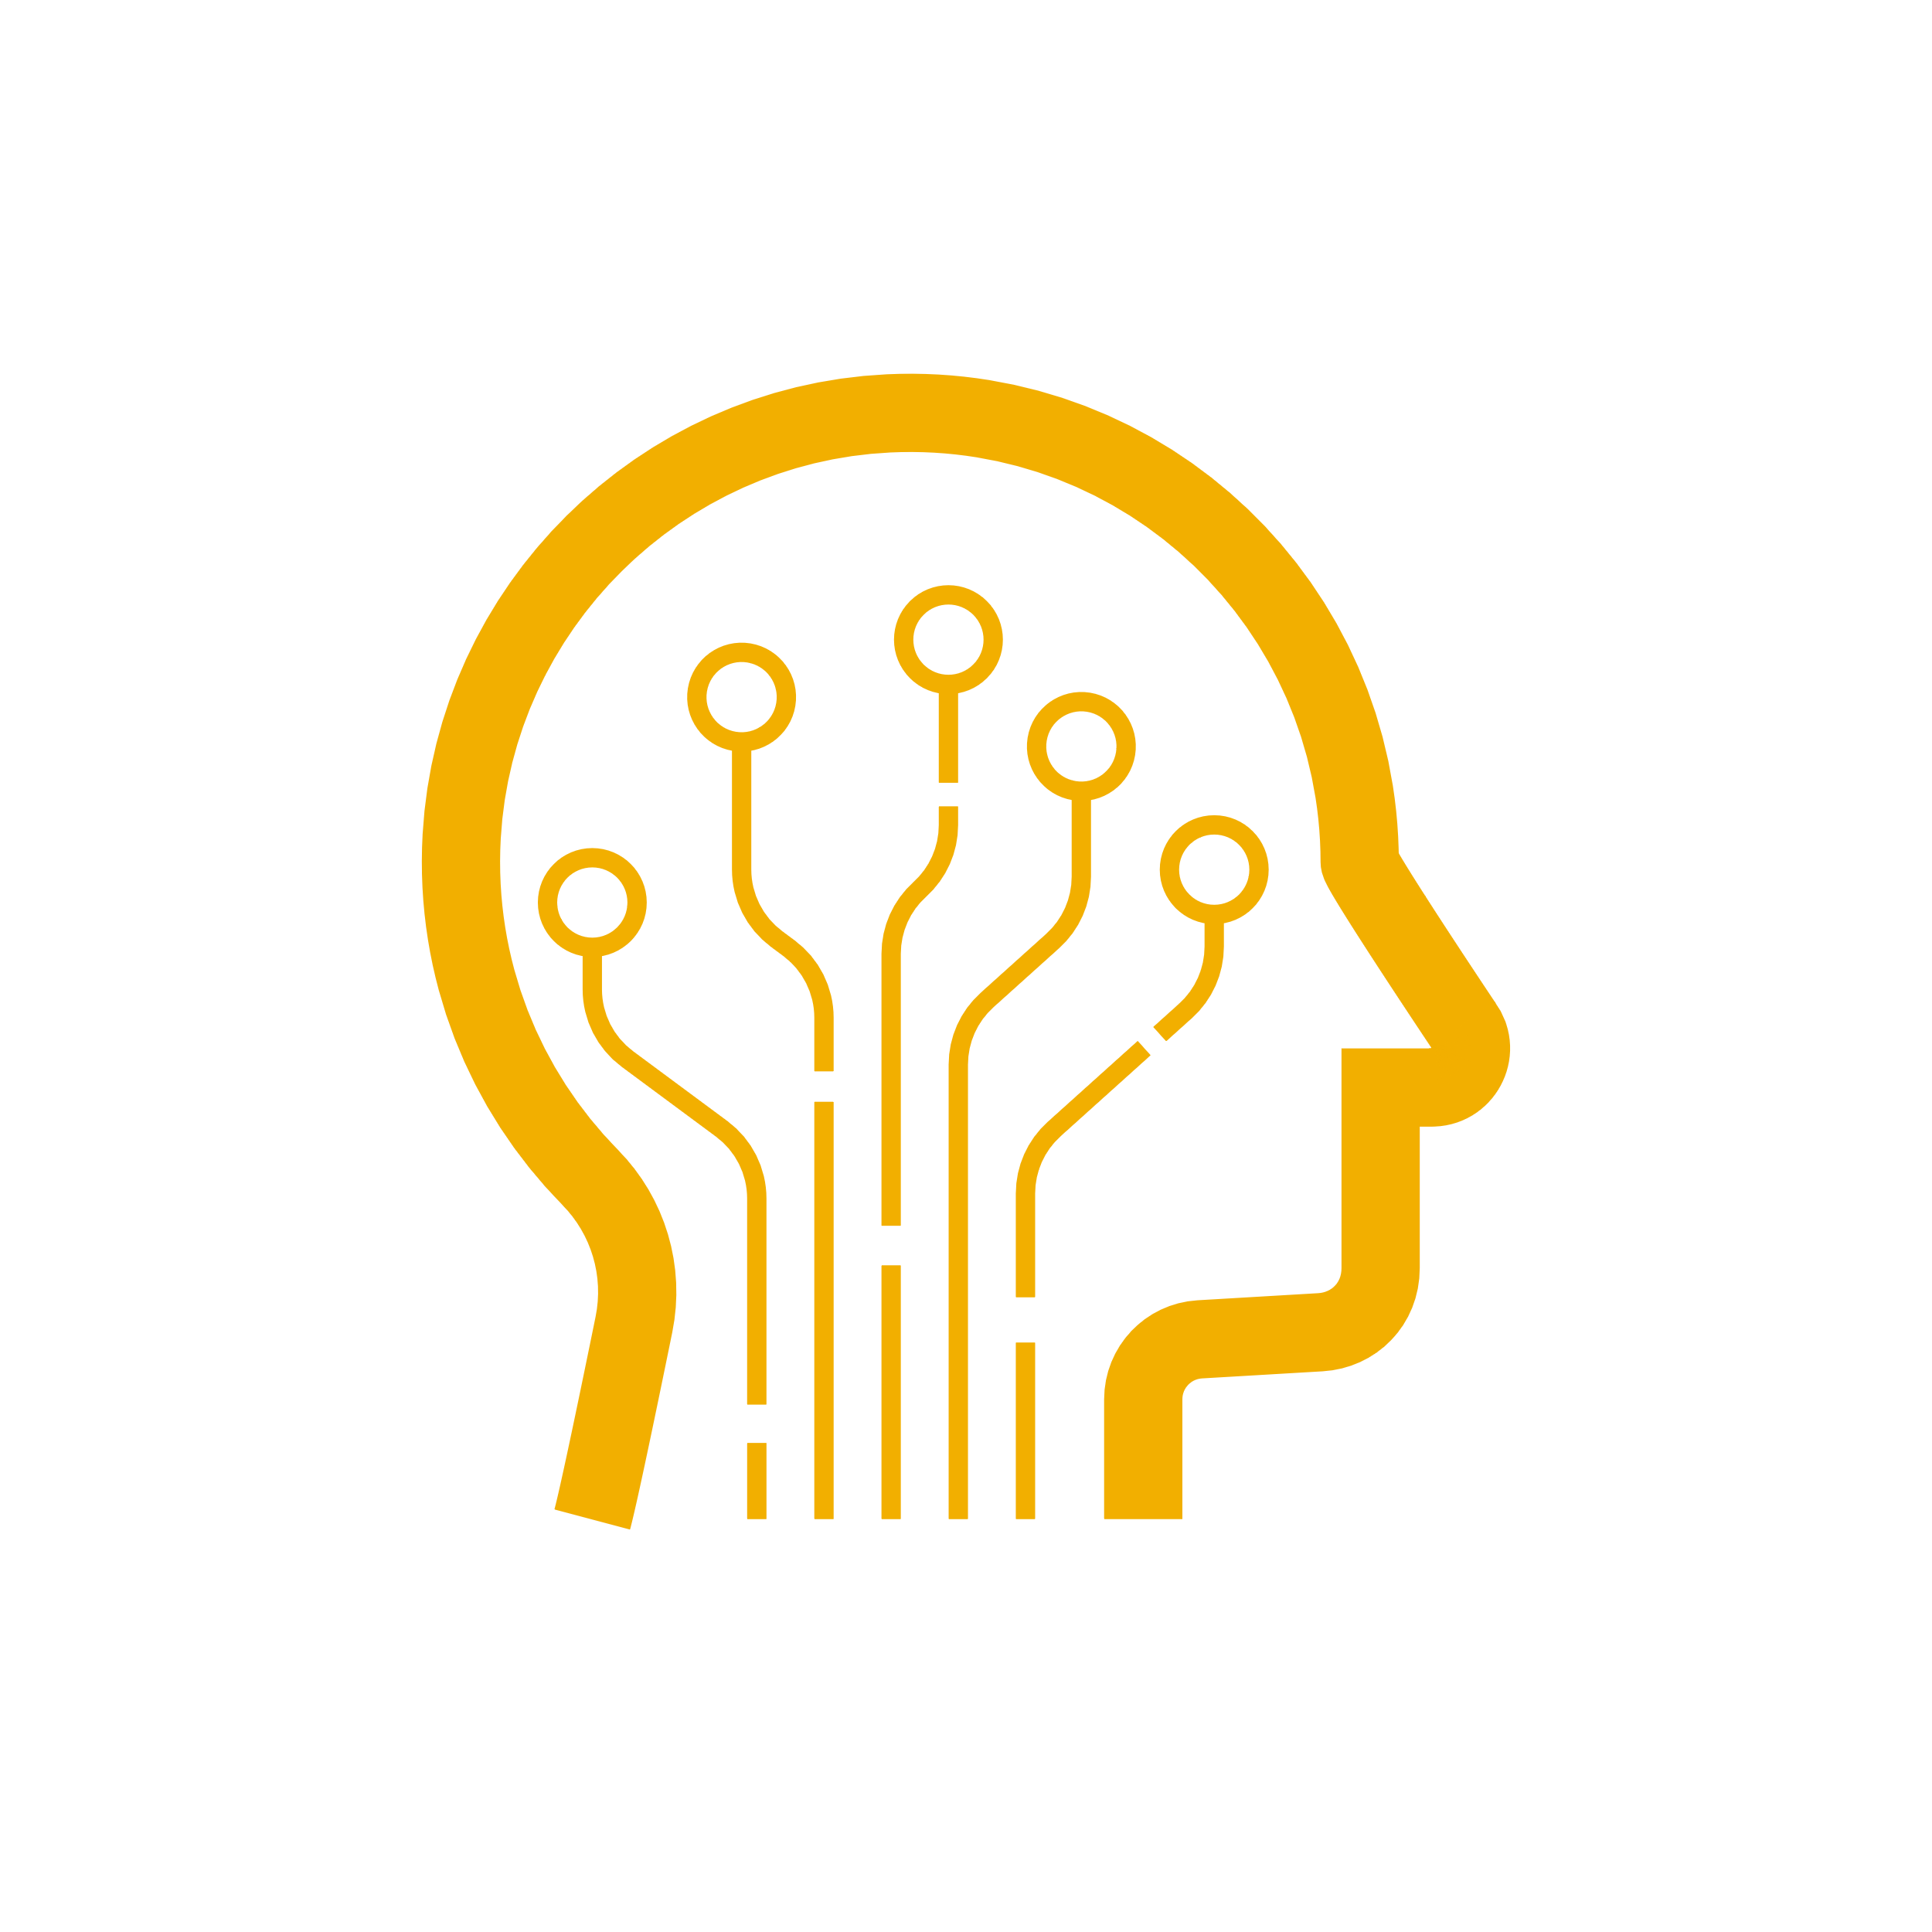



Cyber Recovery Requirements
Modern threats require modern solutions
Immutability
Isolation
Intelligence
Preserve original
integrity of data
Physical & logical
separation of data
ML & analytics
identify threats
Notes:
Speaker Notes:
Over the past 6 years of helping our customers protect their critical data and recover their businesses following a successful cyber attack or ransomware incident, we have found that there are 3 main components and common characteristics of a Cyber Recovery solution:
Isolation – Physical (via a locked room on-prem, in an off-prem or cloud-based vault) and Logical (data and management path, command and control access) separation of the cyber recovery vault from the attack surface of production and backup infrastructure.
Immutability – Although the market disagrees on a standard definition, Dell defines immutability as hardware and/or software, in addition to additional controls that ensure the original integrity, confidentiality and availability of the vault data is preserved.
Intelligence – Applying innovative and comprehensive tools and analytics, machine learning and AI within the security of the vault to identify potential cyber threats or corruption and to help to ensure vaulted data is recoverable.
The significance is the 3 of these components working independently and collectively within an integrated solution to provide the maximum levels of security and protection for vaulted data and to give you the best possible chance to recover vaulted data with integrity and confidence should an attack penetrate the data center.
Solutions that offer 1 or 2 of these components as features of backup or DR products and services, while useful, should not be expected to provide the same levels of protection of critical data when faced with a sophisticated attack that impacts production, backup and perhaps DR.
While such features as storing backups in some immutable form provide an incremental amount of protection over non-immutable backups, this feature alone will not withstand insider credentialed attacks or NTP attacks which fool many software-defined storage systems into releasing the retention period believing it had expired due to the cyber criminals tampering with the NTP setting.
NEXT SLIDE

Slide 22







SITE A
SITE B
IT Infrastructure
Ransomware
protection
IT Infrastructure
Ransomware
protection
Any backup
software
Backup
Recovery
Any backup
software
Data Domain
Disaster Recovery
Data Domain
1% data transfer
100% recovery
Cyber Bunker
Air Gap
PLAN B – Secure data & Recovery
Separation
from production
Management
and automation
Cyber
Recovery
Data Domain
Cyber
Sense
Checking
ransomware
Secure
Historical
backups
Compliance
No possibility to change data
Recovery
automation
Backup
software
Sandbox
Any tests

Slide 23
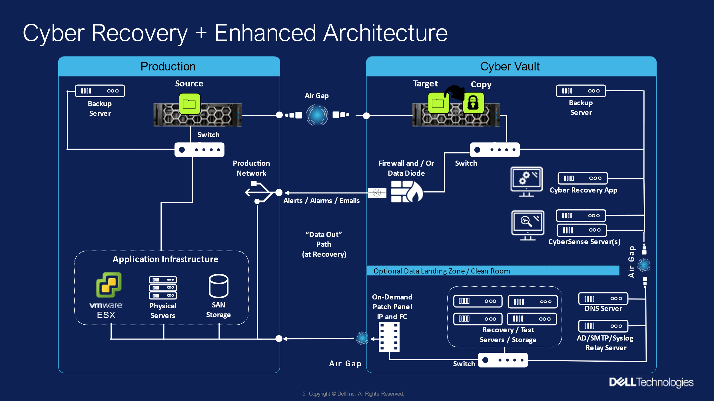

Slide 24
Cyber Bunker gives us answers for the questions
What if I am encrypted?
Am I being encrypted?
Who encrypts me?
How to stop being encrypted?
Which copy to use to recover?
How to recover?

Slide 25
Site A
Site B
Databases
Virtualization
Applications
Servers
Remote offices
Laptops
Databases
Virtualization
Applications
Servers
Remote offices
Laptops
Any backup
software
Backup
Restore
Backup
Restore
Any backup
software
Disaster Recovery
Transfer 1%
Recovery 100% of data
Data Domain
Data Domain

Slide 27
What functions can Cyber Recovery have?
Simple: Golden, guaranted, remote copy
  Not possible to destroy by insider -> physically, logically
  Super cheap approach
Veryfication of production
Test center

Slide 28

SITE A
Recovery / Test Center
IT Infrastructure
Backup
Recovery
Data Domain
Air Gap
Access
Station
Backup
software
Hyp
Data Domain
Cyber
Recovery
DNS
SQL
Cyber Bunker
Cyber
Sense
AD
Oracle
Storage

Slide 29
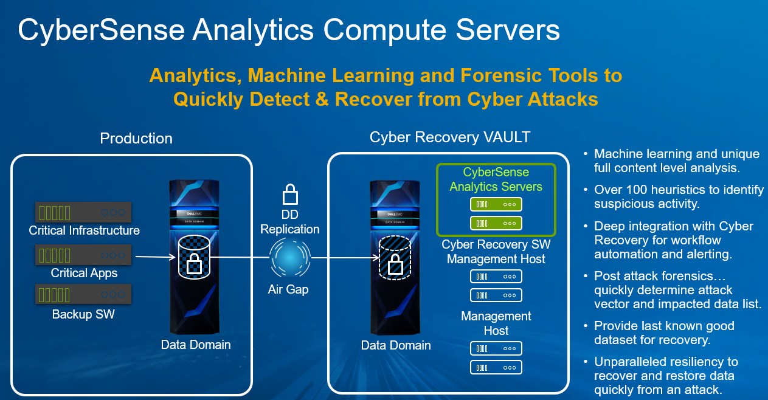

Slide 30

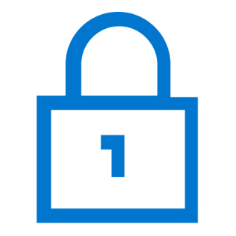


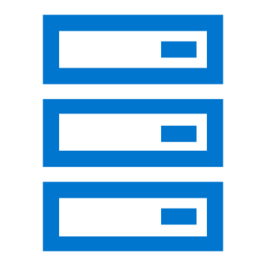

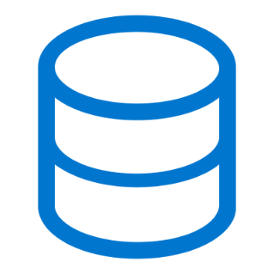




PowerProtect Cyber Recovery for AWS
Data Vaulting and Recovery Processes
‸
Data Center
(on-premises or Cloud)
Cyber Recovery Vault
VPC
1
2
PowerProtect
Cyber Recovery
Copy
Sync
PowerProtect
DDVE
3
Automated
Operational Air Gap
Lock
AWS S3
Production
Backup
Recover
Monitoring & Reporting
Notes:
Speaker Notes:
For rapid deployments with flexible recovery options, PowerProtect Cyber Recovery with AWS provides an isolated data center environment disconnected from corporate or backup networks and managed separately through restricted access clearance. It is similar to the on-premises solution; however, it provides physical isolation within the AWS cloud for the vault's location.
PowerProtect Cyber Recovery with AWS enables organizations to quickly and easily deploy an enhanced data protection solution with minimum investment.
Features include:
- Automated operational air gap and off-site vaulting protect critical data
- Reliable, proven protection with PowerProtect DD Virtual Edition. This solution is also scalable, with up to 5 DDVEs in VPC (256TB each), gives you more than a PB of data in VPC
- Simplify deployment with flexible recovery options
- Software-based immutability
The vault is always logically isolated via an operational air gap. The vault components are never accessible from production, and access to the vault target – when the air gap is unlocked – is extremely limited. This is key to the maturity of our solution. Remember the vault is not an extra data center – it is usually located within a secure VPC on AWS.
The vault operates in 4 basic steps:
1 - Data representing critical applications is synced through the air gap, which is unlocked by the management server into the vault, and replicated into the vault target storage. The air gap is then re-locked
2 - A copy of that data is made. Vault retention is configurable
3 - The data is locked to further protect it from accidental or intentional deletion
Recovering data from the vault in a cyber attack or only for recovery testing procedures is critical. There are several ways recovery can be performed – for example, back to the corporate data center, or an alternate, or to a new VPC or clean environment within AWS . Monitoring and reporting are also provided and shared outside of the vault environment in various secure methods.
NEXT SLIDE

Slide 31


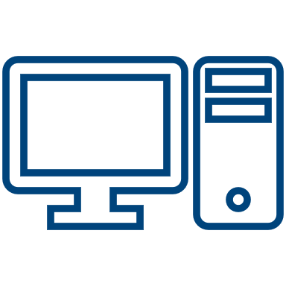
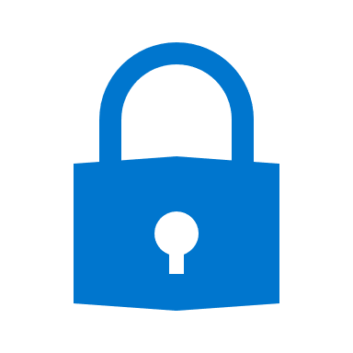


PowerProtect Cyber Recovery for AWS
Vault Security Detail
Cyber Recovery Vault
Customer’s Workstation,
(Limited IP)
VPC
Private Subnet # 1
Vault Jump Host
Network ACL
Security Group
Network ACL
Private Subnet # 2
AWS VPN
Security Group
Customer Gateway
VPN Gateway
Replication data from production PowerProtect DD
Data Center
(on-premises or Cloud)
‸
PowerProtect
Cyber Recovery
PowerProtect Cyber Recovery
securely manages and automates
the enabling / disabling of the air gap
Network ACL
Security Group
PowerProtect
DDVE
Production
Backup
Notes:
The basic Cyber Recovery solution on Amazon Web Services (AWS) architecture includes a single region, a single Virtual Private Cloud (VPC), and a single availability zone (AZ).
The production environment can be on premises or also deployed on AWS. The workstation at the production site enables you to connect to the jump host, which is in a private subnet in the VPC. The jump host provides access to the Cyber Recovery management host and the DDVE management console. For additional security, the workstation has a limited IP range.
The CloudFormation template deploys all the components that the Cyber Recovery solution requires in the VPC on AWS. The template creates two private subnets: A private subnet that includes the jump host and a private subnet that includes the Cyber Recovery management host and DDVE. It also configures security groups, Access Control Lists (ACLs), inbound and outbound rules, and so on.
The network ACLs allow access between:
The production workstation and the jump host subnet
The private subnets that include the jump host, the Cyber Recovery management host, DDVE, and the other components that make up the Cyber Recovery vault
As a best practice, the deployment uses Amazon Simple Email Service (SES) for one-way email from the Cyber Recovery management host.
The security group and the networks ACLs for the private subnet that includes the Cyber Recovery management host contain rules that enable the Cyber Recovery software to send email messages using Amazon SES.
The Cyber Recovery software automatically enables and disables the air gap, which uses AWS security features for additional security.
The PowerProtect DD system and DDVE use bi-directional data communication.
Sensitive Cyber Recovery data, such as passwords, is encrypted and stored in a lockbox. When deployed to AWS, the Cyber Recovery lockbox is located in a secure Elastic Block Store (EBS) volume. Backup data is stored in a Simple Storage Service (S3) bucket, and the backup metadata is stored on a DDVE EBS volume.
You can see the different paths for vault admin access and replication data flow

Slide 32
What is the cost?
Cyber Bunker
Air Gap
Management
and automation
Cyber
Recovery
Cyber
Sense
Checking
ransomware
Backup
software
Recovery
automation
Sandbox
Any tests

Slide 33
Check it – worth!
Discussion
Qualification - Infrastructure / Security departments
Solution

Slide 34
Materials
Cyber Security
https://youtu.be/jtgm2WHpFPk
Article:
http://backuprecoveryguy.blogspot.com/2020/01/ransomware-attack-how-can-we-recover.html

Slide 35
Materiały
Cyfrowy Bunkier
  Skrót: https://youtu.be/nBvyz76rTFg
  Pełna wersja: https://youtu.be/WGUT8aoiYds
  Artykuł: https://backuprecoveryman.pl/cyfrowy-bunkier/
Weryfikacja danych w bunkrze:
  Video: https://youtu.be/SjmM60ZhPHw
  Artykuł: https://backuprecoveryman.pl/cybersense/

Slide 36
Cyber Bunker
Continue business regardless of criminals
Detect attack
Help to remove effect of attack

Slide 37
Questions
Daniel.Olkowski@dell.com

