Slide 1
Cyber Design Proposal CDP
Cyber Vault Technical Architecture
Daniel.Olkowski@dell.com

Slide 2
Agenda
Architecture
Sizing
Assumption

Slide 3
Architecture
Cyber Vault Technical Architecture

Slide 4
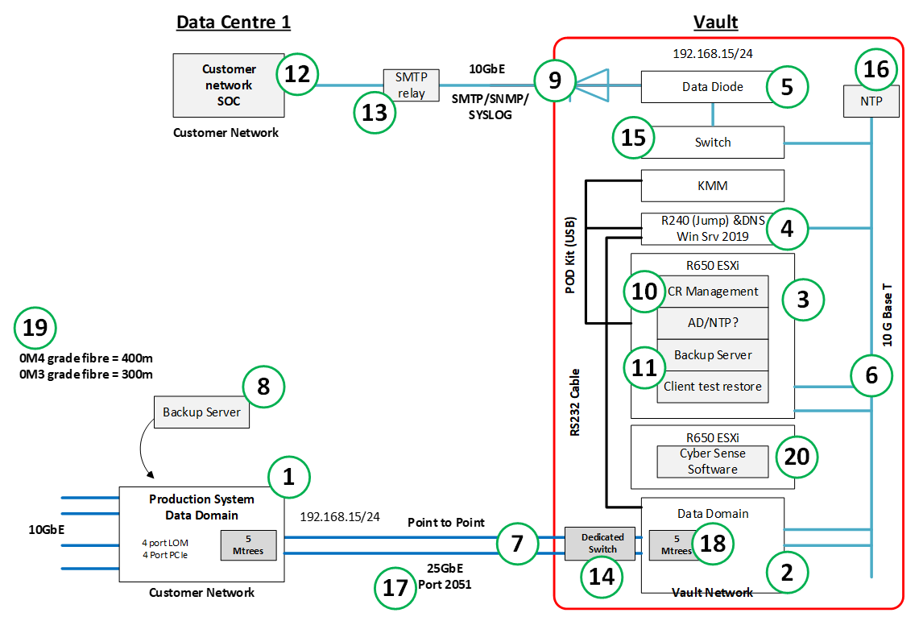

Slide 5
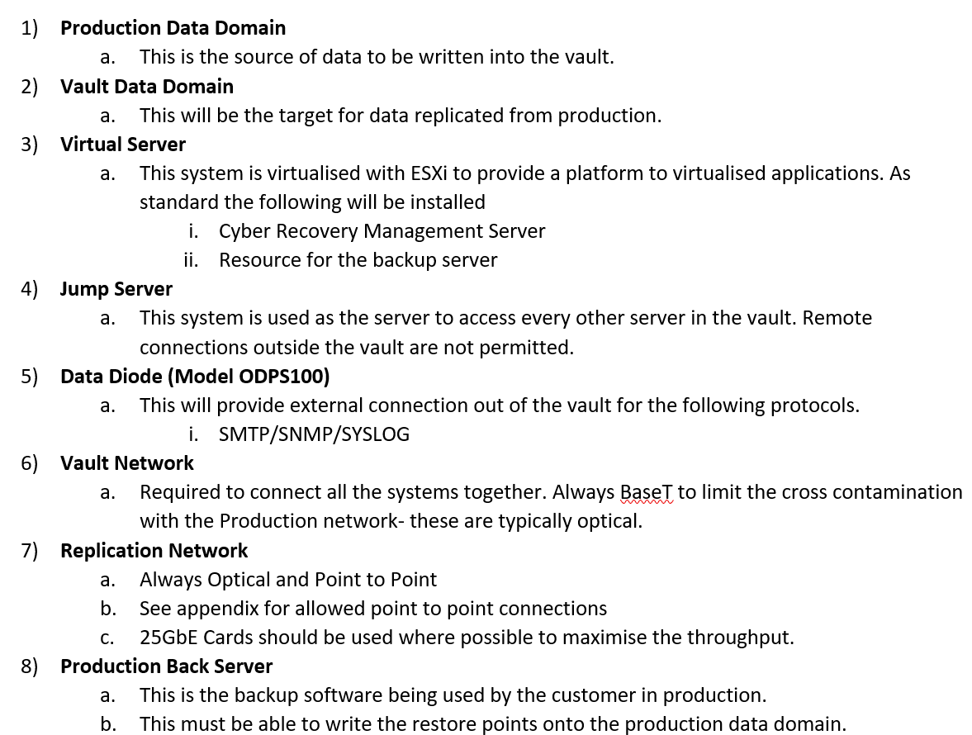

Slide 7
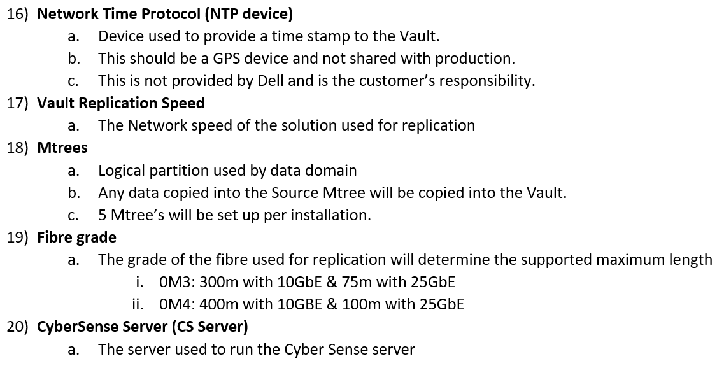

Slide 9
Sizing
Cyber Vault Technical Architecture

Slide 10
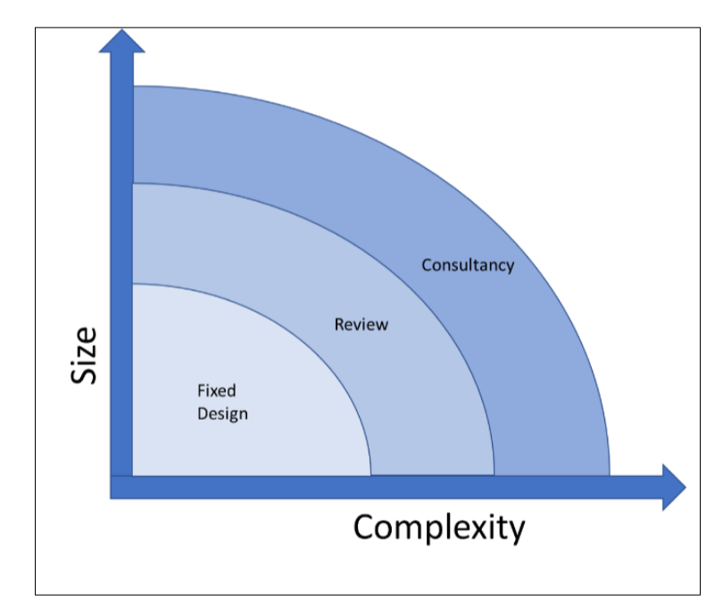

Slide 11
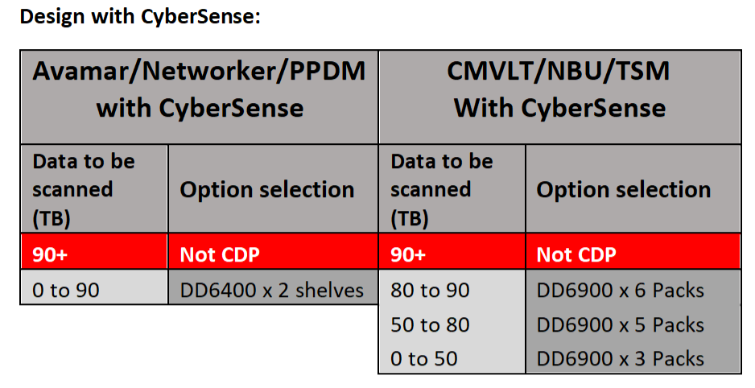

Slide 12
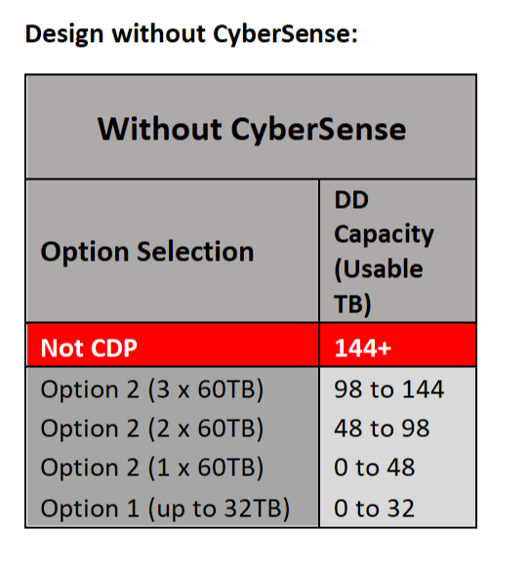

Slide 13
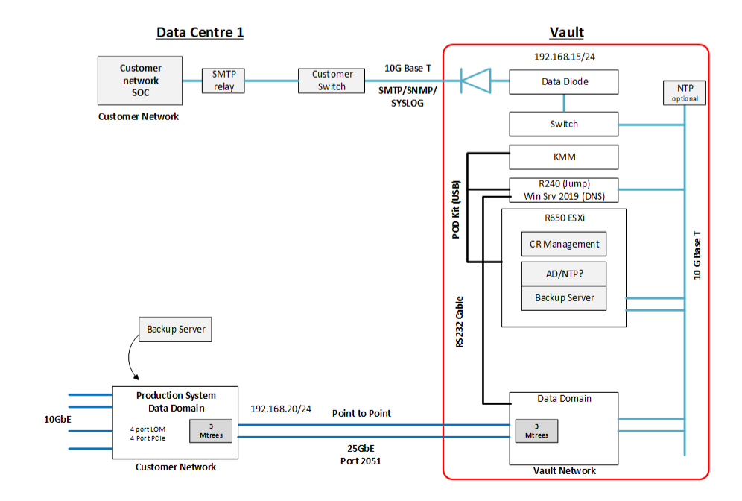

Slide 14
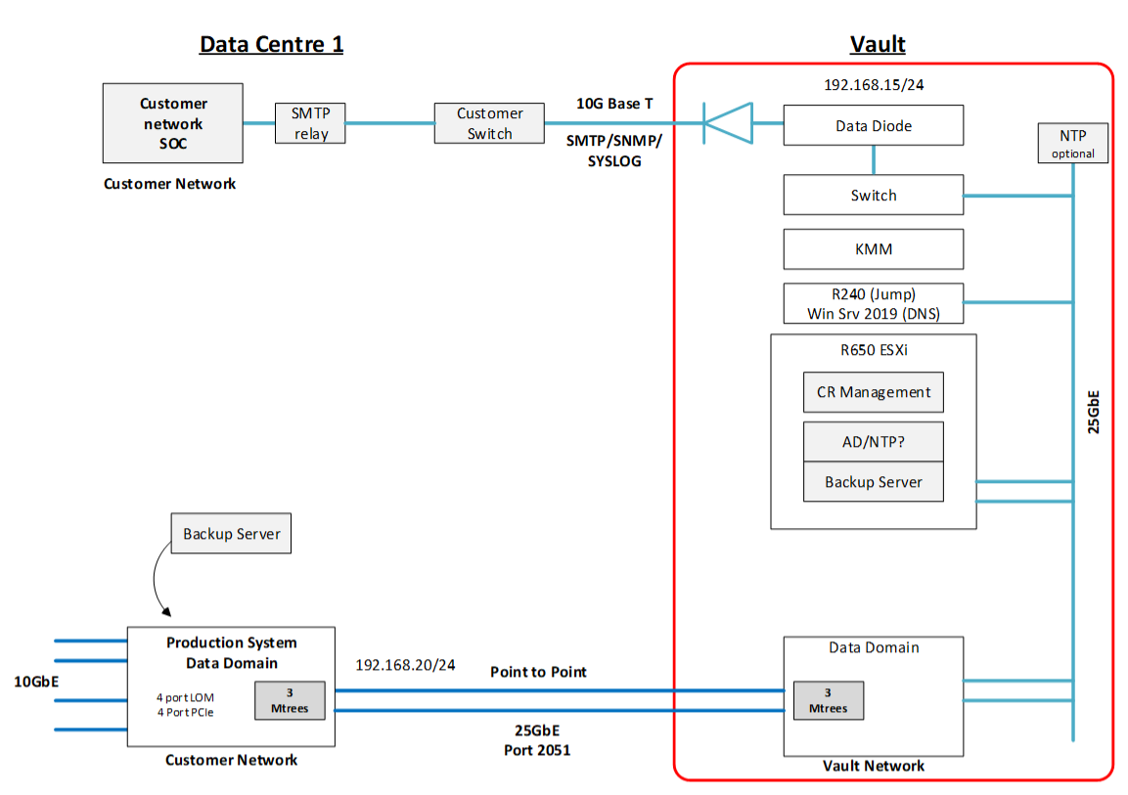

Slide 15
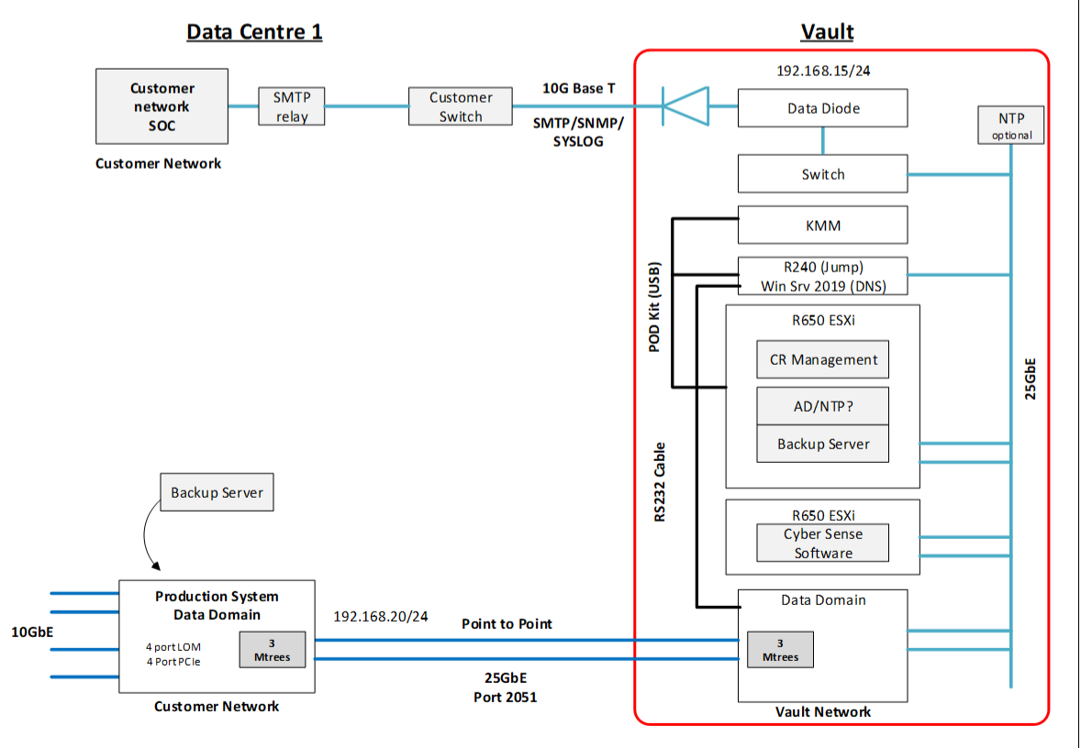

Slide 16
Assumption
Cyber Vault Technical Architecture

Slide 17
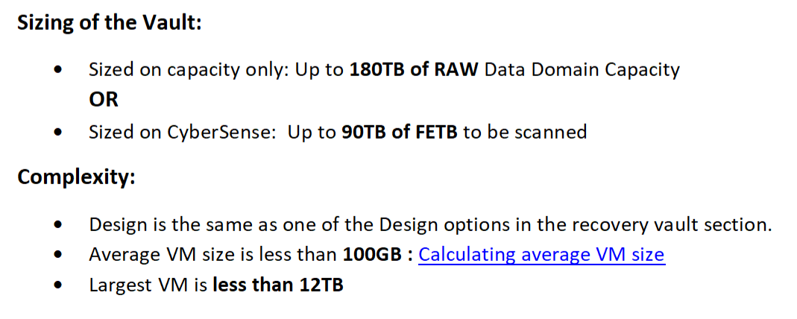
https://communities.vmware.com/t5/VMware-PowerCLI-Discussions/Determining-Average-VM-Sizes/m-p/2160967#M70609

Slide 24
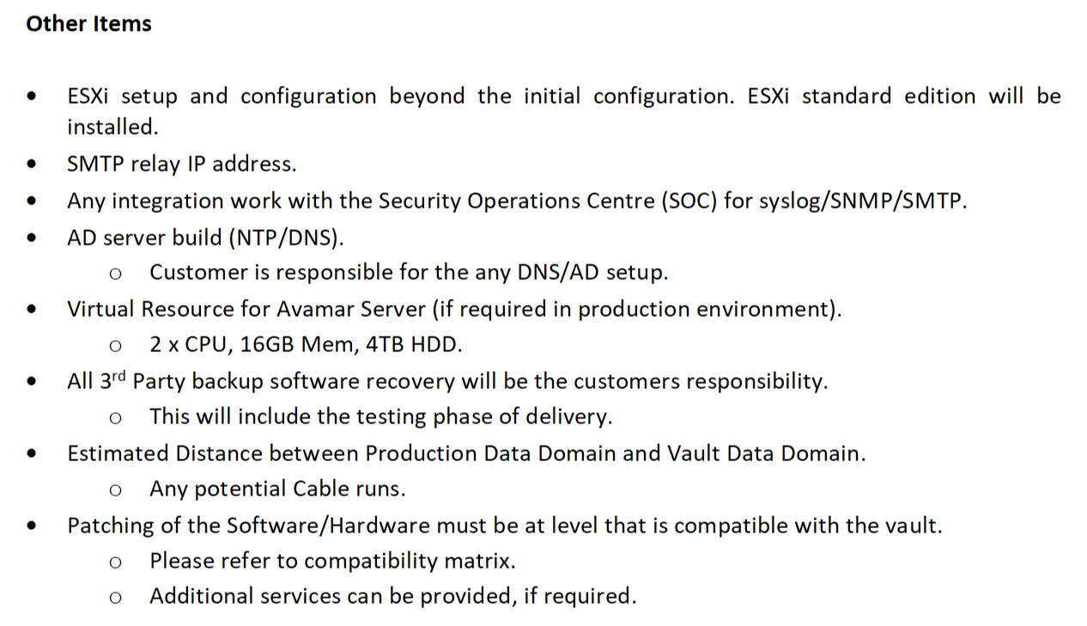

Slide 26
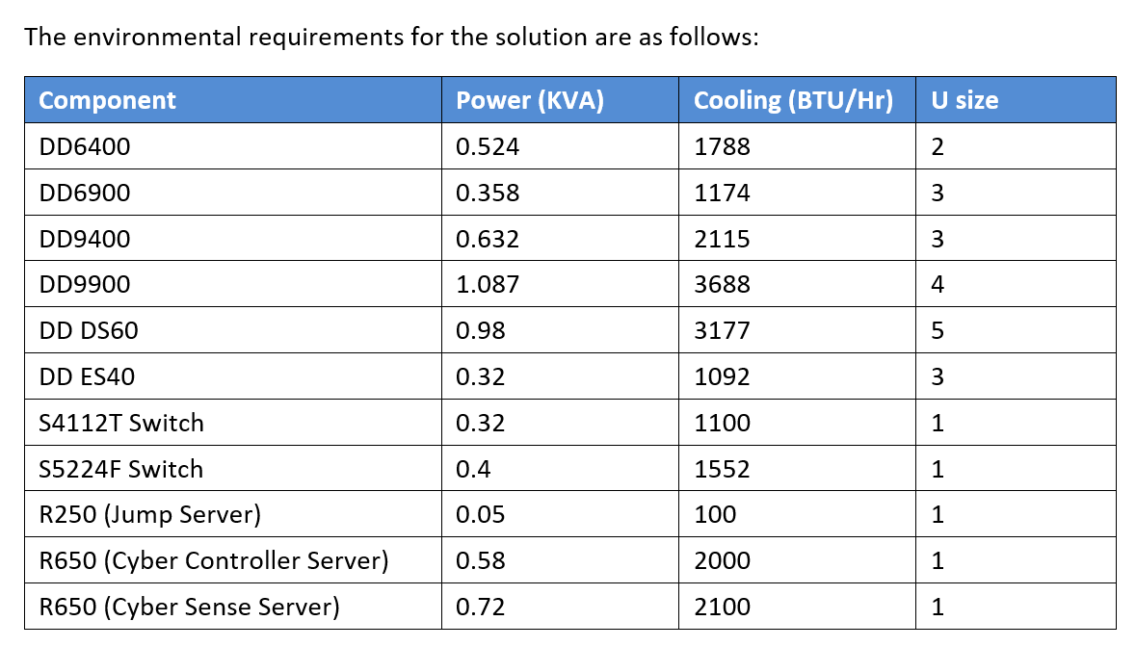

Slide 28
End logo slide
Questions
Daniel.Olkowski@dell.com

